Slide 1
Internetworking

Slide 2
Problems?
How can a host of one network (say, ring) communicate with a host of another network (say, a bus)?
What do we need to establish communications between two subnets?
How can information be exchanged between two hosts on different subnets (hosts are not sharing a common hub, bus or ring)
What do we need to connect a LAN to Internet?

Slide 3
Network Layer
The network layer provides the solutions to those problems
Use a common protocol in communicating subnets
Use a networking device, called router (or gateway) to translate and route packets back and forth between subnets
The most popular network layer protocol is Internet Protocol (IP). Previously used in UNIX systems. Now used in almost all systems for internetworking.

Slide 4
Internet Protocol
A protocol at Layer 3 (Network Layer)
Defines
  Internet addressing
  Internet packet format
  Internet routing
IP specifies “routing protocols”
  A set of rules that enable computers in different subnets to determine how to forward packets to the correct subnet for the recipient

Slide 5
IP Address
In the Internet Protocol, every host on the Internet is given a unique “IP address”
Question: Why do we need another addressing scheme?
Answer: Subnets are heterogeneous. A MAC (medium access control) address of a host on a subnet may not be understandable to a host on a different subnet
Note: IP address is different from a hardware address; a hardware address identifies a device on a subnet, an IP address identifies a device on an internet

Slide 6
IP Address (contd..)
An IP address is a 32-bit address
Independent of hardware addressing
Used by
  Higher-layer protocols
  Applications
Virtual
  Only understood by software
Used for all communication
Unique value for each host

Slide 7
IP Addressing Scheme
Two part addressing scheme
Contains routing and host information used to locate the host on the Internet
Divided into two parts
  Network (or routing) address part
    Prefix part
    Used to direct a packet to the network
  Host address part
    Suffix part
    Used to locate a host within a network
Global authority assigns unique prefix to network
Local administrator assigns unique suffix to host

Slide 8
Classes of IP Addresses
Bits 0 1 2 8 16 24 31
Class A:
0
prefix
suffix
Class B:
1
0
prefix
suffix
1
1
prefix
Class C:
0
suffix
Class D:
1
1
1
0
multicast address
Class E:
1
1
1
1
reserved for future use
Note: The prefix identifies a network and the suffix
identifies a host on that network

Slide 9
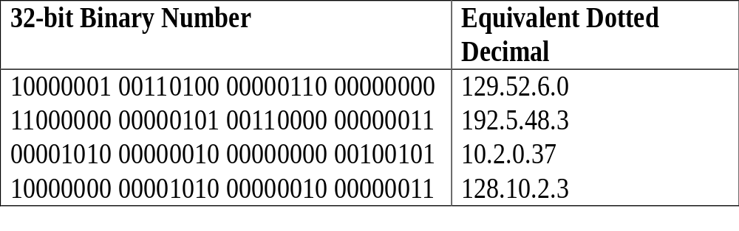
Dotted Decimal Notation
Shorthand for IP address
Allows humans to avoid binary
Represents each octet in decimal separated by dots
Each octet can have a value from 0 to 255

Slide 10
Example IP Addresses
165.95.8.17 merlin.tamucc.edu
165.95.8.16 falcon.tamucc.edu
165.91.22.81 mimir.tamu.edu
165.95.8.60 larry.tamucc.edu
131.96.49.104 techie.cs.gsu.edu
216.239.51.99 www.google.com
66.94.234.13 www.yahoo.com

Slide 11
Range of First Octet Values
Class A: 0 through 127
Class B: 128 through 191
Class C: 192 through 223
Class D: 224 through 239
Class E: 240 through 255

Slide 12
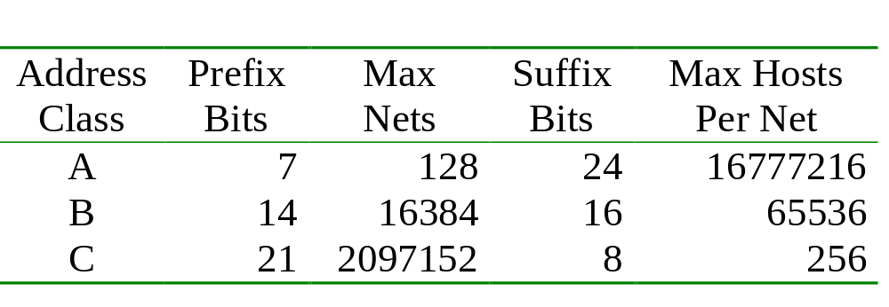
Classes and Network Sizes
Maximum network size determined by class
Class A large
Class B medium
Class C small

Slide 13
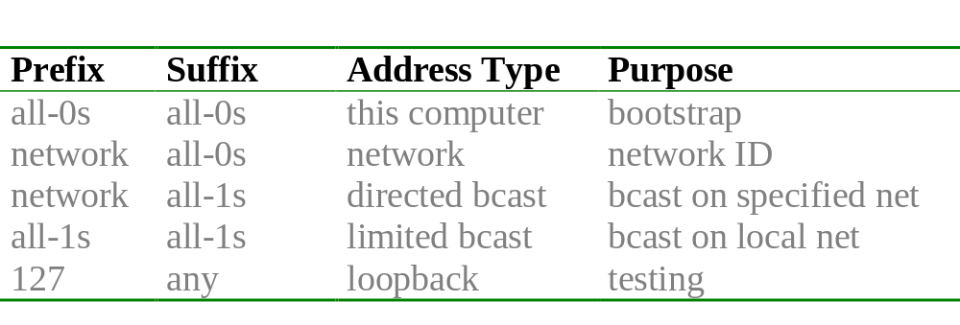
Special Addresses
Special addresses are never assigned to hosts
Network address not used in packets
Loopback never leaves local computer

Slide 14
IP Address in Detail
Let's look at an example IP address in detail: 165.95.11.11 (unet-517.tamucc.edu).
In binary, this address looks like:
(165) (95) (11) (11)
10100101 01011111 00001011 00001011

Slide 15
Subnet Mask
Associated with every subnet is a value known as the "subnet mask"
Subnet mask specifies the number of bits in an IP address that are being used to determine the subnet.
For example
  ci-labs subnet at TAMU-CC (of which unet-517 is a part) uses a subnet mask of 24 bits
(165) (95) (11) (11)
10100101 01011111 00001011 00001011
|---------network---------|--host-|
Thus, for unet-517, the address 165.95.11.x identifies the subnet, and the final 11 identifies the specific host on that subnet.

Slide 16
Subnet Mask (contd..)
To obtain the network address for a subnet
  set the host address bits to zero.
  Or do bit-wise logical AND between the 32-bit IP address and its mask with all network address bits one and host address bits zero.
For example, the network address for the subnet that contains unet-517 is 165.95.11.0
10100101 01011111 00001011 00000000
(165) (95) (11) (0)
Subnet mask for unet-517 is:
11111111 11111111 11111111 00000000
(255) (255) (255) (0)

Slide 17
Two parts of an IP Datagram
Header
  Contains destination address
  Fixed-size fields
Payload
  Variable sized data area up to 64K
  No minimum size
Header
Payload

Slide 18
IP Datagram Header
Key fields
  Source IP address
  Destination IP address
  Time to live (TTL)
  Type

Slide 19
IP Data Transmission Mechanism
When a host has a packet to send to another host:
Sender checks destination IP address to determine whether or not the receiver is on the same subnet or a different subnet
If the receiver is on the same subnet as the sender, transmit the packet directly to the receiver via the data-link-layer protocol.
If the receiver is on a different subnet, forward the packet to a router to be forwarded to the appropriate subnet.

Slide 20
How to locate a receiver
If the receiver is on the same subnet as the sender, then their network address portions of the IP will be the same
If the receiver is on a different subnet, the network addresses will be different

Slide 21
Example 1: IP Datagram Transmission
Suppose the host at 165.95.11.11 wants to send a packet to the host at 165.95.11.240.
Sender compares network address of receiver with network address of sender:
10100101 01011111 00001011 00001011 <- sender's IP (165.95.11.11)
11111111 11111111 11111111 00000000 <- subnet mask
---------------------------------------------------------------------------------------
10100101 01011111 00001011 00000000 <- sender's network address
10100101 01011111 00001011 11110000 <- recvr's IP (165.95.11.240)
11111111 11111111 11111111 00000000 <- subnet mask
----------------------------------------------------------------------------------------
10100101 01011111 00001011 00000000 <- recvr's network address

Slide 22
Example 1: IP Transmission (contd..)
Sender and receiver both share the same network address 165.95.11.0
Sender can use the data-link layer to transmit the packet directly to the receiver

Slide 23
Example 2: IP Transmission
Suppose the host at 165.95.11.11 wants to send a packet to the host at 165.95.8.17.
Sending host compares network addresses of the sender and receiver:
10100101 01011111 00001011 00001011 <- sender's IP (165.95.11.11)
11111111 11111111 11111111 00000000 <- subnet mask
------------------------------------------------------------------------------------------
10100101 01011111 00001011 00000000 <- sender's network address
10100101 01011111 00001000 00010001 <- recvr's IP (165.95.8.17)
11111111 11111111 11111111 00000000 <- subnet mask
-------------------------------------------------------------------------------------------
10100101 01011111 00001000 00000000 <- recvr's network address

Slide 24
Example 2: IP Transmission (contd..)
Sender’s network address is 165.95.11.0 and receiver’s network address is 165.95.8.0.
Because network addresses are different in this case, the sender knows to send the packet to a router, which will then forward the packet to the correct subnet for delivery to the receiver.

Slide 25
IP Packet Format
0
4
8
16
19
31
V
ersion
HLen
TOS
Length
Ident
Flags
Offset
TTL
Protocol
Checksum
SourceAddr
DestinationAddr
Options (variable)
Pad
(variable)
Data

Slide 26
Field Descriptions
Version
  Specifies IP version
HLen
  Header length in 32-bit words
TOS
  Type of service (Application)
Length
  Datagram length, including header in bytes
Ident, Flags, Offset fields
  Used for packet fragmentation and reassembly
TTL (Time to live)
  used to stop circulation of the packet indefinitely due to routing loops; default is 64
Protocol
  a number used for demultiplexing; 6 is for TCP, 17 is for UDP.
Checksum
  Internet checksum on header
SourceAddr, DestinationAddr
Options
  Rarely used
Padding: To make header a multiple of 32 bits

Slide 27
Internet as Concatenation of Networks
Network 1 (Ethernet)
H7
R3
H8
H1
H2
H3
Network 4
Network 2 (Ethernet)
(point-to-point)
R1
R2
H4
Network 3 (FDDI)
H5
H6

Slide 28
View of Protocol Stacks Along a Route
H1
H8
TCP
R1
R2
R3
TCP
IP
IP
IP
IP
IP
ETH
ETH
FDDI
FDDI
PPP
PPP
ETH
ETH

Slide 29
IP Service Model
Connectionless (datagram-based)
Best-effort delivery (unreliable service)
  packets are lost
  packets are delivered out of order
  duplicate copies of a packet are delivered
  packets can be delayed for a long time

Slide 30
Datagram Transmission
Datagram sent across conventional network
  From source host and router
  Between intermediate routers
  From final router to destination host
Network hardware does not recognize
  Datagram format
  IP addresses
Encapsulation needed

Slide 31
Illustration of IP Encapsulation
Entire datagram treated like data
Frame type identifies contents as IP datagram
Frame destination address gives next hop
IP Datagram
F-H
Data

Slide 32
Frame And Datagram Destination Addresses
Frame address
  Hardware (MAC) address
  Next hop
Datagram address
  IP address
  Ultimate destination

Slide 33
Maximum Frame Size
Each network technology imposes maximum frame size
    Called Maximum Transmission Unit (MTU)
    MTUs differ

Slide 34
Fragmentation and Reassembly
Each network has some MTU
Strategy
  try to avoid fragmentation at source host
  fragment when necessary (MTU < Datagram)
  performed by routers
  each fragment has datagram header
  fragments send separately
  fragments are self-contained datagrams
  delay reassembly until destination host (Ultimate destination reassembles fragments)
  do not recover from lost fragments
  re-fragmentation is possible

Slide 35
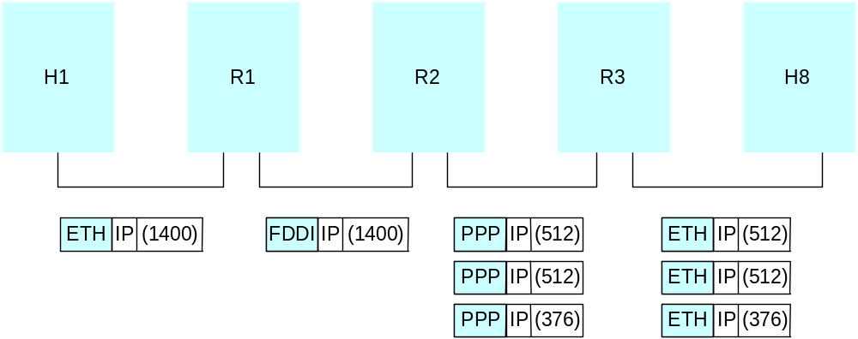
Example
Start of header
Ident
= x
0
Offset
= 0
Rest of header
1400 data bytes
Start of header
Ident
= x
1
Offset
= 0
Rest of header
512 data bytes
Start of header
Ident
= x
1
Offset
= 512
Rest of header
512 data bytes
Start of header
Ident
= x
0
Offset
= 1024
Rest of header
376 data bytes

Slide 36
Fragmenting A Fragment
Needed when fragment too large for network MTU
Arbitrary subfragmentation possible
Router divides fragments into smaller pieces
All fragments at same “level”
Offset given with respect to original datagram
Destination cannot distinguish subfragments

Slide 37
Fragment Loss
  Receiver
    Collects incoming fragments
    Reassembles when all fragments arrive
    Does not know identity of router that did fragmentation
    Cannot request missing pieces
  Consequence: Loss of one fragment means entire datagram lost

Slide 38
Subnet Mask Examples
Subnet masks can be specified in a couple of different ways:
Either as the number of bits in the mask (e.g., 24 bits),
Or as the four octets formed by the subnet mask. For example, a 24 bit subnet mask has the value:
  11111111 11111111 11111111 00000000
  (255) (255) (255) (0)

Slide 39
Subnet Mask Examples (contd..)
A 16-bit subnet mask would be represented in decimal as 255.255.0.0
11111111 11111111 00000000 00000000
A 25-bit subnet mask would be represented in decimal as 255.255.255.128
11111111 11111111 11111111 10000000
The number of bits in the subnet mask determines the maximum number of hosts that can be on the subnet.
For example, a subnet mask of 24 bits means that the subnet can have at most 254 hosts (256 less 2 for reserved addresses).
This is because if we use 24 bits for the network address, that leaves 8 bits for the host address. Eight bits for host address leaves 256 possible host addresses (2⁸ or 2×2×2×2×2×2×2×2)

Slide 40
Subnet Mask Examples (contd..)
In general, a larger subnet mask means more subnets with smaller numbers of hosts, and a smaller subnet mask means fewer subnets with greater number of hosts.

Slide 41
Some Quick Math
Q1: A subnet mask of 24 bits implies that a subnet can have a maximum of 254 hosts.
Reason: A subnet mask of 24 bits leaves 8 bits for the host address, but two host addresses are always reserved: the all-zeros address (00000000) represent the network itself, the all-ones address (11111111) represents the broadcast address. Thus, a subnet mask of 24 bits leaves 8 bits for the host, 2⁸=256, less 2 for the reserved addresses allows 254 hosts on the subnet.

Slide 42
Some Quick Math (contd..)
Q2: A subnet mask of 28 bits implies that a subnet can have a maximum of 14 hosts
Reason: A subnet mask of 28 bits leaves 4 bits for the host address,
2⁴ - 2 = 16 - 2 = 14
Q3: A subnet mask of 16 bits implies that a subnet can have a maximum of 65534 hosts
Reason: A subnet mask of 16 bits leaves 16 bits for the host address,
2¹⁶ - 2 = 65536 - 2 = 65534

Slide 43
Purpose of dividing a network
The purpose of dividing a network into subnets and routers is two-fold:
  The routers enable hosts on the Internet to forward messages to any other host on the Internet
  By subdividing the network into subnets, local network traffic stays local while allowing distant network traffic to be communicated

Slide 44
Subdividing a Subnet
The subnet masks allow a network administrator to further subdivide a class A, B, or C network into appropriate sizes for the physical network requirements at the administrator’s organization.

Slide 45
Subdividing a Subnet (contd..)
For example, TAMUS has a class B network (165.95.x.x), and a minimum subnet mask of 16 bits. This network can hold up to 65,534 hosts (65K).
Impractical and inefficient to put all 65K hosts on a single subnet.
Solution:
  Divide our class B address into smaller segments
  Allocate those smaller segments to network administrators at various institutions (within TAMUS).

Slide 46
Example: Subdividing Subnets
TAMUS received the network address of 165.95.0.0 with a 16-bit subnet mask.
TAMUS then subdivides that network into a set of smaller networks by using a 20-bit subnet mask instead of 16-bit mask:
165.95.0.0 (20-bit subnet) TAMU-CC
165.95.16.0
165.95.32.0
165.95.48.0
...
165.95.224.0
165.95.240.0

Slide 47
Example: Subdividing Subnets (contd..)
TAMUS uses a 20-bit subnet mask to break the network into smaller parts:
10100101 01011111 ssss xxxx xxxxxxxx
|------IANA-----| |AM ||---hosts----|
By using a 20-bit subnet mask instead of the minimum 16-bit subnet mask, the TAMUS system forms 16 subnets, each of which can have up to 4094 hosts.

Slide 48
Example: Subdividing Subnets (contd..)
Network addresses of the subnets:
10100101 01011111 0000xxxx xxxxxxxx (165.95.0-15.x) TAMU-CC
10100101 01011111 0001xxxx xxxxxxxx (165.95.16-31.x)
10100101 01011111 0010xxxx xxxxxxxx (165.95.32-47.x)
10100101 01011111 0011xxxx xxxxxxxx (165.95.48-63.x)
10100101 01011111 0100xxxx xxxxxxxx (165.95.64-95.x)
10100101 01011111 0101xxxx xxxxxxxx
10100101 01011111 0110xxxx xxxxxxxx
10100101 01011111 0111xxxx xxxxxxxx
10100101 01011111 1000xxxx xxxxxxxx
10100101 01011111 1001xxxx xxxxxxxx
10100101 01011111 1010xxxx xxxxxxxx
10100101 01011111 1011xxxx xxxxxxxx
10100101 01011111 1100xxxx xxxxxxxx
10100101 01011111 1101xxxx xxxxxxxx
10100101 01011111 1110xxxx xxxxxxxx (165.95.224-239.x)
10100101 01011111 1111xxxx xxxxxxxx (165.95.240-255.x)

Slide 49
Subnets at TAMU-CC
TAMUS has allocated the first of these subnets (165.95.0-15.x) to TAMU-CC
TAMU-CC then uses this subnet and subdivides it further into the individual subnets needed at the University
For example, most of the subnets at TAMU-CC use a 24 bit subnet mask. Thus, we can have 16 subnets, each of which can hold 254 hosts:
10100101 01011111 0000ssss xxxxxxxx
|--assigned by TAMUS-||CC| |-host-|

Slide 50
ARP Protocol
ICMP Protocol
DHCP Protocol

Slide 51
Resolving Addresses
  Hardware only recognizes MAC addresses
  IP only uses IP address
  Consequence: software needed to perform translation
      Part of network interface
      Known as address resolution

Slide 52
Resolving Addresses (contd..)
Layer 2 protocol
Given
  A locally-connected network, N
  IP address C of computer on N
Find
  Hardware address for C
Technique
  Address Resolution Protocol

Slide 53
Address Resolution Protocol (ARP)
Keep bindings in table
Table entry contains pairs of addresses for one computer
  IP address
  Hardware address
Build table automatically as needed

Slide 54
ARP Table
IP Address Hardware Address
197.15.3.2 0A:07:4B:12:82:36
197.15.3.3 0A:9C:28:71:32:8D
197.15.3.4 0A:11:C3:68:01:99
197.15.3.5 0A:74:59;32:CC:1F
197.15.3.6 0A:04:BC:00:03:28
197.15.3.7 0A:77:81:0E:52:FA
Only contains entries for computers on local network
IP network prefix in all entries identical

Slide 55
ARP Lookup Algorithm
Look for target IP address, T, in ARP table
If not found
  broadcast ARP request message with IP address T (target machine responds with its physical address)
  Receive reply with T's hardware address
  Add entry to table
Return hardware address from table

Slide 56
ARP Packet Format
0
8
16
31
Hardware type = 1
ProtocolT
ype = 0x0800
HLen = 48
PLen = 32
Operation
SourceHardwareAddr (bytes 0
–
3)
SourceHardwareAddr (bytes 4
–
5)
SourceProtocolAddr (bytes 0
–
1)
SourceProtocolAddr (bytes 2
–
3)
T
argetHardwareAddr (bytes 0
–
1)
T
argetHardwareAddr (bytes 2
–
5)
T
argetProtocolAddr (bytes 0
–
3)

Slide 57
ARP Message Details
Hardware type field
  type of physical network (e.g., Ethernet)
Protocol Type field
  higher layer protocol (e.g., IP)
Hlen field
  Hardware address length
Plen field
  Protocol address length
Operation field
  Request or response
Source and target hardware (Ethernet) and protocol (IP) addresses

Slide 58
Notes
  table entries timeout in about 15 minutes
  Refreshing algorithm
    update table with source when you are the target
    update table if already have an entry for a host
    do not refresh table entries upon reference (if host is not the target and there is no entry for the source in the ARP table)

Slide 59
Transmission of ARP Message
ARP Message
F-H
CRC
  ARP message sent in payload area of frame
  Called encapsulation
  Frame type identifies message as ARP (type is 806)
  Receiver examines frame type

Slide 60
Important Note
Because ARP software is part of the network interface software, all higher-layer protocols and applications can use IP addresses exclusively, and remain completely unaware of hardware addresses.

Slide 61
ICMP

Slide 62
IP Semantics
IP is best-effort
Datagrams can be
  Lost
  Delayed
  Duplicated
  Delivered out of order
  Corrupted

Slide 63
Error Detection
IP does not
  Introduce errors
  Ignore all errors
Errors detected
  Corrupted bits
  Illegal addresses
  Routing loops
  Fragment loss

Slide 64
Problems and Solutions
Corrupted header bits
  Header checksum
Illegal destination address
  Routing tables
Routing loop
  Time-To-Live (TTL) field
Fragment loss
  Timeout

Slide 65
Internet Control Message Protocol (ICMP)
Separate protocol for
  Errors
  Information
Required part of IP
Sends error messages to original source

Slide 66
Example ICMP Messages
Source Quench
  Sent by router
  Triggered by datagram overrun
  Requests sending host(s) to slow down
Time Exceeded
  Sent by router
    TTL on datagram reached zero
    Not a request for retransmission
  Sent by host
    Reassembly timeout (some fragments lost)

Slide 67
ICMP Messages (contd..)
Destination unreachable
  Specifies whether
    Destination network unreachable
    Destination host unreachable
    Protocol port on destination unreachable
Redirect
  Sent by router
  Goes to host on local network
  Host used incorrect initial router
  Requests host to change routes

Slide 68
ICMP Messages (contd..)
Echo request and reply
  Not an error
  Tests whether destination reachable
  Request sent by ping program
  Reply sent by ICMP on destination computer

Slide 69
ICMP Message Transport
Error messages go back to original source (may cross internet)
Messages carried in IP

Slide 70
Illustration of ICMP Message Encapsulation
ICMP Hdr
ICMP Data Area
IP Hdr
IP Data Area
Frame Hdr
Frame Data Area
CRC
    Two levels of encapsulation
    IP type fields specifies ICMP

Slide 71
Avoiding an Infinite Loop
What happens if:
  Datagram D causes an ICMP error message, I₁
  Error message I₁ causes another error, which generates ICMP message I₂
  Message I₂ generates another error, I₃
  Error messages cascade
To avoid the problem
  No error messages about ICMP error messages

Slide 72
Path MTU Discovery
IP datagram header contains a bit to specify no fragmentation allowed (DF bit: Don’t fragment bit)
ICMP sends an error message when fragmentation required but not permitted
Technique
  Probe to find largest MTU that does not generate an error message
Note: MTU not guaranteed if routes change

Slide 73
DHCP

Slide 74
Problems in Configuring Hosts Manually
Manually configuring each host on the network is very difficult and it is inefficient and error-prone
Reasons:
  Someone has to "keep track" of which IP addresses have been used and which have not
  If a network configuration needs to change (e.g., a subnet is changing network address or a router is being changed), then all hosts on the network have to be manually reconfigured
Solutions
  BOOTP (Boot Protocol)
  Dynamic Host Configuration Protocol (DHCP)

Slide 75
Boot Protocol for Automatic Configuration
Network administrators created protocol called "BOOTP" (boot protocol) for automatic configuration
BOOTP allows a host (BOOTP client) to obtain its network information from a central database machine (BOOTP server)
When the BOOTP client is turned on, it sends a broadcast request packet (called a BOOTP request) to all workstations on the network
When a BOOTP server receives a BOOTP request, it uses the MAC address in the request to look up the client’s identity in a database, then returns a "BOOTP response" to the client telling the client its IP address, subnet mask, hostname, router IP address, DNS server address(es), and other configuration information

Slide 76
Problems with BOOTP
Once an IP address is given out, it takes a little bit of work to reclaim the address if an administrator wants to reclaim the address for use on a different host
It requires maintaining a database of MAC addresses to IP addresses, for large networking environments this can be a lot of work
It’s not easy to re-use IP addresses among multiple hosts

Slide 77
Dynamic Host Configuration Protocol (DHCP)
Dynamic Host Configuration Protocol (DHCP) overcomes BOOTP's shortcomings
The big difference between DHCP and BOOTP is that when a DHCP server provides IP address and configuration information, it attaches a time limit to the information (commonly called a “lease”)
When the lease expires, the client has to renew the lease on the address and information

Slide 78
DHCP (contd..)
A database of MAC-to-IP addresses is no longer needed; each DHCP server can be given a “pool” of IP addresses to allocate, thus a request for an address can be served from the pool, and when lease expires the address can be returned to the pool
Also, DHCP is a superset of BOOTP, so a DHCP server can handle BOOTP requests.

Slide 79
DHCP Mechanism
A newly booted or attached host sends a DHCPDISCOVER msg using IP broadcast address (255.255.255.255).
DHCP server on the host’s network replies with Config. Info. for the host.
DHCP messages are sent using UDP (User Datagram Protocol) that runs over IP.
DHCP relay agent (but not a router) is used if DHCP server is located on a different network

Slide 80


DHCP client-server scenario
DHCP server: 223.1.2.5
DHCP discover
arriving
client
src : 0.0.0.0, 68
dest.: 255.255.255.255,67
yiaddr: 0.0.0.0
transaction ID: 654
Broadcast: is there a DHCP server out there?
DHCP offer
src: 223.1.2.5, 67
dest: 255.255.255.255, 68
yiaddrr: 223.1.2.4
transaction ID: 654
lifetime: 3600 secs
Broadcast: I’m a DHCP server! Here’s an IP address you can use
DHCP request
src: 0.0.0.0, 68
dest:: 255.255.255.255, 67
yiaddrr: 223.1.2.4
transaction ID: 655
lifetime: 3600 secs
Broadcast: OK. I’ll take that IP address!
DHCP ACK
src: 223.1.2.5, 67
dest: 255.255.255.255, 68
yiaddrr: 223.1.2.4
transaction ID: 655
lifetime: 3600 secs
Broadcast: OK. You’ve got that IP address!

Slide 81
DHCP: more than IP addresses
DHCP can return more than just allocated IP address on subnet:
  address of first-hop router for client
  name and IP address of DNS sever
  network mask (indicating network versus host portion of address)

Slide 82


DHCP: example
DHCP
DHCP
UDP
IP
Eth
Phy
connecting laptop needs its IP address, addr of first-hop router, addr of DNS server: use DHCP
DHCP
DHCP
DHCP
DHCP
DHCP request encapsulated in UDP, encapsulated in IP, encapsulated in 802.1 Ethernet
DHCP
DHCP
UDP
IP
Eth
Phy
168.1.1.1
DHCP
DHCP
DHCP
Ethernet frame broadcast (dest: FFFFFFFFFFFF) on LAN, received at router running DHCP server
DHCP
router with DHCP
server built into
router
Ethernet demuxed to IP demuxed, UDP demuxed to DHCP

Slide 83
DHCP: example
DHCP
UDP
IP
Eth
Phy
DCP server formulates DHCP ACK containing client’s IP address, IP address of first-hop router for client, name & IP address of DNS server
DHCP
DHCP
DHCP
DHCP
encapsulation of DHCP server, frame forwarded to client, demuxing up to DHCP at client
DHCP
DHCP
UDP
IP
Eth
Phy
DHCP
DHCP
DHCP
router with DHCP
server built into
router
client now knows its IP address, name and IP address of DSN server, IP address of its first-hop router
DHCP

Slide 84
Use of DHCP Relay Agent
Unicast to server
DHCP
Other networks
DHCP
relay
server
Broadcast
Host

Slide 85
Adv. and Disadv. of DHCP
Advantages of DHCP:
  A database of MAC addresses is no longer necessary
  A small number of IP addresses can be used to serve a larger number of hosts; IP addresses can be “re-used” on other hosts
Disadvantage
  It is difficult to locate a malfunctioning host on a large network since only the IP address is known and binding it to a hardware address is tedious

Slide 86
Routing for Mobile Hosts
A router called home agent running on home network of the mobile host works as a proxy
  Receives and forwards packets for the mobile host
All agents periodically announces their presence (broadcast)
When mobile host leaves its home network
  it registers with foreign agent in foreign network and provides the address of its home agent to foreign agent
  foreign agent communicates with home agent for all packet delivery to mobile host
Sending host
Home agent
Foreign agent
(10.0.0.3)
(12.0.0.6)
Internetwork
Home network
Mobile host
(network 10)
(10.0.0.9)

Slide 87
Routing on the Internet
The Global Internet consists of Autonomous Systems (AS) interconnected with each other
Types of AS
  Stub AS: small corporation (only carry local traffic)
  Multihomed AS: large corporation (no transit)
  Transit AS: provider (carry both transit and local traffic)
Two-level routing:
  Intra-AS: administrator is responsible for choice
  Inter-AS: unique standard

Slide 88
Route Propagation
Know a smarter router
  hosts know local router
  local routers know site routers
  site routers know core router
  core routers know everything
Autonomous System (AS)
  corresponds to an administrative domain
  examples: University, company, backbone network
  assign each AS a 16-bit number
Two-level route propagation hierarchy
  interior gateway protocol (each AS selects its own) for intradomain routing
  exterior gateway protocol (Internet-wide standard) for interdomain routing

Slide 89
IPv6: motivation
initial motivation: 32-bit address space soon to be completely allocated.
additional motivation:
  header format helps speed processing/forwarding
  header changes to facilitate QoS
IPv6 datagram format:
  fixed-length 40 byte header
  no fragmentation allowed

Slide 90
IPv6 datagram format
priority: identify priority among datagrams in flow
flow Label: identify datagrams in same “flow.”
(concept of“flow” not well defined).
next header: identify upper layer protocol for data
ver
pri
flow label
payload len
next hdr
hop limit
source address
(128 bits)
destination address
(128 bits)
data
32 bits

Slide 91
Other changes from IPv4
Header checksum: removed entirely to reduce processing time at each hop
options: allowed, but outside of header, indicated by “Next Header” field
ICMPv6: new version of ICMP
  additional message types, e.g. “Packet Too Big”
  multicast group management functions

Slide 92
Transition from IPv4 to IPv6
not all routers can be upgraded simultaneously
  no “flag days”
  how will network operate with mixed IPv4 and IPv6 routers?
tunneling: IPv6 datagram carried as payload in IPv4 datagram among IPv4 routers
IPv4 header fields
IPv6 header fields
IPv4 payload
IPv4 source, dest addr
IPv6 source dest addr
UDP/TCP payload
IPv6 datagram
IPv4 datagram

Slide 93
Tunneling
A
B
IPv4 tunnel
connecting IPv6 routers
E
F
logical view:
IPv6
IPv6
IPv6
IPv6
A
B
C
D
E
F
physical view:
IPv6
IPv6
IPv4
IPv4
IPv6
IPv6

Slide 94
Tunneling
A
B
IPv4 tunnel
connecting IPv6 routers
E
F
logical view:
IPv6
IPv6
IPv6
IPv6
A
B
C
D
E
F
physical view:
IPv6
IPv6
IPv4
IPv4
IPv6
IPv6
flow: X
src: A
dest: F
data
src:B
dest: E
src:B
dest: E
flow: X
src: A
dest: F
data
Flow: X
Src: A
Dest: F
data
Flow: X
Src: A
Dest: F
data
A-to-B:
IPv6
B-to-C:
IPv6 inside
IPv4
B-to-C:
IPv6 inside
IPv4
E-to-F:
IPv6

Slide 95
IPv6: adoption
Google: 8% of clients access services via IPv6
NIST: 1/3 of all US government domains are IPv6 capable
Long (long!) time for deployment, use
  20 years and counting!
  think of application-level changes in last 20 years: WWW, Facebook, streaming media, Skype, …
  Why?

