Slide 1
Network Programming

Slide 2
Background
Important guidelines
  Use grok.missouristate.edu or any LINUX machine to develop your network applications
  You may use any text editor to write your program.
  Always save your program with extension .c (example: test.c). Use lowercase letters for file names.
  Compile your program using gcc [GNU c ] compiler. Example:
  gcc -o test test.c [Press Enter]
1

Slide 3
Background (contd..)
Important guidelines (contd..)
  To run your program in foreground you may use:
    test [Press Enter]
    Or
    ./test [Press Enter]
  To run your program in background, you may use:
      test & [Press Enter]
      Or
      ./test & [Press Enter]
  To find the process id number of your program running in background, use
    ps [Press Enter]
  To terminate your background program, use:
    kill process-id of your program [Press Enter]

Slide 4
Some C basics
For comments, use /* */. (gcc also accepts // for in-line comments)
For screen output, use printf function.
For keyboard input, use scanf function.
C does not allow function arguments to have default values.
C does not support arguments passed by reference. Use pointers, instead.
Use malloc, calloc, realloc, and free for memory allocation and deallocation.

Slide 5
Example on printf function
#include <stdio.h>
int main()
{
int age = 40;
float dollar = 49.95;
char response = ‘Y’;
char message[10] = “Thanks”;
printf(“This is a test program.\n”); /* print one line */
printf(“This\nis\na\ntest\nprogram.\n”; /* five lines */
printf(“My message: %s\n”, message); /* print string */
printf(“age: %d\n”, age); /* print integer */
printf(“Balance: $%.2f\n”, dollar); /* print float */
printf(“My Response: %c\n”, response);
/*print character */
return 0;
}

Slide 6
Example on scanf
#include <stdio.h>
int main()
{
int age;
float dollar;
char response;
char message[10];
scanf(“%s”, message); /* read string */
scanf(“%d”, &age); /* read integer */
scanf(“%f”, &dollar); /* read float */
scanf(“%c”, &response); /*read char */
return 0;
}

Slide 7
DNS Name of Local Machine
Question: How can we find the DNS name of our machine using a C/C++ program?
Solution: Use gethostname() function

Slide 8
Function gethostname()
Used to obtain the primary name of the computer on which it is invoked
  #include <unistd.h>
  int gethostname(char *name, size_t len);
Calling form:
  retvalue = gethostname (name, namelen);
  retvalue is 0 if successful
  name is a character string into which the name is placed if successful
  namelen is length of name

Slide 9
Example Program to Find the Name of Local Machine
/* Example program to find the host name of the
local machine */
#include <stdio.h>
#include <unistd.h> /* for gethostname() */
int main(void)
{
char name[81];
const int namelen = 80;
int returncode;
returncode = gethostname(name, namelen);
if (returncode == -1)
printf("*** Error ***\n") ;
else
printf("The official name of the local host is: %s",
name);
return 0;
}

Slide 10
DNS Name to IP Address Conversion
Question: How can we find the IP address of a host given its DNS name?
Answer:Use gethostbyname() function.
DNS Name
gethostbyname()
struct of IP Addresses, etc.

Slide 11
Function gethostbyname()
It finds IP address from some host name using DNS search
#include <netdb.h>
struct hostent *gethostbyname(const char *name);
Returns a pointer to a hostent structure if successful. Returns a NULL if unsuccessful

Slide 12
Structure of hostent
The hostent structure is defined in <netdb.h> as follows:
struct hostent {
char *h_name; /* official name of host */
char **h_aliases; /* alias list */
int h_addrtype; /* host address type */
int h_length; /* length of address */
char **h_addr_list; /* list of addresses */
}
#define h_addr h_addr_list[0] /* for backward compatibility */

Slide 13
Illustration of hostent structure
h_name
String (official name)
(Other names)
h_aliases
[0]
string
h_addrtype
(AF_INET)
[1]
string
h_length
(4)
(IP addrs)
[2]
string
h_addr_list
4Bytes
[0]
…..
string
4Bytes
[1]
4Bytes
NULL
[2]
4Bytes
…..
4Bytes
NULL

Slide 14
Example Program to find IP Address
#include <netdb.h>
#include <arpa/inet.h>
int main(void)
{
struct hostent *hostPtr;
char hostName[]=“grok.missouristate.edu";
hostPtr = gethostbyname(hostName);
if (hostPtr == NULL)
printf( " Host %s not found \n ", hostName);
else
{
/* Display IP address */
struct in_addr *addrPtr;
addrPtr = (struct in_addr *) *hostPtr->h_addr_list;
printf("%s\n",inet_ntoa(*addrPtr));
}
return 0;
}

Slide 15
Binary IP Address to Dotted Decimal Notation
Question: How can we convert a binary IP address (network byte order , Big Endian) (MSB in smallest address) in decimal dotted notation?
Answer: Use inet_ntoa() function
Binary IP Address
inet_ntoa()
Dotted Decimal IP Address

Slide 16
Function inet_ntoa()
Synopsis
  char *inet_ntoa(struct in_addr in);
Converts Internet host address in given in network byte order to a string in decimal dotted notation.

Slide 17
Structure in_addr
Structure in_addr is defined in netinet/in.h as:
struct in_addr {
unsigned long int s_addr;
}
in_addr
s_addr ( long int)

Slide 18
IP Address to DNS Name Conversion
Question: How can we find the DNS name of a host given its IP address?
Answer: Use gethostbyaddr() function
Binary IP Address
gethostbyaddr()
struct with DNS Names, etc

Slide 19
Function gethostbyaddr()
SYNOPSIS
#include <netdb.h>
#include <sys/socket.h> /* for AF_INET */
struct hostent *gethostbyaddr(const char *addr,
int len, int type);
Returns a structure of type hostent for the given host address addr of length len and address type type. The only valid address type is currently AF_INET for LINUX.

Slide 20
Example to find DNS Name
#include <stdio.h>
#include <netdb.h>
#include <arpa/inet.h>
#include <sys/types.h>
int main(void) {
struct hostent *hostPtr;
char ip_addr_dot[]="146.7.10.150";
u_long ip_addr_long;
char* addr_ptr;
ip_addr_long = inet_addr(ip_addr_dot);
addr_ptr = (char *) &ip_addr_long;
hostPtr = gethostbyaddr(addr_ptr, 4, AF_INET);
if (hostPtr == NULL)
printf(" Host %s not found\n", ip_addr_dot);
else {
printf("The official name of the site is: %s\n",
hostPtr->h_name); }
return 0;
}

Slide 21
Dotted Decimal Notation to Binary IP Address
Question: How can we convert an IP address in decimal dotted notation to binary (network byte order)?
Answer: Use inet_addr() function
Dotted Decimal IP Address
inet_addr()
Binary IP Address

Slide 22
Function inet_addr()
Synopsis
  #include <sys/socket.h>
  #include <netinet/in.h>
  #include <arpa/inet.h>
  unsigned long int inet_addr(const char *cp);
Converts the Internet host address cp from numbers-and-dots notation into binary data in network byte order. If the input is invalid, INADDR_NONE (usually -1) is returned.

Slide 23
How to display all the DNS names and IP Addresses of a host given its one DNS name

Slide 24
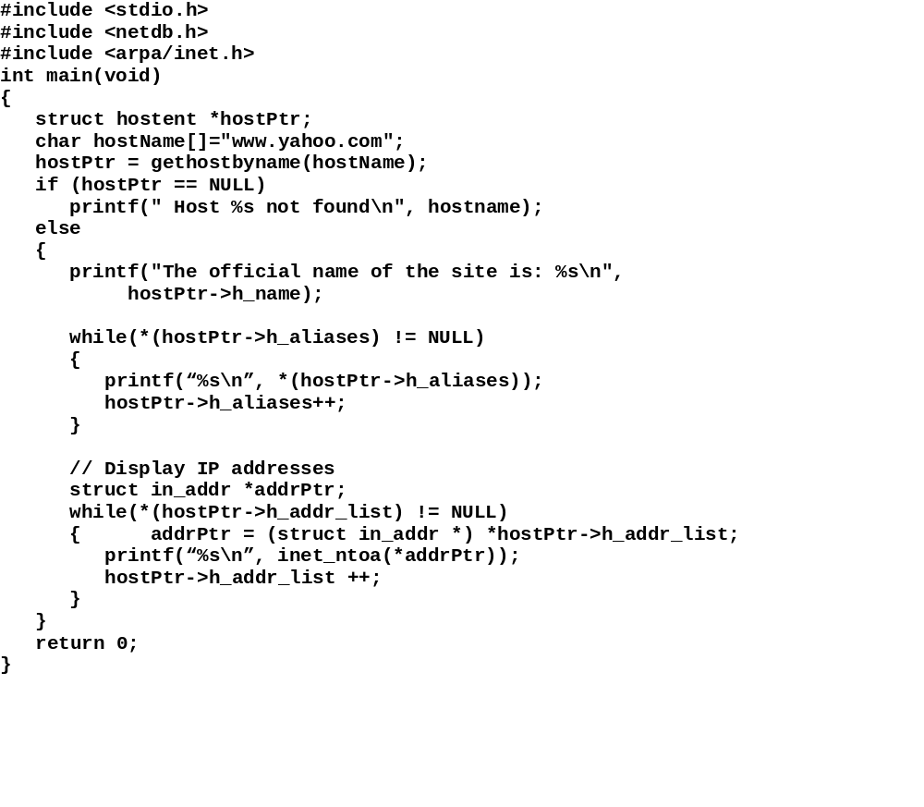
Example

Slide 25
How to display all the DNS names and IP Addresses of a host given its one IP Address

Slide 26
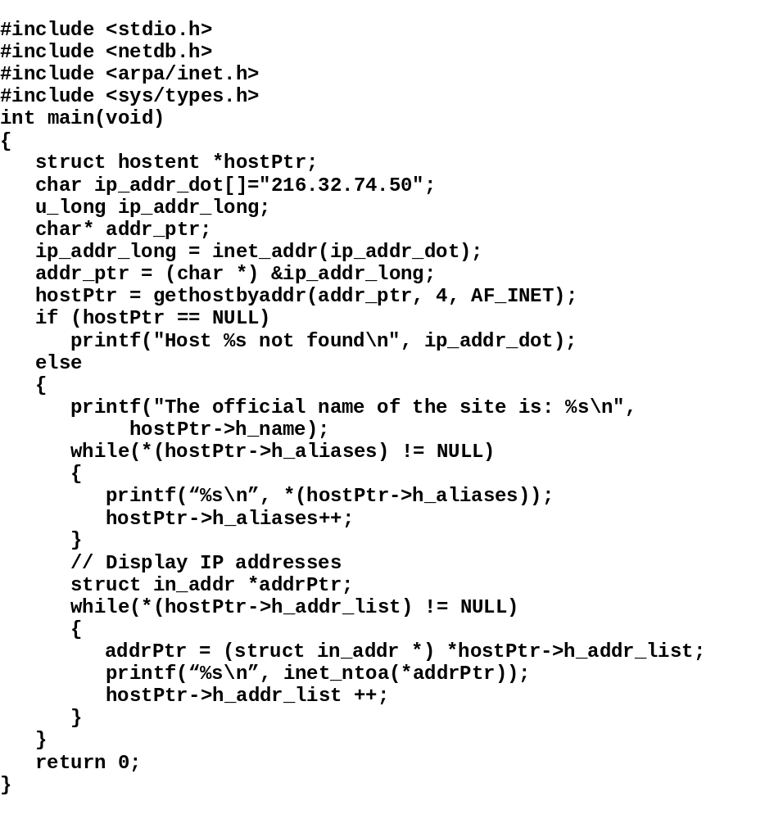
Example

Slide 27
Passing Arguments to main() Function

Slide 28
Question: How can we pass command line arguments to our program?
Solution: Define the header of your main() function as:
  void main(int argc, char* argv [])
  argc is the number of arguments including the program name
  argv [0] holds the program name as a string
  argv [1] holds the first argument as a string
  :
  argv [argc - 1] holds the last argument as a string

Slide 29
Illustration of Passing Arguments to main() Function
  void main(int argcount, char* argvector[])
argc (int)
argv
[0]
string (program name)
[1]
string (argument 1)
[2]
string (argument 2)
. . .
[argc -1]
string (last argument)

Slide 30
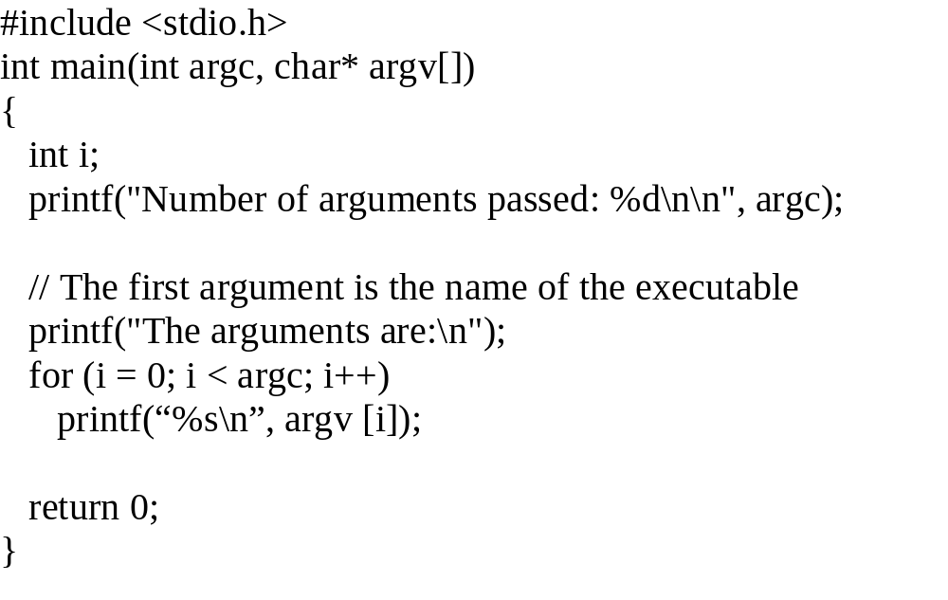
Example on how to access command line Arguments

Slide 31
Byte Ordering
Memory locations are addressed byte by byte
A data unit can span more than one byte. What is the order of bytes from most significant (MS) to least significant (LS) in memory? We call it host byte order.
Example
  On most computers, a long integer is four bytes. Assume a long integer in binary:
  00111000 11000001 10010000 10110001
(MS Byte)
(LS Byte)
Memory
Memory
(MS)
00111000
A
A+1
A+2
A+3
(LS)
10110001
A
A+1
A+2
A+3
11000001
10010000
10010000
11000001
(LS)
10110001
(MS)
00111000
Case 1. Big endian byte order
Case 2. Little endian byte order

Slide 32
Network Byte Order
TCP/IP supports only big endian byte order, we call it network byte order.
For portability of your source code, always use conversion functions:
  htons() : (Host to network short) Converts 16-bit integer from host byte order to network byte order
  ntohs(): (Network to host short) Converts network 16-bit integer to host byte order
  htonl() : (Host to network long) Converts 32-bit integer from host byte order to network byte order
  ntohl(): (Network to host long) Converts network 32-bit integer to host byte order
16-bit host
32-bit host
htons()
ntohs()
htonl()
ntohl()
16-bit net
32-bit net

Slide 33
htonl, htons, ntohl, and ntohs Functions
For LINUX System
#include <netinet/in.h>
uint32_t htonl(uint32_t hostlong);
uint16_t htons(uint16_t hostshort);
uint32_t ntohl(uint32_t netlong);
uint16_t ntohs(uint16_t netshort);

Slide 34
Example
#include <arpa/inet.h>
#include <netinet/in.h>
#include <stdio.h>
// It checks whether host byte order is same as net byte order
// in this machine
int main()
{
long int num1 = 0x0a170e06; // 10.23.14.6 in dotted decimal
// Output in decimal dotted form without conversion
struct in_addr* addr_ptr; // needed for call
addr_ptr = (struct in_addr *) &num1;
printf("%s\n", inet_ntoa(*addr_ptr));
// Output after conversion
long int num2;
num2 = htonl(num1); // Convert
addr_ptr = (struct in_addr *) &num2;
printf("%s\n", inet_ntoa(*addr_ptr));
return 0;
}
Output
6.14.23.10
10.23.14.6
What is your conclusion?

Slide 35
Review
Functions
  gethostname()
  gethostbyname()
  gethostbyaddr()
  inet_ntoa()
  inet_addr()
  htons()
  ntoh()
  htonl()
  ntohs()
Structures
  hostent
  in_addr

Slide 36
Some Useful UNIX Commands
netstat
  Print network connections, routing tables, interface statistics, masquerade connections, and multicast memberships
dig
  DNS lookup utility
route
  Show / manipulate the IP routing table
host
  DNS lookup utility
ip
  TCP/IP interface configuration and routing utility
ifconfig
  Configure a network interface or show config. info
arp
  Manipulate or display the system ARP cache
tcpdump
  dump traffic on a network
whereis
  Find a command or file

Slide 37
Client-Server Paradigm
Server program
  Run 24 hours, 7 days a week listening for requests from clients
  Process a client’s request according to some agreed upon (or standard) protocol
  Serve many clients concurrently or one client at a time
  Should be robust and powerful
Client program
  Run when a user decides to
  Send requests for service to intended server according to some agreed upon (or standard) protocol
  Should have a good user interface

Slide 38
Client-Server Paradigm (contd..)
Note:
  A computer system can have many server programs running and can also be used to run many client programs simultaneously
  There is no such distinction that a machine is a server machine or a client machine

Slide 39
Server Types Based on Implementation
Server Types
TCP Based
UDP Based
Concurrent
Iterative
Concurrent
Iterative

Slide 40
Protocol Families in UNIX Environment
Protocol family PF_UNIX
  Designated by an integer constant 1
  Strictly supported on UNIX system
Protocol family PF_INET
  Designated by an integer constant 2
  Related to Internet protocols
Protocol Families
PF_UNIX
PF_INET
(Used for Internet
Programming)

Slide 41
Address Families
Address family AF_UNIX
  Designated by an integer constant 1
  Strictly used for UNIX hosts
Address family AF_INET
  Designated by an integer constant 2
  Related to Internet hosts
Address Families
AF_UNIX
AF_INET
(Used for Internet
Programming)

Slide 42
Socket Abstraction
Used for client-server data communication
An application layer abstraction similar to a file descriptor
Hide transport layer details
Is opened in an application program at the beginning
Data can be sent to or received from it
Is closed at the end of use
Client Application
Create/open socket
Initialize/configure socket
Communicate data
Close socket

Slide 43
Socket Abstraction (cont’d)
S
E
R
V
E
R
C
L
I
E
N
T
Network

Slide 44
Types of Sockets in UNIX (LINUX) system
Stream socket SOCK_STREAM
  uses TCP as transport protocol
  designated by an integer constant 1
Datagram socket SOCK_DGRAM
  uses UDP as transport protocol
  designated by an integer constant 2
Raw socket SOCK_RAW
  designated by an integer constant 3
  Useful for sending ICMP messages
Two more types: SOCK_SEQPACKET and SOCK_RDM

Slide 45
SOCK_STREAM
(TCP)
SOCK_DGRAM
(UDP)
Socket Types
SOCK_RAW
SOCK_SEQPACKET
SOCK_RDM

Slide 46
Socket Address Structures
Struct sockaddr
  holds socket address information for many types of sockets (not only for AF_NET family)
  struct sockaddr {
  u_short sa_family; // address family
  char sa_data[14]; // protocol address
  };
  sa_family is AF_INET for an Internet socket address
  sa_data contains destination address and port number packed in some format

Slide 47
Socket Address Structures (contd..)
Struct sockaddr_in
  holds socket address information for Internet (“in” for Internet)
  struct sockaddr_in {
  short int sin_family; // Address family
  u_short sin_port; // Port number
  struct in_addr sin_addr; // Internet address
  u_char sin_zero[8]; // Same size as struct sockaddr
  };
  sin_family is AF_INET for Internet
  sin_port is port number in network byte order
  sin_addr holds IP address in network byte order (see next slide for detail)
  sin_zero is needed for padding. It makes sockaddr_in to type-cast to sock_addr and vice versa

Slide 48
Socket Address Structures (Cont’d)
Struct in_addr
  It contains IP address in network byte order (NBO)
    struct in_addr {
    u_long s_addr; // 32-bit IP address in network byte order
    };

Slide 49
Illustration of Address Structures
NBO: Network Byte Order
sockaddr
sockaddr_in
sa_family
(2 bytes)
NBO
sin_family
(2 bytes, NBO)
sa_data
sin_port
(2 bytes, NBO)
in_addr
sin_addr
s_addr
(14 bytes)
(4 bytes, NBO)
sin_zero
(8 bytes)
(16 bytes total )
(16 bytes total)

Slide 50
Memory Copy and Initialization Functions
Network programming frequently involves coping one memory area to some other memory area
  bcopy() or memcpy() function can be used for the purpose
Network programming also involves initializing some memory area with binary zeros
  bzero() or memset() can be used for this

Slide 51
bzero() Function
Memory
Writes zeros to a byte string
#include <string.h>
void bzero(void *s, size_t n);
Sets the first n bytes of the byte string s to zero (binary 00000000).
????????
????????
????????
????????
(before)
bzero()
00000000
00000000
00000000
00000000
(after)

Slide 52
bcopy() Function
Copies byte strings
#include <string.h>
void bcopy (const void *src,
void *dest, size_t n);
Copies first n bytes of the source string src to destination string dest.
0B10100A
0C11000B
001A2001
1001000F
Source
bcopy()
0B10100A
0C11000B
001A2001
1001000F
Destination

Slide 53
Example with bzero() and bcopy()
/* use of bzero() and bcopy() functions */
#include <stdio.h>
#include <string.h>
int main(void)
{
char *srcPtr, *destPtr;
int numbytes;
typedef struct
{
long int ssn;
char name[41];
unsigned short age;
} Person;
Person John = {502085332, "John Foster", 30};
numbytes = sizeof(Person);
destPtr = (char *) malloc(numbytes);
srcPtr = (char *) &John;
bzero(destPtr, numbytes);
bcopy(srcPtr, destPtr, numbytes);
Person *personptr;
personptr = (Person *) destPtr;
printf("%d\n", personptr->ssn);
printf("%s\n", personptr->name);
printf("%d\n", personptr->age);
return 0;
}

Slide 54
Illustration
srcPtr
502085332
(long int)
“John Foster”
(string)
30
(short int)
bcopy()
destPtr
(personptr)
(long int)
502085332
“John Foster”
(string)
30
(short int)
Note: char * destPtr is typecast to Person * personptr to access
members in the data structure

Slide 55
socket() Function
Returns a socket descriptor (an integer), or -1 on error
#include <sys/types.h>
#include <sys/socket.h>
int socket(int domain, int type, int protocol);
  domain is PF_INET for Internet (protocol family)
  type is SOCK_STREAM and protocol is 0 for TCP
  type is SOCK_DGRAM and protocol is 0 for UDP

Slide 56
connect() Function
Initializes and initiates a connection on a socket to communicate with a destination host
#include <sys/types.h>
#include <sys/socket.h>
int connect(int sockfd, const struct sockaddr *serv_addr,
socklen_t addrlen);
  sockfd is a socket descriptor that refers to a socket
  serv_addr is for destination host address structure (server)
  addrlen is length of server (destination) address structure

Slide 57
read() Function
Reads bytes from a socket (or a file descriptor). Technically, it transfers bytes (if available) from transport layer area to application program area
int read(sock_fd, char* buffer, int len);
Returns number of bytes read from socket sock_fd
Bytes are saved in buffer
len is the largest number of bytes a programmer would like to read from socket and save in buffer. len must not exceed the size of the buffer.

Slide 58
Example: Day time Service
Day time server runs on port 13
When a client connects to a TCP-based day time server, it returns information on day and time and then closes the connection.
Atomic timer server
  time-a.timefreq.bldrdoc.gov
  IP addr: 132.163.4.101
  National Institute of Standards and Technology, Boulder, Colorado
Listen
Accept connection
Send day time info
Close connection

Slide 59
Example: Daytime Client Program
// Daytime client
// Protocol: TCP
#include <sys/socket.h>
#include <stdio.h>
#include <string.h>
#include <sys/types.h>
#include <netinet/in.h>
#include <arpa/inet.h>
#include <unistd.h>
#include <stdlib.h>
int main(void)
{
// create socket
int sock;
sock = socket(PF_INET, SOCK_STREAM, 0); // 0, tcp by default
if(sock < 0)
{
printf("Failed to create a socket\n");
exit(1);
}

Slide 60
Daytime Client (contd..)
// initialize remote host address structure
struct sockaddr_in sin;
bzero((char *) &sin, sizeof(sin));
sin.sin_family = AF_INET; // set to internet address type
sin.sin_port = htons(13); // set to daytime port number 13
// Set IP address for time-a.timefreq.bldrdoc.gov
sin.sin_addr.s_addr = inet_addr("132.163.4.101");
// Connect to remote host using socket and address structure
int retcode;
retcode = connect(sock, (struct sockaddr *) &sin, sizeof(sin));
if(retcode < 0){
printf("Failed to connect with the host\n"); exit(2);
}
// Get and print day-time info
int bytesread;
char buffer[200];
bytesread = read(sock, buffer, sizeof(buffer)-1);
buffer[bytesread] = '\0'; // ensures null terminated
printf("%s\n", buffer);
close(sock);
}

Slide 61
Flow Diagram of Daytime Client Program
Open Socket
Initialize remote host address structure with port no, IP address, etc.
Establish connection
Read and print daytime info.
Close socket

Slide 62
Remarks
Our daytime client program is a very simple, bare-bone client application
  It is a TCP-based client program
  It does not do any DNS look-up to obtain the IP address of the daytime server
  IP address of the server is embedded in the program
  Port number is hard-coded in the program
  It does not send any data to the daytime server
  It only receives data
A somewhat different daytime client is given next

Slide 63
Daytime client, Example 2
// Daytime client 2
// Protocol: TCP
#include <sys/socket.h>
#include <stdio.h>
#include <string.h>
#include <sys/types.h>
#include <netinet/in.h>
#include <arpa/inet.h>
#include <unistd.h>
#include <stdlib.h>
#include <netdb.h>
char host[] = "time-a.timefreq.bldrdoc.gov";
char service[] = "daytime";
char protocol[] = "tcp";
int main(void) {
// create socket
int sock;
struct protoent *protoPtr;
protoPtr = getprotobyname(protocol);
if (protoPtr == NULL) {
printf("Failed to map protocol name to number\n");
exit(1);
}

Slide 64
Example 2 (contd..)
sock = socket(PF_INET, SOCK_STREAM, protoPtr->p_proto);
if(sock < 0)
{
printf("Failed to create a socket\n");
exit(1);
}
// Initialize remote host address structure
struct sockaddr_in sin;
bzero((char *) &sin, sizeof(sin));
// Get port number for the service
struct servent * servPtr;
servPtr = getservbyname(service, protocol);
if (servPtr == NULL)
{
printf("No entry found for the service\n");
exit(1);
}
sin.sin_port = servPtr->s_port; // set to daytime port number

Slide 65
Example 2 (contd..)
// Get IP address for time-a.timefreq.bldrdoc.gov
struct hostent * hostPtr;
hostPtr = gethostbyname(host);
if (hostPtr == NULL)
{
printf("Failed to resolve host name\n");
exit(2);
}
bcopy(hostPtr->h_addr, (char *) &sin.sin_addr, hostPtr->h_length);
sin.sin_family = hostPtr->h_addrtype; // usually AF_INET
int retcode;
retcode = connect(sock, (struct sockaddr *) &sin, sizeof(sin));
if(retcode < 0)
{
printf("Failed to connect with the host\n");
exit(2);
}

Slide 66
Example 2 (contd..)
// Get daytime info.
int bytesread;
char buffer[200];
bytesread = read(sock, buffer, sizeof(buffer)-1);
buffer[bytesread] = '\0'; // ensures null terminated
printf("%s\n", buffer);
close(sock);
return 0;
}

Slide 67
Remarks
This program
  Does DNS-lookup to obtain the IP address of the server
  Finds the protocol number for TCP protocol and accordingly opens a socket for communication
  Finds the port number for daytime service and uses it to initialize remote host address structure

Slide 68
Monitoring or Detecting Available Services on a Remote System
A server program runs on a port
A TCP-based server program
  Runs in listening mode waiting to receive connection request
  Accepts connection from a client
A successful connection to a port on a remote system by a client is an indication of the presence of a service on the remote system

Slide 69
Service Monitoring or Port Scanning
//Service Monitor or Port scanner
// Protocol: TCP
#include <sys/socket.h>
#include <stdio.h>
#include <string.h>
#include <sys/types.h>
#include <netinet/in.h>
#include <arpa/inet.h>
#include <unistd.h>
#include <stdlib.h>
#include <netdb.h>
char host[] = “cs.missouristate.edu";
int main(void) {
int sock;
int retcode;
struct sockaddr_in sin;
// Get IP Address
struct hostent *hostAddr;
hostAddr = gethostbyname(host);
if (hostAddr == NULL){
printf("Failed to resolve host name\n");
exit(1);
}
Caution: Don’t try it on
an unauthorized system

Slide 70
Service Monitor or Port Scanner (contd..)
// scan port from 1 to 1000
int portno;
for (portno = 1; portno < 1001; portno ++) {
sock = socket(PF_INET, SOCK_STREAM, 0); // 0, tcp by default
if(sock < 0) {
printf("Failed to create a socket\n");
exit(1);
}
// initialize remote host address structure
bzero((char *) &sin, sizeof(sin));
bcopy(hostAddr->h_addr, (char *) &sin.sin_addr, hostAddr->h_length);
sin.sin_family = AF_INET; // set to internet address type
sin.sin_port = htons(portno); // set to port number to i
retcode = connect(sock, (struct sockaddr *) &sin, sizeof(sin));
if(retcode == 0) // connection successful {
printf("Service found at port: %d \n", portno);
}
close(sock);
}
return 0;
}
Disclaimer: I’m not responsible if you try this
program on some unauthorized site

Slide 71
Remarks
When a client application attempts to connect to a non-existent port on a remote host
  The remote host sends an ICMP error message
  TCP on the client machine, upon receiving the ICMP error message, returns an error code to the client application
If the client machine is protected by a firewall, it may not get the ICMP error message from the remote system
If the remote system is protected by a scan detection program, the client program may not be able to find out available services on the remote system

Slide 72
Server Program
An network application program that provides a specific service to clients
Examples: http server, ftp server, telnet server, e-mail server, etc.
A server always remains online to serve any client requesting for service

Slide 73
TCP Servers
We will call connection-oriented servers as TCP servers
A TCP server socket always remains open and listens to its port for any connection request from a client
It accepts a connection by opening a separate socket (serving socket) for communication with a client. In case of iterative server, only one such socket is opened. In case of concurrent server, multiple such sockets may remain open, one of each client request.
It closes the socket when done with the client.
Note: Listening or server socket always remains open.

Slide 74
An Iterative, TCP-Based Server
Setup address structure with its own IP address, own port number, etc
Open a socket for listening (sockListen)
Bind sockListen with address structure and set it to listen
Accept whenever a connection request arrives from a client and create a new socket (sockAccept)
Communicate or exchange data with the client via sockAccept
Close sockAccept

Slide 75
bind() Function
Specifies a local IP address and protocol port number for a socket (or links a socket to the address structure of the local machine)
Primarily used by servers to specify a well-known port
  #include <sys/socket.h>
  int bind(int socket, struct sockaddr * serv_addr, int addr_len);
Returns
  0 if successful
  -1 if unsuccessful

Slide 76
listen() Function
#include <sys/socket.h>
int listen(int s, int backlog);
Sets a socket to listening mode to receive connection requests from clients
Only applicable for sockets of type
SOCK_STREAM or SOCK_SEQPACKET
backlog parameter defines the maximum length of the queue of pending connections
s is the socket number

Slide 77
accept() Function
Accepts a connection request and returns a separate socket for communication with the client
#include <sys/types.h>
#include <sys/socket.h>
int accept(int socket, struct sockaddr *addr, socklen_t *addrlen);
addr is a pointer to a sockaddr structure to be filled in with address of the connecting entity (i.e. client)
addrlen argument is a value-result parameter
  Used to pass the size of the structure pointed by addr;
  on return, it contains actual length (in bytes) of the address returned.

Slide 78
Example: An Iterative TCP Server
// Example of an iterative server
#include <stdio.h>
#include <sys/types.h>
#include <sys/socket.h>
#include <netinet/in.h>
#include <netdb.h>
#include <stdlib.h>
#include <string.h>
#include <unistd.h>
const int SERVER_PORT = 8888;
const int Q_LEN = 5; // number of waiting clients
int main(void)
{
struct sockaddr_in serv_sin;
struct sockaddr_in cli_sin;
char buffer[500];
int sockListen;
int sockAccept;
unsigned int addrLen; // or socklen_t addrLen
int length;

Slide 79
Example (contd..)
// Setup address structure
bzero((char *) &serv_sin, sizeof(serv_sin));
serv_sin.sin_family = AF_INET;
serv_sin.sin_addr.s_addr = INADDR_ANY;
serv_sin.sin_port = htons(SERVER_PORT);
// Setup listening socket
sockListen = socket(PF_INET, SOCK_STREAM, 0);
if (sockListen < 0)
{
printf("Failed to create listening socket\n");
exit(1);
}

Slide 80
Example (contd..)
if (bind(sockListen, (struct sockaddr *) &serv_sin,
sizeof(serv_sin)) < 0)
{
printf("Failed to bind listening socket to address \n");
exit(1);
}
if (listen(sockListen, Q_LEN) < 0)
{
printf("Failed to listen\n");
exit(1);
}
addrLen = sizeof(cli_sin);

Slide 81
Example (contd..)
// Wait for connection requests
while (1){
sockAccept = accept(sockListen,(struct sockaddr *) &cli_sin,
&addrLen);
if (sockAccept < 0){
printf("Failed to accept connection\n");
exit(1);
}
while (sockAccept > 0) {
length = read (sockAccept, buffer, sizeof(buffer));
if(length > 0){
int count;
for(count = 0; count < length; ++ count)
printf("%c", buffer[count]); // Display client's msg
printf("\n");
write(sockAccept, buffer, length); // Echo msg
if(buffer[0]=='Q') // Quit communication with client
break;
}
else
break;
}
close(sockAccept);
}
return 0;
}

Slide 82
Constant INADDR_ANY
A host can have multiple IP addresses
INADDR_ANY specifies a wildcard IP address that matches any of the host’s addresses
Will allow a single server accept incoming communication addressed to any of its IP addresses

Slide 83
Remarks
In client-server communications, any party can close its socket first
A client program in the middle of data communication can crash
A server program must continue running to serve even some client crashes in the middle of communication
Therefore, you should check in your program validity of your socket descriptor as well as return code of every read or write operation on the socket and accordingly take corrective actions in your program

Slide 84
Obtaining Client’s Information in a Server Program
When a connection request arrives from a client, the server also gets address information about the client
Client’s IP address, port number, etc are passed in an address structure

Slide 85
Example: Obtaining Client’s Addressing Info in a Server Program
// Example of an iterative server that shows client's
// addressing info
#include <stdio.h>
#include <sys/types.h>
#include <sys/socket.h>
#include <netinet/in.h>
#include <netdb.h>
#include <stdlib.h>
#include <string.h>
#include <unistd.h>
#include <arpa/inet.h>
const int SERVER_PORT = 8888;
const int Q_LEN = 5; // number of waiting clients

Slide 86
Example (contd..)
int main(void)
{
struct sockaddr_in serv_sin;
char buffer[500];
int sockListen;
int sockAccept;
struct sockaddr_in cli_sin;
unsigned int addrLen; // or socklen_t addrLen
int length;
// Setup address structure
bzero((char *) &serv_sin, sizeof(serv_sin));
serv_sin.sin_family = AF_INET;
serv_sin.sin_addr.s_addr = INADDR_ANY;
serv_sin.sin_port = htons(SERVER_PORT);

Slide 87
Example (contd..)
// Setup listening socket
sockListen = socket(PF_INET, SOCK_STREAM, 0);
if (sockListen < 0) {
printf("Failed to create listening socket\n");
exit(1);
}
if (bind(sockListen, (struct sockaddr *) &serv_sin,
sizeof(serv_sin)) < 0) {
printf("Failed to bind listening socket to address\n");
exit(1);
}
if (listen(sockListen, Q_LEN) < 0) {
printf("Failed to listen\n");
exit(1);
}

Slide 88
Example (contd..)
addrLen = sizeof(cli_sin);
// Wait for connection requests
while (1) {
sockAccept = accept(sockListen,(struct sockaddr *) &cli_sin,
&addrLen);
if (sockAccept < 0) {
printf("Failed to accept connection\n");
exit(1);
}
// Display information
printf("Client IP Address: %s\n", inet_ntoa(cli_sin.sin_addr));
printf("Client Port: %d\n", ntohs(cli_sin.sin_port));
close(sockAccept);
}
return 0;
}

Slide 89
Adv. and Disadv. of Iterative Servers
Some advantages
  Simple to implement
  Only allocate resources to communicate with one client at a time
Some Disadvantages
  While one client is being served, others remain in waiting state (even refused). Can cause long delays.
  Exchange of messages among a group of clients served by the server is not feasible!

Slide 90
UDP Servers
Server applications designed to run on UDP protocol provide connectionless service
No listening socket required in implementing a connectionless server
No separate socket required to serve a client’s request
Server program processes each request independent of any other requests
No connection establishment/tear down phase

Slide 91
Function setsockopt()
Sets and manipulate the options associated with a socket.
SYNOPSIS
#include <sys/types.h>
#include <sys/socket.h>
int setsockopt(int s, int level, int optname,
const void *optval, socklen_t optlen);
To manipulate options at the socket level, level is specified as SOL_SOCKET
The parameters optval and optlen are used to access option values for setsockopt
SO_REUSEADDR is used for optname to allow reuse of the same port.

Slide 92
Function recvfrom()
Receives a message from a socket
SYNOPSIS
#include <sys/types.h>
#include <sys/socket.h>
int recvfrom(int s, void *buf, size_t len, int flags, struct sockaddr
*from, socklen_t *fromlen);
May be used to receive data on a socket whether or not it is connection-oriented
If from is not NULL, and the socket is not connection-oriented, the source address of the message is filled in. The argument fromlen is a value- result parameter, initialized to the size of the buffer associated with from, and modified on return to indicate the actual size of the address stored there.

Slide 93
Function sendto()
Sends a message from a socket to a socket
SYNOPSIS
#include <sys/types.h>
#include <sys/socket.h>
int sendto(int s, const void *msg, size_t len, int flags, const struct
sockaddr *to, socklen_t tolen);
May be used for connection-oriented socket.
The address of the target is given by to with tolen specifying its size.
The length of the message is given by len. If the message is too long to pass atomically through the underlying protocol, the error EMSGSIZE is returned, and the message is not transmitted.

Slide 94
UDP Server Example: Echo Server
#include <sys/types.h>
#include <sys/socket.h>
#include <netinet/in.h>
#include <iostream.h>
#include <stdlib.h>
#include <string.h>
void main()
{
int retcode;
int sock;
struct sockaddr_in servAddr;
struct sockaddr_in clientAddr;
char buffer[500];
unsigned int length;
sock = socket(PF_INET, SOCK_DGRAM, 0);
if (sock < 0)
{
cout << "Failed to create a socket" << endl;
exit(1);
}

Slide 95
Example (contd..)
// To reuse the same port again and again
int i = 1;
retcode = setsockopt(sock, SOL_SOCKET, SO_REUSEADDR,
(char *) &i, sizeof (i));
if (retcode < 0)
{
cout << "Failed to set socket options for reuse" << endl;
exit(1);
}
length = sizeof(servAddr);
bzero((char *) &servAddr, length);
servAddr.sin_family = AF_INET;
servAddr.sin_addr.s_addr = htonl(INADDR_ANY);
servAddr.sin_port = htons(8888);
retcode = bind( sock, (struct sockaddr*)&servAddr, length);
if (retcode < 0)
{
cout << "Failed to bind" << endl;
exit(1);
}

Slide 96
Example (contd..)
int bytereceived;
// receive and send datagrams in a loop
while (1)
{
bytereceived = recvfrom(sock, buffer, sizeof(buffer) - 1,
0, (struct sockaddr *) &clientAddr, &length);
if (bytereceived < 1)
{
cout << "Failed to receive any message" << endl;
exit(1);
}
buffer[bytereceived] = '\0';
// convert to upper case and send message back
for(int count = 0; buffer[count] != '\0'; ++count)
if(buffer[count] >= 'a' && buffer[count] <= 'z')
buffer[count] = buffer[count] -('a' - 'A');
sendto(sock, buffer, strlen(buffer), 0,
(struct sockaddr *) &clientAddr, sizeof(clientAddr));
}
}

Slide 97
UDP Client
Uses UDP as the underlying transport protocol
Very similar to a UDP server in structure
One difference: it does not run in an endless loop
It does not need to run on a particular port (any port is fine)

Slide 98
UDP Client Example
// UDP Client for an UDP Echo Server
#include <iostream.h>
#include <sys/types.h>
#include <sys/socket.h>
#include <netinet/in.h>
#include <arpa/inet.h>
#include <netdb.h>
#include <string.h>
#include <stdlib.h>
void main(void)
{
struct sockaddr_in servAddr;
unsigned int addrlen;
int sock;
struct hostent *hostPtr;
char buffer[1000];

Slide 99
Example (contd..)
int readBytes;
int retcode;
sock = socket(PF_INET, SOCK_DGRAM, 0);
if (sock < 0)
{
cout << "Failed to create a socket" << endl;
exit(1);
}
hostPtr = gethostbyname("penguin.tamucc.edu");
if (hostPtr == NULL)
{
cout << "Failed to find host info" << endl;
exit(1);
}
bzero((char *) &servAddr, sizeof(servAddr));
servAddr.sin_family = AF_INET;
bcopy(hostPtr->h_addr, (char *) &servAddr.sin_addr, hostPtr->h_length);
servAddr.sin_port = htons(8888);
addrlen = sizeof(servAddr);
// Without bind() and connect(), we need to use
// sendto() and recvfrom() for datagram exchanges
// we cannot use write() and read() since they
// do not have any address parameter

Slide 100
Example (contd..)
char message[] = "Hello World";
if (sendto(sock, message, sizeof(message)-1, 0,
(struct sockaddr*) &servAddr,addrlen) < 0)
{
cout << "Failed to send message" << endl;
exit(1);
}
cout << "Sent: " << message << endl;
readBytes = recvfrom(sock,buffer,999,0,
(struct sockaddr*) hostPtr, &addrlen);
if (readBytes < 0)
{
cout << "Failed to receive message back" << endl;
exit(1);
}
buffer[readBytes] = '\0';
cout << "Received: " << buffer << endl;
}

