Slide 1
Approach on handling deleted EBP Summary Objects in SR after Plant Disconnection
US 5148 : When a plant(s) is removed from a part/specification, that part/specification shall be removed from the unauthorized plant/company's Views. Below are 2 use cases where the disconnection of plant happens on a part
  UC1 : When part is moved to Obsolete State
  UC2 : When plant is removed/disconnected from the part
UC1: When part is moved to Obsolete State
Release
PMP(20328762)
Obsolete
Modified timestamp
EBP Object Disconnect (ebpsum_20328762001~15145967)
ENOVIA DB
HVR Hub
Spec Reader DB
EBP Object
Modified timestamp
Disconnect from PMP
Disconnect from plant
Automated Job
Update in Postgres DB
Update in Elastic Search
Update in UI

Slide 2
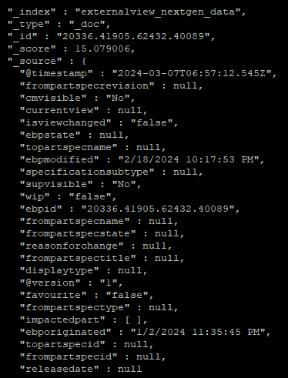
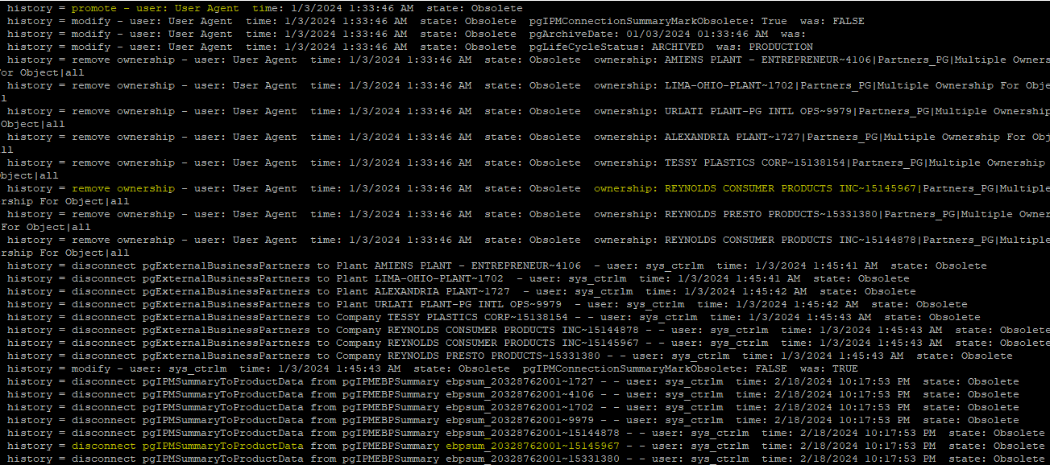
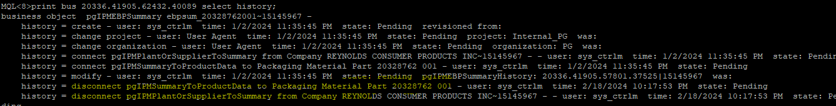
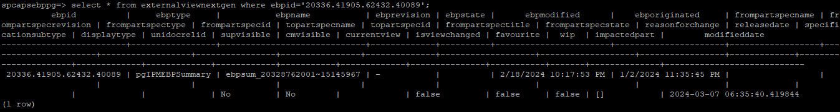
Approach on handling deleted EBP Summary Objects in SR after Plant Disconnection
UC1: When part is moved to Obsolete State

Slide 3


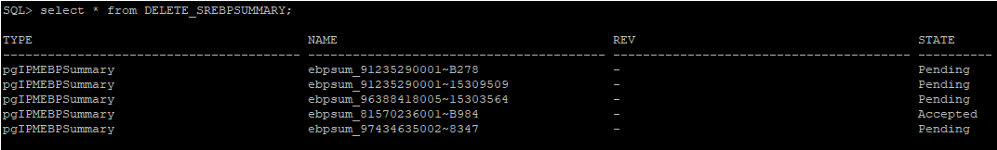
Approach on handling deleted EBP Summary Objects in SR after Plant Disconnection
UC2: When plant is removed/disconnected from the part
COP-00267211
Release
Plant Disconnect
No modification timestamp on EBP Object
Delete EBP from Database (ebpsum_COP-00267211001~CA25)
X
ENOVIA DB
HVR Hub
Spec Reader DB
Delete/Update Event Trigger LXBO_4F70A3B1_EBP_DEL_TRG
EBP Object
No Update in Postgres DB
No Update in Elastic Search
Still Reflect in UI
DELETE_SREBPSUMMARY
EBP TNR and state will be present
Shall script to connect DB and read these values
Delete from ES and Postgres DB
Impacted parts will not be displayed in UI

