Slide 1
Spec Reader GIT Commit Process
For Enovia Developers

Slide 2
Before we being..
# | Prerequisite | Action if no access
1 | Secure Windows VM Access(28/52) | Share your P&G id to Parshant/Amit to add into SR VM group. For temporary VM access contact your lead
2 | Secure P&G GIT access (github.pg.com) | Share your P&G id to Parshant/Amit to request P&G to provide access. P&G POC (normand.b@pg.com)
3 | GitHub Desktop (>=V2.8.1)installed on VM | Open source and can be downloaded and installed on VM.
4 | Beyond Compare Installed in VM | Open source and can be downloaded and installed on VM.
5 | Complete Development Workspace setup | Contact your lead to help to get workspace setup
6 | Deployment/Pipeline access for DEVS environment | Contact DevOps engineer Sushil (sushil.kumar23128 or kumar.sk.16@pg.com)

Slide 3
1. Developer updates his local git repo by “Fetch origin” from GitHub desktop and update his workspace on daily basis.
2. Developer will create his own feature branch by updating development branch from GitHub desktop
3. Developer will merge his code into development branch by comparing from Beyond compare. a. execute “Fetch origin” (Before any merge its mandatory to update branch by git pull) b. Compare your code using beyond compare and merge only your changes into your “feature”. c. Add proper comments before you commit your code (Ex: Defect/req: <Description>) d. Execute git push command to push your code to “feature” branch
4. click on “Create Pull request” or Navigate to github.pg.com and “compare & pull request”. One reviewer is mandatory to merge/commit the feature. Before creating pull request always please validate source and destination branches. Developer will communicate to Lead to review/approve the pull request
5. Using azure pipeline Development branch will deploy into DEV2 environment.
6. Developer will perform the Unit Testing/Internal Testing
7. SIT/QA/PROD Deployment by DevOps Engineer
Workflow:
Git Development Branch
(SpecReader_Development_6.0.1)
Git Development Branch
Updated with latest code
Developer
No Action
1
5
Dev &Lead
Developer Develops the fix for Defect/req on Local workspace
Deploy Development branch into DEVS/DEVAP environment from pipeline
Lead
Fail
DevOps Eng
2
6
Create Own Development Branch(feature) from development(SpecReader_Development_6.0.1) branch
Developer will perform the unit testing
Fail
Repeat the process from step
Pass
1
3
Pass
Developer merges his code into feature branch(Ex: SpecsReader_Dev)
Pull request will be raised to merge
Specreader_Release_6.0.1 from developer created feature/defect branch
4
7
Create pull request to merge feature branch into development branch (SpecReader_Development_6.0.1)
Specreader_Release_6.0.1 will be deployed into SIT/QA/PROD

Slide 4
Attached the Word document which explains below points:
1. Git Desktop installation and set up
2. Updating latest workspace, create branch, code merge and create pull request with screenshots
P&G Specs Reader git repo: https://github.com/procter-gamble/SpecAnywhere.git

Slide 5
Thank you!

Slide 6
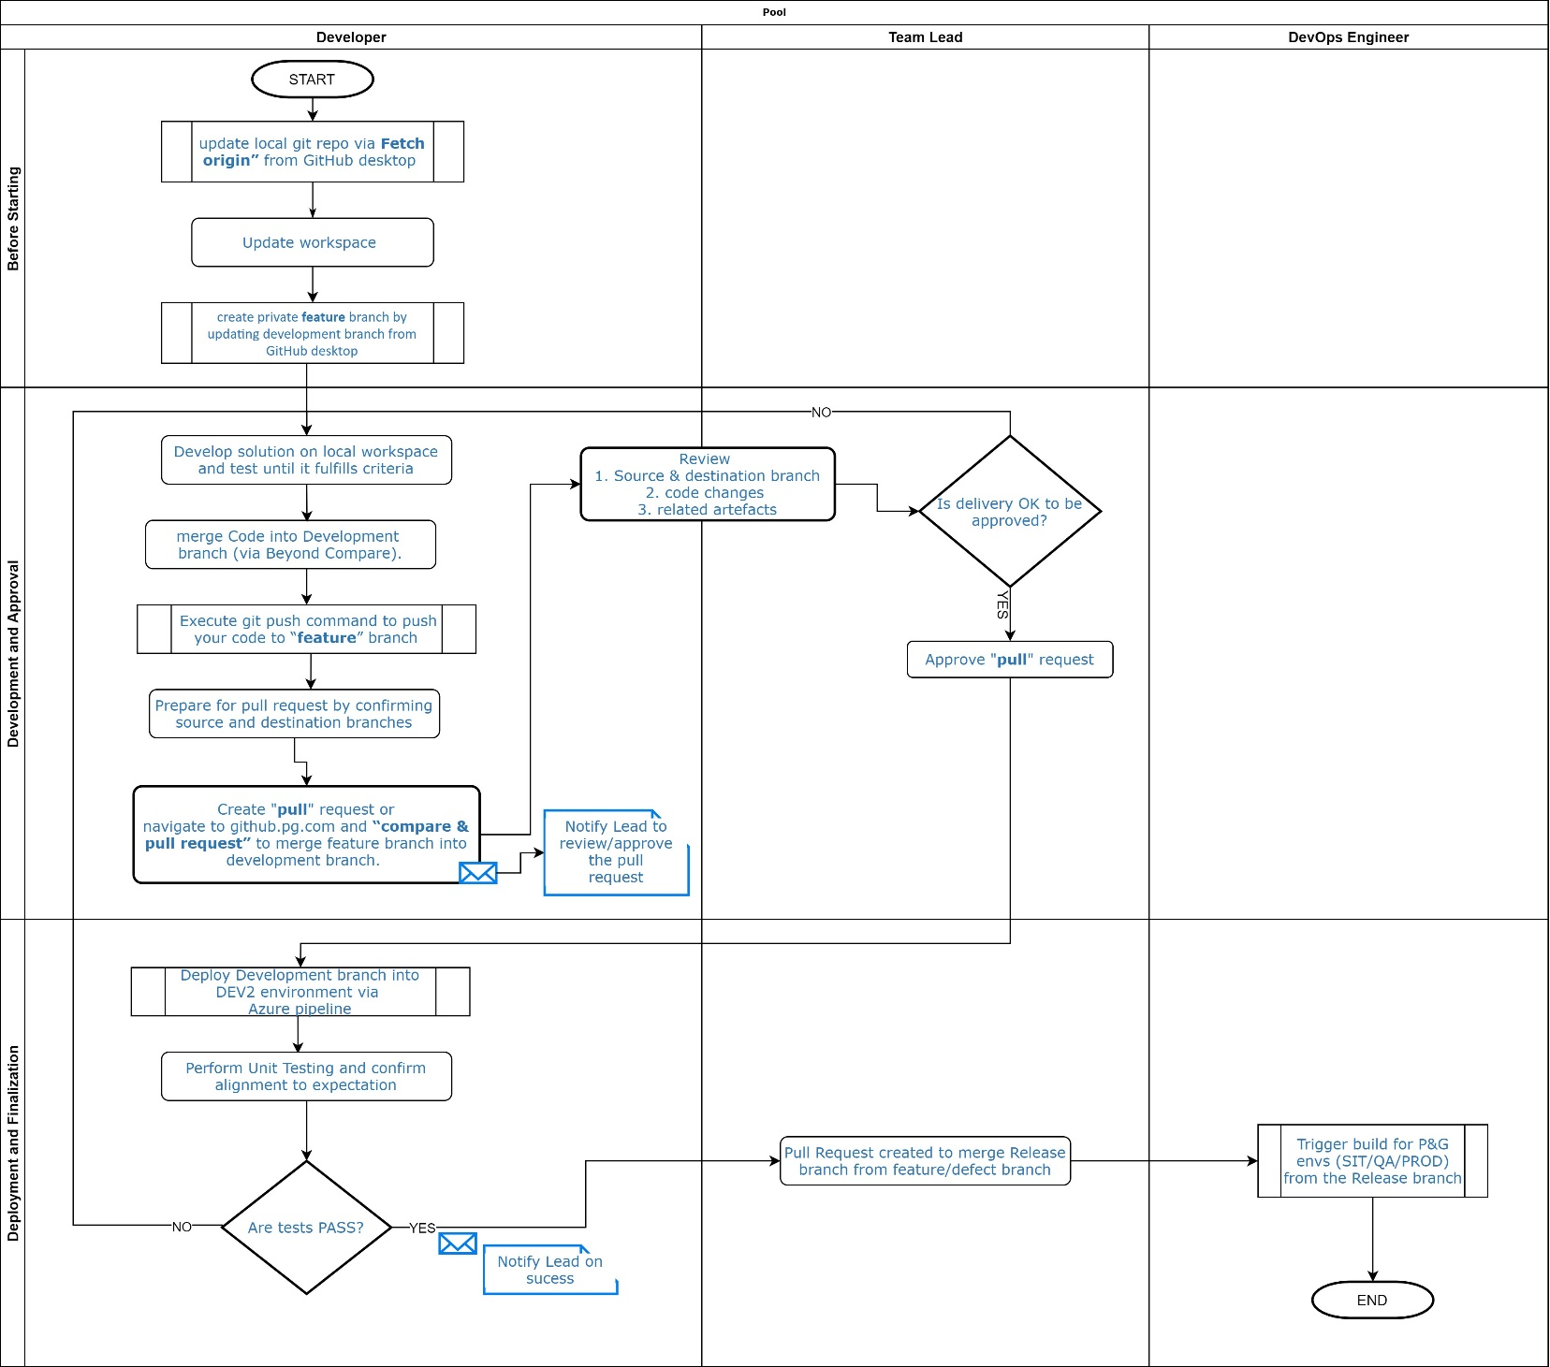

Slide 7
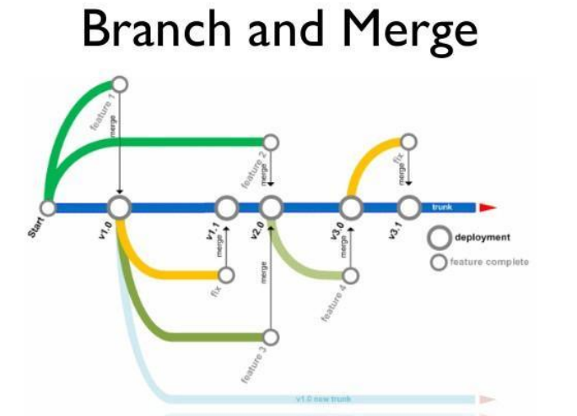

Slide 8
Developer
Git Development Branch
(SpecReader_Development_6.0.1)
Git Development Branch
Updated with latest code
No Action
Dev &Lead
Lead
1
5
DevOps Eng
Developer Develops the fix for Defect/req on Local workspace
Deploy Development branch into DEVS/DEVAP environment from pipeline
2
6
Create Own Development Branch(feature) from development(SpecReader_Development_6.0.1) branch
Developer will perform the unit testing
Fail
Repeat the process from step
Fail
Pass
1
3
Pass
Developer merges his code into feature branch(Ex: SpecsReader_Dev)
Pull request will be raised to merge
Specreader_Release_6.0.1 from developer created feature/defect branch
4
7
Create pull request to merge feature branch into development branch(SpecReader_Development_6.0.1)
Specreader_Release_6.0.1 will be deployed into SIT/QA/PROD

Slide 9
1. Developer will update his local git repo by “Fetch origin” from GitHub desktop and update his workspace on daily basis.
2. Developer will create his own feature branch by updating development branch from GitHub desktop
3. Developer will merge his code into development branch by comparing from Beyond compare. a. execute “Fetch origin” (Before any merge its mandatory to update branch by git pull) b. Compare your code using beyond compare and merge only your changes into your “feature”.
C. Add proper comments before you commit your code (Ex: Defect/req: <Description>) d. Execute git push command to push your code to “feature” branch
4. click on “Create Pull request” or Navigate to github.pg.com and “compare & pull request”. One reviewer is mandatory to merge/commit the feature. Before creating pull request always please validate source and destination branches. Developer will communicate to Lead to review/approve the pull request
5. Using azure pipeline Development branch will deploy into DEV2 environment.
6. Developer will perform the Unit Testing/Internal Testing
7. SIT/QA/PROD Deployment by DevOps Engineer

Slide 10
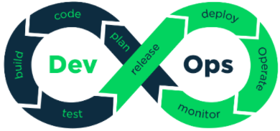
DevOps POC on AWS:
EC2(Elastic Compute Cloud)

