Slide 1
Specs Reader Partial Index
Architecture

Slide 2













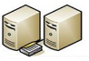










PROD Azure Infra - External Subscription – Southeast Asia (Proposed)
Front End IP configuration
and Front End port
App Service Plan
Load balancer
Spec Viewer
Standard
WAF
Firewall Configuration
Web App
https:
Internal
Name
Resolution
https:
HTTP Setting
Http/Https Setting
https:
https:
Frontend Routing
Application Gateway
Web Application Firewall
Spec Viewer
https:
Web App
Frontend IP or
FQDN
Http/Https
Listener
Rule
Integration
MQL Service
Web Apps
4 A4 v2 (4 vCPU(s), 8 GB RAM)
Standard Tier; 5 S3 (4 Core(s), 7 GB RAM, 50 GB Storage)
Virtual Machines
https:
https:
Ping Fed
Authentication
https:
https:
A4 v2 (4 vCPU(s)
8 GB RAM)
Azure Blob Storage
A4 v2 (4 vCPU(s)
8 GB RAM)
4 D8s v3 (8 vCPU(s), 32 GB RAM)
A4 v2 (4 vCPU(s)
8 GB RAM)
ES Documents
1 Gs5-8 (8 vCPU(s), 448 GB RAM)
A4 v2 (4 vCPU(s)
8 GB RAM)
Elastic Search
https:
CSV Files
https:
https:
https:
Virtual Machine
Elastic Search
Kibana
Logstash
Initial Load and
Delta
Enova DB
User DB
Node(1)
Enovia Documents
Oracle
Postgres
Azure Blob Storage
Master Node (1)
Data Node (3)
https:
Virtual Machine
Virtual Machines
Virtual Machine
Virtual Machine
Replica
Replica - AzCopy
Virtual Network
Enovia Documents
HVR Data
* Oracle DB storage – Premium drives
* All Storage - Standard SSD drives.
File Server

Slide 3



LxBO
Data modified event
Trigger
Elastic
Replication
ENOVIA DB
HVR Hub
Spec Reader DB
Logstash
csv files
SR_MONITOR
Shell script

Slide 4


SR_MonitorData
Input files
SRMonitortableData.sh
SR_MONITOR
Elastic
<TYPE>.sh
Copy csv
runpartialIndex.sql
csv files
csv files
Logstash
Output
staging
Mount Point
inputtime.txt (Updated Every 5 minuets with sysdate – 1/(24*60))
Azure Storage

Slide 5
Preference Column Update:
1. From Initial Load CSV for all EBP users(CM/Suppliers) preference=true
2. From partial indexing we are not update preference column?
Drawbacks :
a. The user profile process is not unique
b. TCLs are different(partial indexing and Partial indexing)
c. When any user is associated with different Plant, we are not updating the correct preference value in user DB.
Example:
User is AW5 : VTO TEST SUPPLIER 1~20514297 in User DB preference value is false
AW5 user changed plant VTO TEST SUPPLIER 4~19004191 in user DB preference value should be updated to true
Approach: in CSV preference value always true for EBP users
CSV_value = VTO TEST SUPPLIER 4~19004191 Value_from_User_DB: VTO TEST SUPPLIER 1~20514297
If (! CSV_value.equalsToIgnoreCase(Value_from_User_DB)) { updated from CSV both the values : CSV as is }
else if(CSV_value.equalsToIgnoreCase(Value_from_User_DB) && ! (preference value from CSV).equalsTo(preference value from User DB)) ) ) { DO NOT Update preference value and all other values should be update}
When we update Initial Load user profile, we should not delete all users and just update from CSV only

Slide 6
PDF download from direct URL:
Present PDF download.
From Part context page we have download Button
when user click on PDF button, request come to MQL service with Object ID, Enovia send JSON response same as Properties page
MS pdf download service will generate PDF with Json and watermark stamping adding footer(from JSON info from header section) generate PDF
Direct URL:
https://specreader.pg.com/pdf/02772144
pdf is new service implementation
Enovia service will receive GCAS name (02772144)
pdf service will get object ID, type name, revision from GCAS of latest release revision
with Object id and these info will call our existing imply page and generate service(Existing service already handling all security, Views etc...)
JSON will return to pdf service and same will go to PDF download service. Since JSON is ready MS existing service will generate PDF

Slide 7
Approach on handling deleted EBP Summary Objects in SR after Plant Disconnection
US 5148 : When a plant(s) is removed from a part/specification, that part/specification shall be removed from the unauthorized plant/company's Views. Below are 2 use cases where the disconnection of plant happens on a part
  UC1 : When part is moved to Obsolete State
  UC2 : When plant is removed/disconnected from the part
UC1: When part is moved to Obsolete State
Release
PMP(20328762)
Obsolete
Modified timestamp
EBP Object Disconnect (ebpsum_20328762001~15145967)
ENOVIA DB
HVR Hub
Spec Reader DB
EBP Object
Modified timestamp
Disconnect from PMP
Disconnect from plant
Automated Job
Update in Postgres DB
Update in Elastic Search
Update in UI

Slide 8
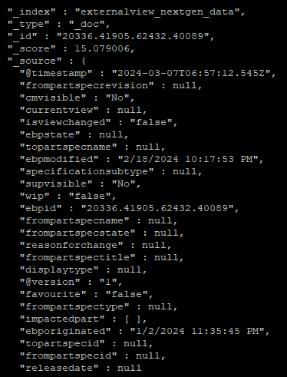
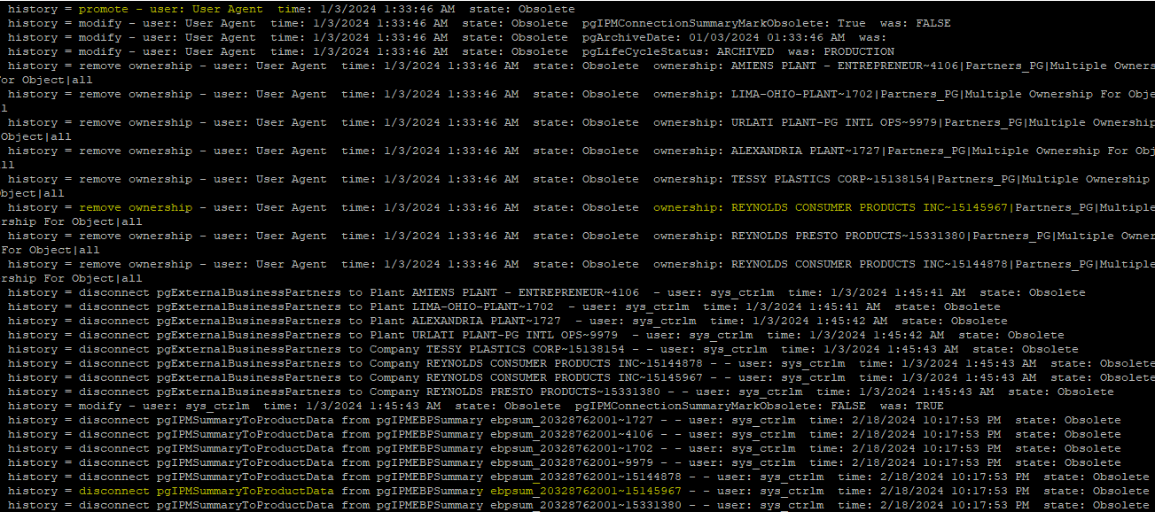
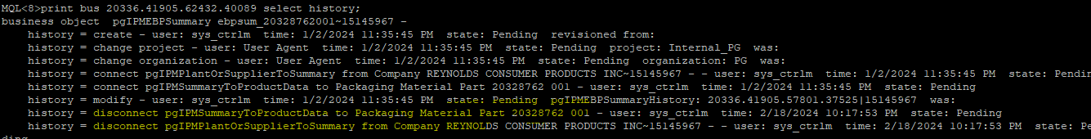
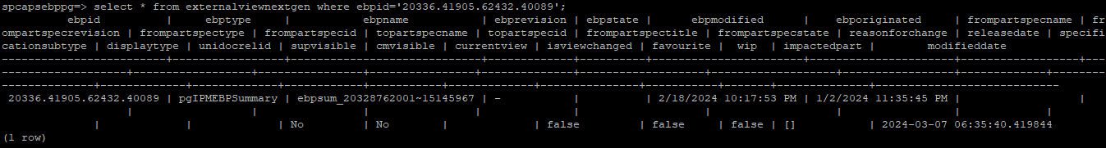
Approach on handling deleted EBP Summary Objects in SR after Plant Disconnection
UC1: When part is moved to Obsolete State

Slide 9
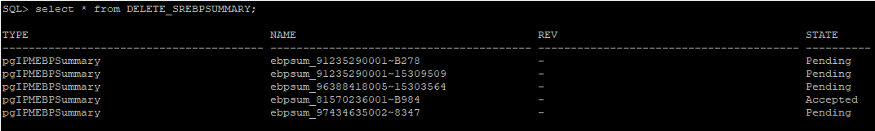
Approach on handling deleted EBP Summary Objects in SR after Plant Disconnection
UC2: When plant is removed/disconnected from the part
COP-00267211
Release
Plant Disconnect
No modification timestamp on EBP Object
Delete EBP from Database (ebpsum_COP-00267211001~CA25)
X
ENOVIA DB
HVR Hub
Spec Reader DB
Delete/Update Event Trigger LXBO_4F70A3B1_EBP_DEL_TRG
EBP Object
No Update in Postgres DB
No Update in Elastic Search
Still Reflect in UI
DELETE_SREBPSUMMARY
EBP TNR and state will be present
Shall script to connect DB and read these values
Delete from ES and Postgres DB
Impacted parts will not be displayed in UI

Slide 10


Approach on handling deleted EBP Summary Objects in SR after Plant Disconnection(2/2)
EBPSummaryData
fetchebpobjects.sql
EBPDeletionSummary.sh
DELETE_SREBPSUMMARY
DeleteByQuery.sh
EBPScanScript.tcl
Output
Elastic
EBP Data Deletion

