Slide 1

Spec Reader
Mar 28

Slide 2
Minutes of last meeting
Attendees: Nick, Ben, Janine, Jwala, Sharmila
Sharmila
# | Notes | Remarks
1 | Trigger and table details to capture delete event for EBP objects. This can be used to delete the index objects to reduce EBP object mismatches. | Details in upcoming slide
2 | Missing objects from Comparison report | Details in upcoming slide

Slide 3
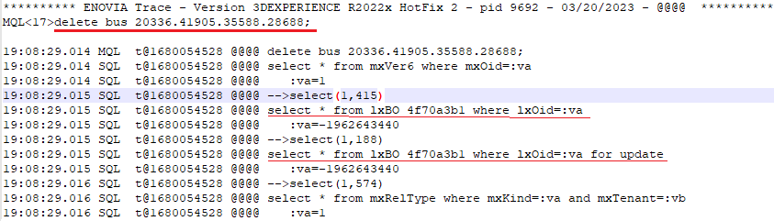
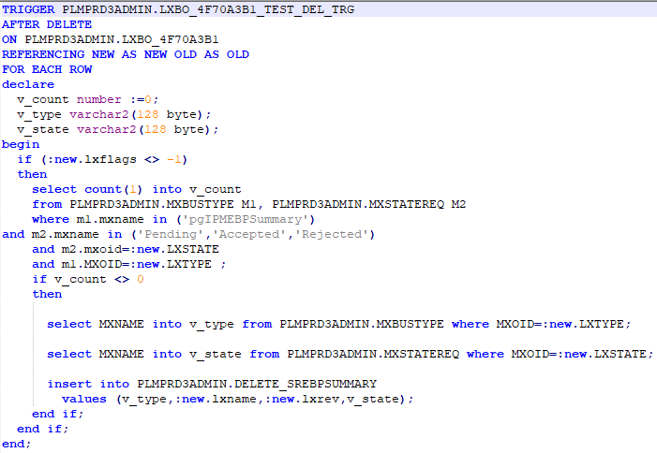
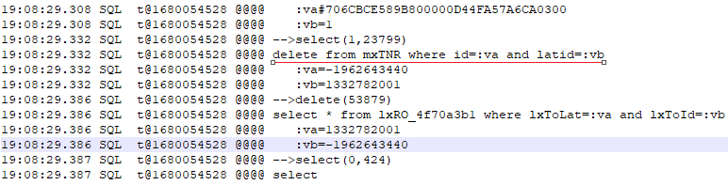

Technical Details regarding trigger to capture delete even on EBPSummary Objects
Trigger : PLMPRD3ADMIN.LXBO_4F70A3B1_TEST_DEL_TRG
Table : PLMPRD3ADMIN.DELETE_SREBPSUMMARY
<To be Removed> : We have created the above new trigger and Table and placed in FF/Dev. We have disconnected Parent object and Plant from EBP Summery object and try to delete from Enovia and SR. But no details captured in New table.
When we did the RCA on SQL trace logs, we observed that the actual deletion is happening on mxTNR. We need to understand more on the object deletion….

Slide 4
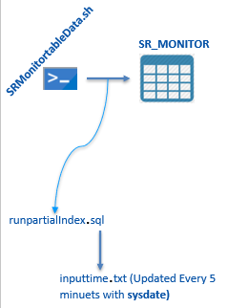
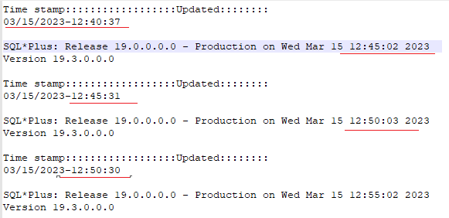
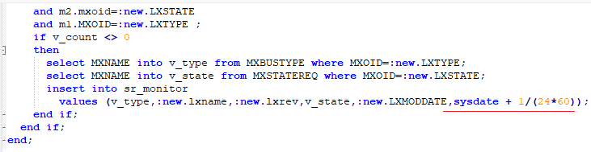
Missing Objects from Comparison Report
spool '/opt/mql/PartialIndexing/inputtime.txt';
set head off
set verify off
select &vartime - 1/(24*60) from dual;
spool off;
<To be Removed> : On The cron job execution runpartialindex.sh file will update InputTime.txt file. When we did the RCA, We observed that, there is a gap in SQL connection time stamp. We have updated runpartialindex.sh to update time stamp to capture 1 minte backword. Unfortunately that did not helped because the cap when it connected to DB.
We understand that we need to update in trigger. Since this is happening only on continue data, we have updated this trigger in FF env. Data creation and testing is in progress. DB is down since cloudops team doing some patching activities.

Slide 5
Thank You

