Slide 1

FLIGHT DELAY PREDICTION
ABHIRAM DESAI
JWALIT SHAH
GROUP 5
IE 7275 - Data Mining in Engineering

Slide 2

Table of Contents
Problem Overview
Problem Setting
Problem Definition
Data Source and Description
Description of Variables
Data Cleaning and Exploration
Data Mining Models
Performance Evaluation
Project Result

Slide 3

Project Overview
The primary aim of the project is to predict
if a given flight is getting delayed or not.

Slide 4



Problem Setting
People all around the world face issues with delayed flights due to reasons which are not under their own control.

Slide 5
Problem Definition
The intention of this analysis is to identify the best classification model for correctly classifying flights that are delayed at the destination airport and give an estimation about the delay time.
This estimation, in turn would help the customers make better decisions while booking tickets online, if they know in about the flights which are likely to get delayed and about the duration of delay.

Slide 6
Data Source and Data Description
The dataset contains 5,83,986 rows and 22 columns. From the original 22 columns, one column is “Unnamed” which does not contain any records. Hence, we drop it.
Moreover, after examining the dataset we dropped some of the redundant columns.
After dropping the redundant variables, we are left with 13 columns of which 12 are the predictors and “ARR_DEL15” is the target variable.

Slide 7
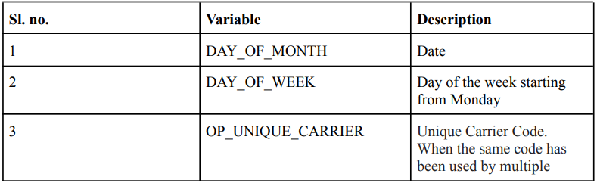
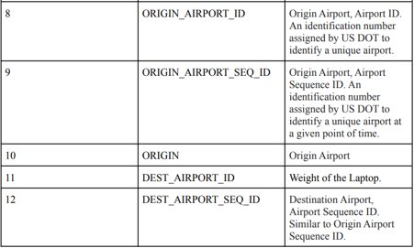
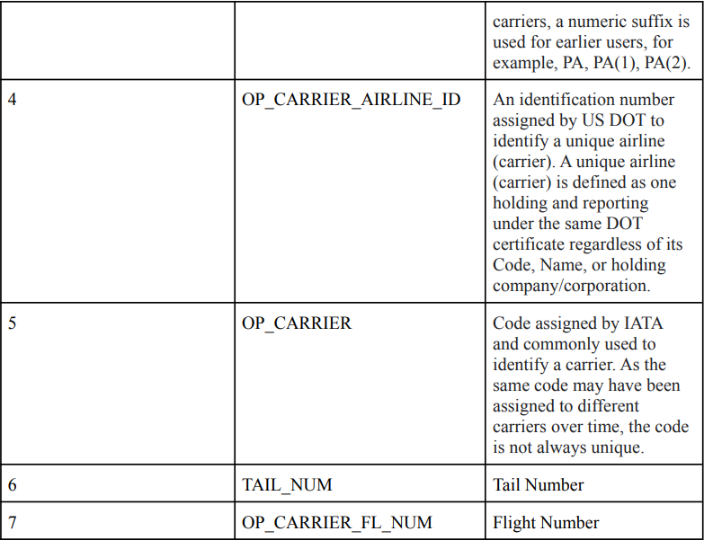
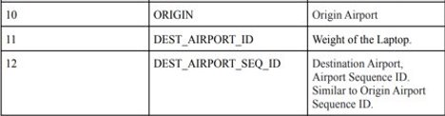
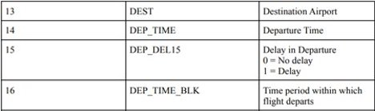
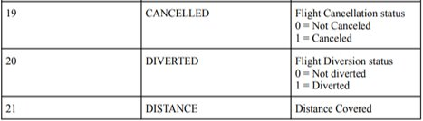

Description of Variables

Slide 8
Data Cleaning and Exploration
After examining and understanding the dataset, we calculated the number of null values for each attribute. In order to clean the data, we removed the records with null values.
Apart from this, we determined the attributes which were redundant as the flight from a particular origin to its respective destination can be determined by more than one attributes. Hence, we dropped the redundant attributes.
Using Label Encoder, we converted the relevant categorical variables into numerical variables. After obtaining the label encoded attributes, we dropped the original categorical variables.
These steps reduced our dataset to 5,65,963 rows and 14 columns.

Slide 9
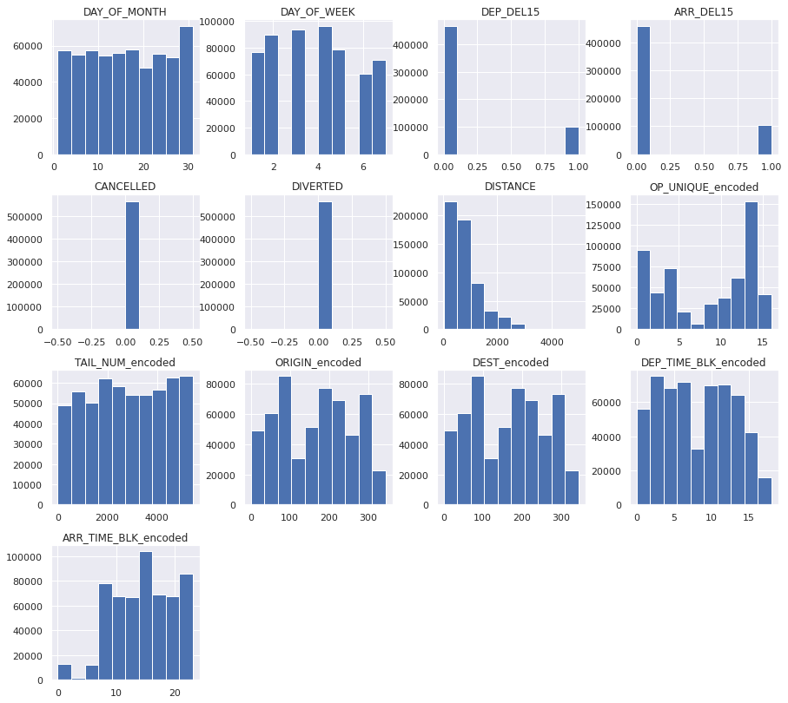
Exploratory Data Analysis : Histogram for frequency Distribution of variables

Slide 10
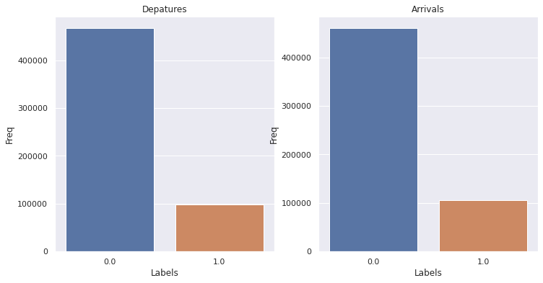
Data Exploration
This visualization depicts the number of flights that departed and arrived on time (0.0), and the ones that are delayed (1.0)

Slide 11
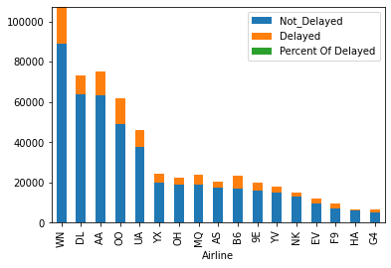
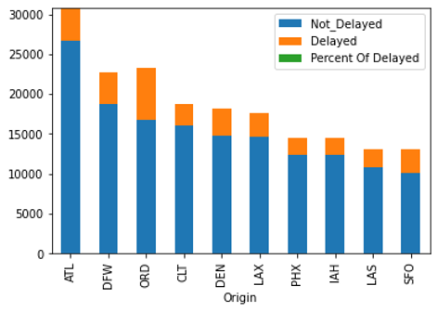
Data Exploration
Top 10 airlines- Percentage of delayed flights vs total flights.
Top 10 airports- Percentage of delayed flights vs total flights.

Slide 12
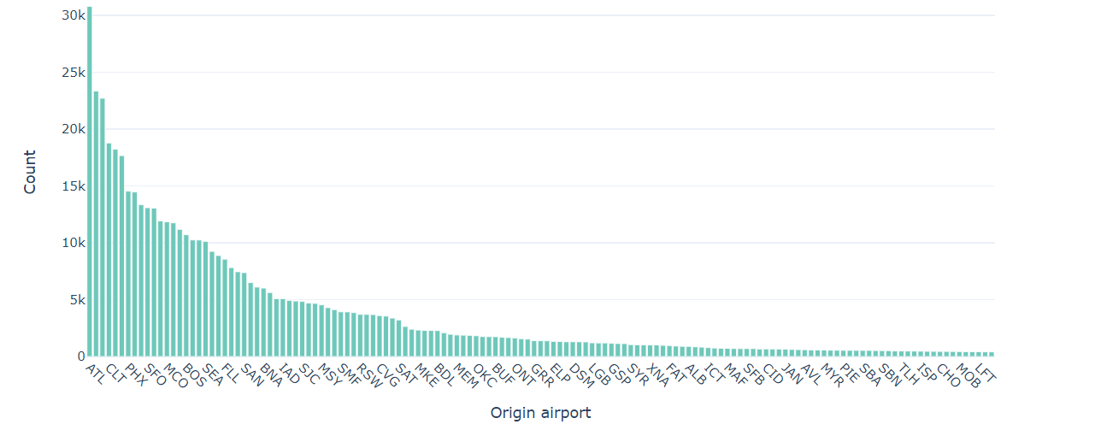
Data Exploration
Flights delayed (departure) by Origin airport

Slide 13
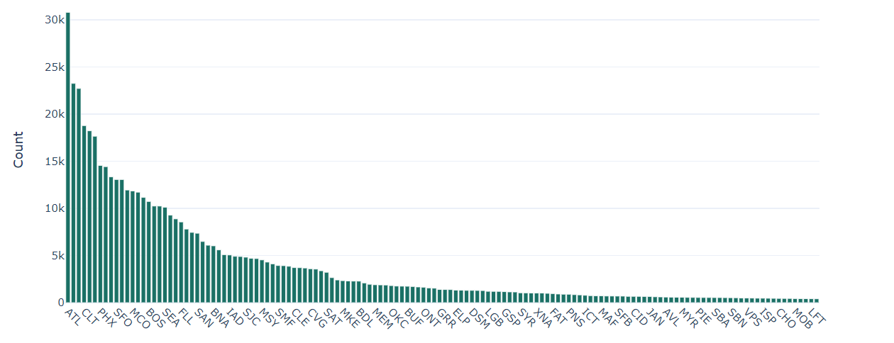
Data Exploration
Flights delayed (arrival) by Destination airport

Slide 14
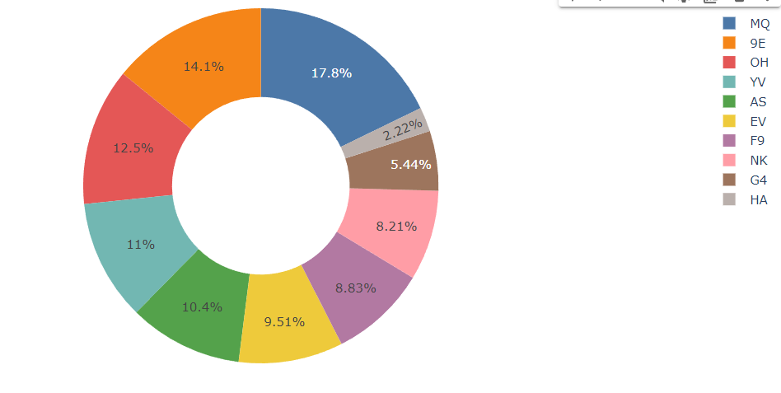
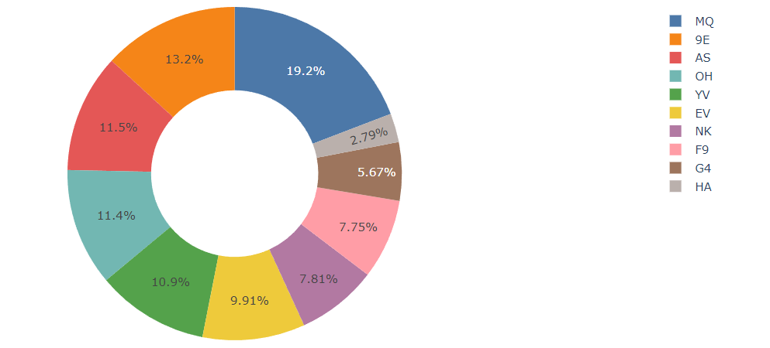
Data Exploration
Top 10 Airlines with most delayed flights (departure)
Top 10 Airlines with most delayed flights (arrival)

Slide 15
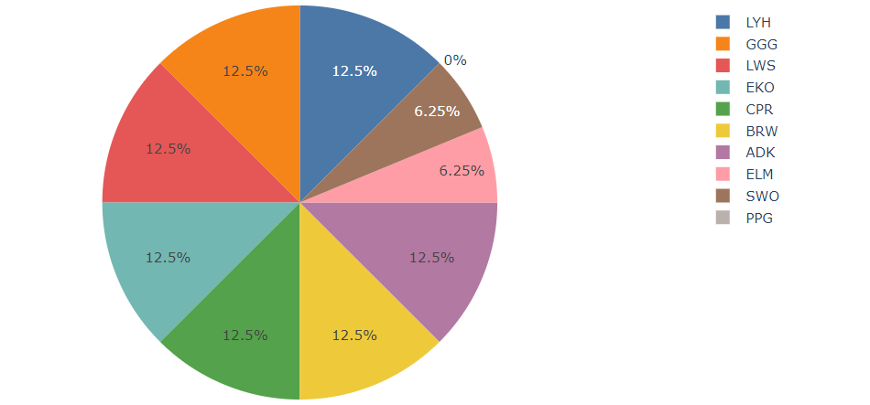
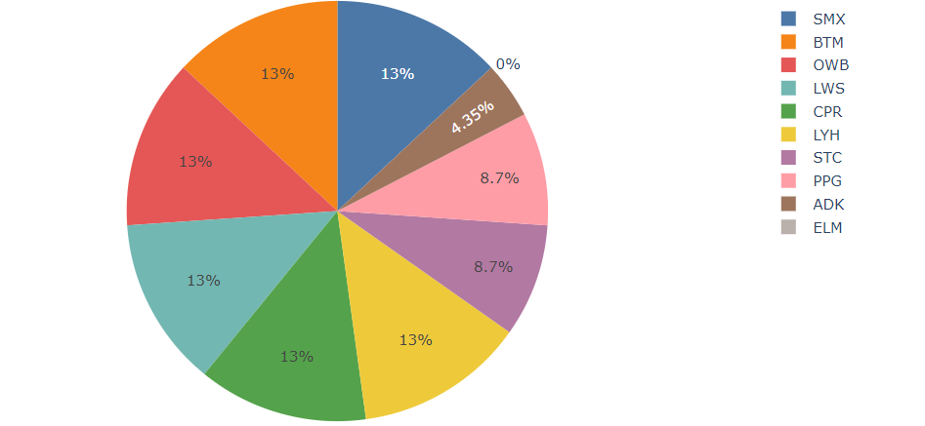
Data Exploration
Top 10 Airports with most delayed flights (departure)
Top 10 Airports with most delayed flights (arrivals)

Slide 16
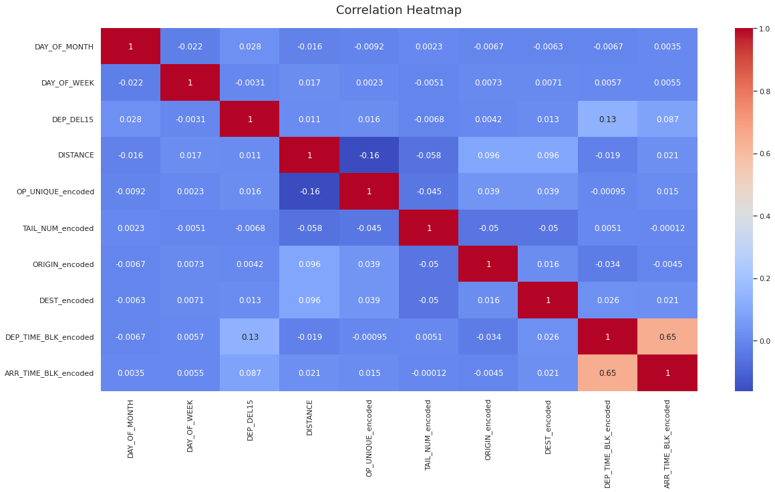
Exploratory Data Analysis : Heatmap

Slide 17
Data Mining Models
We split the dataset into a 80% training dataset and a 20% test dataset. The models used are as follows:-
Decision Tree Model
Naïve Bayes Model
Neural Network Model
Logistic Regression Model
Random Forest Classifier Model

Slide 18
Data Mining Models
Decision Tree - A nonparametric tree-resembling model that creates splits on predictors such that homogeneity increases after each split. The split segregates records into sub-groups, resulting in easily interpretable logical rules.
Implementation - A grid-search was done to obtain the best model using max_depth=6, impurity method= ‘gini’, with an Accuracy of 87.7%.
Naive Bayes - One of the key assumptions of Naïve Bayes Model is that it assumes the predictors to be conditionally independent given the target class. It is scales linearly with the predictors and is relatively robust to outside noise.
Implementation - The Naïve Base model was implemented on our data, which provided us with an Accuracy of 91.74%.
Neural Network - A parametric model that may be used for classification or prediction, some complex neural network models are also used for feature extraction. It mimics the neurons present in human brains, as they have properties that resemble learning and memory, based on experience.
Implementation - An accuracy of 81.50% was obtained by implementing the Neural Network model, which is the lowest among all the models implemented.
Logistic Regression - A parametric model that generates the output as estimates of the probabilities of belonging to each class, and uses a threshold cutoff on the probabilities for classifying into either of the classes. The outcome variable called logit, can be modeled as a linear function of the predictors.
Implementation - The logistic Regression model fits our data well and it results in an accuracy of 91.74%.
Random Forest Classifier - An ensemble method that uses a collection of decision trees for classification instead of individual models, such that predictions of individual models are independent of one another and each individual model is better than a random classifier.
Implementation - The random forest classifier provides us with an accuracy of 91.88%, which is the highest amongst all the models.

Slide 19
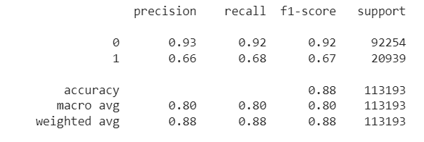
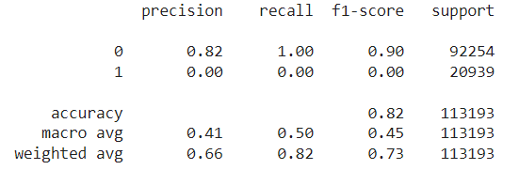
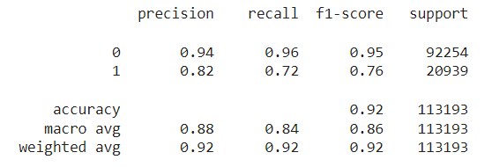
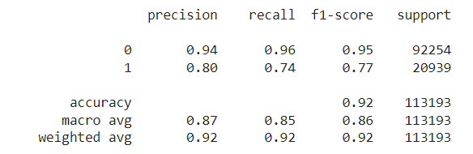
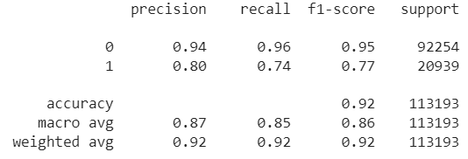
Data Mining Models
Decision Tree
Neural Network
Random Forest Classifier
Naïve Bayes Model
Logistic Regression

Slide 20
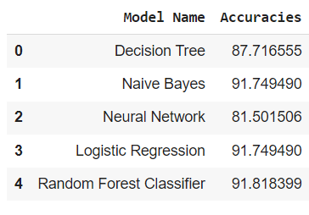
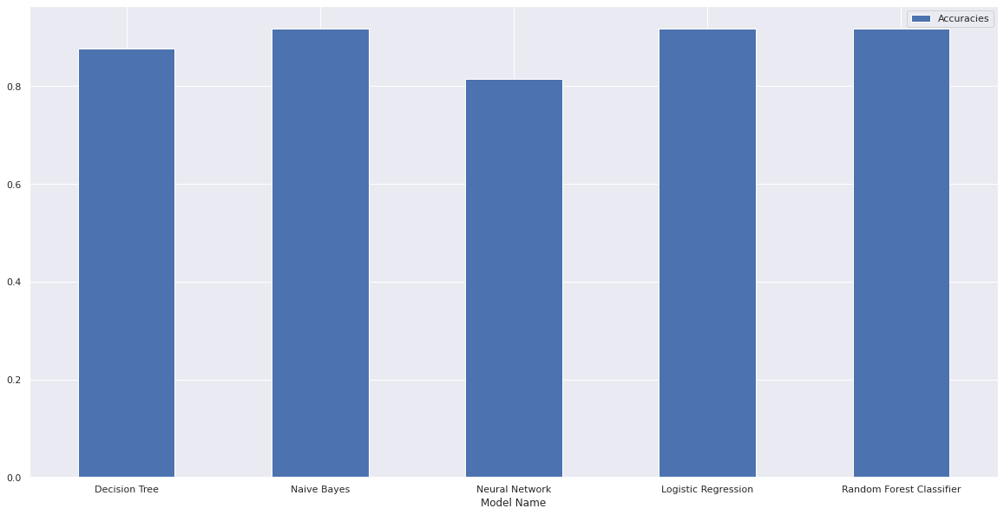
Performance Evaluation

Slide 21
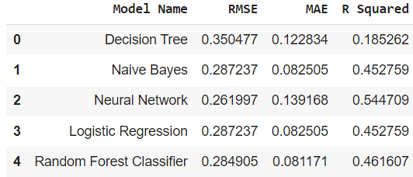
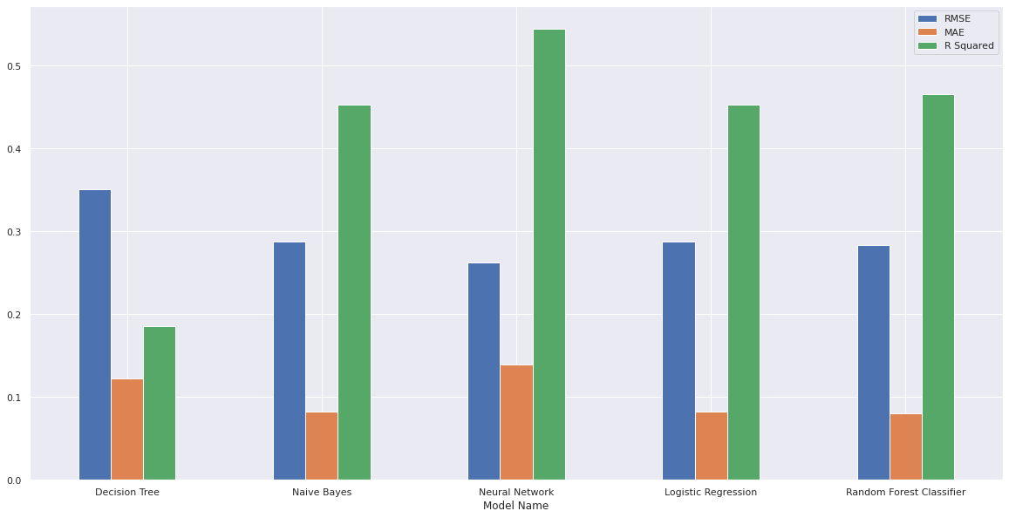
Performance Evaluation

Slide 22
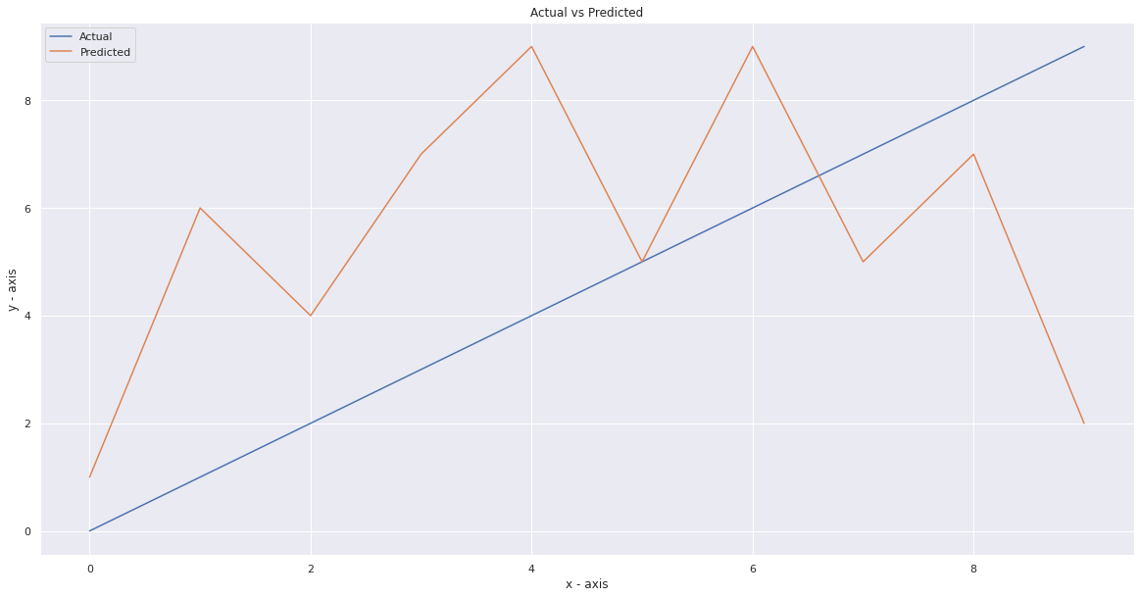
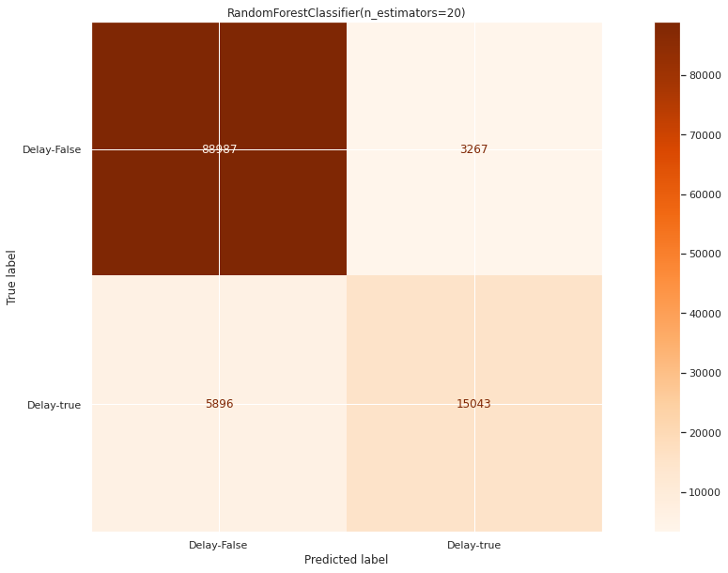
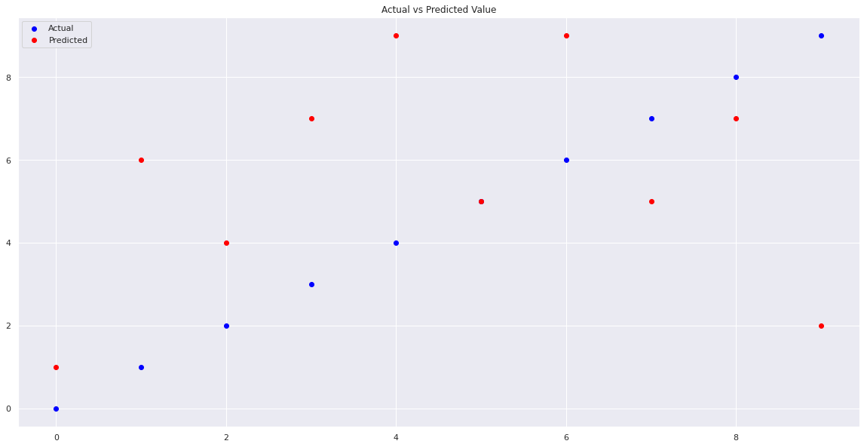
Project Results
Classification Matrix

Slide 23
Impact of the Project Outcomes
From our results, we can conclude that the Random Forest Classifier Model best fits our dataset with an accuracy of 91.81% and RMSE value of 0.284.
The main goal of our project is to compare the performance of machine learning classification algorithms when predicting flight delays.
Predicting flight delays can improve airline operations and passenger satisfaction, which will result in a positive impact on the economy.

Slide 24
THANK YOU

