Slide 1

CDS501 Principles and Practices of Data Science and Analytics Semester 1, 2019/2020 Predicting Risk of Cardiovascular Diseases From Easily Obtainable Health Factors By Lee Kar Choon (P-COM0130/19) Lee Jing Wen (P-COM0087/19) Sammak Musabbir Hasan (P-COM0092/19) Wang Huaixu (P-COM0103/19)

Slide 2
INTRODUCTION
Cardiovascular diseases are one of the complex & deadliest diseases that affect human life in every aspect possible.
They are the number 1 cause of death globally, taking an estimated 17.9 million lives annually (WHO).
According to WHO, by the end of 2020, CVDs will kill 24.8 million people annually if preventive measures are not taken.
According to Centers for Disease Control & Prevention (CDC), it is the leading cause of death in US, leaving cancer, accidents, diabetes far behind.
In a survey performed in 2013, CVD was found to be the leading cause of death among males in Malaysia.

Slide 3
INTRODUCTION
On time diagnosis is of utmost priority for both prevention & management of cardiovascular diseases.
According to Mark McClellan et al., detecting & managing risk factors can reduce odds of CVD by 80%, and 20%-40% heart attacks occur in undiagnosed CVD patients.
They showed that disparities in primary health care access, income, education, gender, ethnicity, etc. still persists which make management of CVDs more complex.
For example, unavailability of diagnostic apparatus & experienced physicians, especially in developing countries and rural areas, make the situation more challenging.

Slide 4
AIM
Our aim is to predict the risk of developing cardiovascular diseases from easily obtainable health factors using machine learning techniques.
Our selected dataset include factual or subjective information and medical examination reports of 70,000 patients.
Subjective information include Age, Height, Weight, Gender, Smoking Habit, Alcohol Consumption, and Physical Activity.
Health examination reports include Systolic and Diastolic blood pressures, blood Glucose level, and blood cholesterol level.
Association of Smoking, Alcohol, Glucose, Cholesterol, etc. with CVDs is well established in medical literatures.

Slide 5
RELATED WORKS
Predicting CVDs is the most interesting and challenging field in contemporary clinical data analysis.
Haleh Ayatollahi et al. predicted coronary artery disease with 88.01% sensitivity using ANN and achieved 92.32% sensitivity using SVM.
Amin Ul Haq et al. predicted heart disease with 89% accuracy using Logistic Regression and obtained 88% accuracy using SVM.
S. Palaniappan et al. developed an intelligent system that predicted heart disease with 86.53% accuracy using Naïve Bayes algorithm.
P. W. F. Wilson et al. developed their own algorithm for predicting risk of CVDs.

Slide 6
PROBLEM STATEMENT
We want to improve the sensitivity of cardiovascular disease prediction model at least 1% from 61.17%.
We selected sensitivity/recall to be the main metric for model evaluation.
Although many researchers & industries achieved higher accuracies that should’ve been the null model, we had to consider the data and the infrastructure available.
We set the null model or lower bound to be the highest recall achieved by any single feature, which was 61.11% sensitivity by systolic blood pressure.
We used KNN to select the Bayes Rate or upper bound which was 66.96% sensitivity.

Slide 7
DATA COLLECTION & PREPROCESSING
The dataset was collected from Kaggle in a structured CSV format.
Loading the dataset was therefore straight forward using the read.csv function.
For cleanliness & readability, we changed the column names to more readable form. For example, “ap_hi” column was renamed to “Systolic” and “ap_lo” to “Diastolic”.
Categorical features like “Smoking”, “Alcohol”, “Glucose”, etc. were encoded as factors.
Two new features were added. One is “BMI” from respective “Weight” and “Height”. Another is “BloodPressure” from respective “Systole” and “Diastole”
The unit of “Age” was changed from days to years.

Slide 8
DATA COLLECTION & PREPROCESSING
Feature | Data Type
Gender | Factor (Man, Woman)
Cholesterol | Factor (Normal, Above Normal, Well Above Normal)
Glucose | Factor (Normal, Above Normal, Well Above Normal)
Smoking | Factor (Smoker, Non-smoker)
Alcohol | Factor (Alcoholic, Non-alcoholic)
Feature | Data Type
Age (Years) | Numeric
Height (CM) | Numeric
Weight (KG) | Numeric
Systole (mmHg) | Numeric
Diastole (mmHg) | Numeric
BMI | Numeric
Active | Factor (Active, Inactive)
Target | Factor (Positive, Negative)

Slide 9
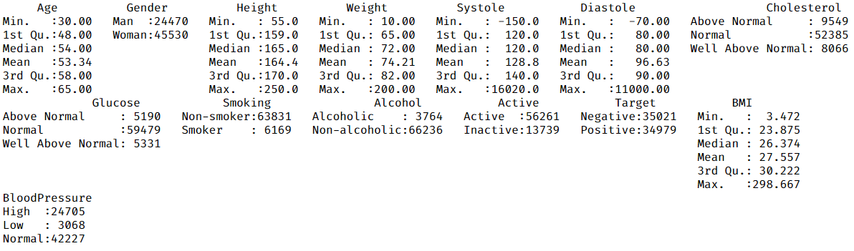
DATA EXPLORATION (Summary Statistics)
It was evident from summary statistics that Systole & Diastole had some invalid negative values that needed to address, and BMI, Height, and Weight had some outliers.

Slide 10
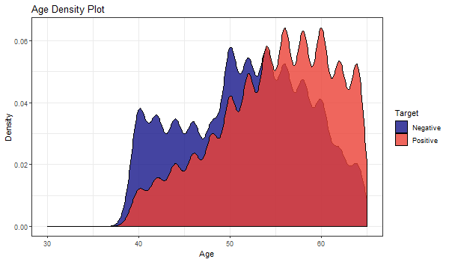
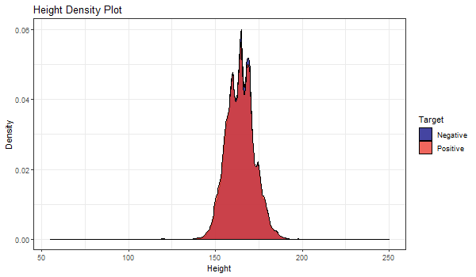
DATA EXPLORATION (Density Plots)
Mean age of patients with CVDs was higher than those without. However, distribution of Height was normal and remained same for both classes.

Slide 11
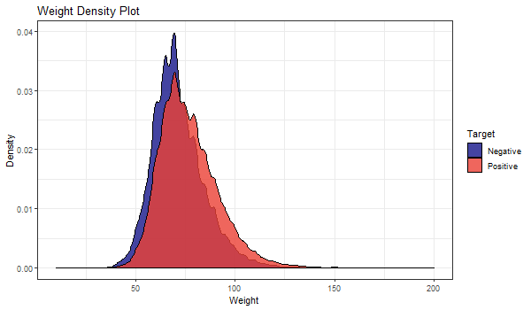
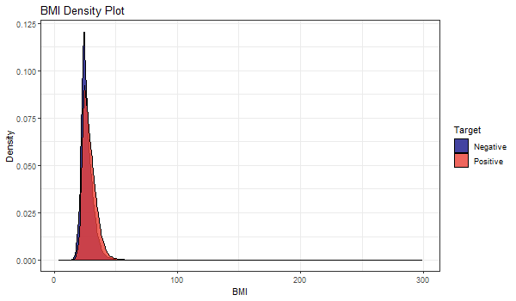
DATA EXPLORATION (Density Plots)
Mean weight of patients with CVDs was little higher than those without. Distribution of BMI was normal, and mean was slightly higher if not the same for patients with CVD.

Slide 12
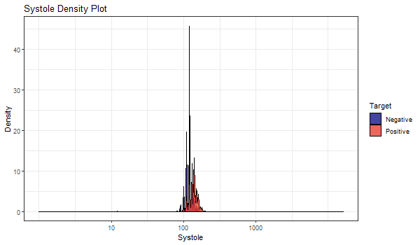
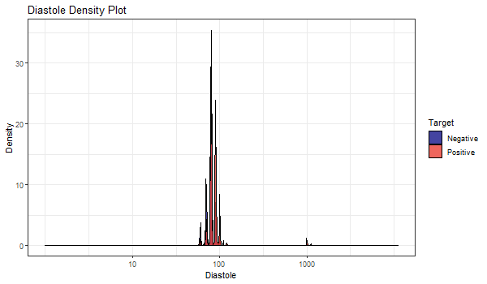
DATA EXPLORATION (Density Plots)
Both Systole and Diastole featured a lot of outliers and invalid values that need to be taken care of. The mean Systolic blood pressure was slightly high in CVD affected patients.

Slide 13
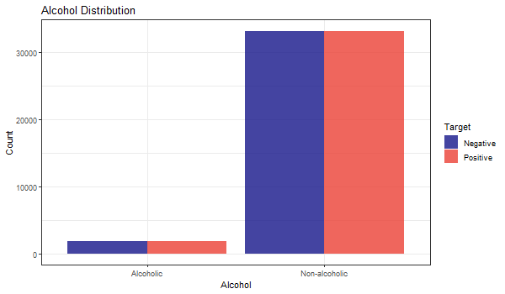
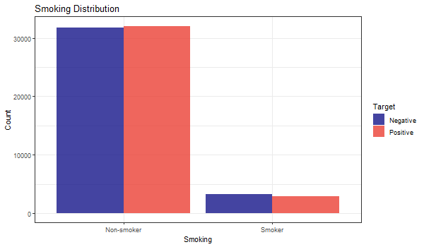
DATA EXPLORATION (Side-by-side Bar Charts)
There was no identifiable association between Smoking and CVDs or between Alcohol consumption and CVDs in the population.

Slide 14
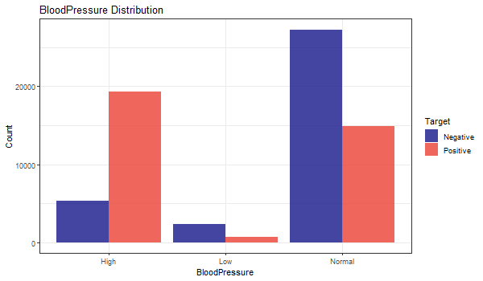
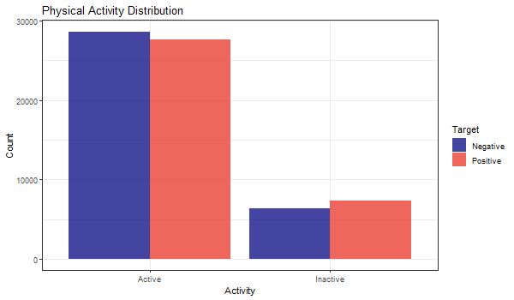
DATA EXPLORATION (Side-by-side Bar Charts)
Patients with high blood pressure had significantly higher rate of CVD. Also, frequency of CVDs was slightly higher in physically inactive patients.

Slide 15
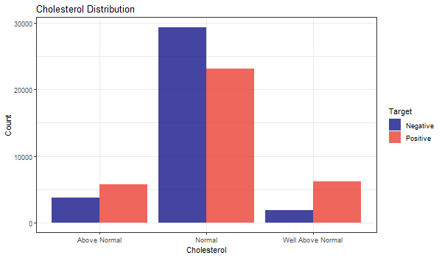
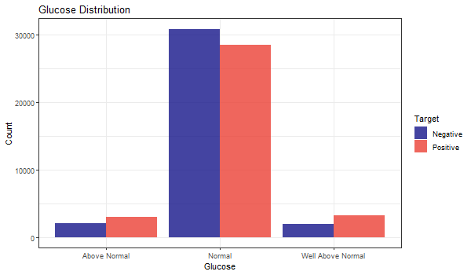
DATA EXPLORATION (Side-by-side Bar Charts)
Patients with cholesterol and glucose levels above and well above normal were more susceptible to cardiovascular diseases than their counterparts.

Slide 16
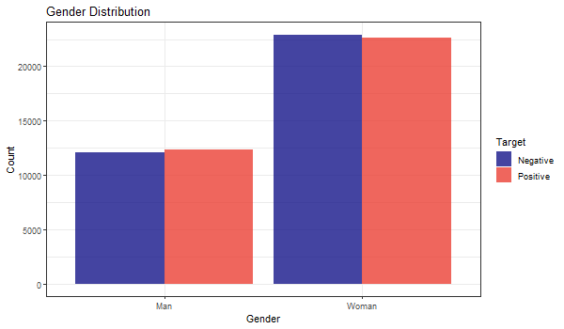
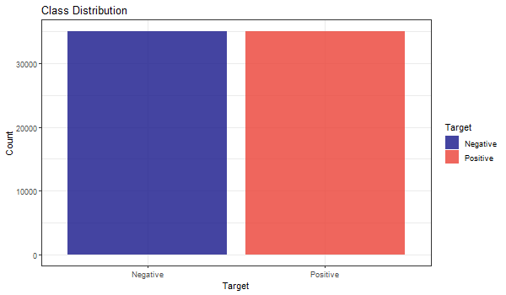
DATA EXPLORATION (Side-by-side Bar Charts)
CVDs were slightly more prevalent in male patients than their counterparts (left). Class distribution in the dataset was well balanced (right).

Slide 17
DATA CLEANING
The dataset did not contain any missing value.
Negative values of Systolic and Diastolic blood pressure were removed from the dataset.
Cases where Systolic pressure was lower than Diastolic pressure were removed from the dataset.
Outliers of Systolic and Diastolic blood pressure, Weight, and Height were removed.
Outliers were selected to be 5 times the Inter Quartile Range as the usual 1.5 times IQR removes too many observations.

Slide 18
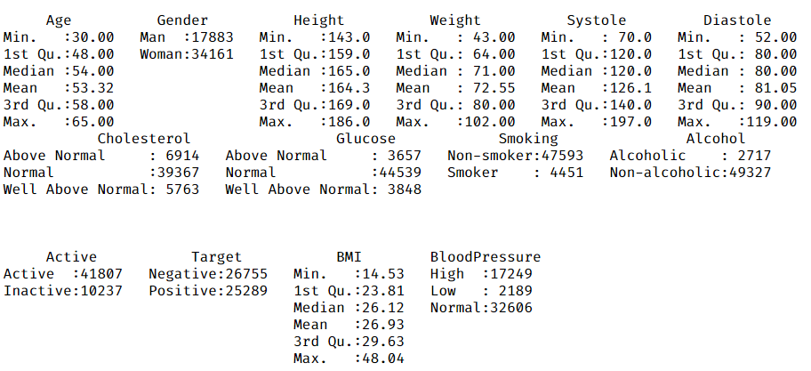
DATA CLEANING
As seen in the summary statistics, invalid values and outliers of systolic and diastolic blood pressures, Weight, and Height has been removed after data cleaning.

Slide 19
TRAIN/TEST SPLIT
We split the dataset into train and test right after data cleaning.
80% of the data were kept for training and the rest was for testing.
Ensured that class distribution was equal in both training and test data.
Further feature selection and exploratory analysis were done using the training data only.
Test dataset was never analyzed and solely kept for final evaluation to make mode validation more rigorous.

Slide 20
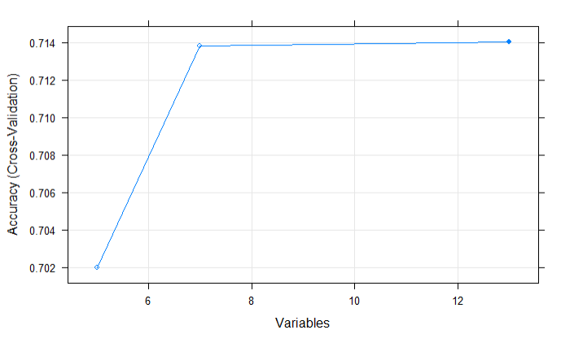
FEATURE SELECTION (Recursive Feature Elimination)
We used Recursive Feature Elimination (RFE) to select the best features.
RFE trains an algorithm using different subsets of features and selects the best combination.
We used rfe() function of the caret package with Naïve Bayes algorithm.
RFE yielded Systole, BloodPressure, Diastole, Age, BMI, Weight, and Cholesterol as the best features, and the performance did not improve using other features.

Slide 21
FEATURE SELECTION (Decision Tree)
We also used Decision Tree to extract the best features that explain the class variance.
Decision Tree yielded Systole, BloodPressure, Diastole, BMI, Weight, and Cholesterol as the best 6 features.
Feature | Systole | BloodPressure | Diastole | BMI | Weight | Cholesterol
Importance | 4941.37 | 3654.02 | 2915.97 | 465.89 | 423.25 | 405.60
We checked for features with near zero variance but found none.
We checked for linearly dependent features but found none.
We checked for correlated features and found that only BMI and weight are highly correlated, which was obvious.

Slide 22
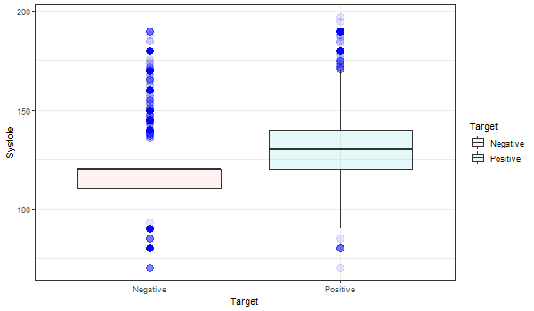
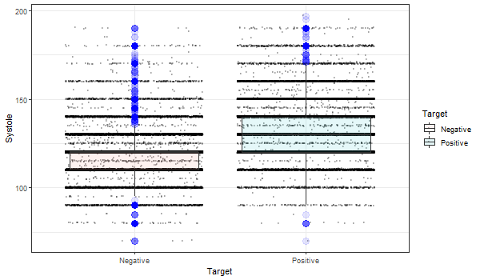
FEATURE SELECTION (Exploratory Analysis)
Patients diagnosed with CVDs had on average higher systolic blood pressure than normal patients (left), but jitter box plot shows there are lots of outliers and noisy data in both classes (right).

Slide 23
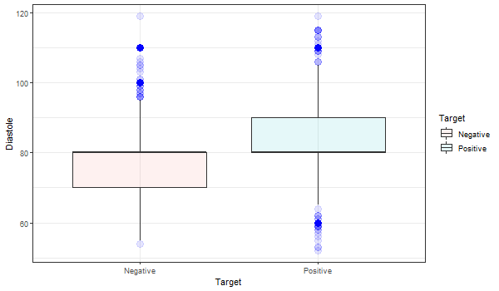
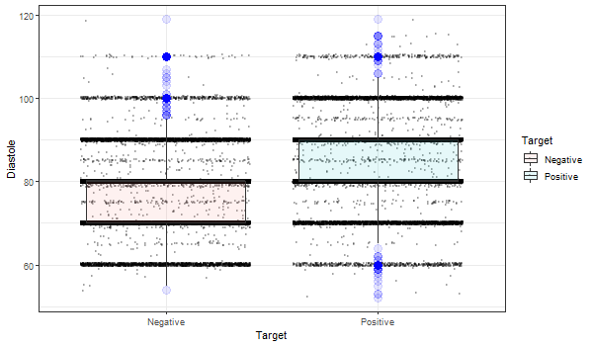
FEATURE SELECTION (Exploratory Analysis)
Mean diastolic blood pressure was same for both classes but the difference was in variance and outliers (left). Jitter box plot shows lots of variance and outliers in the positive class (right).

Slide 24
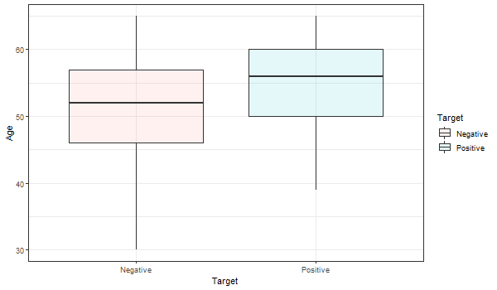
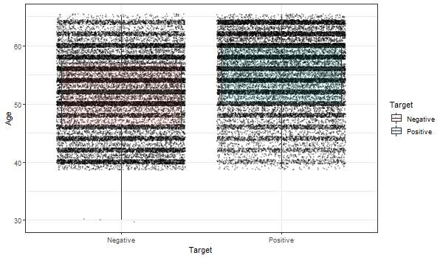
FEATURE SELECTION (Exploratory Analysis)
Mean age of patients with CVDs was higher than those without (left). However, jitter box plot shows there is too much noisy data in both classes (right).

Slide 25
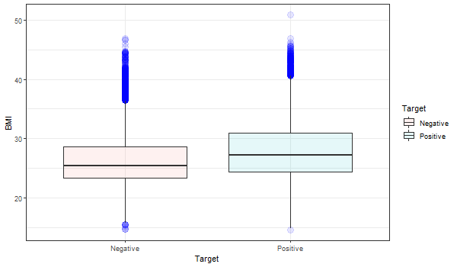
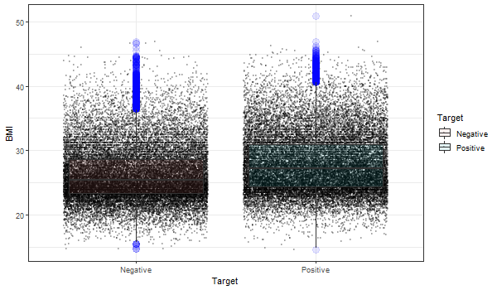
FEATURE SELECTION (Exploratory Analysis)
Patients with CVDs clearly had a higher average BMI than normal patients (left). But BMI too had lots of outliers and noisy data points as shown in the jitter box plot (right).

Slide 26
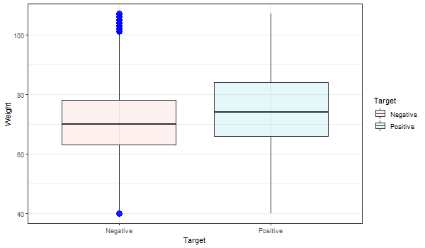
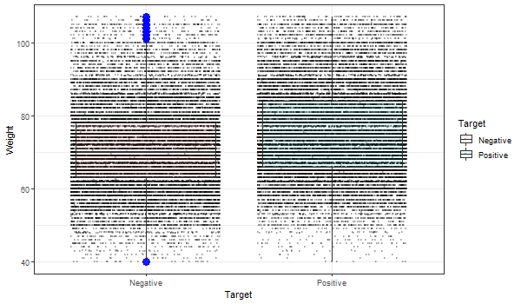
FEATURE SELECTION (Exploratory Analysis)
Weights of patients with CVDs were higher than normal patients (left). But as usual there was lots of outliers and noisy data in both classes.

Slide 27
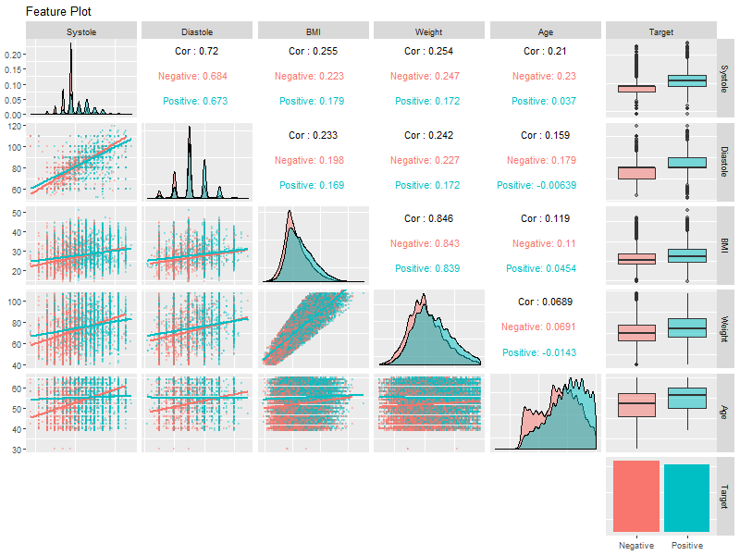
FEATURE SELECTION (Exploratory Analysis)
As seen in the pair plot of the selected numeric features, all of them can explain a certain portion of the class variance.
However, they all featured lots of outliers and noises, which should make the prediction task challenging.

Slide 28
MODELLING (Overview)
Model features include: Systole, Diastole, Blood Pressure, Age, BMI, Cholesterol, and Weight.
Each model was trained using a 5-fold cross validation.
We first trained the training dataset using Decision Tree to select the best single variable performance. We found that the feature Systole could predict with sensitivity of 61.17%. This is the Null model or lower bound for our model.
We used KNN to assess the highest possible performance which was 66.96%. This is the Bayes rate or the upper bound of our model.
Next, we trained Logistic Regression, SVM, and Naïve Bayes, and evaluated their performances.

Slide 29
MODELLING (Naïve Bayes)
Pros & Cons

Slide 30
MODELLING (Support Vector Machine)
Pros & Cons

Slide 31
MODELLING (Logistic Regression)
Pros & Cons

Slide 32
Evaluation (Naïve Bayes)
Evaluation

Slide 33
Evaluation (Support Vector Machine)
Evaluation

Slide 34
Evaluation (Logistic Regression)
Evaluation

Slide 35
Discussion
discussion

Slide 36
Documentation
The codes for this project was written in R Markdown file and proper documentation in every step was ensured.
Collaboration between the project members and project history were tracked by using Git.
The codes and documents of this project is hosted on GitHub (https://github.com/mhsammak/cds501-predicting-heart-disease).

