Slide 1
Synthetic-to-Real Object Detection Using HOG+SVM
An Analysis of Domain Effects on a Classical Model
| Justin Wenzel
| CPRE/EE 5290
| 5/1/2025
Notes:
Justin

Slide 2

Introduction
Motivation
Real-world labeled data is expensive, time-consuming to collect, and limited for rare objects
Synthetic data (e.g., from game engines) offers a scalable alternative but suffers from domain shift
Project Objectives
Compare model performance when trained on:
Synthetic-only data
Real-only data
Mixed data (synthetic + real)
Keep model and feature extraction fixed to isolate data effects
Analyze impact of detection accuracy using real test images
| Justin Wenzel
| 5/1/2025
Synthetic-to-Real Detection Analysis | 2
Notes:
Justin

Slide 3
Background & Related Work
Course Relation
Feature-based detection: HOG, SVM, kernels
HOG: Module 3: 11svm)slides
SVM: Module 3: 11svm_slides
Kernels: Module 3: 12kernel_slides
Key References
Dalal & Triggs (2005)
Introduced HOG for pedestrian detection
Basis for feature extraction setup
Maji & Malik (2009)
Chi-squared kernel SVM with multiscale HOG
Inspired nonlinear modeling and additive kernel comparison for HOG+SVM
Tools
OpenCV
Skimage (capture HOG descriptors)
Sklearn (training and AdditiveChi2Sampler)
| Justin Wenzel
| 5/1/2025
Synthetic-to-Real Detection Analysis | 3
Notes:
Justin

Slide 4
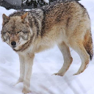
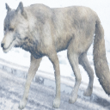
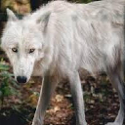
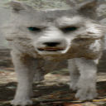
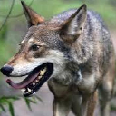
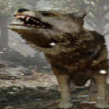
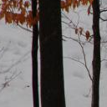
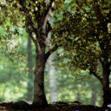
Positive Examples
Methodology: Dataset & Setup
Data Sources
Synthetic:
Captured in Unreal Engine via AirSim
640x480 resolution, ground truth labeled automatically
Real:
Public online image data, resized to match the synthetic
Source: IA informatique
Test Set:
Source: Manav Dhelia
Patch Extraction
128x128 crops centered on the object
Covers wolf body in varying poses
Sample Balancing
1824 positive / 1824 negative images per training split
Negative Examples
| Justin Wenzel
| 5/1/2025
Synthetic-to-Real Detection Analysis | 4
Notes:
Justin

Slide 5
Methodology: Models & Training
Aspect | Linear SVM | Chi-Square Kernel SVM
Feature Extraction | HOG (Dalal & Triggs) | Multiscale HOG (Maji & Malik (2009)
Cell Sizes | 8X8 | 18X18, 6X6, 3X3
Block Size | 2x2 | 1x1
Feature Vector | Single-scale | Concatenated multiscale
Kernel Type | Linear | Non-linear
HOG Normalization | L2-Hys (per block) | L2-Hys (per scale)
Model Complexity | Lower (constrained, faster) | Higher (capture more information, slow)
| Justin Wenzel
| 5/1/2025
Synthetic-to-Real Detection Analysis | 5

Slide 6
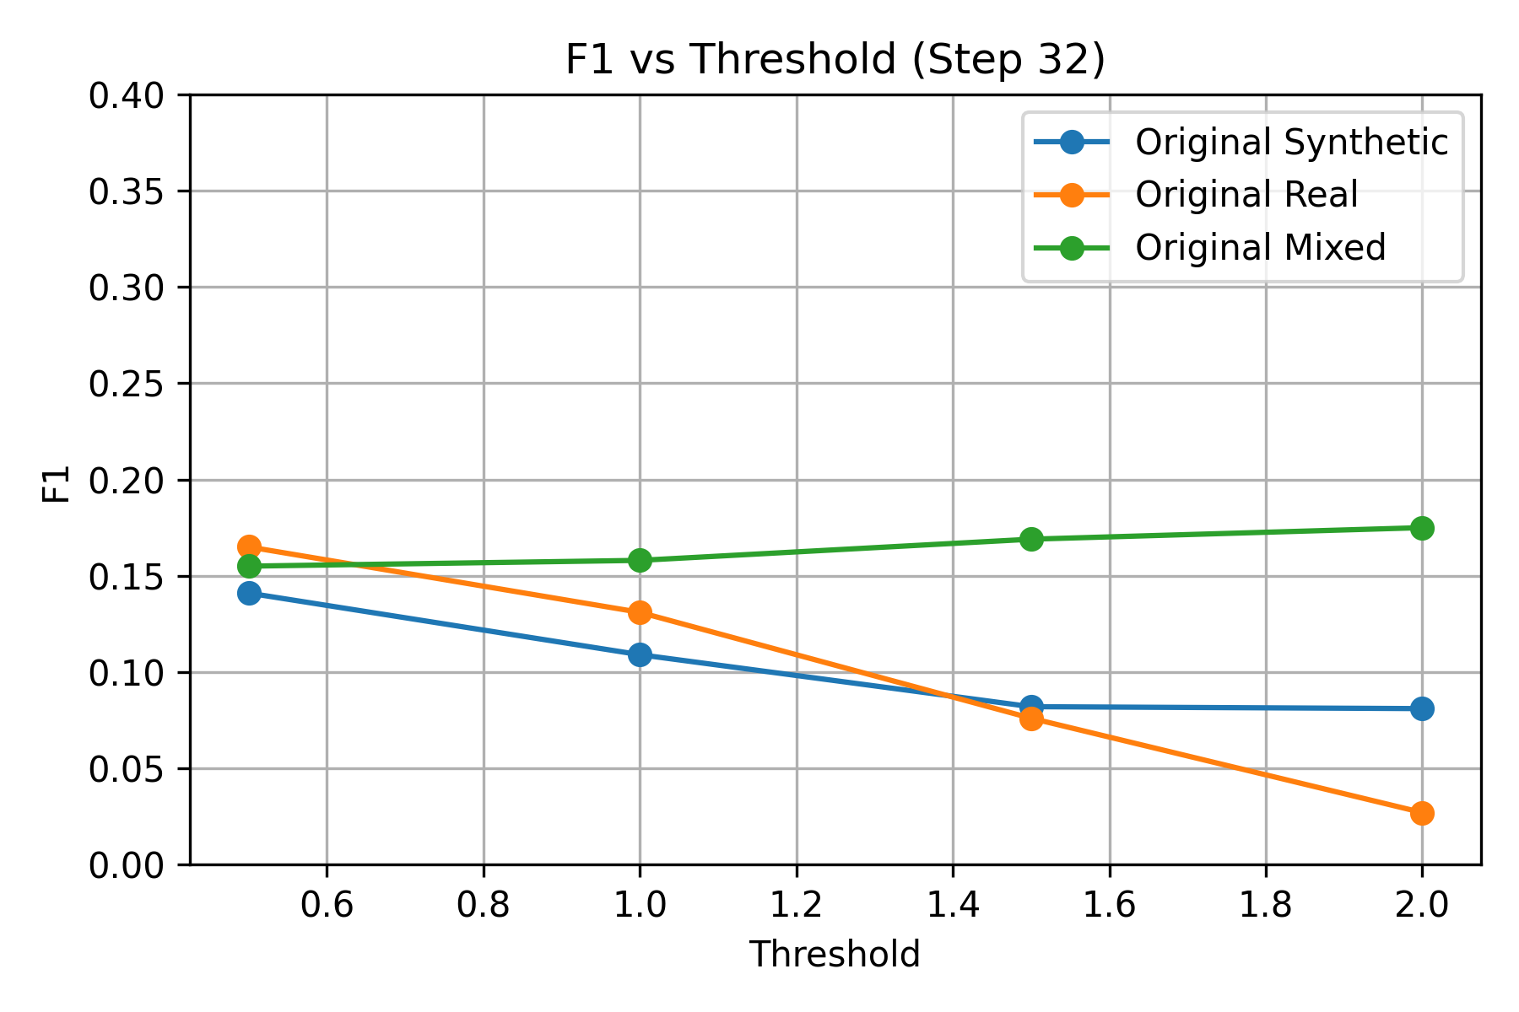
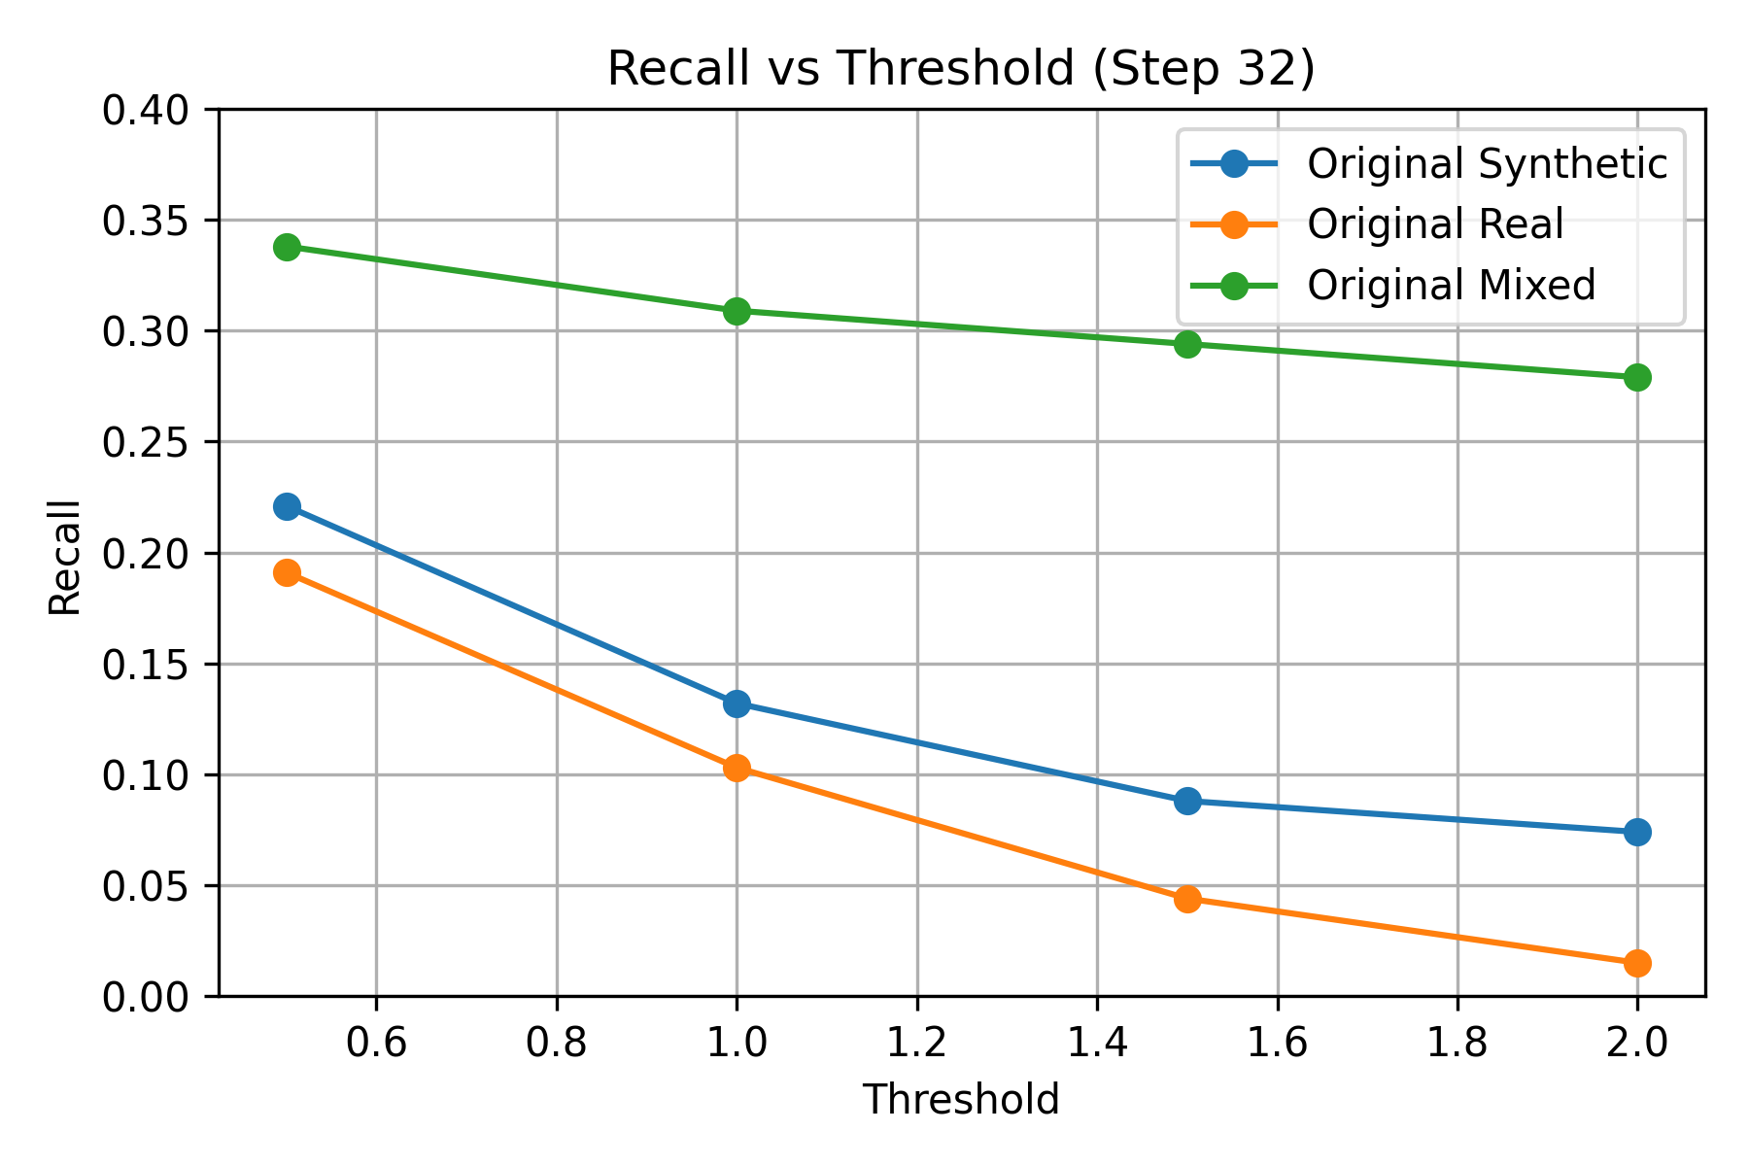
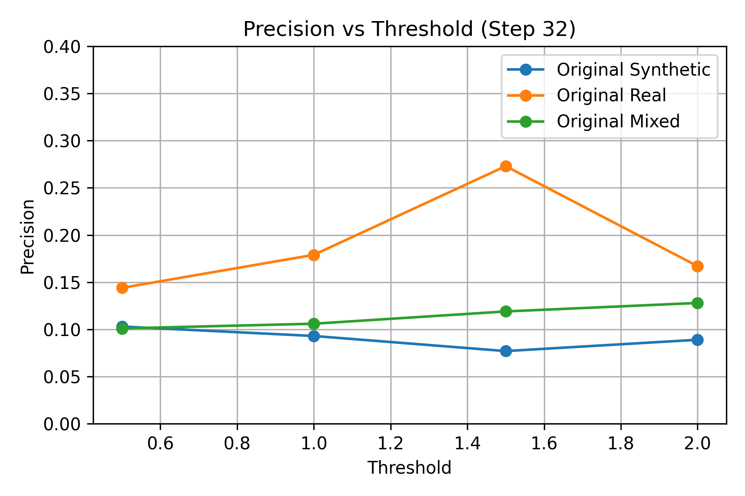
Results I: Linear SVM
Step Size of 32:
Model | TP(1) | FP(1) | FN(1) | TP (1.5) | FP(1.5) | FN(1.5) | TP(2) | FP(2) | FN(2)
Synthetic | 9 | 88 | 59 | 6 | 72 | 62 | 5 | 51 | 63
Real | 7 | 32 | 61 | 3 | 8 | 65 | 1 | 5 | 67
Mixed | 21 | 177 | 47 | 20 | 148 | 48 | 19 | 130 | 49
| Justin Wenzel
| 5/1/2025
Synthetic-to-Real Detection Analysis | 6
Notes:
Precision – Out of all model detections, how many were correct
Recall – Out of all the target objects, how many did the model find
F1 – Harmonic mean between precision and recall (2*P*R)/(P+R)

Slide 7
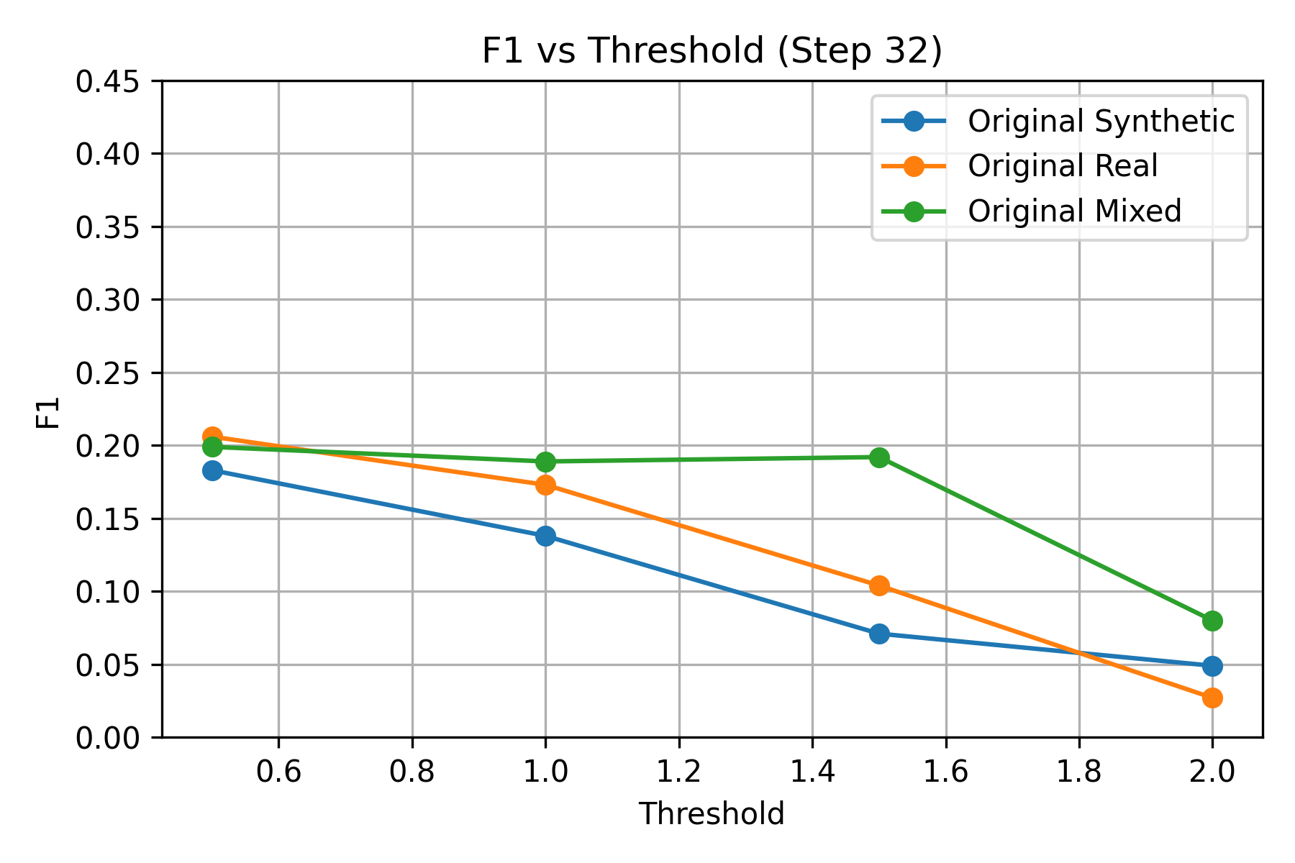
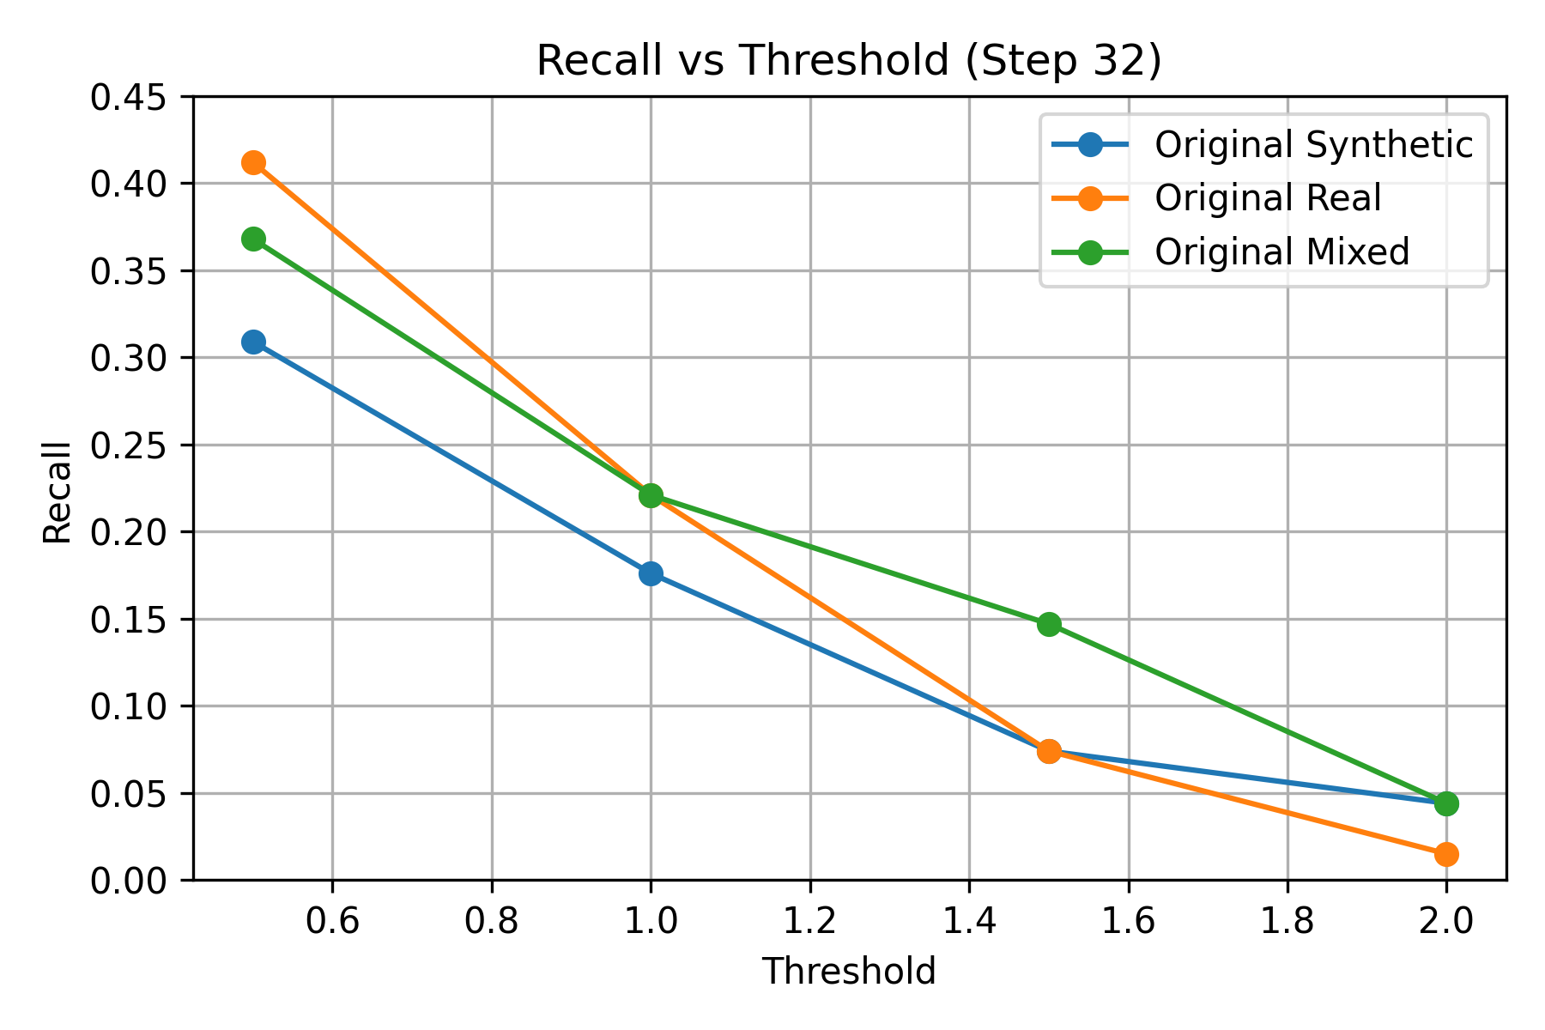
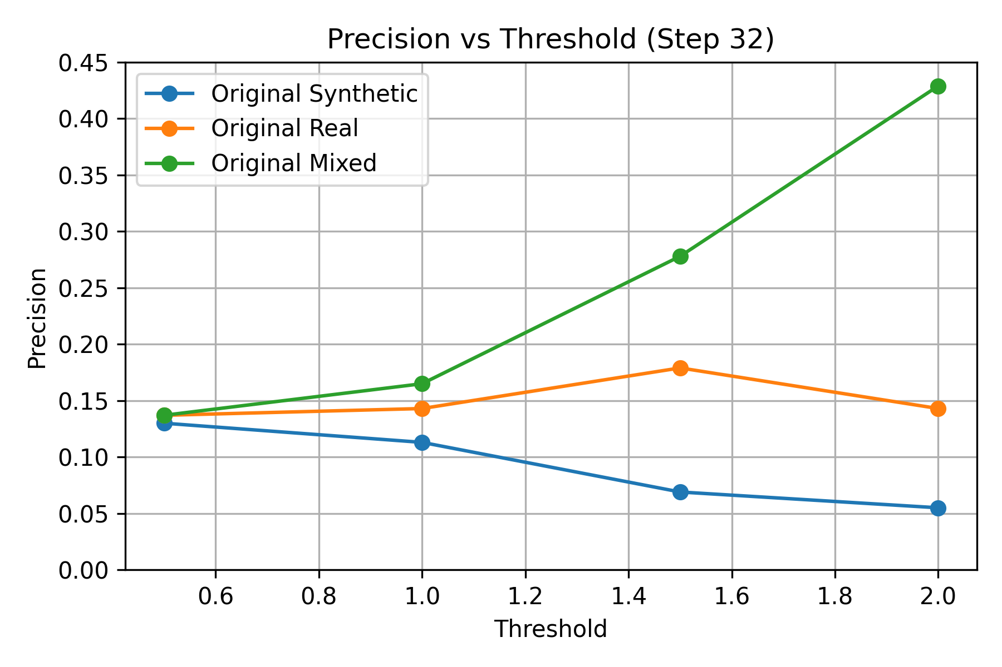
Results II: Kernel SVM
Step Size of 32:
Model | TP(1) | FP(1) | FN(1) | TP (1.5) | FP(1.5) | FN(1.5) | TP(2) | FP(2) | FN(2)
Synthetic | 12 | 94 | 56 | 5 | 67 | 63 | 3 | 52 | 65
Real | 15 | 90 | 53 | 5 | 23 | 63 | 1 | 6 | 67
Mixed | 15 | 76 | 53 | 10 | 26 | 58 | 3 | 4 | 65
| Justin Wenzel
| 5/1/2025
Synthetic-to-Real Detection Analysis | 7
Notes:
Justin

Slide 8
Analysis & Trends
Key Observations
Mixed datasets perform the best overall, but vary depending on the model
Kernel SVM made fewer predictions, boosting precision but reducing recall
High threshold sensitivity:
Raising the threshold tended to reduce false positives but hurt recall
Domain Gap:
Synthetic-only models are the weakest
Real-only models did not generalize well to test cases
Mixed helped close the gap more, but not complete
| Justin Wenzel
| 5/1/2025
Synthetic-to-Real Detection Analysis | 8
Notes:
Linear SVM (More Trigger-Happy):
Cause: The linear decision boundary is too simple to separate subtle textures, lighting, and poses in wolf imagery, especially across domains.
Kernel SVM (More Conservative):
Cause: The chi-squared kernel maps features into a more expressive (nonlinear) space, allowing tighter boundaries, but also requires more consistency in input features.

Slide 9
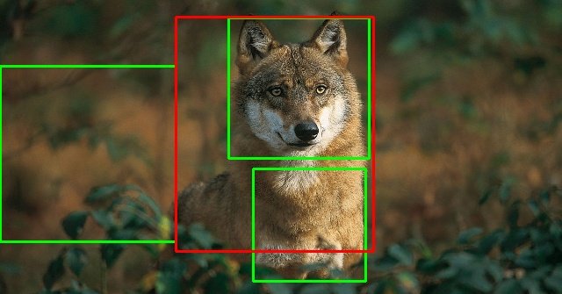
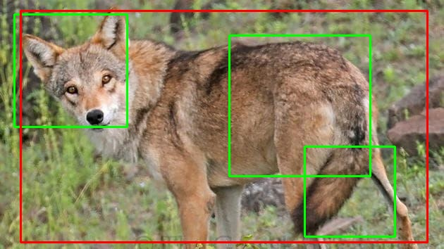
Conclusion & Comments
Key Takeaways
Mixed datasets improved performance, but model-dependent still
Traditional models did not fully close the domain gap
Future Work
Test with deep learning detectors (YOLO)
Try domain adaptation using a GAN to assist in domain transfer
Simplify the object in question
Bounding Box Comment
| Justin Wenzel
| 5/1/2025
Synthetic-to-Real Detection Analysis | 9
Notes:
Justin

Slide 10
THANK YOU
| Justin Wenzel
| 3/6/2025
Notes:
Justin

