Slide 1
ECE 212 Lab 4
Khashayar Hashemi

Slide 2
Objectives
To learn how to interface a PCB to the Nucleo-L432KC board
To gain more experience working with stack and to use it to pass parameters between subroutines

Slide 3
Connecting the LED Array to the Board
Follow the instructions on the following documents:
Lab 4 – How to use Hardware Verification Program (on Canvas)
The second page of the lab manual
Once you finished the interfacing, make sure to verify your connections using the verification software. (This step is crucial and has to be done before writing the subroutines.)

Slide 4
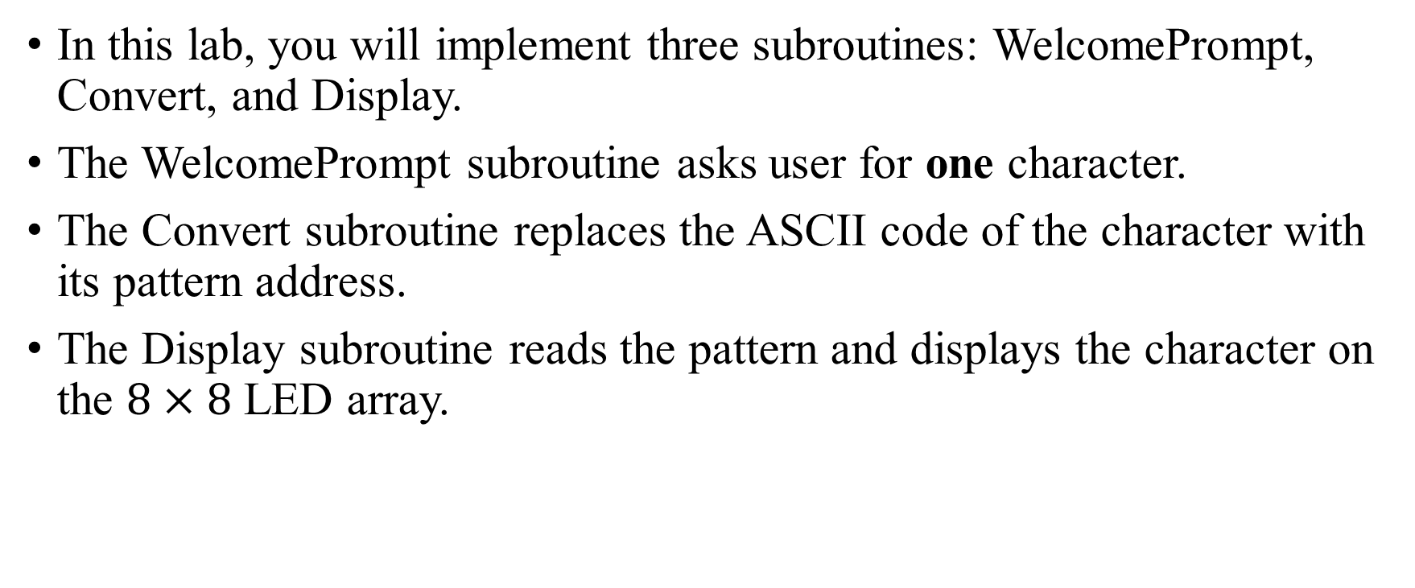
Overall Procedure
In this lab, you will implement three subroutines: WelcomePrompt, Convert, and Display.
The WelcomePrompt subroutine asks user for one character.
The Convert subroutine replaces the ASCII code of the character with its pattern address.
The Display subroutine reads the pattern and displays the character on the $8×8$ LED array.

Slide 5
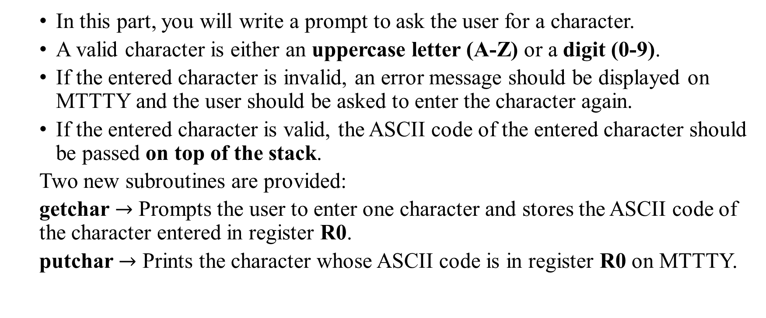
Part 1 (WelcomePrompt)
In this part, you will write a prompt to ask the user for a character.
A valid character is either an uppercase letter (A-Z) or a digit (0-9).
If the entered character is invalid, an error message should be displayed on MTTTY and the user should be asked to enter the character again.
If the entered character is valid, the ASCII code of the entered character should be passed on top of the stack.
Two new subroutines are provided:
getchar $→$ Prompts the user to enter one character and stores the ASCII code of the character entered in register R0.
putchar $→$ Prints the character whose ASCII code is in register R0 on MTTTY.

Slide 6
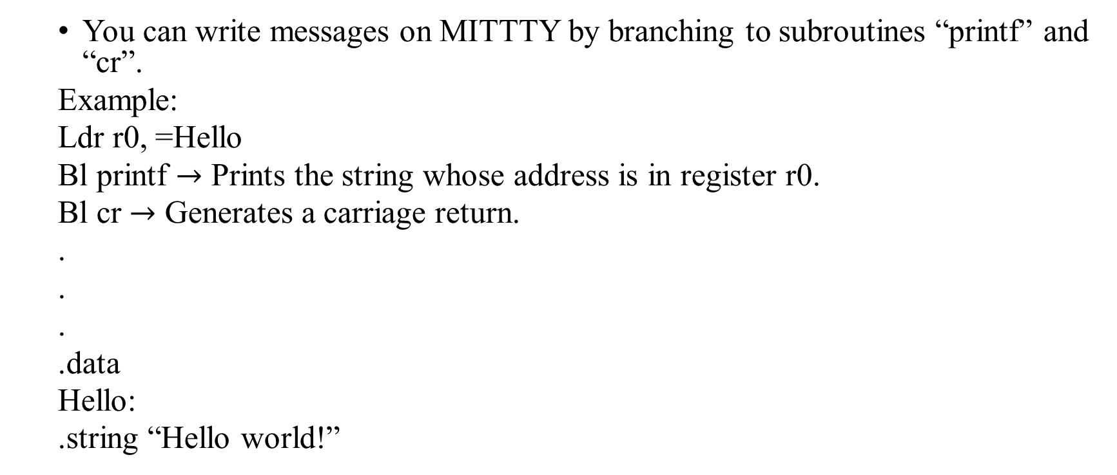
Displaying Message on MITTTY
You can write messages on MITTTY by branching to subroutines “printf” and “cr”.
Example:
Ldr r0, =Hello
Bl printf $→$ Prints the string whose address is in register r0.
Bl cr $→$ Generates a carriage return.
.
.
.
.data
Hello:
.string “Hello world!”

Slide 7
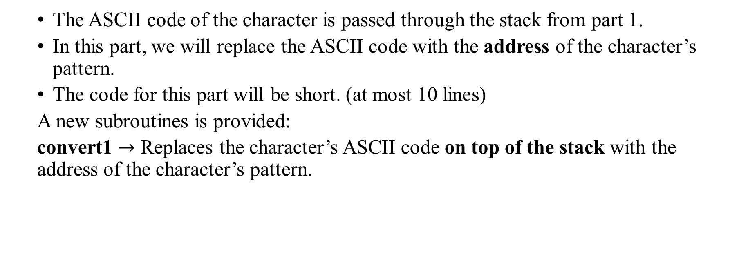
Part 2 (Convert)
The ASCII code of the character is passed through the stack from part 1.
In this part, we will replace the ASCII code with the address of the character’s pattern.
The code for this part will be short. (at most 10 lines)
A new subroutines is provided:
convert1 $→$ Replaces the character’s ASCII code on top of the stack with the address of the character’s pattern.

Slide 8
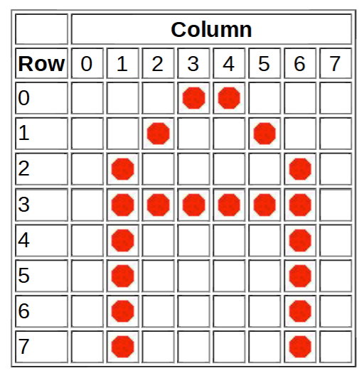
Pattern of the Character
Each character has an 8-byte pattern that is stored somewhere in the memory.
Each bit in the pattern determines the configuration of an LED (1=ON, 0=OFF).
Example: Suppose memory location 0x20001000 contains the pattern of character “A”:
Letter_A:
.byte 0b00011000 0x18 0x20001000
.byte 0b00100100 0x24 0x20001001
.byte 0b01000010 0x42 0x20001002
.byte 0b01111110 0x7E 0x20001003
.byte 0b01000010 0x42 0x20001004
.byte 0b01000010 0x42 0x20001005
.byte 0b01000010 0x42 0x20001006
.byte 0b01000010 0x42 0x20001007

Slide 9
Part 3 (Display)
The address of the pattern is passed through the stack from part 2.
The following procedure can be used to display the pattern (recommended):
Load one byte of the pattern using LDRB into a register
Extract bits one by one (8 times) by shifting to the right (LSRS)
For each extracted bit, use the carry conditions (CS or CC) to check whether it is 1 or 0.
If the bit is 1, turn the corresponding LED on.
Otherwise, move on to the next bit.
Once all bits are extracted, go back to step one to load the next byte.
The above procedure has to be repeated a couple of times (100 for example) so that the pattern can be seen on the LED array for a few seconds.

Slide 10
Turning on an LED
The code below turns on and off the LED on column 3 and row 4:
mov r0,#3 /*move #3 into register R0 */
bl column /*Jump to column subroutine */
mov r0,#4 /*move #4 into register R0 */
bl row /*Jump to row subroutine */
bl onled /*jump to TurnOnLed subroutine */
mov r0,#10 /* move delay number into register R0*/
bl HAL_Delay /*jump to delay subroutine*/
bl offled /*turn off LED*

Slide 11
Important!!!
The provided subroutines (printf, cr, …) overwrite registers r0-r3. Use registers r4-r11 to store your data.
There is no report for this lab.
This lab is done in one week.

