Slide 1
ECE 212 Lab 1
Khashayar Hashemi

Slide 2
Objectives
To learn how to code in assembly language
To learn how to work with registers and arithmetic operations like SUB and ADD
To learn how to read from and write at memory and get familiar with memory operations like LDR and STR
To learn how to implement loops in assembly using branches and labels

Slide 3
Lab 1.A
Load one word (32 bits) of data from memory starting from 0x20001000
If the data is valid (‘0’- ‘9’, ‘A’- ‘F’, ‘a’- ‘f’), convert to decimal
If the data is invalid, the result will be -1.
Store the result in the memory starting from 0x20002000
Repeat the above procedure until the input is ‘Enter’

Slide 4
Assigning values to registers
For assigning a value to a register, if the value is small, we use mov. For larger values, like memory addresses, we use ldr. An “=” sign is put before the value when using ldr.
Example:
Ldr r0, =0x20002000
Mov r0, #-3

Slide 5
Arithmetic Operations
Use add for addition and sub for subtraction.
Example:
Add r2,#5
Sub r3,#2

Slide 6
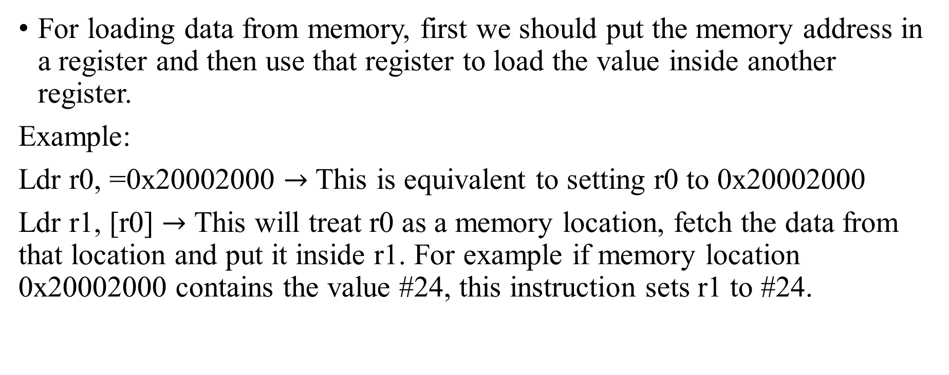
Loading data from memory
For loading data from memory, first we should put the memory address in a register and then use that register to load the value inside another register.
Example:
Ldr r0, =0x20002000 $→$ This is equivalent to setting r0 to 0x20002000
Ldr r1, [r0] $→$ This will treat r0 as a memory location, fetch the data from that location and put it inside r1. For example if memory location 0x20002000 contains the value #24, this instruction sets r1 to #24.

Slide 7
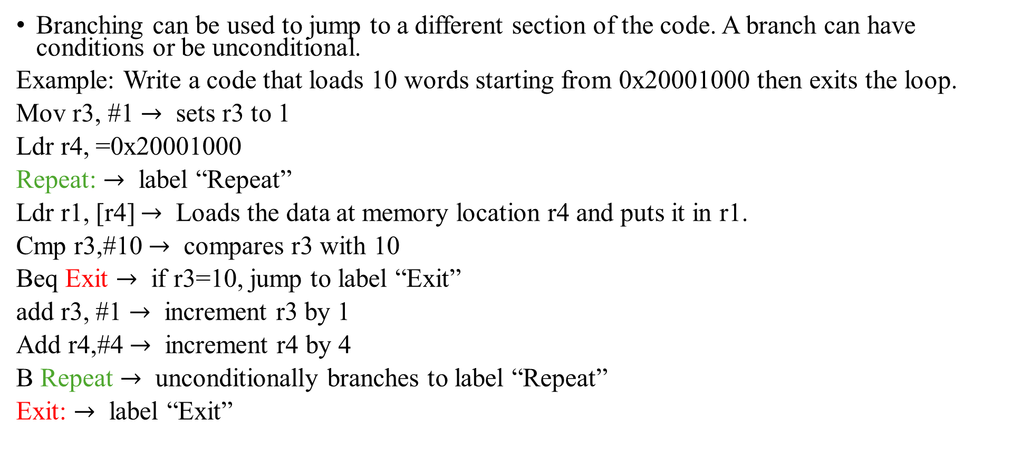
Labels and Branching
Branching can be used to jump to a different section of the code. A branch can have conditions or be unconditional.
Example: Write a code that loads 10 words starting from 0x20001000 then exits the loop.
Mov r3, #1 $→$ sets r3 to 1
Ldr r4, =0x20001000
Repeat: $→$ label “Repeat”
Ldr r1, [r4] $→$ Loads the data at memory location r4 and puts it in r1.
Cmp r3,#10 $→$ compares r3 with 10
Beq Exit $→$ if r3=10, jump to label “Exit”
add r3, #1 $→$ increment r3 by 1
Add r4,#4 $→$ increment r4 by 4
B Repeat $→$ unconditionally branches to label “Repeat”
Exit: $→$ label “Exit”

Slide 8
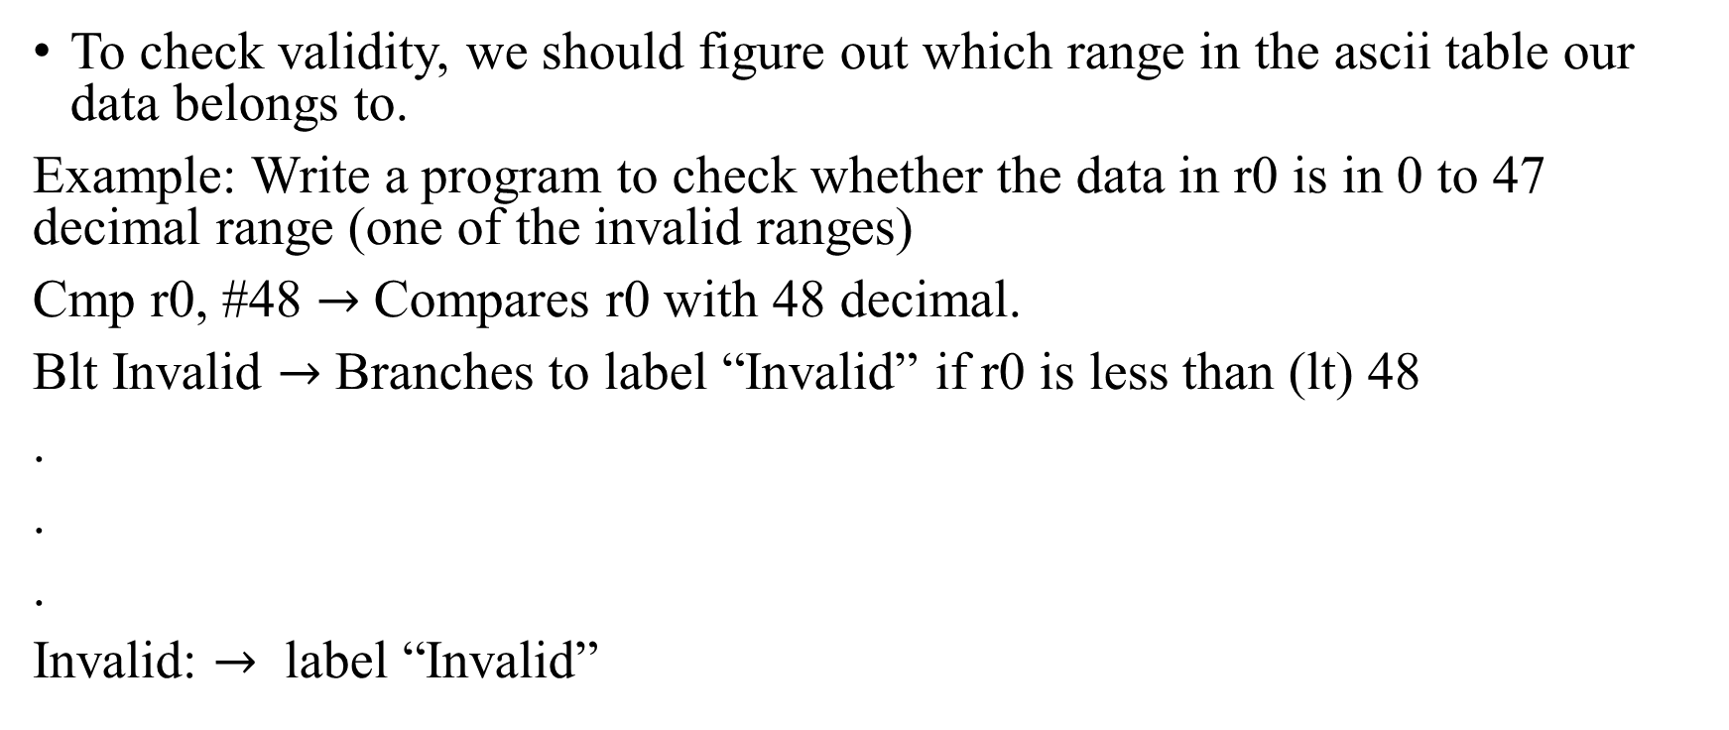
Checking Validity
To check validity, we should figure out which range in the ascii table our data belongs to.
Example: Write a program to check whether the data in r0 is in 0 to 47 decimal range (one of the invalid ranges)
Cmp r0, #48 $→$ Compares r0 with 48 decimal.
Blt Invalid $→$ Branches to label “Invalid” if r0 is less than (lt) 48
.
.
.
Invalid: $→$ label “Invalid”

Slide 9
Conversion
‘0’ –‘9’ (48 – 57 decimal) should be converted to 0 to 9 decimal.
‘A’ –‘F’ (65 – 70 decimal) should be converted to 10 to 15 decimal.
‘a’ –‘f’ (97 – 102 decimal) should be converted to 10 to 15 decimal.

Slide 10
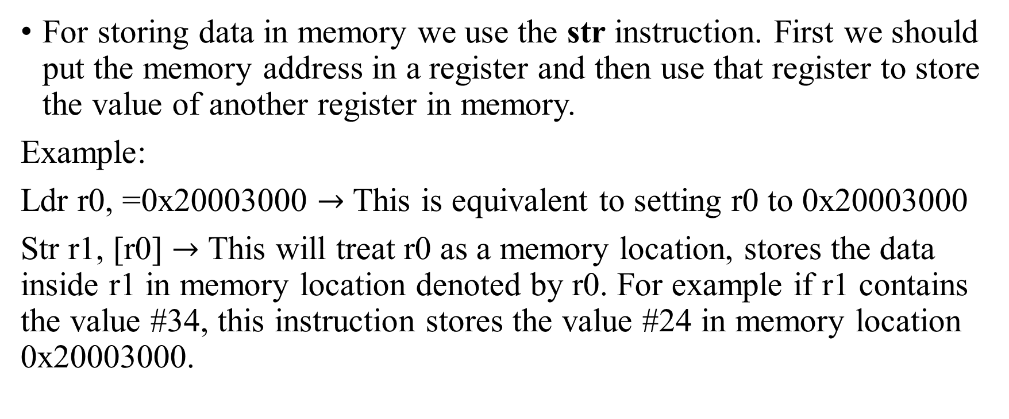
Storing data in memory
For storing data in memory we use the str instruction. First we should put the memory address in a register and then use that register to store the value of another register in memory.
Example:
Ldr r0, =0x20003000 $→$ This is equivalent to setting r0 to 0x20003000
Str r1, [r0] $→$ This will treat r0 as a memory location, stores the data inside r1 in memory location denoted by r0. For example if r1 contains the value #34, this instruction stores the value #24 in memory location 0x20003000.

Slide 11
Lab 1.B
Load one word (32 bits) of data from memory starting from 0x20001000
If the data is a lowercase character (‘a’ – ‘z’), convert to uppercase (‘A’ – ‘Z’) and vice versa.
If the data is invalid, the result will be ‘*’.
Store the result in the memory starting from 0x20003000
Repeat the above procedure until the input is ‘Enter’

Slide 12
Testing your program
Please go through the instructions given in the “How to use the Test Program” file available in Lab 1 section on Canvas.
You can also use debug mode for checking your results using memory monitor and debugging, however the test program is used for final demo.

