Slide 1
ECE 212 Lab 3
Khashayar Hashemi

Slide 2
Objectives
To get familiar with subroutines and functions
To learn how to work with stack
To learn how to pass parameters between subroutines

Slide 3
Overall Procedure
In this lab, you will implement three subroutines: WelcomePrompt, Sort, and Display.
The WelcomePrompt subroutine asks user for some inputs.
The Sort subroutine sorts the entries provided through WelcomePrompt.
The Display subroutine displays the final sorted results on MITTTY.

Slide 4
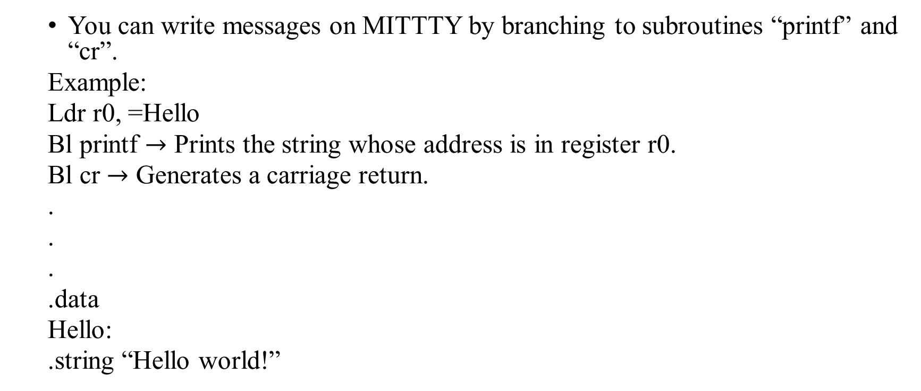
Displaying Message on MITTTY
You can write messages on MITTTY by branching to subroutines “printf” and “cr”.
Example:
Ldr r0, =Hello
Bl printf $→$ Prints the string whose address is in register r0.
Bl cr $→$ Generates a carriage return.
.
.
.
.data
Hello:
.string “Hello world!”

Slide 5
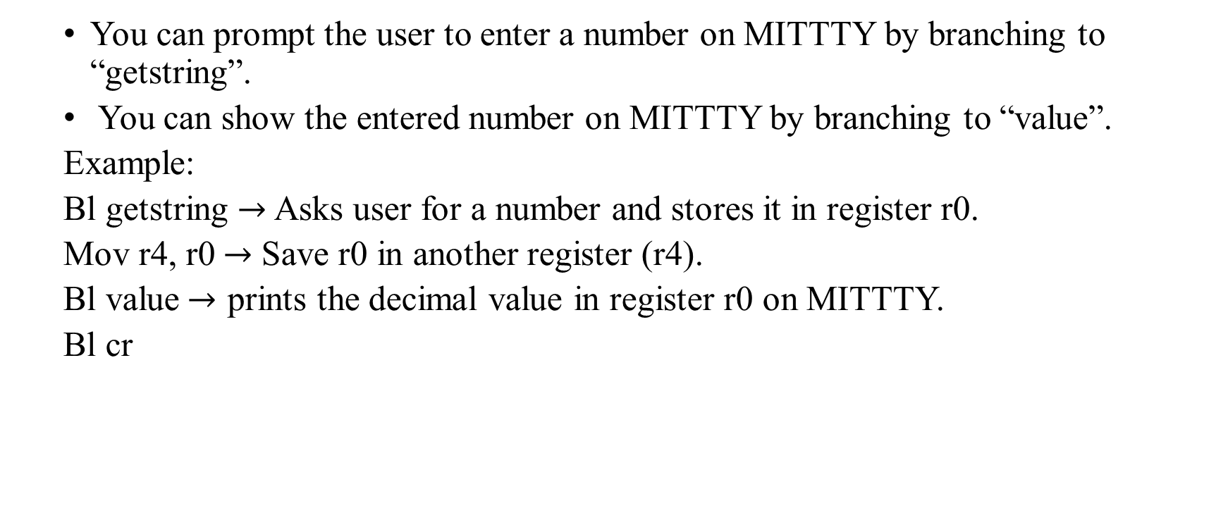
Getting Inputs on MITTTY
You can prompt the user to enter a number on MITTTY by branching to “getstring”.
You can show the entered number on MITTTY by branching to “value”.
Example:
Bl getstring $→$ Asks user for a number and stores it in register r0.
Mov r4, r0$→$ Save r0 in another register (r4).
Bl value$→$ prints the decimal value in register r0 on MITTTY.
Bl cr

Slide 6
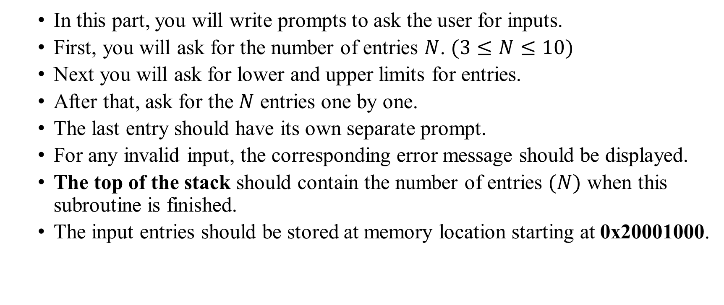
Part 1 (WelcomePrompt)
In this part, you will write prompts to ask the user for inputs.
First, you will ask for the number of entries $N$. $(3≤N≤10)$
Next you will ask for lower and upper limits for entries.
After that, ask for the $N$ entries one by one.
The last entry should have its own separate prompt.
For any invalid input, the corresponding error message should be displayed.
The top of the stack should contain the number of entries $(N)$ when this subroutine is finished.
The input entries should be stored at memory location starting at 0x20001000.

Slide 7
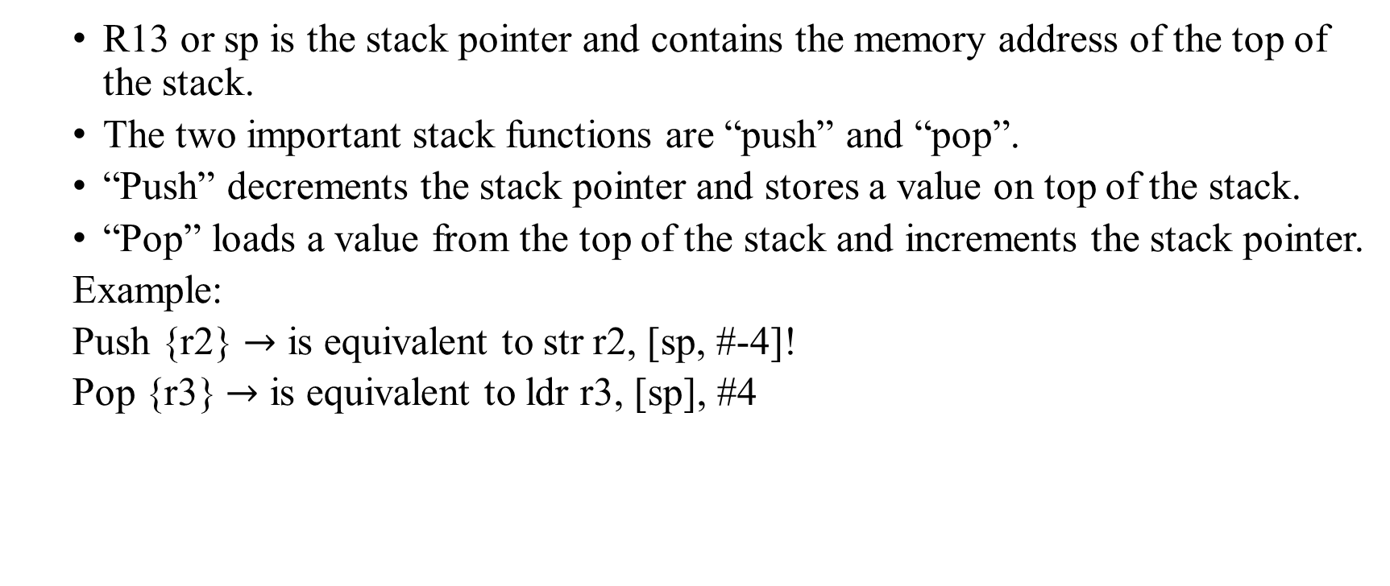
Working with Stack
R13 or sp is the stack pointer and contains the memory address of the top of the stack.
The two important stack functions are “push” and “pop”.
“Push” decrements the stack pointer and stores a value on top of the stack.
“Pop” loads a value from the top of the stack and increments the stack pointer.
Example:
Push {r2} $→$ is equivalent to str r2, [sp, #-4]!
Pop {r3} $→$ is equivalent to ldr r3, [sp], #4

Slide 8
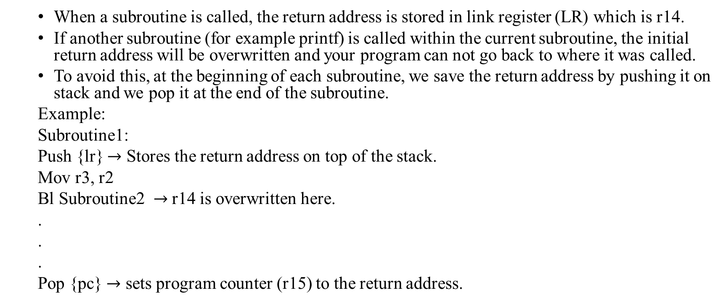
Working with Stack
When a subroutine is called, the return address is stored in link register (LR) which is r14.
If another subroutine (for example printf) is called within the current subroutine, the initial return address will be overwritten and your program can not go back to where it was called.
To avoid this, at the beginning of each subroutine, we save the return address by pushing it on stack and we pop it at the end of the subroutine.
Example:
Subroutine1:
Push {lr} $→$ Stores the return address on top of the stack.
Mov r3, r2
Bl Subroutine2 $→$ r14 is overwritten here.
.
.
.
Pop {pc} $→$ sets program counter (r15) to the return address.

Slide 9
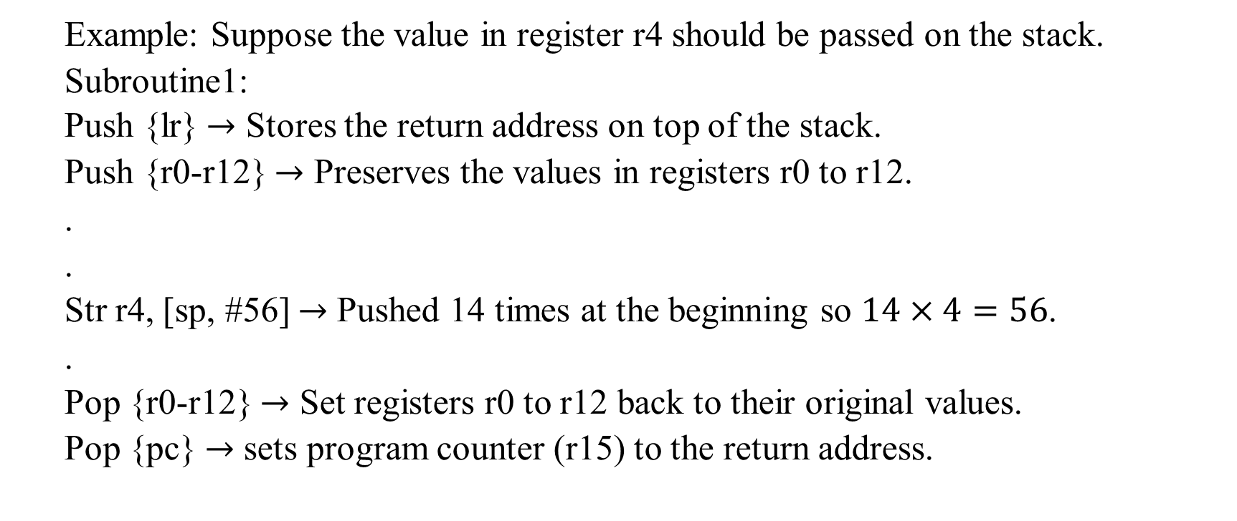
Passing a value on top of the stack
Example: Suppose the value in register r4 should be passed on the stack.
Subroutine1:
Push {lr} $→$ Stores the return address on top of the stack.
Push {r0-r12} $→$ Preserves the values in registers r0 to r12.
.
.
Str r4, [sp, #56] $→$ Pushed 14 times at the beginning so $14×4=56$.
.
Pop {r0-r12} $→$ Set registers r0 to r12 back to their original values.
Pop {pc} $→$ sets program counter (r15) to the return address.

Slide 10
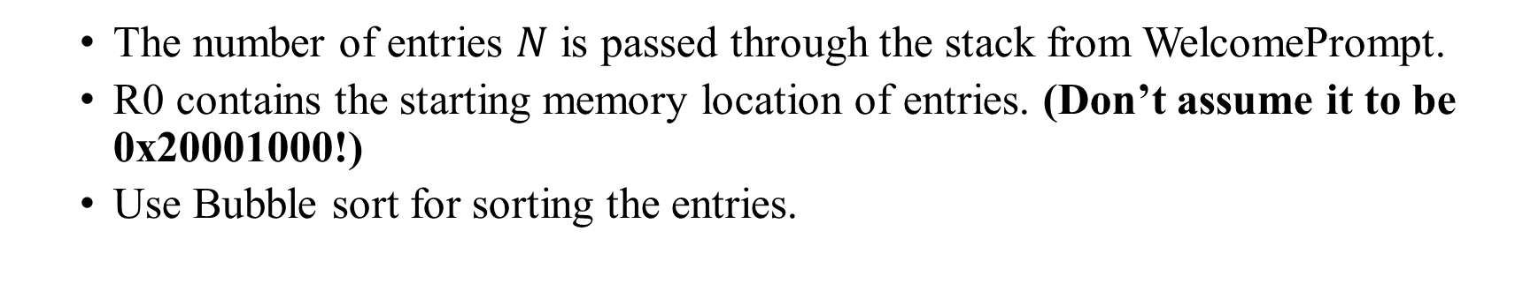
Part 2 (Sort)
The number of entries $N$ is passed through the stack from WelcomePrompt.
R0 contains the starting memory location of entries. (Don’t assume it to be 0x20001000!)
Use Bubble sort for sorting the entries.

Slide 11
Bubble Sort
0x20001000
0x20001004
0x20001008
0x2000100C
0x20001010
6
4
45
20
10
4
6
45
20
10
4
6
45
20
10
4
6
20
45
10
4
6
20
10
45
4
6
20
10
45
4
6
20
10
45
4
6
10
20
45
4
6
10
20
45

Slide 12

Part 3 (Display)
The number of entries $N$ and the starting memory location of entries are both passed through the stack. (Don’t assume the starting memory location to be 0x20001000!)
You will display the sorted entries on MITTTY.

Slide 13
Important!!!
The provided subroutines (printf, cr, …) overwrite registers r0-r3. Use registers r4-r12 to store your data.
At each subroutine, preserve the return address (r14) and register values (r0-r12) by pushing to and popping from the stack.
This lab is done in three weeks. Next week, TAs will not be available but you can still use the lab equipment.

