Slide 1
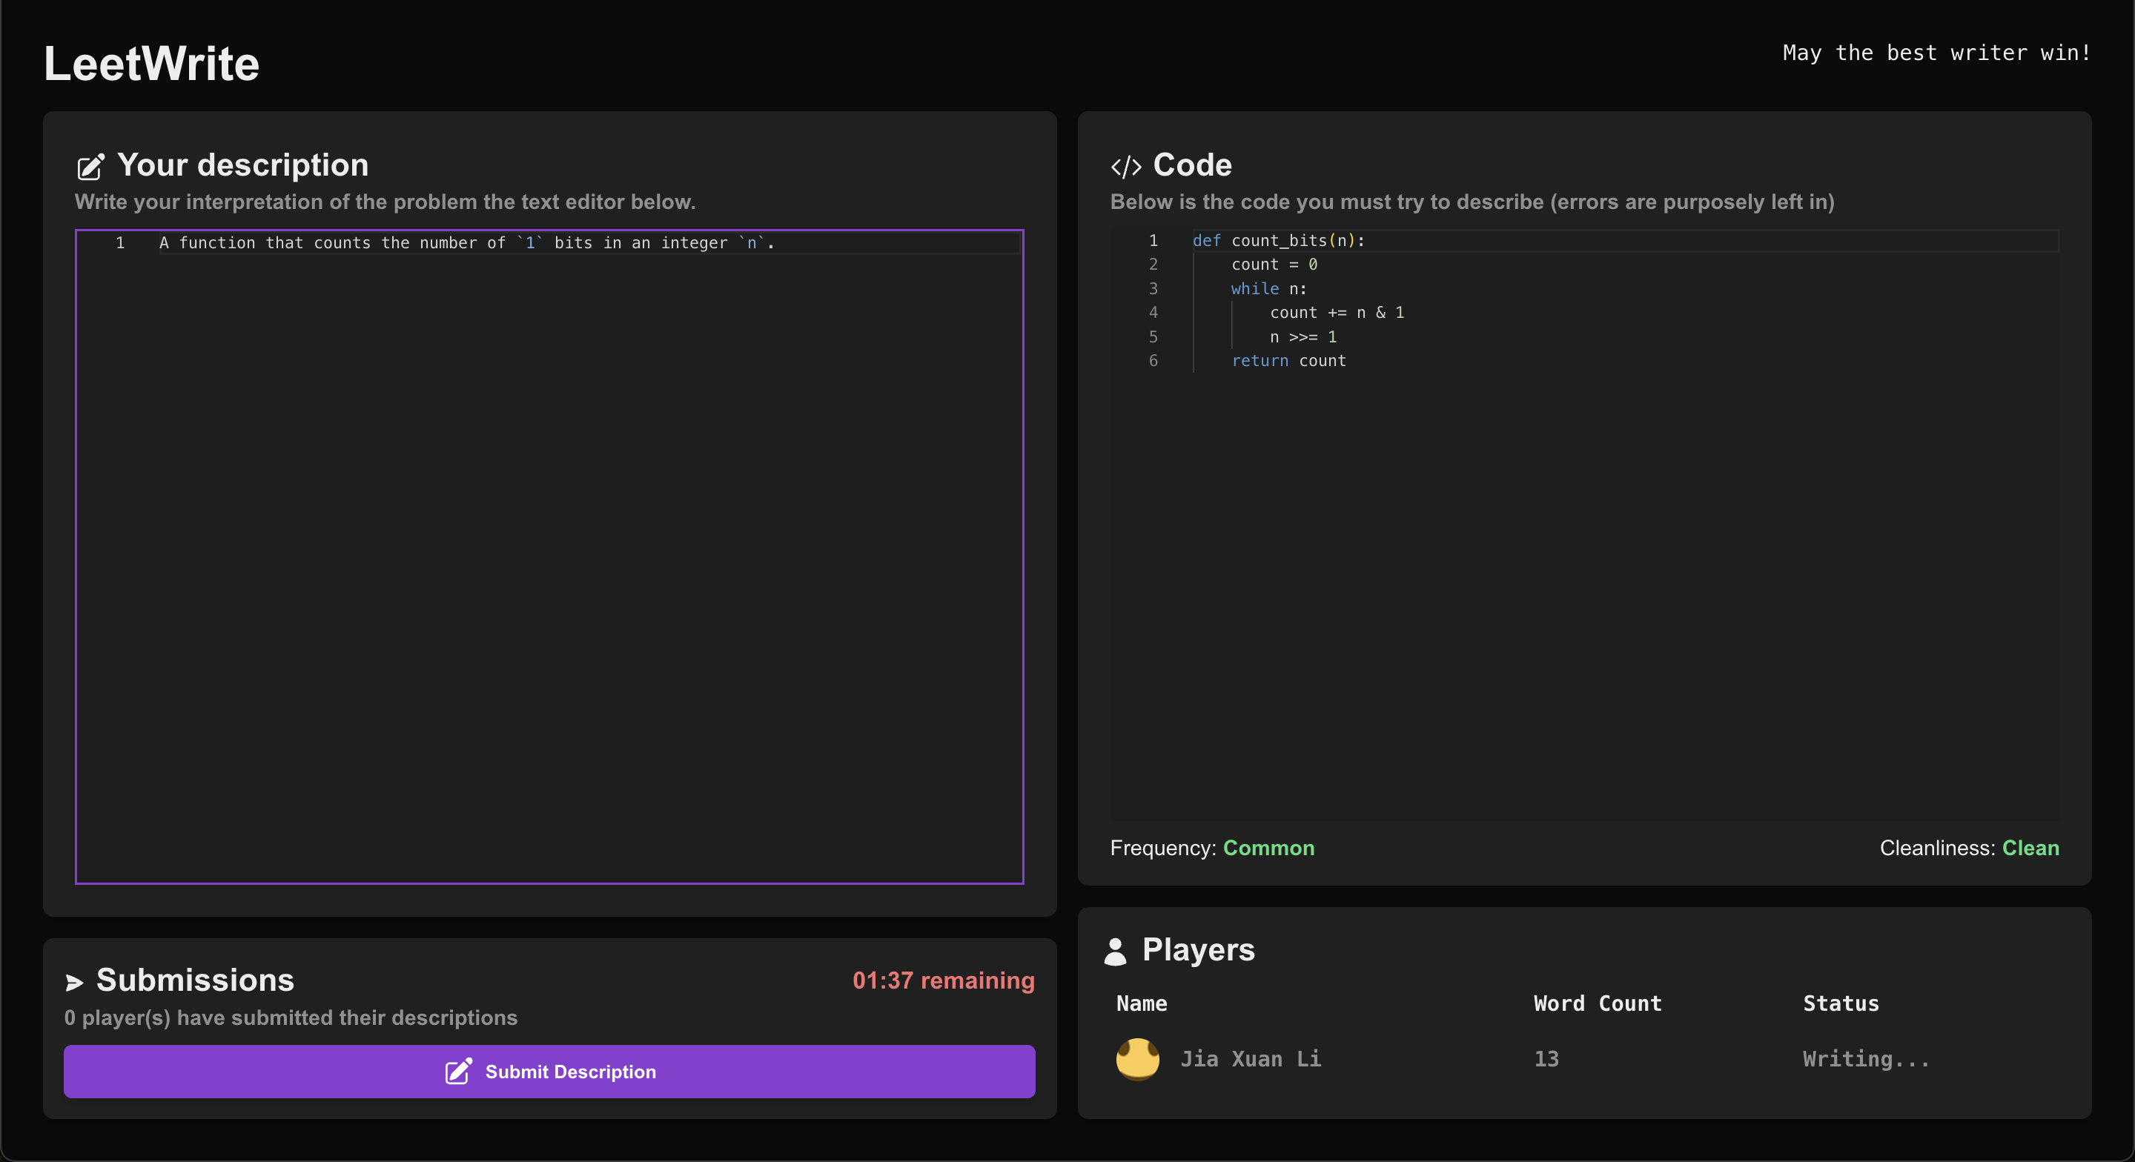
LeetWrite
Where Coders become Creators
By Jia Xuan Li

Slide 2


What is LeetWrite?
“Reverse-LeetCode”
Given a code snippet, interpret it and “guess” the original problem.
Allows to develop critical thinking skills
4-player PvP matchmaking

Slide 3
Why LeetWrite?
Real Life: Read and debug existing code
Legacy Code: Must reverse-engineer to reconstruct the intention
Code Reviews: Must understand code written by another engineer
Deeper Understanding: Forces you to articulate your ideas

Slide 4





Tech Stack
Backend: Express + Socket.IO
Data Storage: MongoDB Atlas
LLM: OpenAI’s GPT-4o-mini
Frontend: Next.JS

Slide 5
Demo
https://youtu.be/CKVScKptAec

Slide 6
Use of AI
Math behind ELO ranking system
Setting up authentication
GitHub CoPilot for repetitive portions

