Slide 1
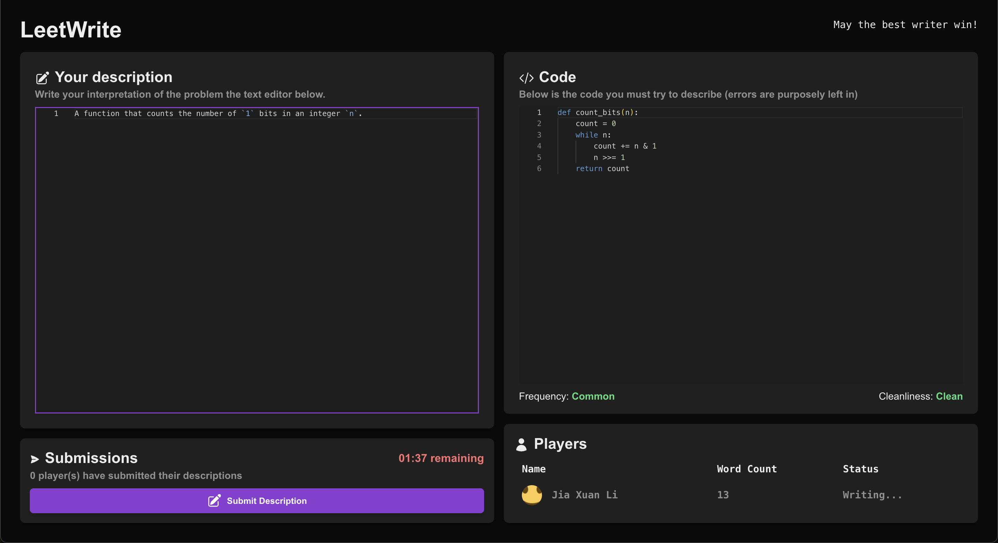
LeetWrite
Where Coders become Creators
By Jia Xuan Li

Slide 2


What is LeetWrite?
“Reverse-LeetCode”
Given a code snippet, interpret it and “guess” the original problem.
Allows to develop backward reasoning skills
4-player PvP matchmaking

Slide 3





Tech Stack
Backend: Express + Socket.IO
Data Storage: MongoDB Atlas
LLM: OpenAI’s GPT-4o-mini
Frontend: Next.JS

Slide 4
Demo
https://youtu.be/CKVScKptAec

Slide 5
Use of AI
Math behind ELO ranking system
Setting up authentication
GitHub CoPilot for repetitive portions

