Slide 1
PinPoint
App. Dev. 2 Project

Slide 2
Project Description
The project will allow users to remember the places they have visited by adding pins on a map, that are then saved in a database
They can also write notes on pins of public places, and they are able to friend other users to share their notes.

Slide 3
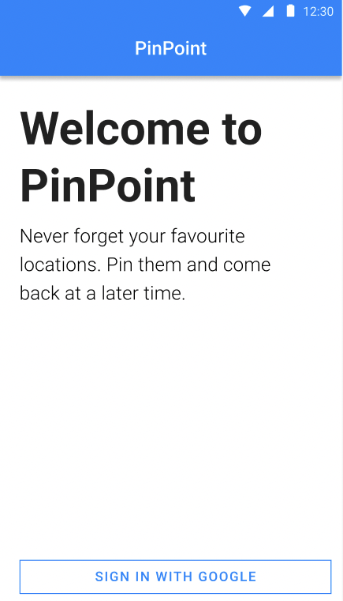
Landing Page
Welcome message
Small introduction
Google authentication
If already signed in, go to the Map view

Slide 4
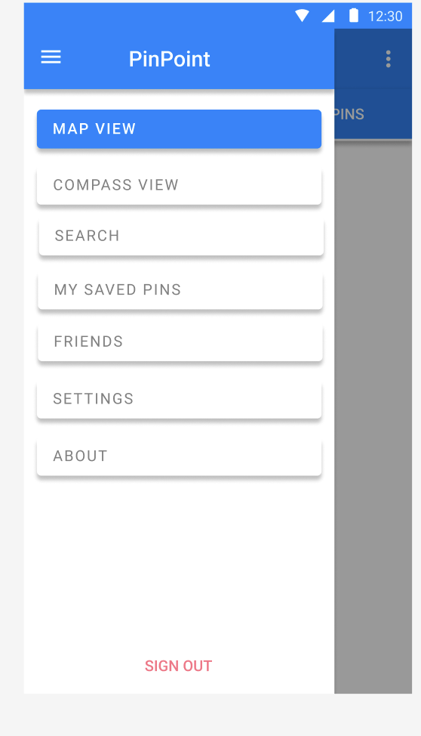
Navigation Bar – Side Bar
Map view:
Interactions related to the map
Compass view:
Indicator for closest pinpoints
Cool feature
Search
Searching for locations
My Saved Pins:
Quick actions to delete/edit pins
Friends:
Friends to share notes
Settings:
Clear pinpoints / sign out / delete account
About:
Information about developers

Slide 5
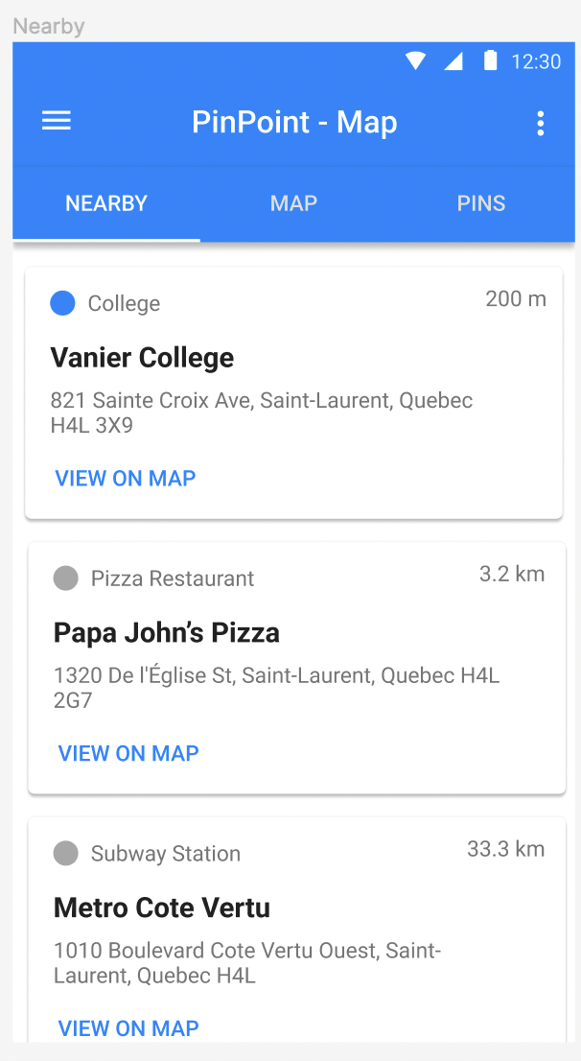
Map View - Nearby
Shows nearby locations
Cards display:
Type (college, restaurant, etc.)
Distance from current location
Location name
Location address
Button to redirect to the ”Map” page, in the map view

Slide 6
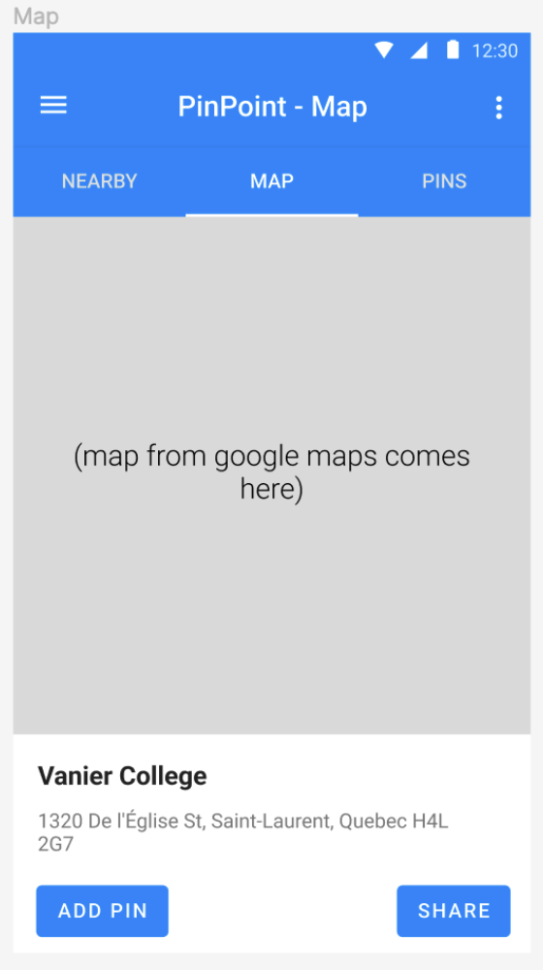
Map View - Map
Shows the location of the selected “nearby” or searched.
Also allows to share a location to a friend

Slide 7
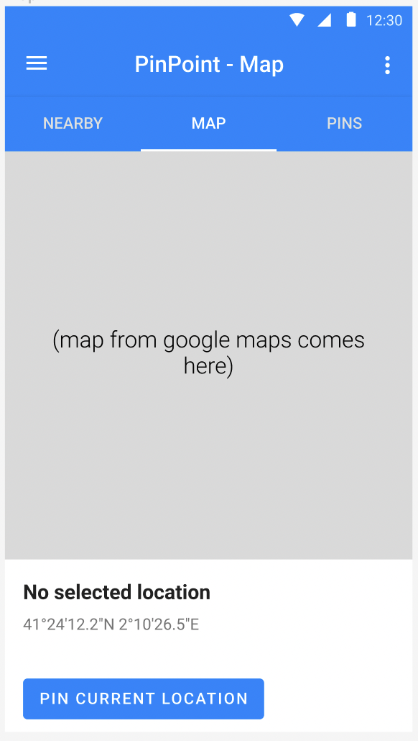
Map View - Map
If the user navigates to this page, then allow them to pin their current coordinates

Slide 8
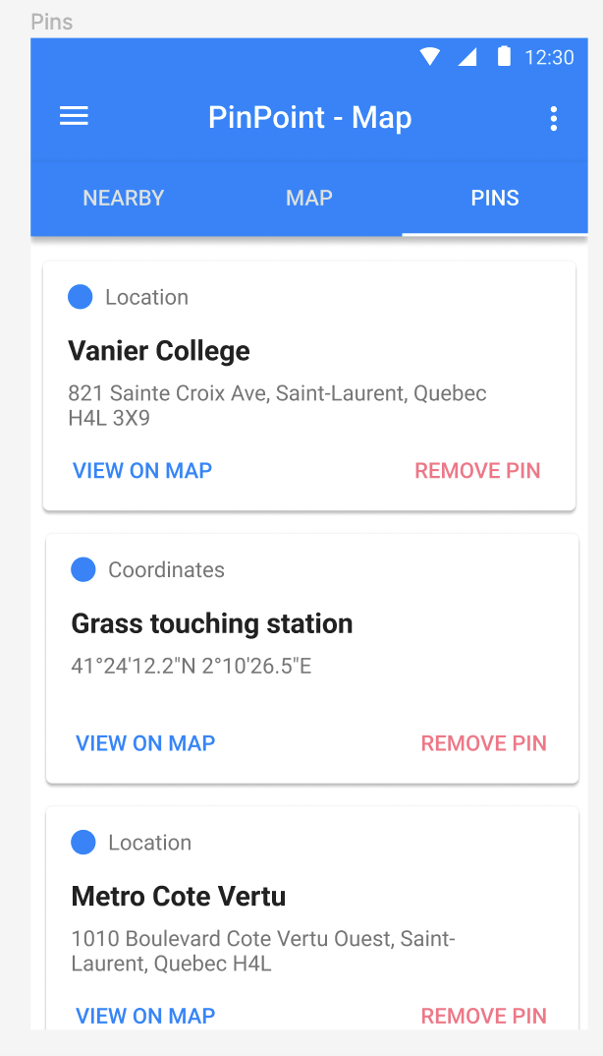
Map View - Pins
Quick way to view saved pins, and delete pins

Slide 9
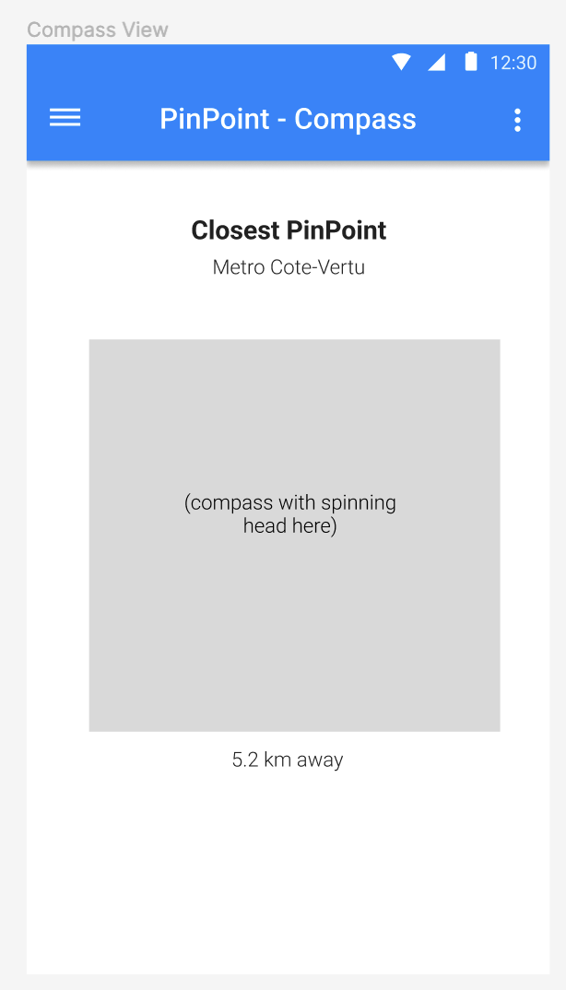
Compass View
Shows a compass, indicating the nearest location with the compass head
Also shows the location name / coordinate name
Just for fun purposes

Slide 10
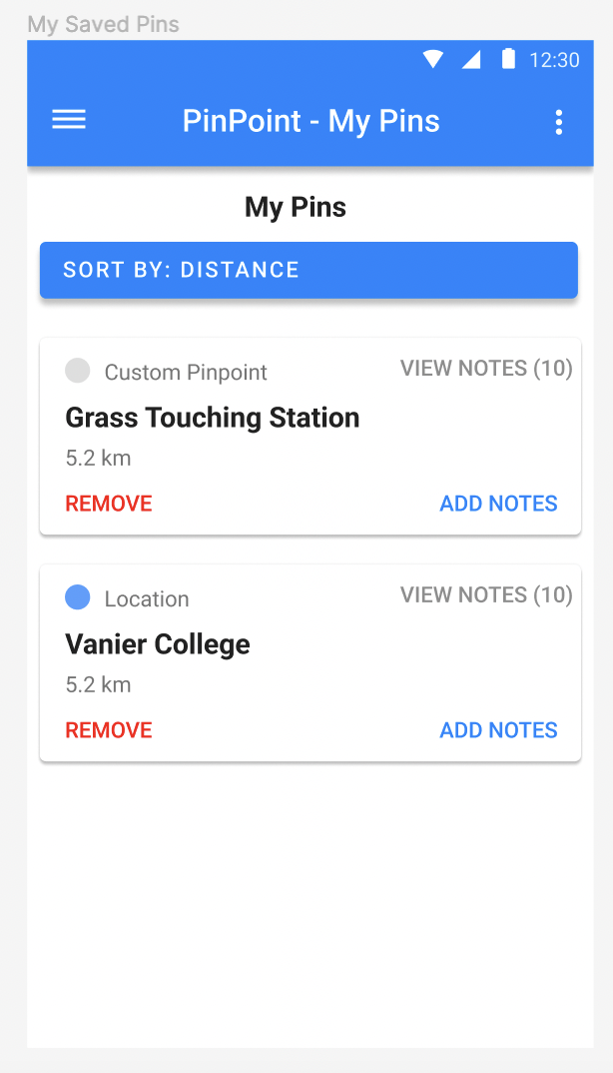
My Pins
Shows saved pins
User can add / view notes
Adding notes shows a dialog box
Can also remove pinpoints
Can sort list by name, distance, and dates

Slide 11
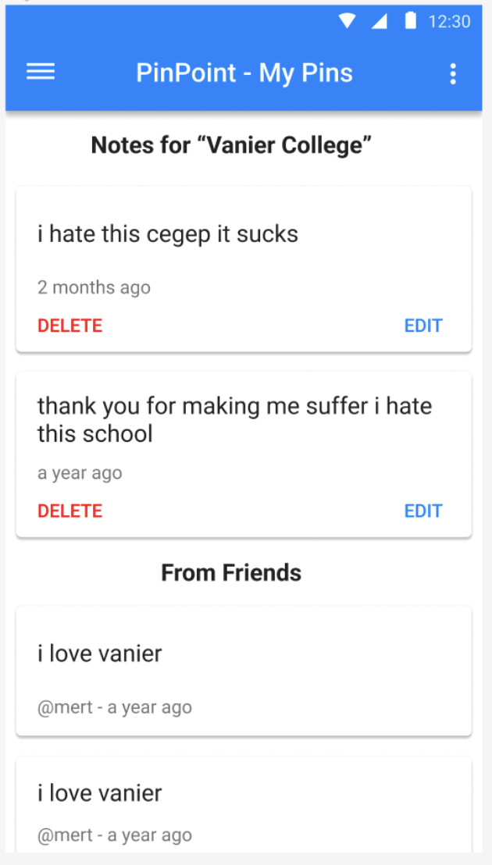
My Pins – View notes
Read personal notes on a location, timestamp is included
Can also read notes from friends, depending on their notes privacy status

Slide 12
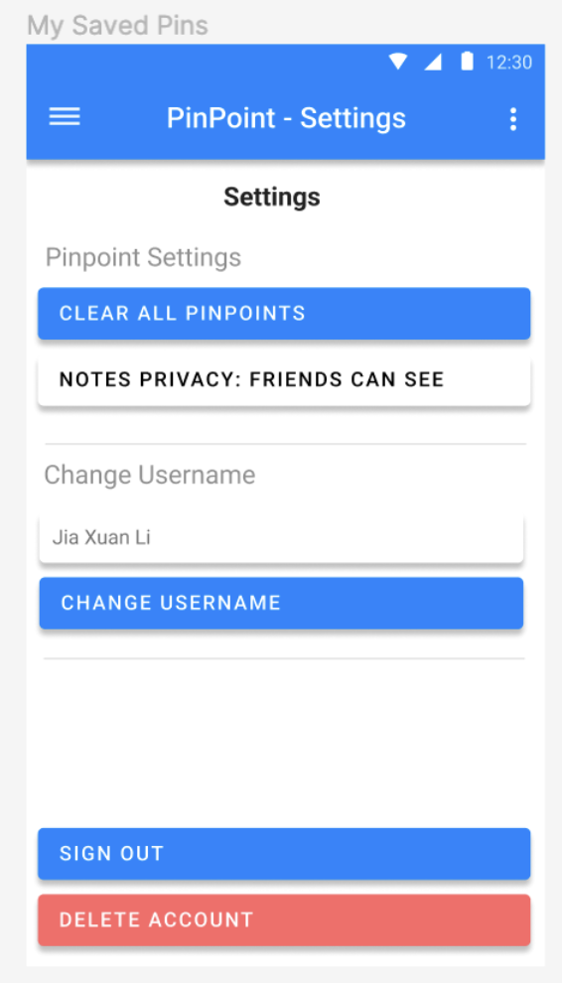
Settings
Can clear all pinpoints
Can set if friends can see notes
Can sign out, and delete account
Deleting account will send dialog box to make sure it was not an accident

Slide 13
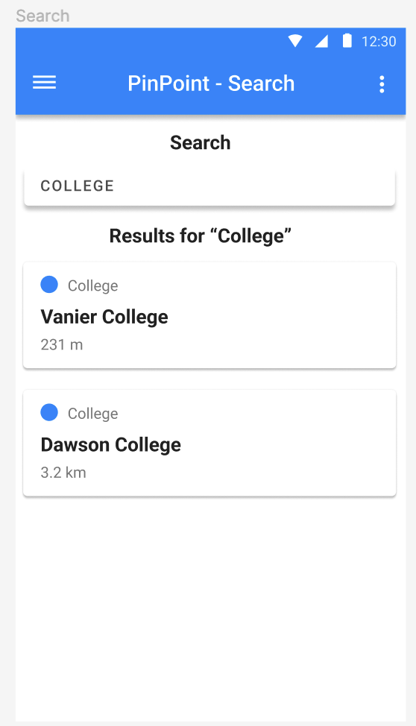
Location Search
Input box, will query google map api to get the results
Can click on cards to see them on the map

Slide 14
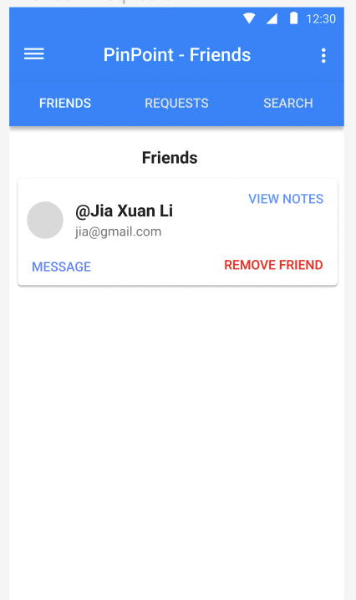
Friends – My friends
Can see list of friends, and remove them
Can send them messages
Can also view their list of notes
Profile picture will be provided by their google account

Slide 15
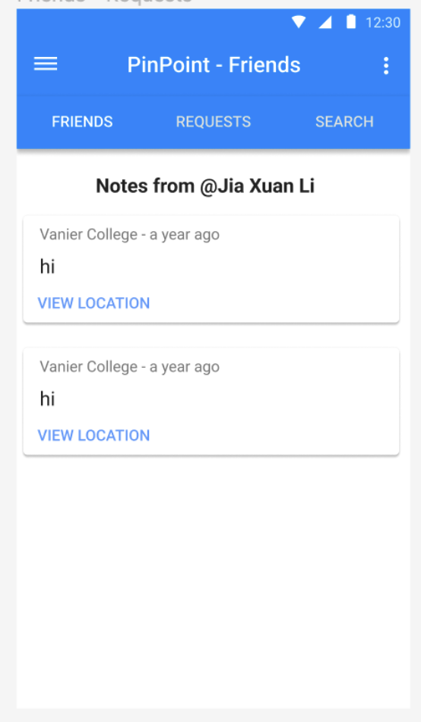
Friends – My friend’s notes
See the notes from a friend
Can view the location and be redirected to the map

Slide 16
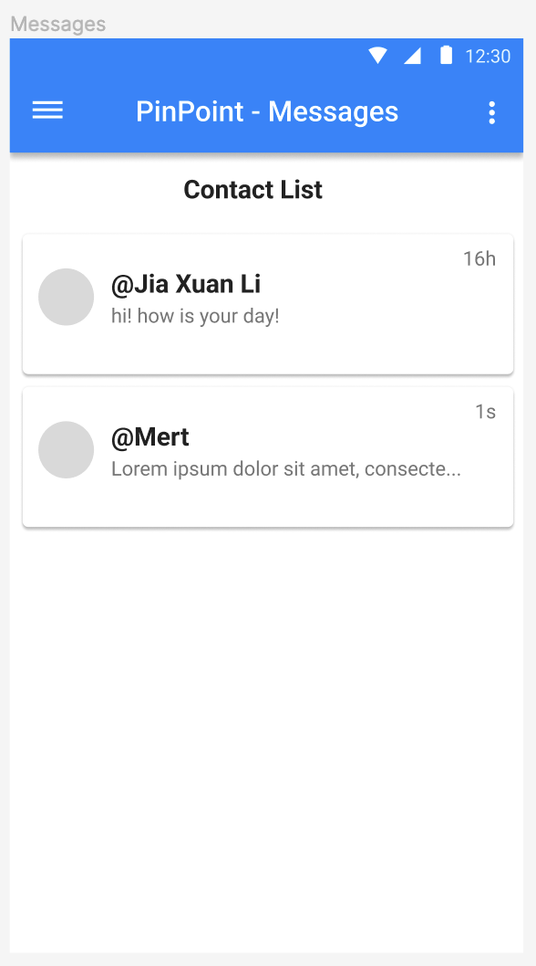
Messages – Contact List
Shows list of contact, with the names
Shows the latest message, and how long ago the message was sent

Slide 17
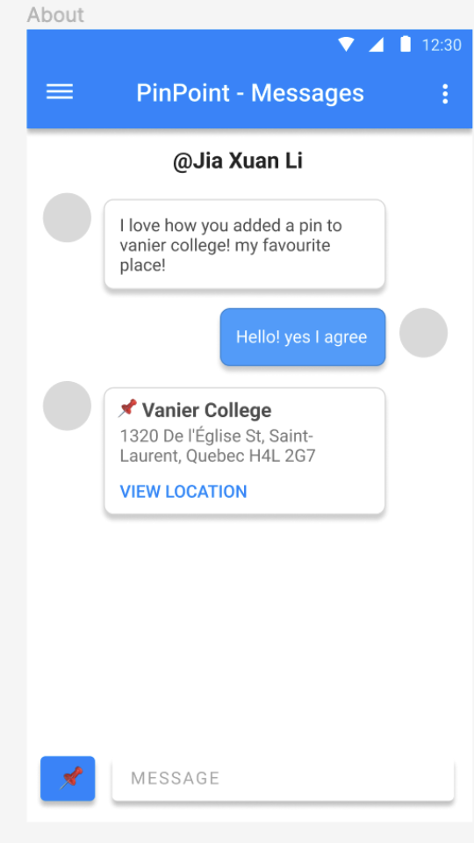
Messages – Private messages
Can send messages to friends
Can also share locations, recall to map page

Slide 18
End
Github: https://github.com/adinashby-vanier-college/app-dev-2-project-jiaxuanli3
Screen count: Currently 12, but more in the future as we get new ideas

