Slide 1
PinPoint – Deliverable 1
App. Dev. 2 Project

Slide 2
Task split & Progress
Split:
Page designs: Mert
Database setup & interactions: Jia
Progress estimation:
About 60% finished
Note: we took some advance & did research on own time

Slide 3
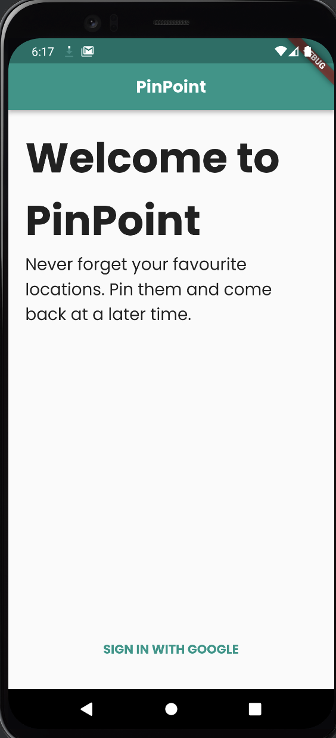
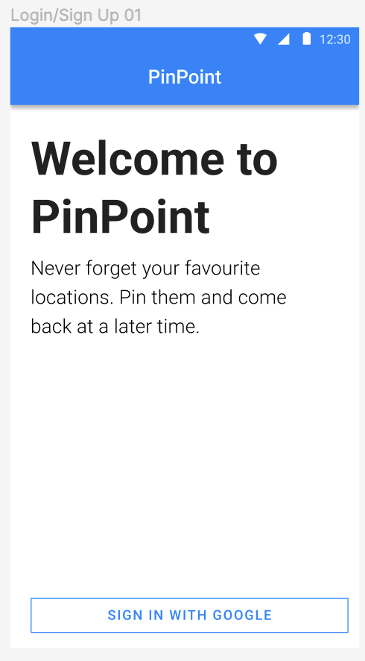
Screen – Landing Screen
Requirement from teacher: use 3 providers for authentication
No border for buttons
Will be shown, if not logged in

Slide 4
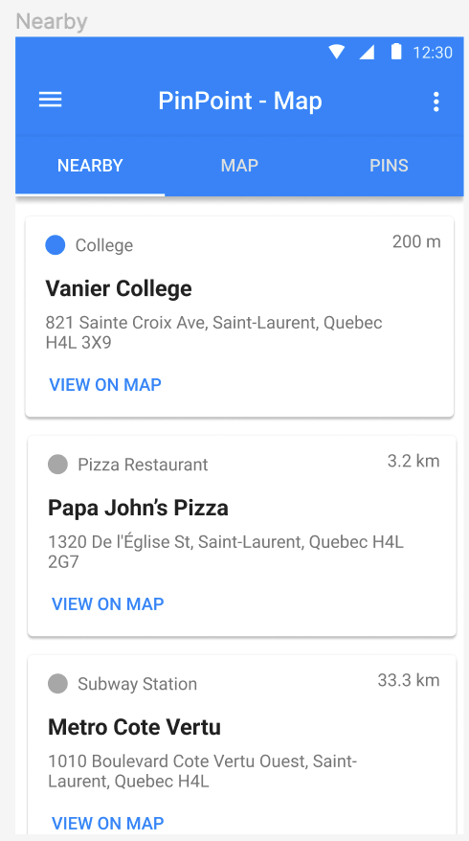
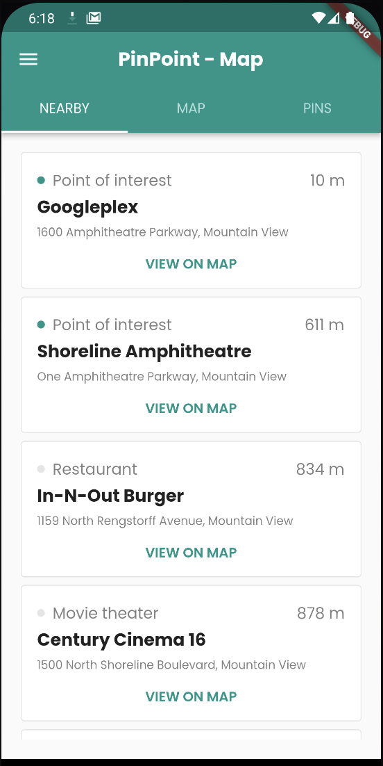
Screen – Map (Nearby)
No shadows & no border radius
‘View on Map’ centered

Slide 5
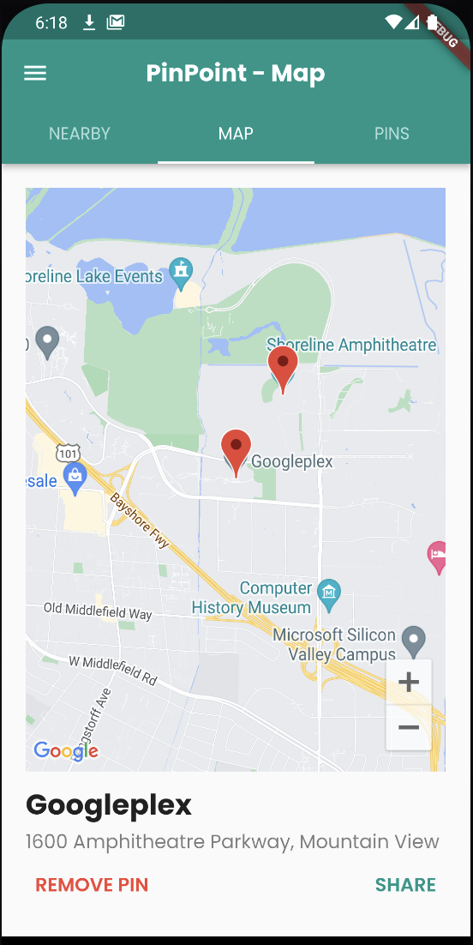
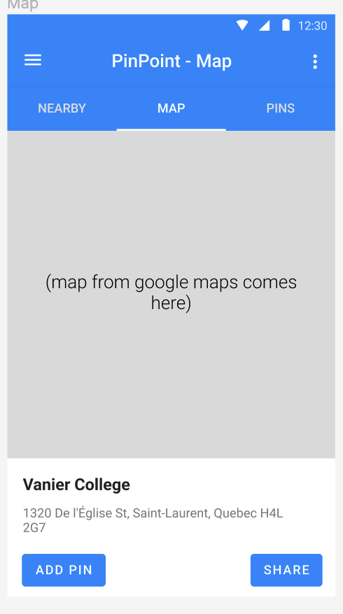
Screen – Map (Map)
No background for buttons
Added real map, using google maps API

Slide 6
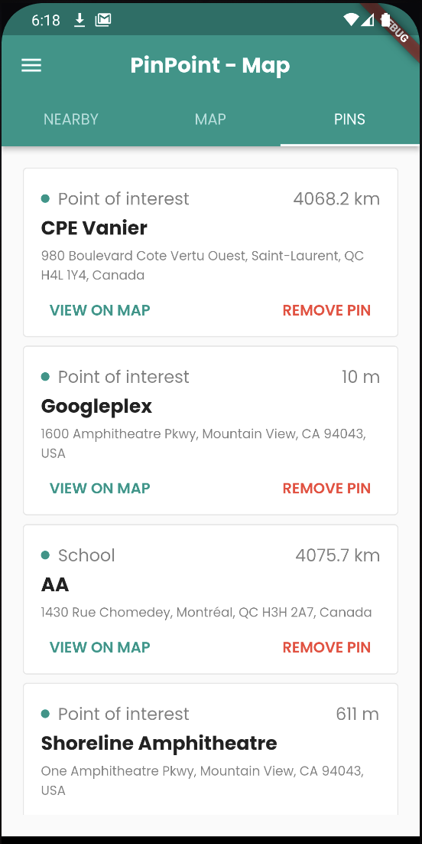
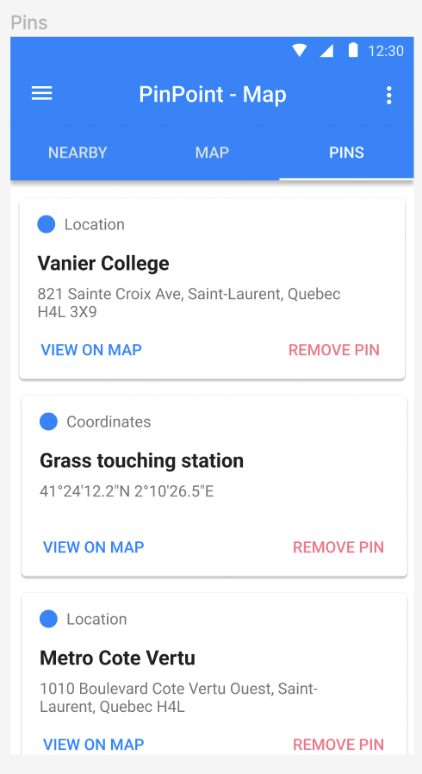
Screen – Map (Pins)
- No shadows & no border radius

Slide 7
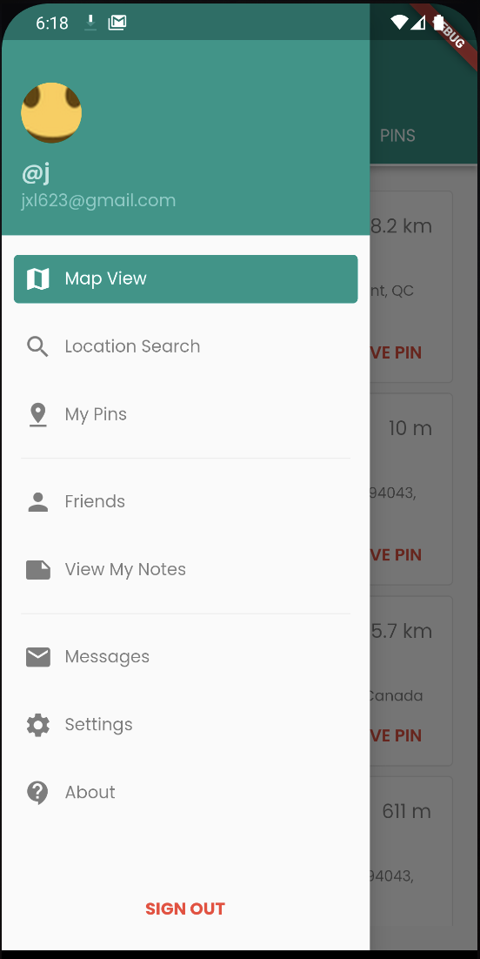
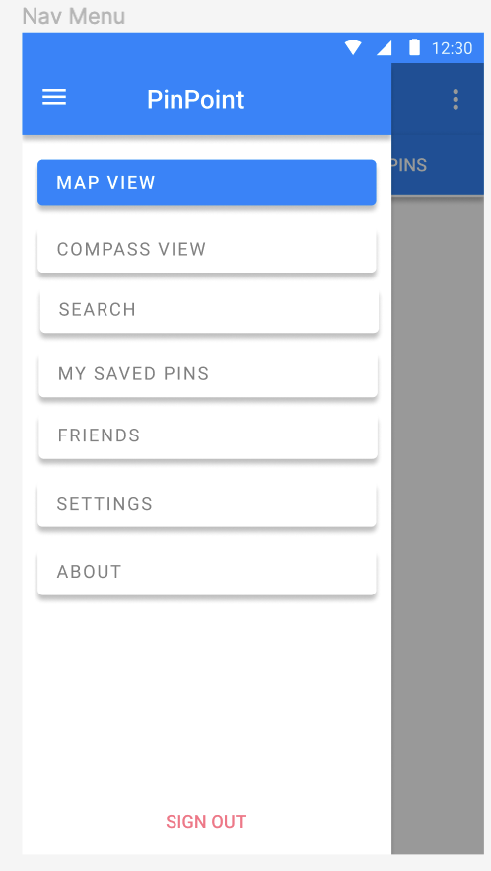
Navbar
Icons next to navigation button
No shadow on buttons
Now show display name, email, profile picture on top

Slide 8
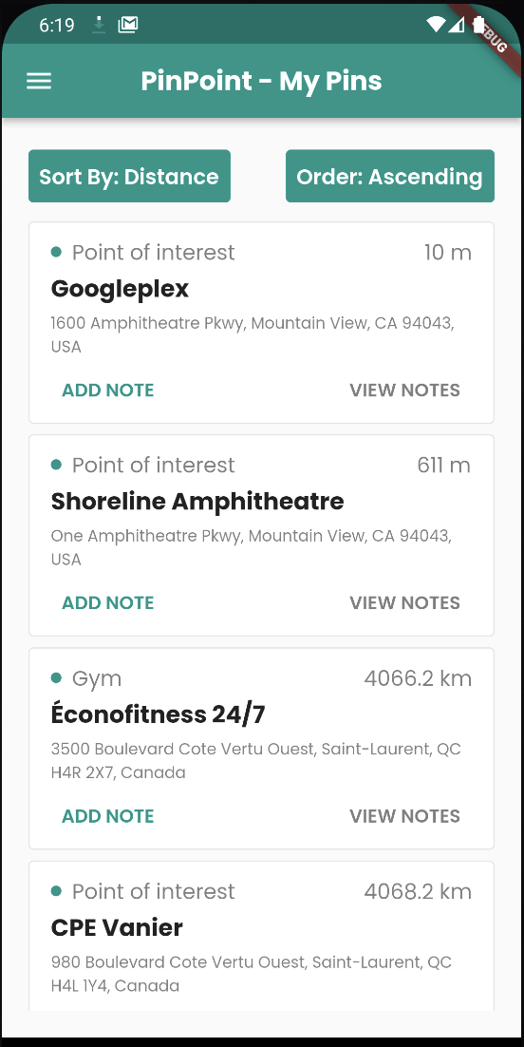
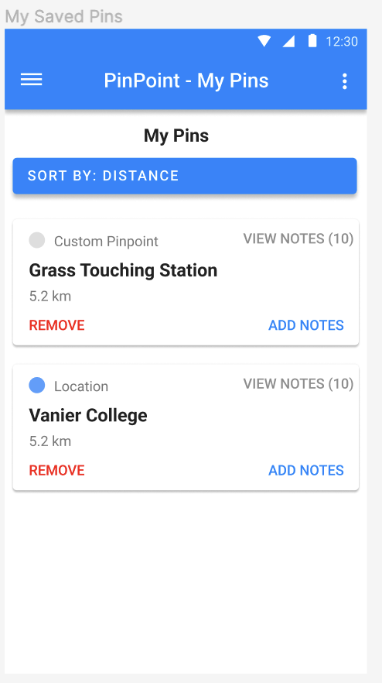
Screen – My Pins
- No ‘Remove’ button, it is now in the pins page

Slide 9
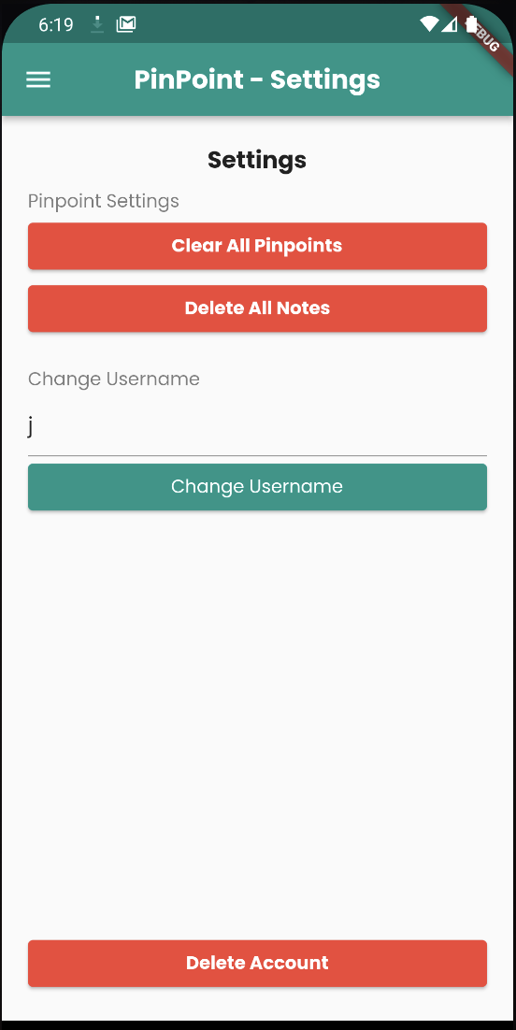
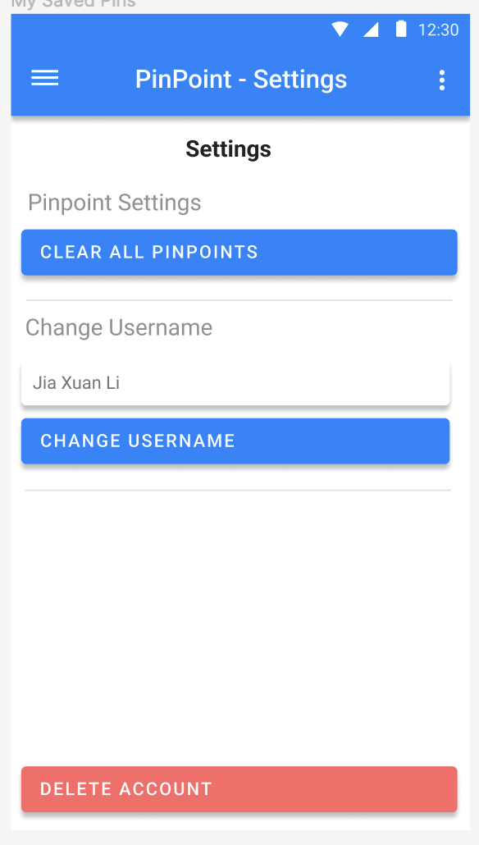
Screen – Settings
Can now delete notes

Slide 10
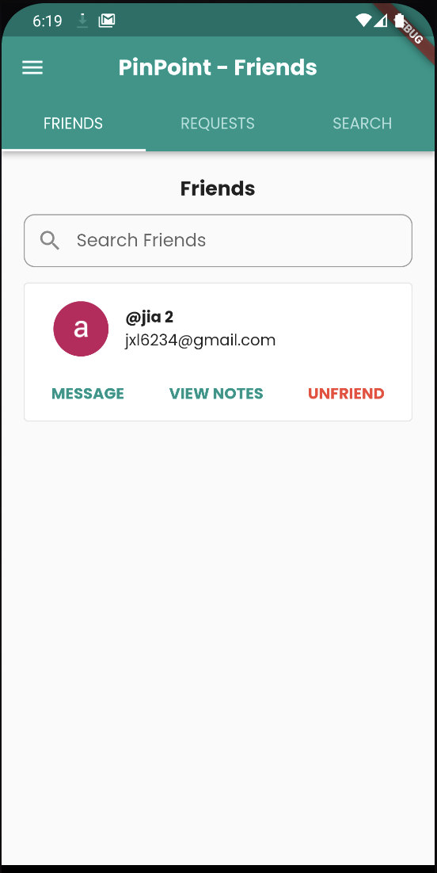
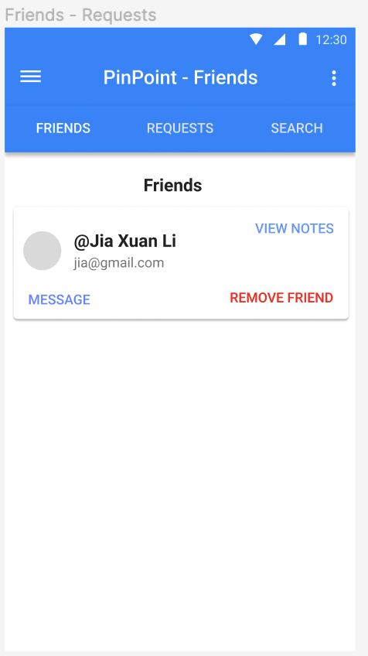
Screen – Friends (Friends)
Buttons now at bottom of card
Added search bar, narrow down results

Slide 11
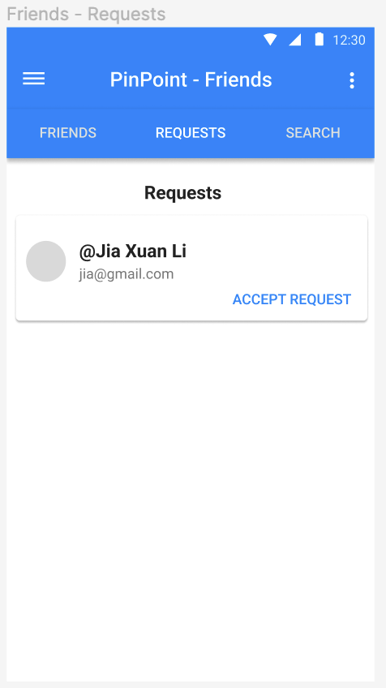
Screen – Friends (Requests)
Search user by keyword
Firebase limitation: can only search start of strings
(Image not available, but same thing)

Slide 12
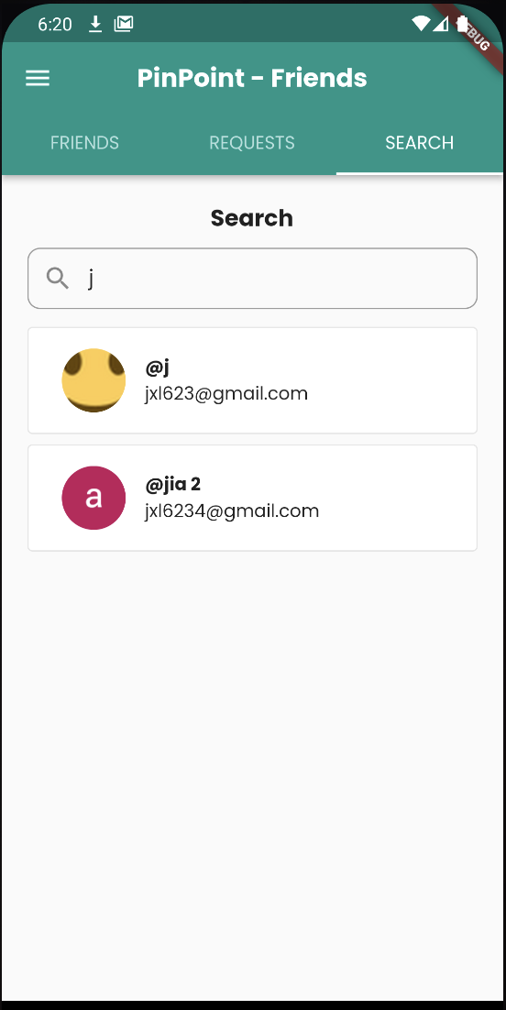
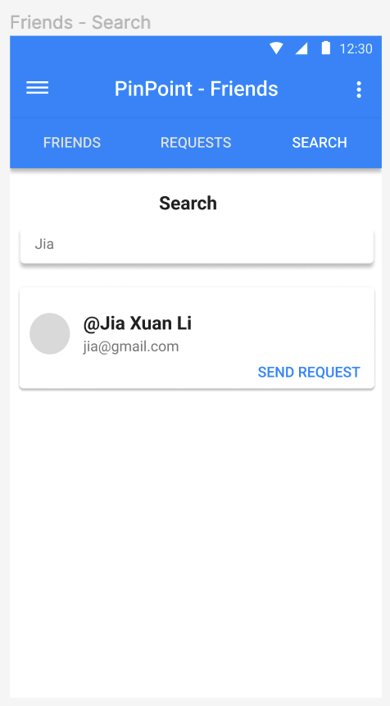
Screen – Friends (Search)

Slide 13
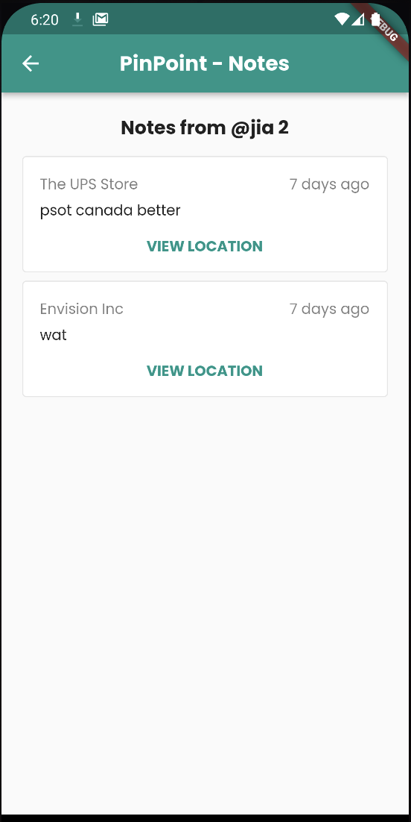
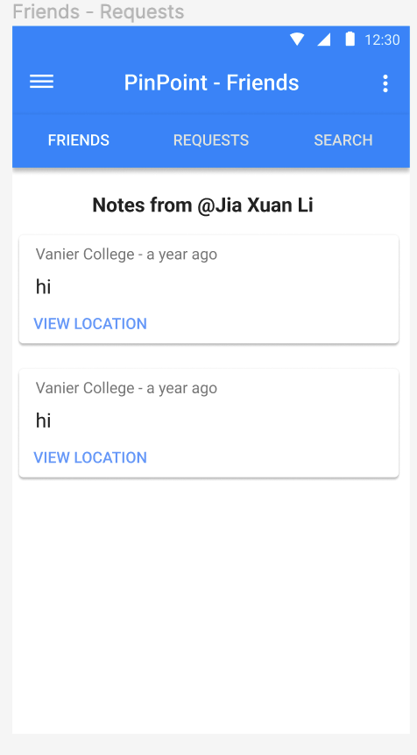
Screen – Friends (Notes)
__

Slide 14
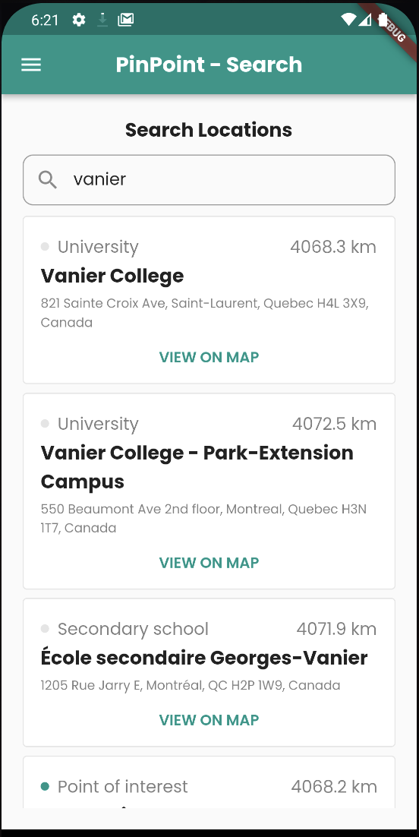
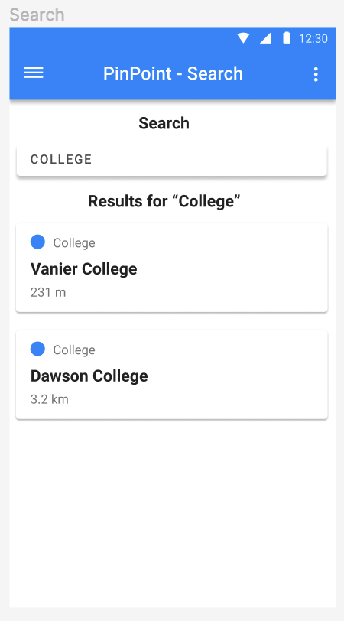
Screen – Search

Slide 15
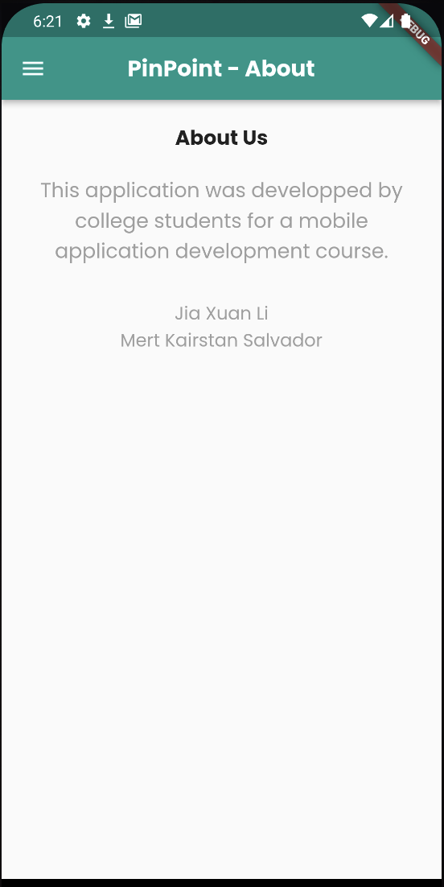
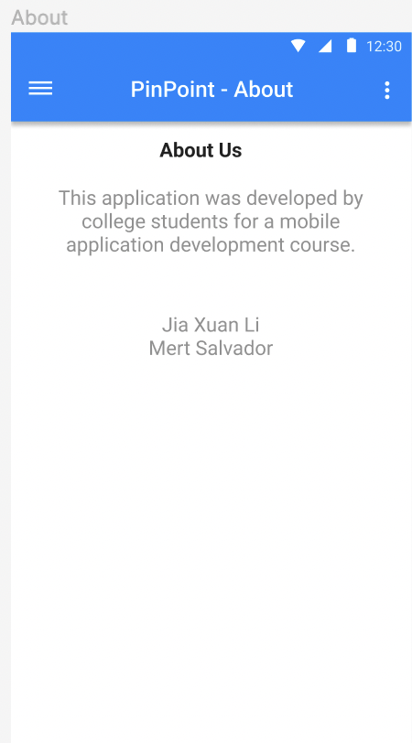
Screen – About
TODO

Slide 16
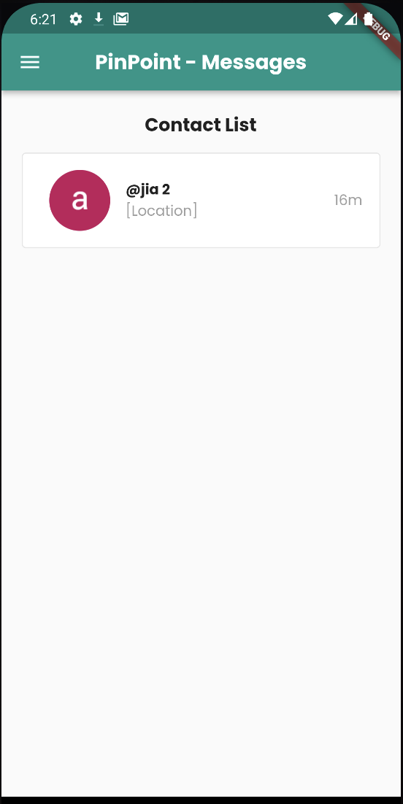
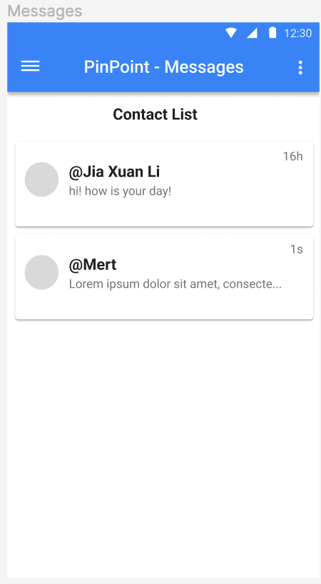
Screen – Messages (Contacts)

Slide 17
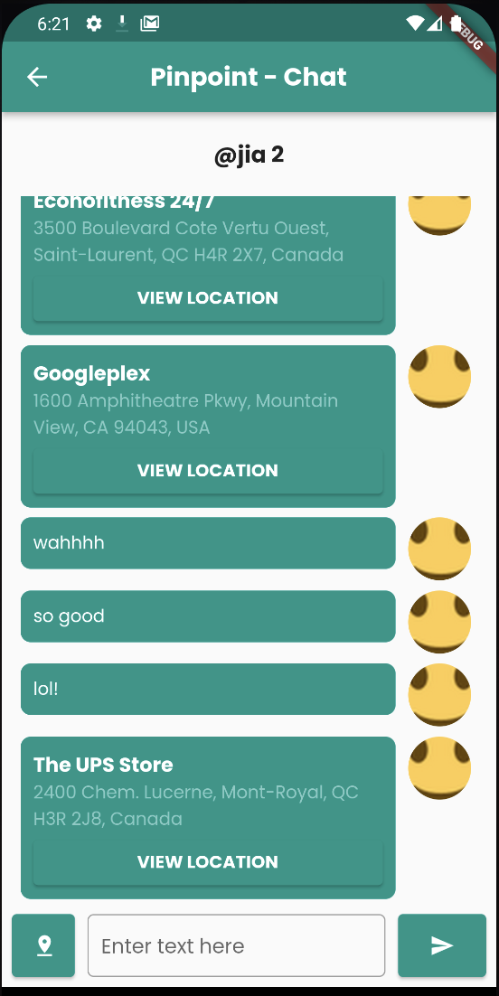
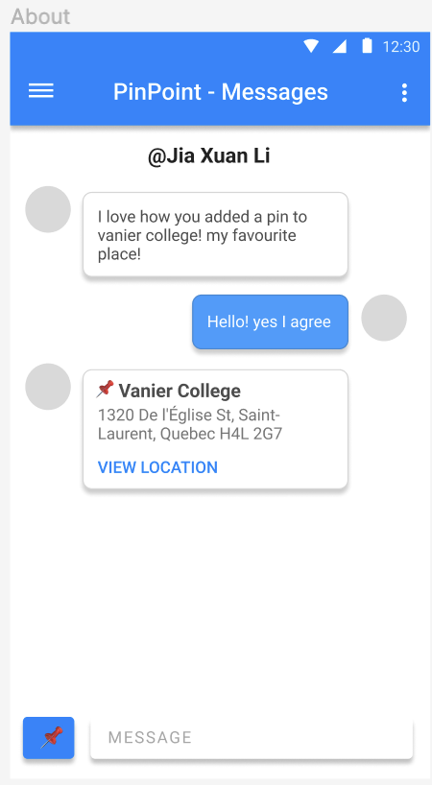
Screen – Messages (Chat)

Slide 18
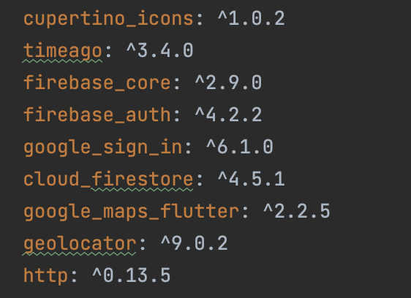
Application
Packages:

