Slide 1
ENGI 301 “Stupidly Secure Safe” Proposal
October 22nd, 2019
John Perez

Slide 2
Background Information
The proposed project would effectively be a safe with three levels of security
The safe would be closed with three solenoid locks, each wired to a different unlock mechanism
The three mechanisms represent unique ways to open a lock – keypad, pattern lock, and dial combination lock
When one of the three mechanisms is correctly activated (i.e. the correct password input, the correct pattern put in, or correct number combination) and enter button pressed, the associated lock would disengage, and a green indicator light would turn on
An incorrect password results in a red indicator light to flash
With all three correct passwords put in and all three locks disengaged, the door will be able to physically open
The user can access the contents, close the door, then press a reset button to turn off green indicator lights and relock all three locks simultaneously

Slide 3
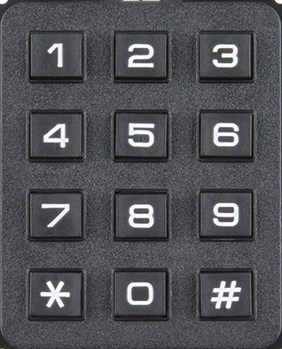

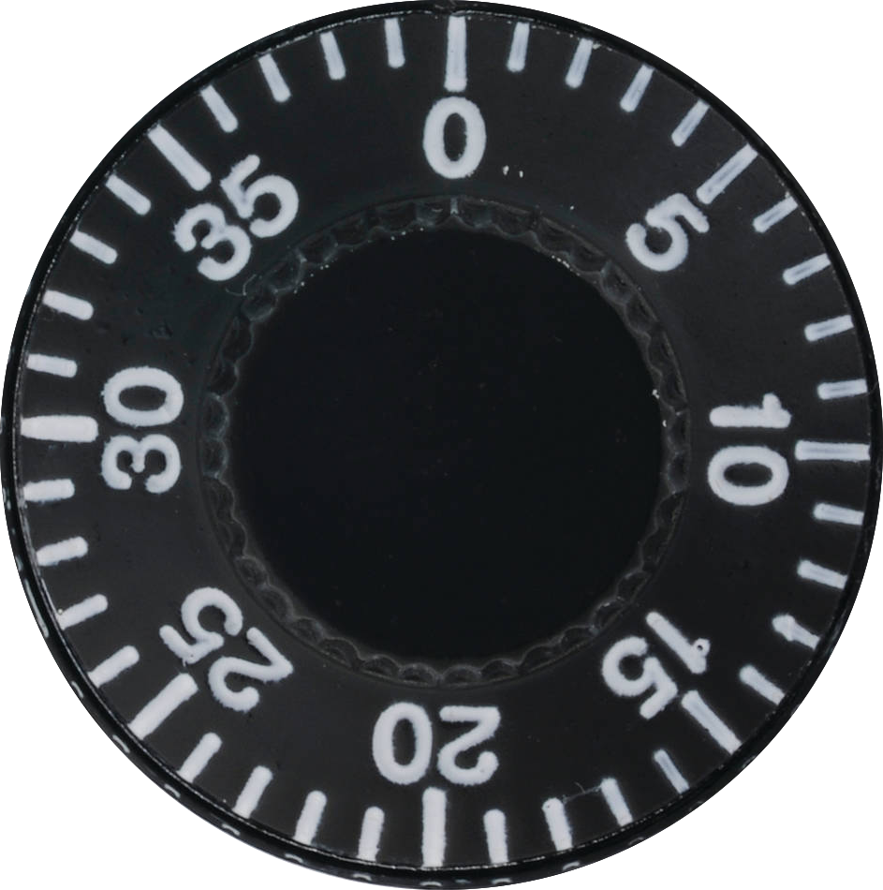
Background Information
1
2
3
1
RESET
ENTER
2
ENTER
3
ENTER

Slide 4
Background Information
Reset Button
Keypad
1
2
3
1
RESET
Incorrect
Indicator Lights
Correct
Indicator Lights
ENTER
2
Pattern Lock w/ buttons
ENTER
Door w/ Solenoid Locks
Combination Lock w/ dials
3
ENTER

Slide 5
Notes on Design
Physical System
Beyond electronic hardware components, tools in the OEDK could be used to create the safe itself
The box, door, and handle are all physical systems that could be manufactured in the OEDK
While the safe would ideally be made of metal, laser cut wood can be used for prototyping
Button covers can be made at the OEDK as well using 3D printers or similar

Slide 6
Addendum: Advanced Design
To better take advantage of the PocketBeagle a more advanced security system will be put in place
A 2 factor identification system will be used so the user texts themselves a secure password
That password is then entered into the keypad

Slide 7
Notes on Design
Areas for potential change
Instead of 3 separate solenoid locks, 1 could be used. This single lock would require activation from all 3 password inputs to disengage
Enter buttons could be removed in favor of an automatic entry of password
The dial combo section could be reduced to a single dial for simplicity – this would still have an adequate security value

Slide 8
Background Information
Preexisting projects
Timed lockbox using an Arduino: https://www.hackster.io/LoganSpace42/arduino-lock-box-0d52c0
Pattern lock: https://www.hackster.io/najad/pattern-lock-8ede38
Keypad lock: https://www.hackster.io/camdelk/keypad-entry-lock-4d7a03

Slide 9
System Block Diagram
Create a System Block Diagram
Label interfaces / pins
Components (part numbers if possible)

Slide 10
System Block Diagram
G. LED 1
RESET Button
Red LED 1
Keypad
Enter Button
Solenoid 1
G. LED 2
Enter Button
GPIO 109
Button 1
Button 2
Button 3
Solenoid 2
GPIO 59
Red LED 2
GPIO 58
GPIO 57
G. LED 3
Dial 1
Dial 2
Dial 3
Enter Button
Solenoid 3
Red LED 3

Slide 11
System Block Diagram
G. LED 1
Solenoid
Red LED 1
Keypad
Enter Button
Send Button
G. LED 2
Note: These are all different GPIO channels
Enter Button
GPIO
Button 1
Button 2
Button 3
GPIO
Red LED 2
GPIO
GPIO
AIN
Red LED 3
G. LED 3
Dial 1
Dial 2
Dial 3
Enter Button

Slide 12
Power Block Diagram
USB Power
Solenoid 1
12 V Battery
USB Connection
VIN_BAT
G. LED 1
Red LED 1
SYS_OUT
G. LED 2
Red LED 2
G. LED 3
Red LED 3

Slide 13
Components / Budget
Component | Need to Buy | Cost (total)
Keypad | x1 | 5.95
Button (Pattern, Enter, Reset) | x3, x3, x1 | 2.50
Turn Potentiometer (Dial) | x3 | 3.75
Green LED | x3 | 1.08
Red LED | x3 | 1.80
Linear Solenoid (Lock) | x3 | 44.85

Slide 14
Components
Link to Components w/ specific names
4x4 Matrix Keypad: https://www.adafruit.com/product/3844
Tactile Button Switch: https://www.adafruit.com/product/367
Potentiometer with built-in in knob: https://www.adafruit.com/product/4133
Lock-Style Solenoid: https://www.adafruit.com/product/1512
Green 569nm LED Indication: https://www.digikey.com/product-detail/en/lite-on-inc/LTL-4233/160-1130-ND/217580
OEDK
Red 630nm LED Indication: https://www.digikey.com/product-detail/en/rohm-semiconductor/SLR-56VR3F/511-1264-ND/636992
OEDK

