Slide 1
Predicting New Users' Next-Month Activity
Experiment report: finding and fixing a polluted label, class weighting, tuning, and per-category features
Xiaoyu Yi · Huixi Wang
AI7101 Python final project · Zindi “New User Engagement” challenge

Slide 2
Summary: four improvements
1
Label pollution fixed
One record, badge_OCZE, lifted the M12 cohort's next-month active rate from ~29% to 78%.
Best 5-fold CV F1
0.475
weighted logistic regression
0.469
tuned tree, per-category features
vs 0.328 for the all-ones baseline
2
Class weighting
Eases the 1:4 positive/negative imbalance.
3
Hyper-parameter search
Cures the decision tree's overfitting.
4
Per-category features
Replace per-page columns so features generalise to new months.
The biggest problem was the labels, not the model.

Slide 3
1 · Task, data and features
Task. From a new user's behaviour in the signup month, predict whether they are active in the next month. Metric: F1 of the positive class (Active = 1) on hard 0/1 labels.
Data. 12,413 users. Signup months are masked but ordered 11 → 12 → 1 → 2 → 3 → 4 → 5 (M11 … M5). Predictions are needed for the 1,340 M4 signups.
Label Y. 1 if the user has any record in the month after signup (clicks, competition joins, posts, comments). M4 is hidden, M5 has no next month → 9,026 labelled users (M11–M3).
Features X. Signup-month events only: 5 profile columns + one count column per behaviour (specific pages get one column per page ID).
from src.data import DatasetSpec, build_xy, load_raw
spec = DatasetSpec(
feature_groups=("profile", "activity_counts"))
xy = build_xy(load_raw(), spec)
X = xy.X[xy.labelled] # features
y = xy.y[xy.labelled].astype(int) # next-month active
# y = 1 if any event in month t+1
# X uses only events in month t
Profile: FeatureX, FeatureY, country, signup day, signup hour

Slide 4
1 · Evaluation setup
Item | Setting
Internal evaluation | Labelled users split at random into 5 folds, stratified by label (seed 42). All models share the same split; we report mean ± std of F1
External evaluation | Official leaderboard, computed on the M4 users
Decision threshold | Predict 1 when probability ≥ 0.5; never tuned in any experiment
Why the all-ones baseline reveals the positive rate
# F1(all-ones) = 2p / (1 + p)
def positive_rate(f1_all_ones):
return f1_all_ones / (2 - f1_all_ones)
positive_rate(0.25) # leaderboard -> 0.143
positive_rate(0.468) # our CV -> 0.305
Predicting 1 for everyone gives recall = 1 and precision = p (the positive rate).
So F1 depends only on p, and we can invert it to recover p from any all-ones score.
Section 2 uses this inversion to discover the problem.

Slide 5
2 · Starting point: CV and leaderboard disagree
Model | 5-fold CV F1 | Leaderboard F1
all-ones | 0.468 | 0.25
Logistic regression | 0.677 ± 0.019 | below all-ones
Hypotheses to test
 | Hypothesis | Explains
H1 | Part of the training labels is abnormally inflated | Anomaly 1
H2 | 1:4 imbalance + 0.5 threshold make the model too conservative | Anomaly 2
H3 | An unlimited-depth decision tree overfits | New issue with trees
H4 | Per-page-ID features do not generalise to new months | New competitions / blogs in test
Anomaly 1: all-ones fell from 0.468 to 0.25. Inverting gives a positive rate of 0.305 in labelled data vs ~0.143 in test, so the gap sits in the labels.
Anomaly 2: logistic regression flags only 47 of 1,340 test users (3.5%) as active; the true rate is ~14%.

Slide 6
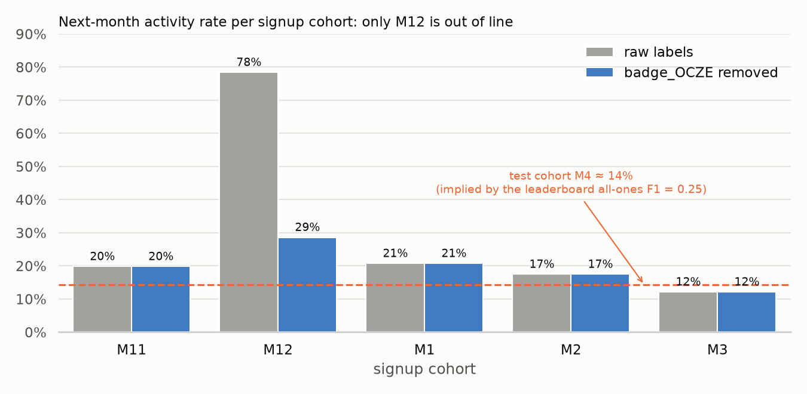
3 · H1: which cohort is off?
M11, M1, M2, M3 sit at 12–21%, and the test cohort's ~14% fits that range.
M12 alone is at 78%.
The inflated overall positive rate (0.305) therefore comes almost entirely from one month.
Next-month active rate by signup cohort. Grey = raw labels, blue = without badge_OCZE, dashed = test rate implied by the leaderboard.

Slide 7
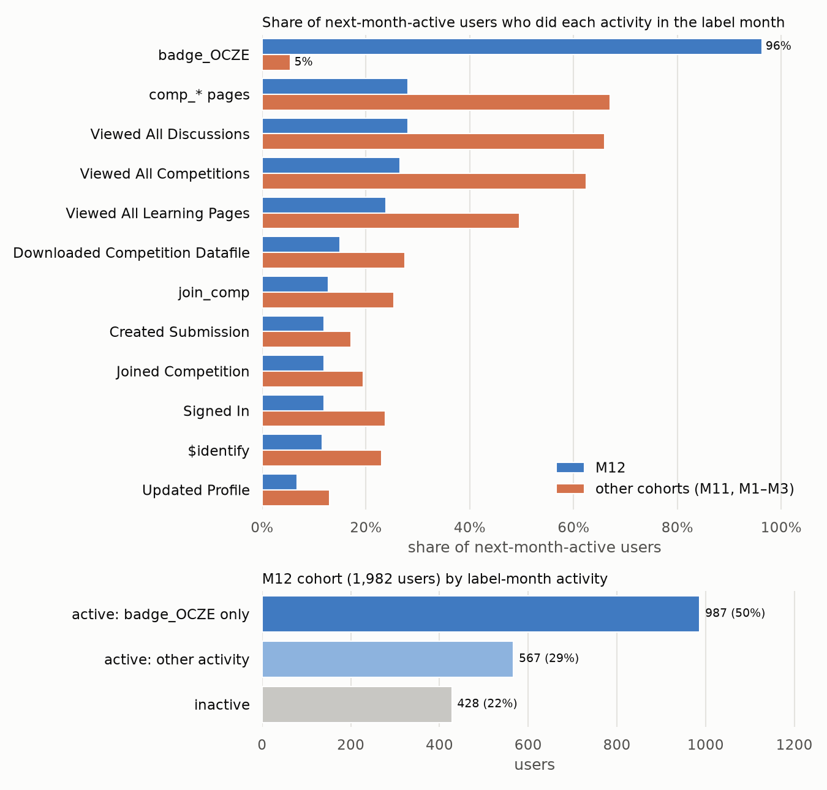
3 · H1: which behaviour is responsible?
Only badge_OCZE is abnormal: 96% of M12's active users have it, vs 5% in other cohorts.
Real usage (browsing competitions and discussions, downloads, submissions, sign-ins) is about half as common in M12.
987 users (50%) of M12 have only this one record in the next month.
It appears on day 15 of month 1 for 3,005 users at once: it looks like a batch badge granted by the system (our inference; undocumented).

Slide 8
3 · H1: fix and verify
# in src/data/loading.py
EXCLUDED_TITLES = ("badge_OCZE",)
activity = tables["activity"]
tables["activity"] = activity[
~activity.Title.isin(exclude_titles)
].reset_index(drop=True) # 8,864 rows dropped
Metric | Before | After
M12 next-month active rate | 78.4% | 28.6%
Other cohorts | 12–21% | unchanged
Overall positive rate | 0.305 | 0.196
all-ones CV F1 | 0.468 | 0.328
Logistic regression CV F1 | 0.677 | 0.375
Dropped at load time, so both X and Y are unaffected.
H1 confirmed. The earlier high score came largely from recognising M12 users, not from learning behaviour. All later experiments use the cleaned data.

Slide 9
4 · H2: 1:4 imbalance makes the model say “active” too rarely
After the fix: 1,770 positives (19.6%), about 1:4.
Logistic regression gives test users a mean probability of only ~0.12, so just 51 (3.8%) cross 0.5; the true rate is ~14%.
F1 punishes missed positives: with ~190 true actives, even 51 perfect hits give recall ≈ 27%.
Experiment: one change only, class_weight="balanced" (each positive weighs ~4× a negative). Threshold and everything else unchanged.
LogisticRegression(
C=1.0, max_iter=2000,
class_weight="balanced", # <- only change
random_state=42)
Model | CV F1 | Test flagged active
Logistic regression | 0.375 ± 0.027 | 51 (3.8%)
+ class weights | 0.475 ± 0.011 | 137 (10.2%)
H2 confirmed: +0.10 F1, far above the fold-to-fold noise (~0.01–0.03).

Slide 10
5 · H3: the default decision tree overfits
Default tree: depth 46–63, ~1,400 leaves, train F1 0.995 vs validation F1 0.391.
Experiment: grid search over 216 settings, chosen by inner 5-fold F1.
Nested CV: in each outer fold the search sees only that fold's training data, so tuning does not inflate the score.
TREE_GRID = {
"max_depth": [2,3,4,5,6,8,10,15,None],
"min_samples_leaf": [1,5,10,20,50,100],
"criterion": ["gini","entropy"],
"class_weight": [None,"balanced"],
} # 9 x 6 x 2 x 2 = 216
GridSearchCV(tree, grid, scoring="f1",
cv=StratifiedKFold(5, shuffle=True))
Model | Depth | Leaves | Train F1 | Valid F1
Default tree | 46–63 | ~1,400 | 0.995 | 0.391 ± 0.014
Tuned tree | 8 | ~151 | 0.553 | 0.456 ± 0.019
H3 confirmed: train–valid gap 0.60 → 0.10, valid F1 +0.065. Best: depth 8, min leaf 5, gini, balanced (class weights re-selected, consistent with H2).

Slide 11
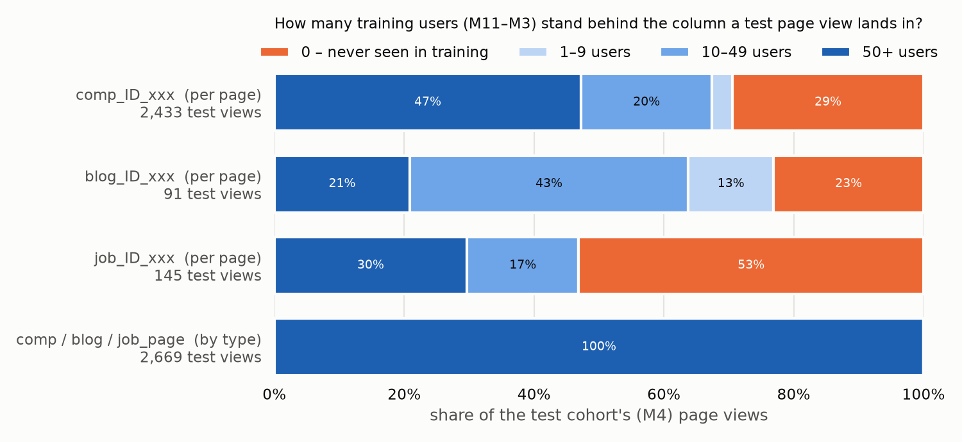
6 · H4: per-page features do not transfer to new months
Per page ID: 29% of competition, 23% of blog and 53% of job views land on columns never seen in training.
M4's most popular competition, comp_ID_WZ0H, is new. Not special to M4: 31–64% of competition views in other months also hit new ones (WOVD → 528W → GAV9 → WZ0H → IMTG).
Per category: 100% of the same 2,669 views land on well-supported columns.
Each M4 page view is coloured by how many training users have that column. Orange = never seen in training. Bottom row = per-category columns.

Slide 12
6 · H4: per-category features, experiment and result
PAGE_TYPES = {"comp_": "comp_page",
"blog_": "blog_page",
"job_": "job_page",
"badge_": "badge"}
# comp_ID_WZ0H -> comp_page, ...
ActivityCounts(by_type=True)
# X: 390 -> 45 columns; total
# behaviour counts per user unchanged
Tuned tree | Features | CV F1 | Best params | Test flagged
Per page ID | 390 | 0.456 ± 0.019 | depth 8, leaf 5 | 246 (18.4%)
Per category | 45 | 0.469 ± 0.011 | depth 5, leaf 1 | 233 (17.4%)
Partly confirmed. F1 +0.013, smaller std (0.019 → 0.011), shallower tree (8 → 5): simpler and more stable.
But +0.013 is the size of the fold noise.
Random splits mix the same months, so “new page” issues are underestimated; the benefit should show on the leaderboard or a time-based split.
Search space, nested CV and splits are identical to section 5.

Slide 13
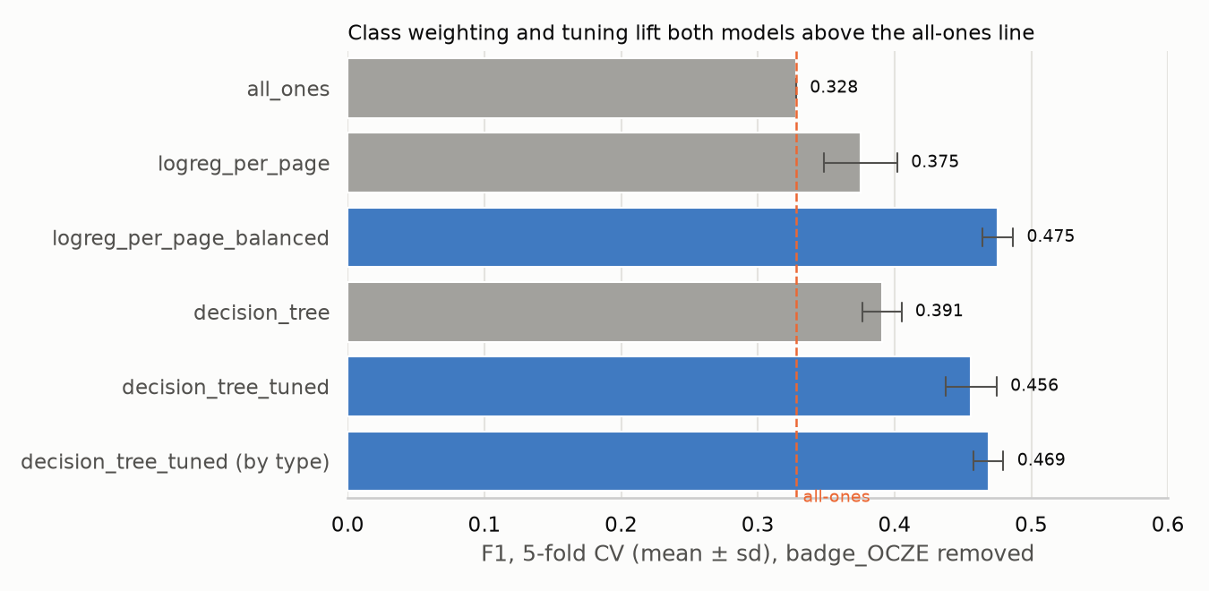
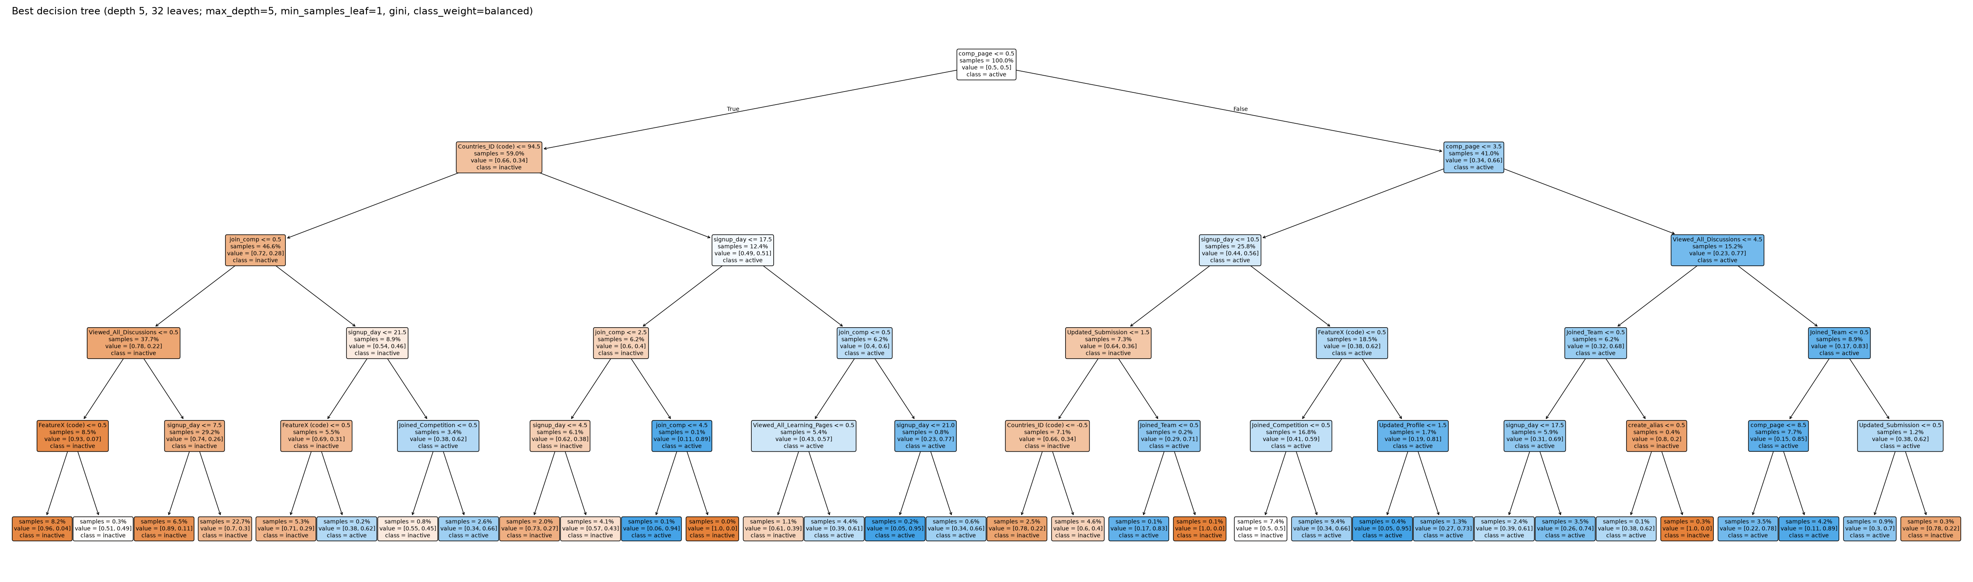
7 · Results summary
Improvement | Comparison | F1
H1 drop badge_OCZE | before → after | not comparable (labels changed)
H2 class weights | LogReg → weighted | 0.375 → 0.475
H3 tuning | default → tuned tree | 0.391 → 0.456
H4 per-category X | per page → per type | 0.456 → 0.469
Top two: weighted logistic regression 0.475 and tuned per-category tree 0.469, both well above all-ones (0.328).
5-fold CV F1 on cleaned data (mean ± sd). Blue = models with improvements; dashed = all-ones.

Slide 14
7 · Overall conclusions
The main problem was the labels
One system-written badge polluted a whole month and made internal evaluation far too optimistic. We found it from the gap between all-ones scores in CV and on the leaderboard.
1
On clean labels, two changes matter most
Class weighting (≈ +0.10 F1) and controlling model complexity (≈ +0.065 F1).
2
Per-category features are well motivated
Figure on page support supports them, but under random-split CV the gain is only 0.013.
3

Slide 15
8 · Limitations and notes
Random splits mix months. Same-month users appear in train and validation, hiding new-page and distribution-shift issues. A time-based split (past months → next month) is closer to real use.
Threshold fixed at 0.5. Kept for comparability, but F1 is sensitive to it: tuning it is a separate direction.
Leaderboard results incomplete. Only the pre-fix all-ones (0.25) and logistic regression (below all-ones) are confirmed; submission files for the fixed models are generated in outputs/.
Unconfirmed inference. That badge_OCZE is a batch system badge is deduced from the data; neither it nor the definition of “active” is documented.
Test positive rate is an estimate. ~14% is inverted from the all-ones leaderboard score; partial scoring would make it inexact.
python3 scripts/run_cv.py # CV -> outputs/cv_scores.csv
python3 scripts/make_submissions.py # submission_*.csv
Thank you. Questions?

