Slide 1

Search.io
Mini-project

Slide 2
Abstract
The website Search.io' s main goal is to provide students with more options after they graduate from high school. They receive enrollment calls from colleges all over the world without being informed. However, with the help of this website, we can obtain information on colleges, such as their rankings, locations, photos allowing users to choose the colleges of their dreams.
On the website, we will be able to search for colleges by name using a search query. We can also see where they are by using a Google Maps embed view. Students can also see how many courses are available at the college and how many steps remain so that they can plan their next steps.

Slide 3
Abstract
Administrators can create accounts on the website and change necessary or unnecessary data. This allows users to search for legitimate colleges. Users can also create an account and save the selected colleges in a bookmark section if they want to learn more about the college. The website will also include official links to the college website, saving time searching. More information, such as the number of courses in a college, the number of seats in the college, the number of exams, their location, and images of the college, will be available on the website.

Slide 4
MODULE Description
Administrator
The administrator will have the ability to update or add information about the colleges on the website.
Can add suggestions to the website for the users.
Also update locations and other new feature to the website.
Add option for the user to select their qualifications.

Slide 5
MODULE Description
User
Users can select and also research about all the universities/colleges within the state.
Users can also search for work dependent course.
Can choose colleges also by searching by the course name.
Can also find location about the college within the website.
Search for how many entrances and their cutoff.
Can save college details in a bookmark section for later reference.

Slide 6
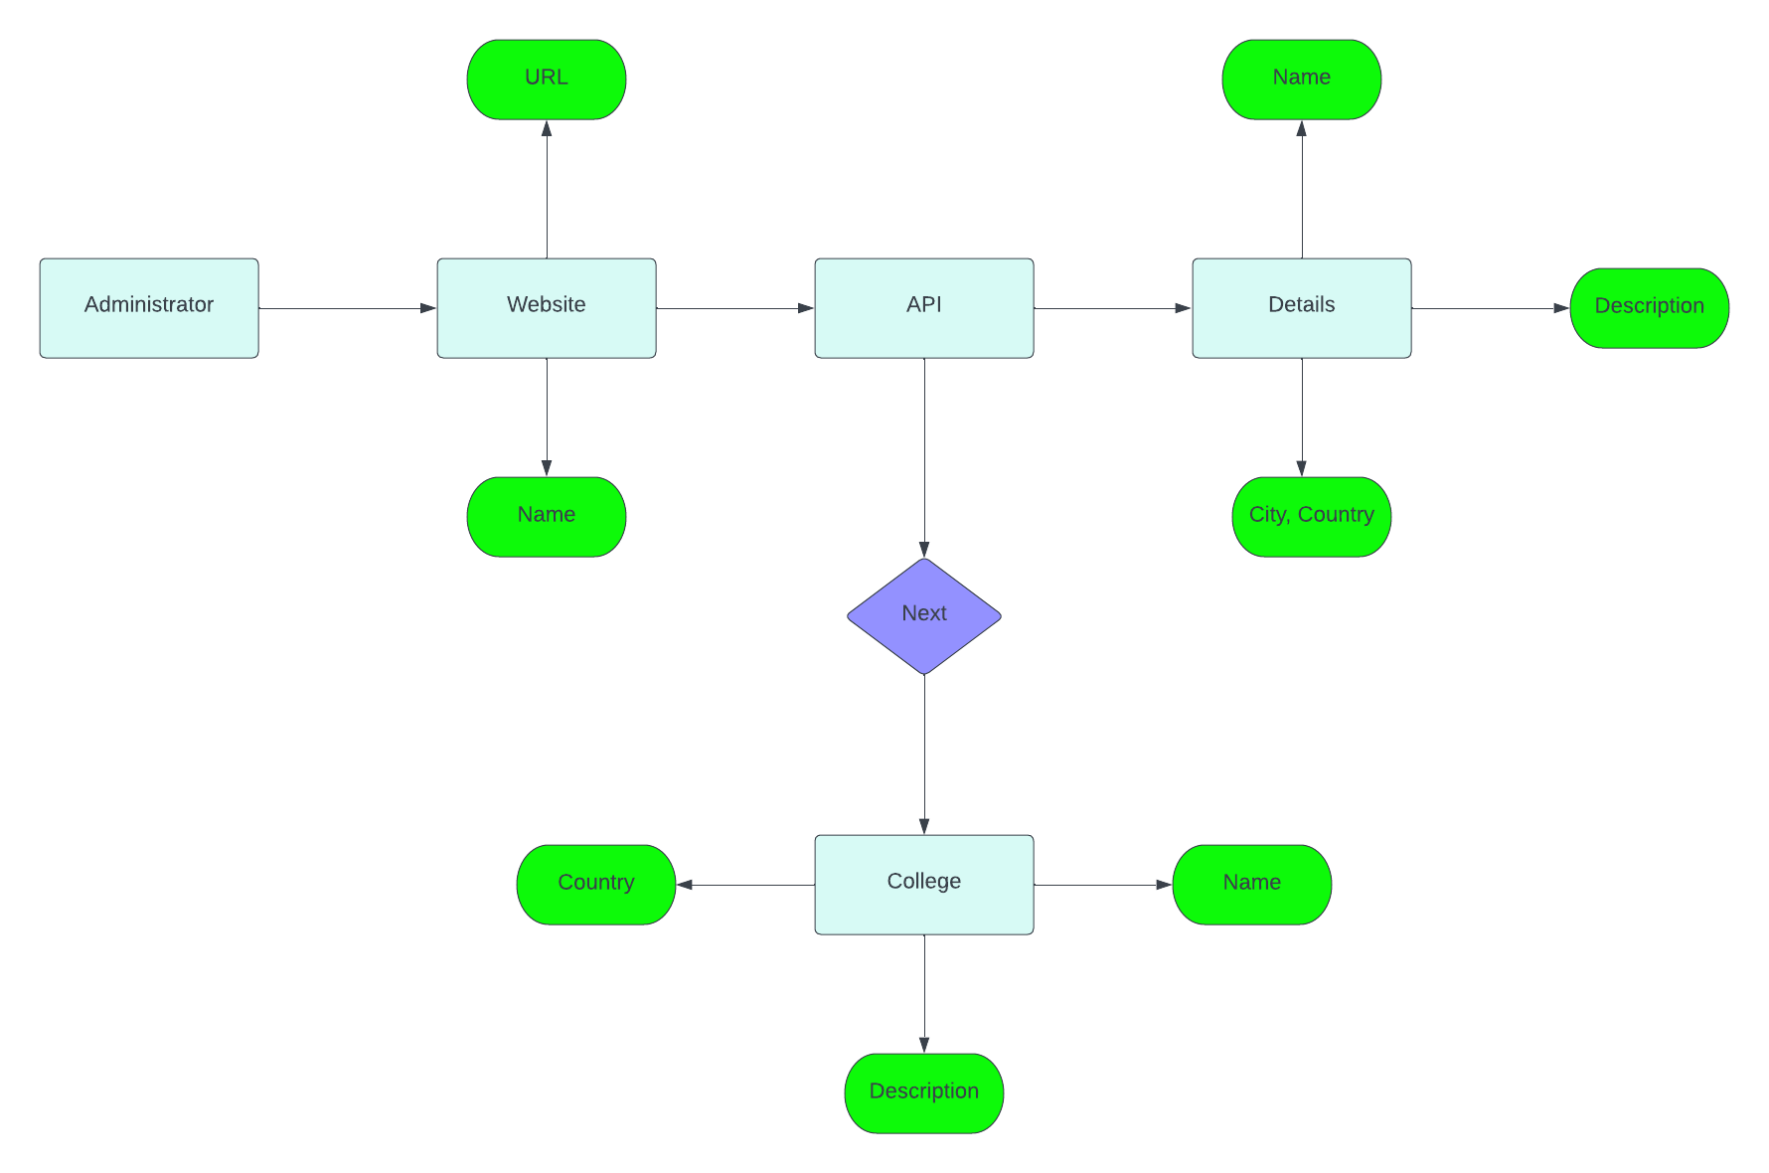
ER-model for search.io

