Slide 1

Search.io
Mini-project

Slide 2
Abstract
The major goal of the website Search.io is to give students more options once they graduate from high school. They receive calls from colleges all across the world for enrolling without informing them. But with the aid of this website, we can obtain information on colleges, including their rankings, locations, photos, and user reviews, enabling users to select the colleges of their dreams.
We will be able to search the colleges by name on the website using a search query. We can also see where they are, which will be a Google Maps embed view. . Also, students may see how many courses are offered at the college and how many steps remain so that they can plan their next move. You can bookmark necessary colleges to learn more about them later by creating an account.

Slide 3
MODULE Description
Administrator
The administrator has the ability to update or add information about the colleges on the website.
Can add suggestions to the website for the users.
Also update locations and other new feature to the website.
Added option for the user to select their qualifications.

Slide 4
MODULE Description
User
Users can select and also research about all the universities/colleges within the state.
Users can also search for work dependent course.
Can choose colleges also by searching by the course name.
Can also find location about the college within the website.
Search for how many entrances and their cutoff.
Can save college details in a bookmark section for later reference.

Slide 5
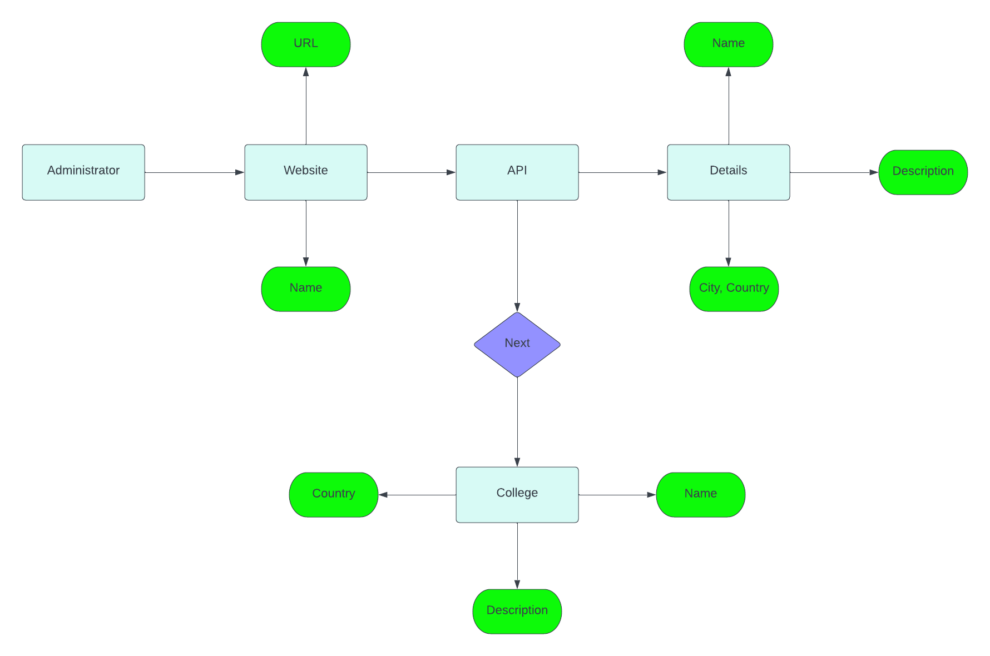
ER-model for search.io

