Slide 1
Private Meeting Jun-You Liu 2017/02/15
User dependent power management policy & QoS standard
Redifining QoS
Prediction model
User satisfaction optimization

Slide 2
Redefining QoS
Assumption: Split user time into UPT & UIT
Responsiveness:
Adjust CPU/GPU frequency according to UPT/UIT
Display quality:
Modify the display color or screen brightness without affecting user satisfaction to save power (usually on UIT)
q = [d_{p}/D_{b}, 1/l]^{T} -> lower the better
d_{p}: system response delay during UPT; D_{b}; on baseline; l: display proximity (how much the new color is close to the original color)

Slide 3
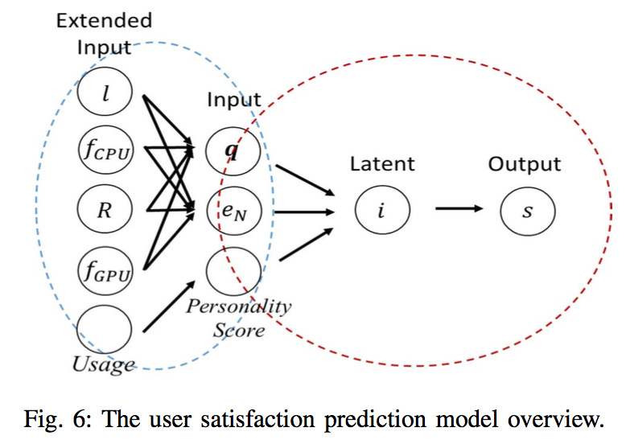
Prediction model
User personality is highly related to user preference
In psychology, there is a standard called “OCEAN” to model different personality.
Latent i bridging
Find parameter for different applications and different sessions (interactive & streaming session)
Notes:
Set up two equations. One for the β₁, β₂ between latent and output, the other for the ƛ between q as well as e_{N} and latent.
Use the training data to construct user preference matrix and user personality matrix. Find σ by minimizing the error between predicted value and real value.
Then we can use the σ to transform a personality vector into its corresponding preference 2-d vector for response as well as display proximity.

Slide 4
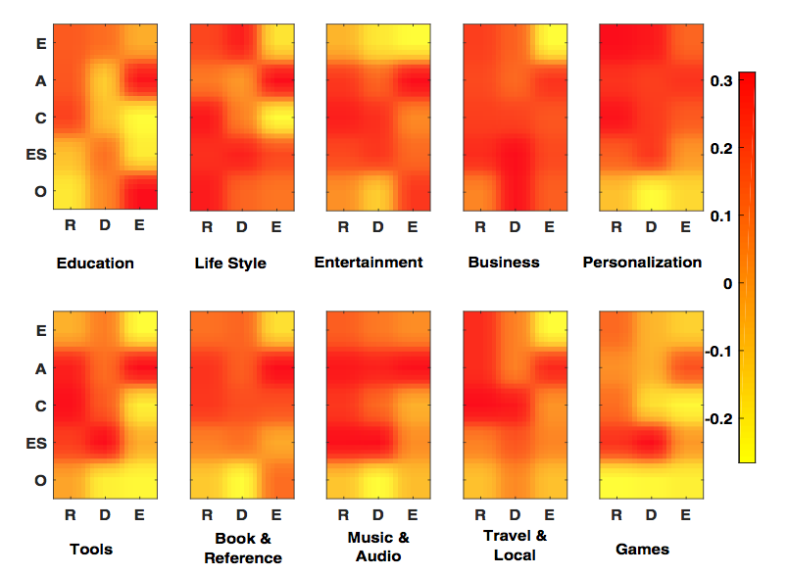
User satisfaction optimization
Online user satisfaction optimization
Because the β₁, β₂ between latent and output score as well as the σ in user personality transformation, we can use online model optimize the f_{cpu}, f_{gpu}, proximity l…etc. offline and adjust dynamically.
(β₁, β_{2,} σ) pair is for one category.
There are ten categories in Google Play Store.

