Slide 1
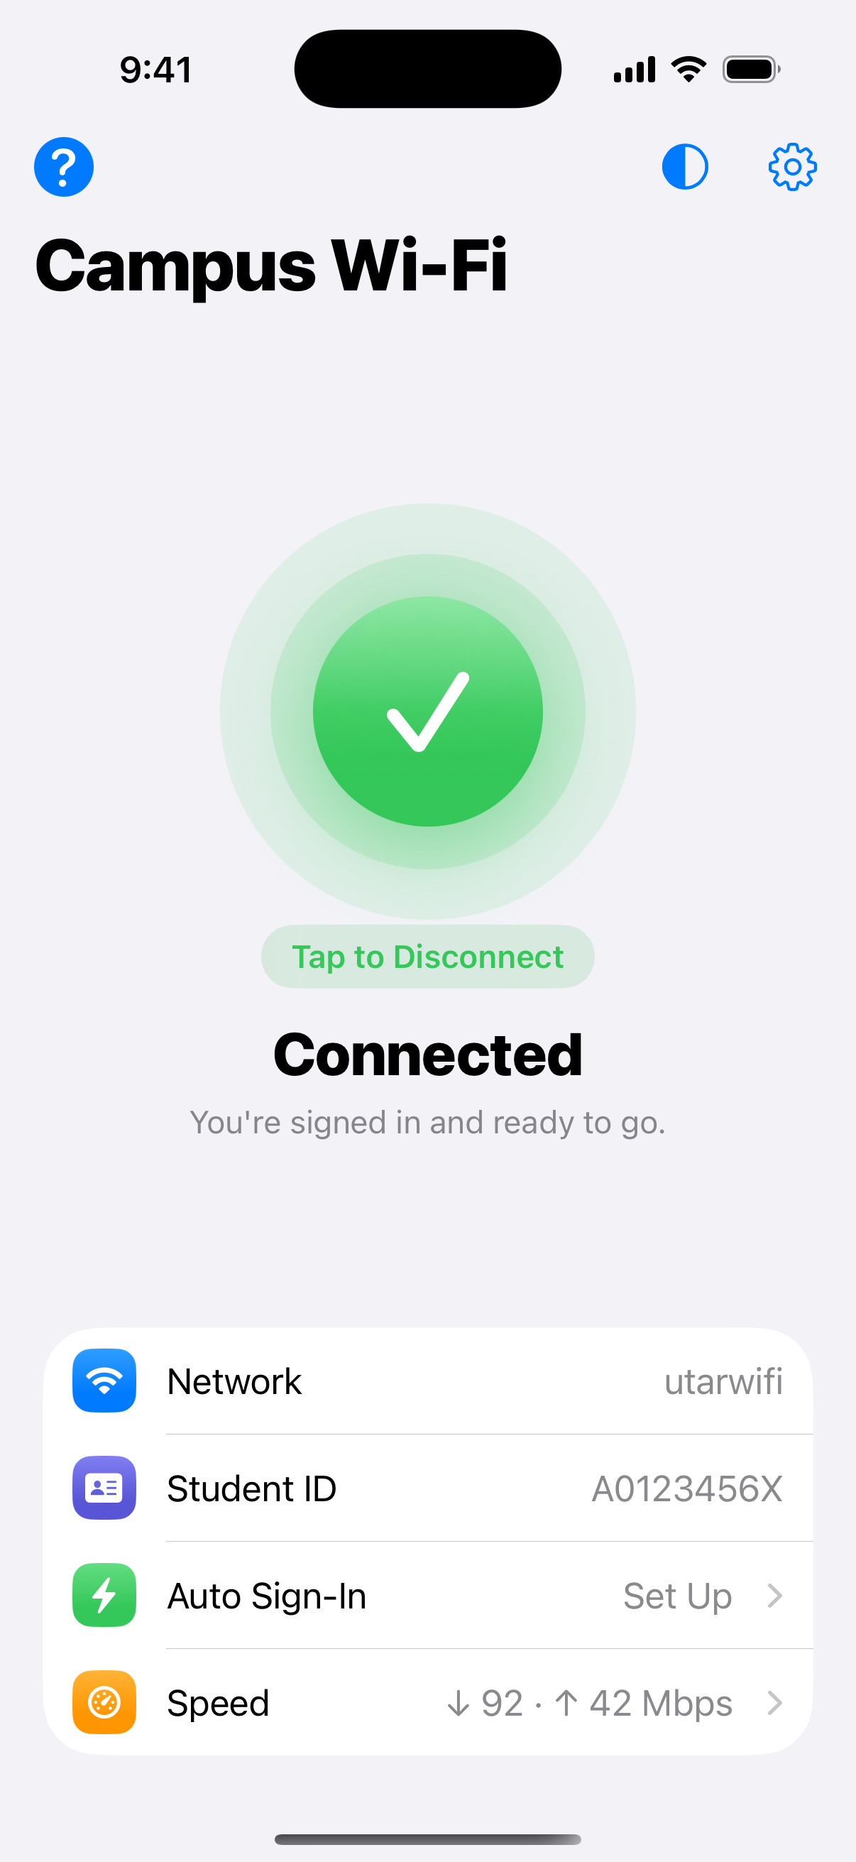
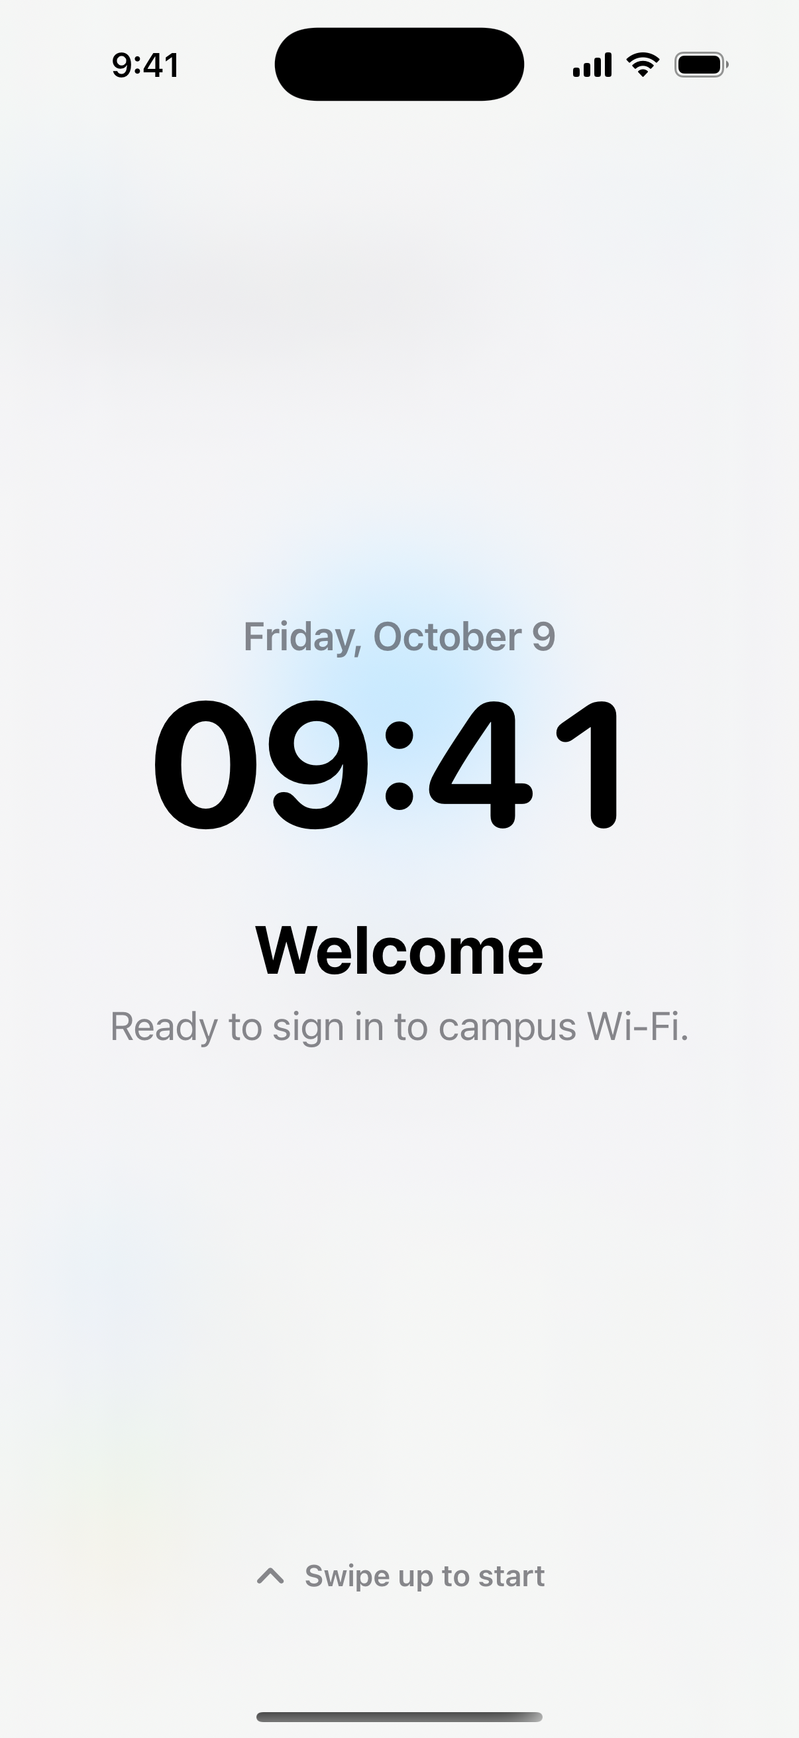
WiFi Connect
UTAR CAMPUS WI-FI
One tap to sign in to utarwifi on iPhone, Android and Windows. No more typing your student ID at every login page.
Notes:
WiFi Connect signs students in to the campus Wi-Fi login page automatically, on iPhone, Android and Windows laptops.

Slide 2



Signing in to campus Wi-Fi is a daily chore
A login page every time
A different address in every block
Typing on a small screen
Join utarwifi and nothing loads until you find the login page and sign in again.
Each building's login page sits at its own address, so bookmarks and saved forms break.
Student ID and password, over and over, on your phone and your laptop.
WiFi Connect does all of it for you: open the app, tap the circle, and you're online.

Slide 3




One tap, four steps behind the scenes
1
2
3
4
Join utarwifi
Find the login page
Fill it in
Check you're online
Connect to the campus Wi-Fi as usual.
The app follows the redirect to this building's own login page.
Student ID, password and any hidden fields the page needs.
It confirms the internet works, then turns the circle green.
Works with login pages that redirect, use hidden security tokens, "I agree" boxes, drop-down menus or a separate login server.

Slide 4
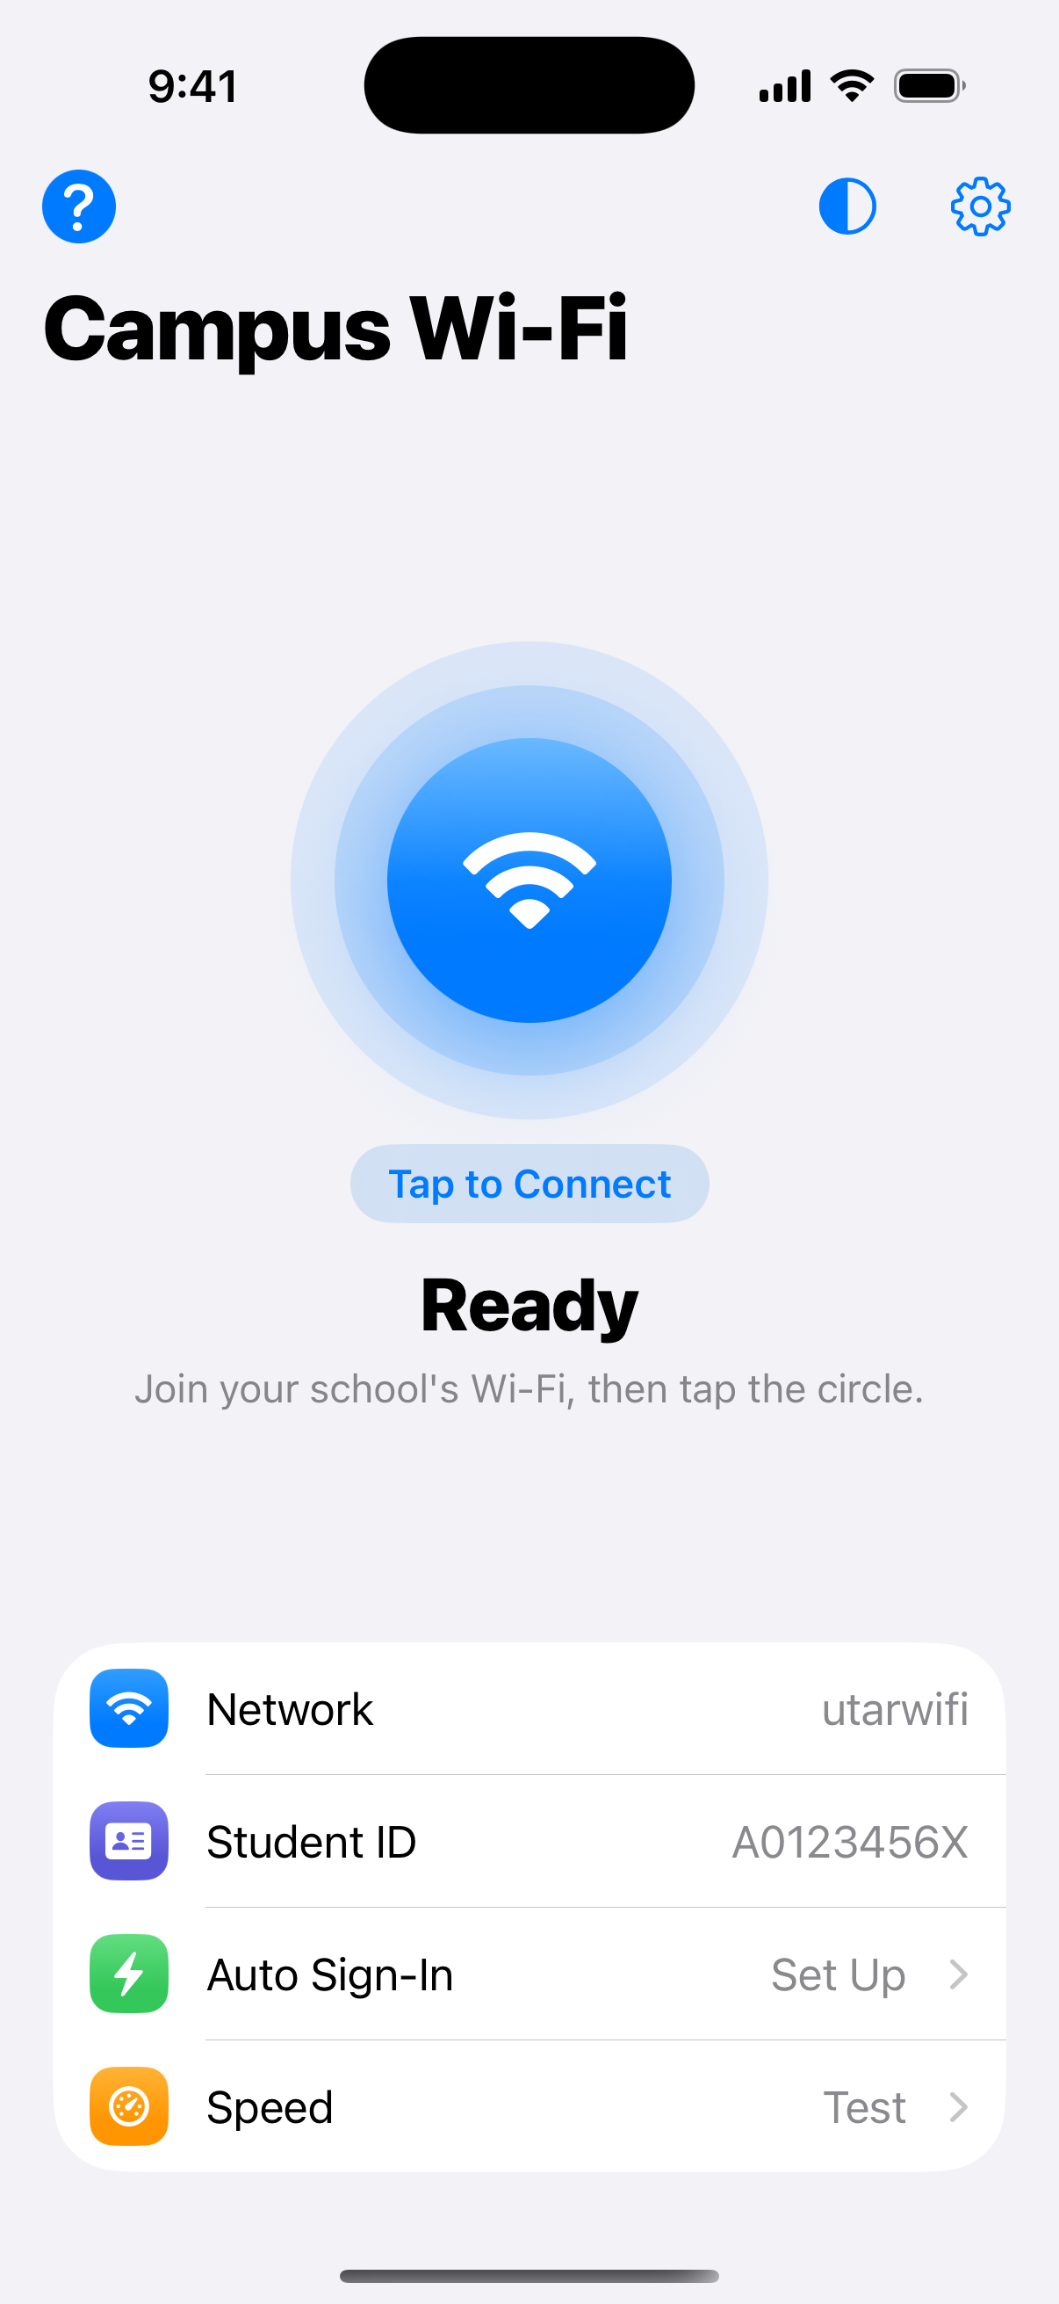
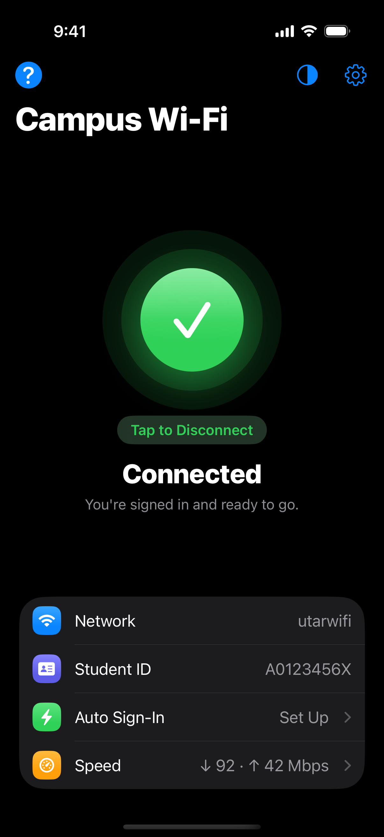
One circle: blue to connect, green when online
Swipe up to start
Tap to Connect
Connected
Dark Mode

Slide 5





Built for everyday campus life
Automatic sign-in
Every building
Speed test
Android signs in by itself when you join utarwifi; iPhone uses a one-time Shortcuts automation.
Finds each block's login page, wherever it is.
Live gauge with ping, jitter, download and upload.
Widgets and quick buttons
Five languages
Share with classmates
Home Screen widget, Control Center button, Quick Settings tile.
English, Bahasa Melayu, Chinese, Japanese and Tamil.
A QR code with the setup, never the password.

Slide 6
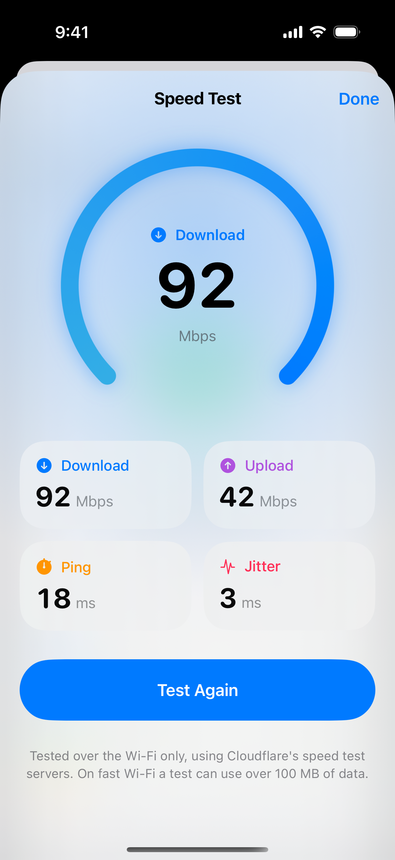
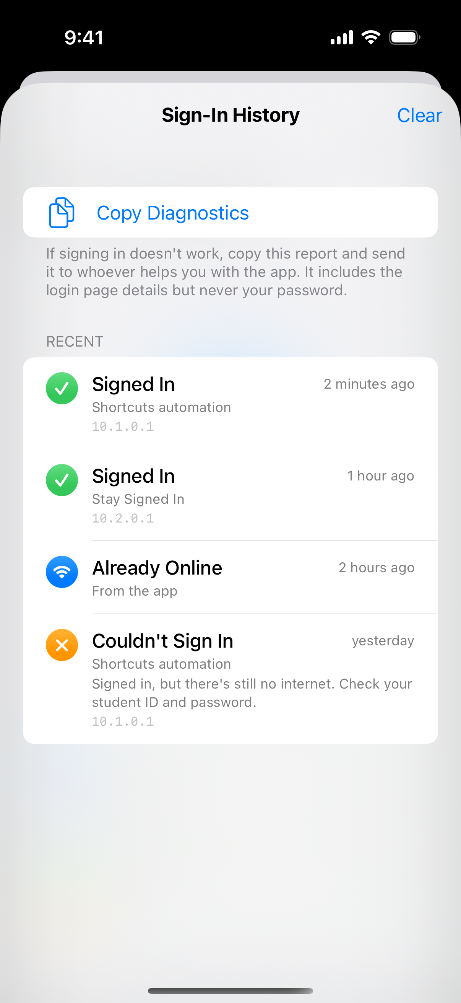


Check the connection, and see every sign-in
Speed test
Test the campus Wi-Fi from the main page: ping, jitter, download and upload.
Sign-in history
Every sign-in and sign-out, with Copy Diagnostics if something goes wrong.
Connected notification
"Connected to utarwifi" when the app signs you in on arrival.

Slide 7
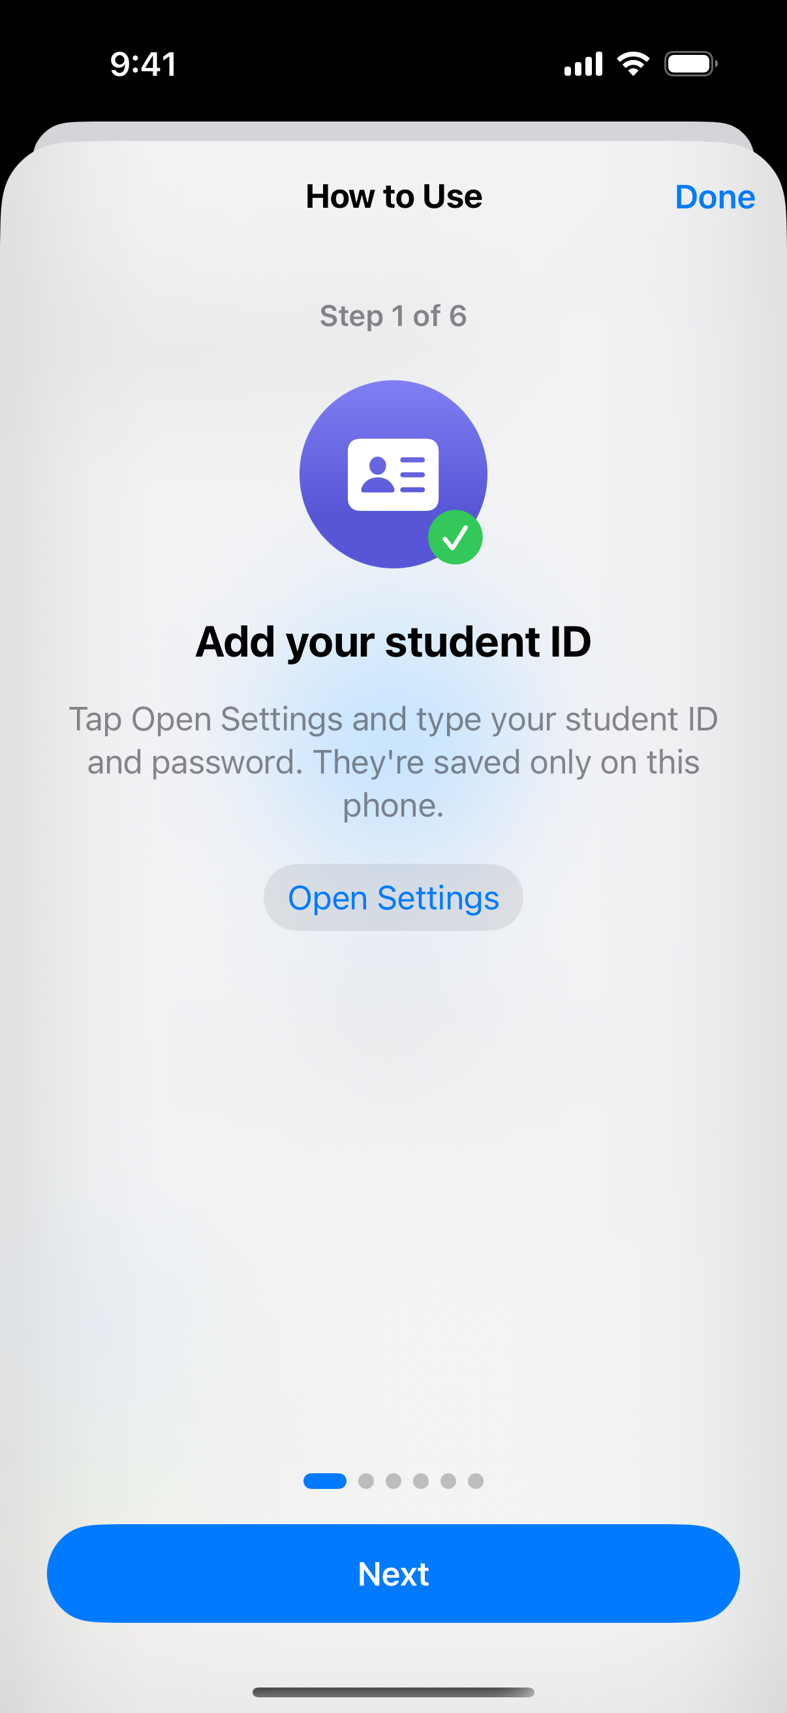
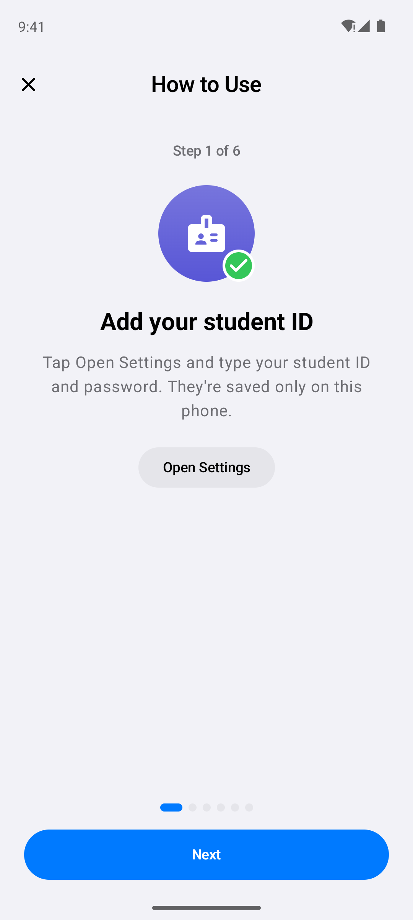




Help is one tap away
The ? button
Top left of the main page, on iPhone and Android.
One step at a time
Six steps with Next and Back: add your ID, join the Wi-Fi, tap, and what to do if it goes wrong.
Takes you there
Buttons open Settings, Wi-Fi settings or the auto sign-in guide, and finished steps get a tick.
Welcome page, your choice
Turn the clock page off in Settings to open straight to the Wi-Fi circle.

Slide 8
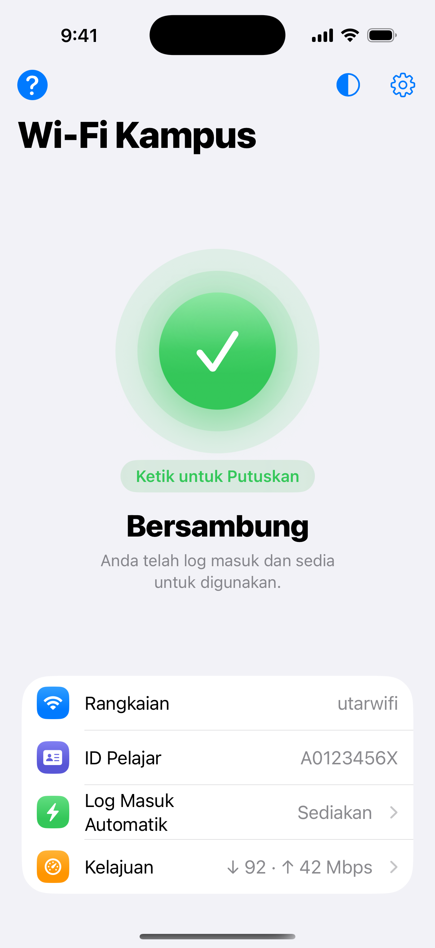
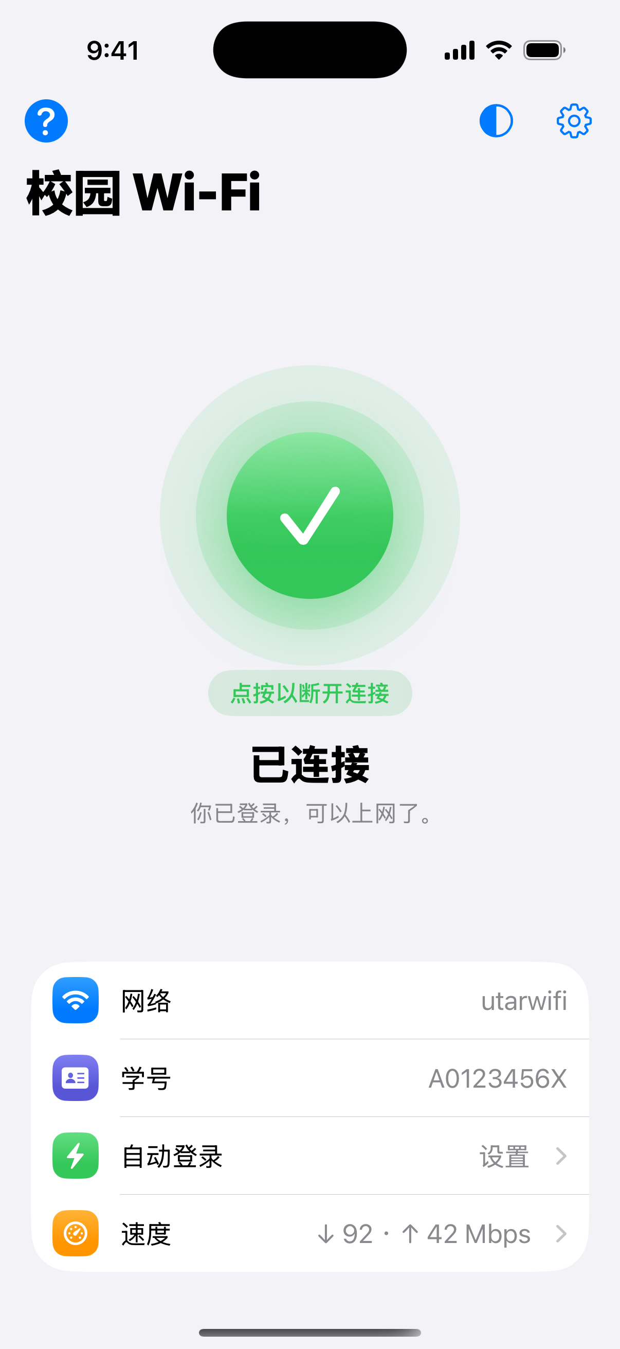
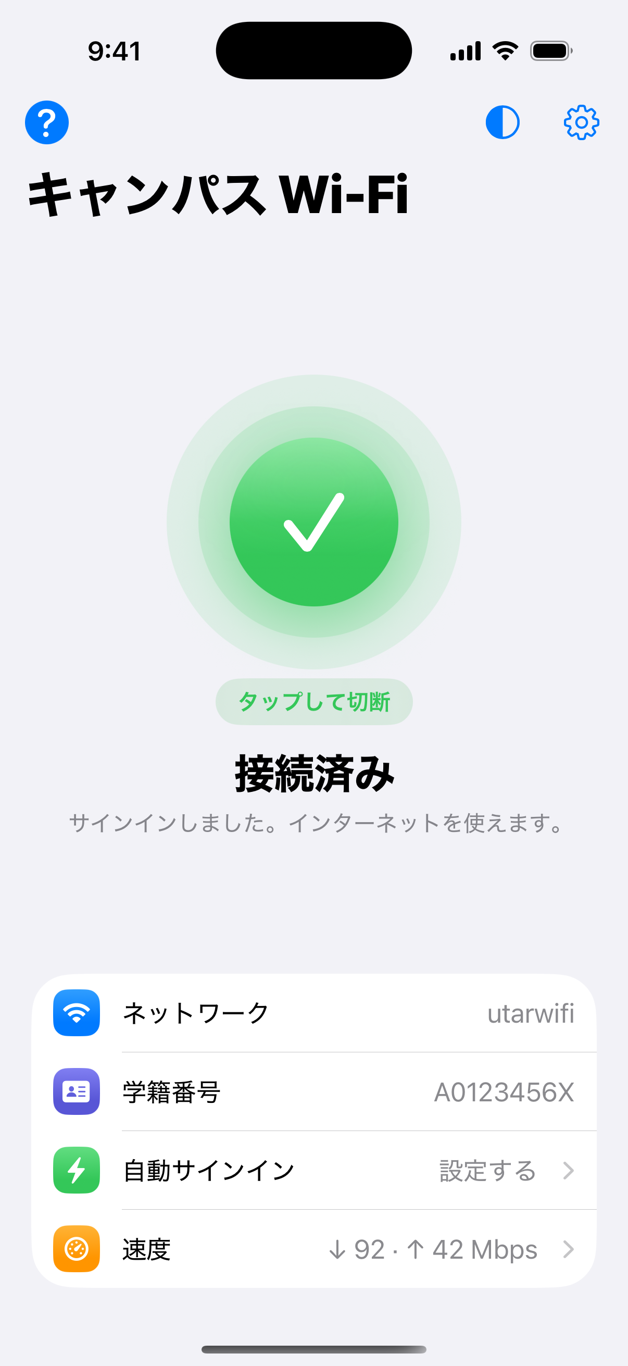
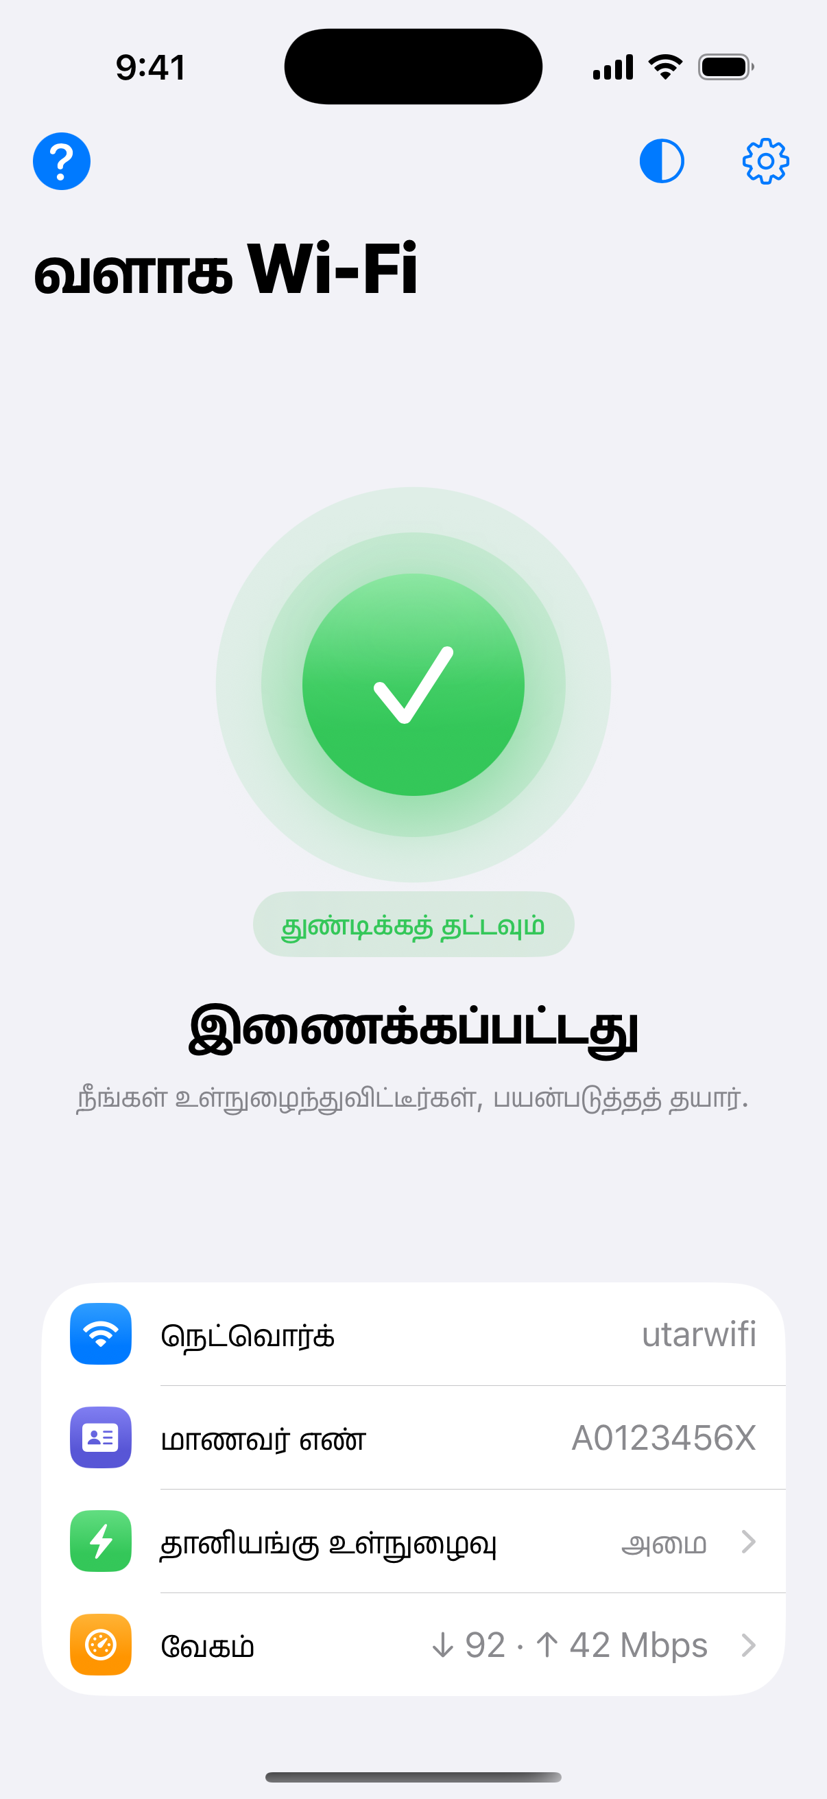
Speaks five languages
English
Bahasa Melayu
简体中文
日本語
தமிழ்
Change it in Settings › Language, or let it follow the phone.

Slide 9



iPhone, Android and your Windows laptop
iPhone
Android
Windows laptop
iOS 17 or later
No Mac needed: Sideloadly or AltStore on Windows
Widget, Control Center button, Face ID lock
Android 9 or later
Install the APK
Signs in by itself, Quick Settings tile, widget
Double-click Install.cmd
Signs in when you join Wi-Fi and every 15 minutes
Uninstall.cmd removes everything

Slide 10




Your password stays yours
Stored encrypted
iPhone Keychain, Android Keystore, and Windows encryption tied to your account.
Only sent to the school's login page
Automatic sign-ins only go to a private campus address or the page you used before.
No accounts. No servers. Nothing leaves your device except the sign-in itself.
App lock
Face ID, Touch ID or your phone's lock before Settings opens.
Sharing leaves the password out
Classmates get the setup, never your ID or password.

Slide 11
Tested the way students use it
5
3
login page styles, each at its own address, like different campus blocks
platforms tested on every change: iPhone, Android and Windows
12/12
12/12
9/9
steps passed on iPhone: install, type the ID, use the ? guide, tap, online, sign out
steps passed on Android, the same journey by tapping the screen
steps passed on Windows: install, sign in, run by itself, uninstall

Slide 12
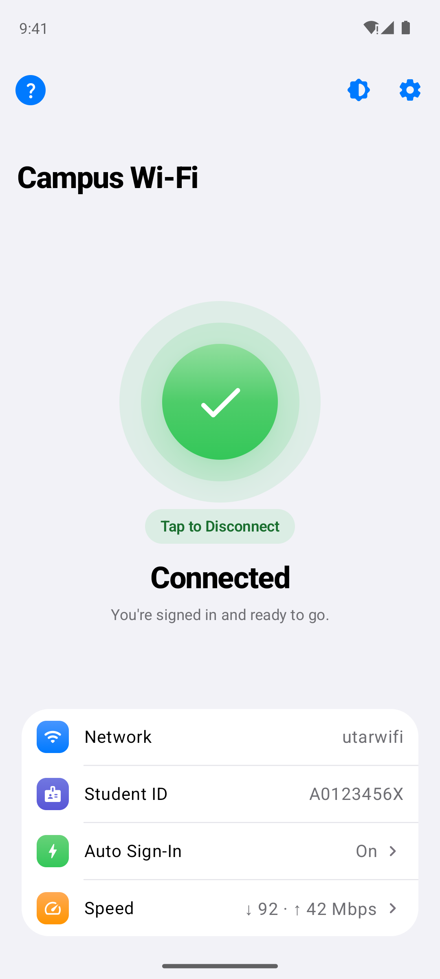
Ready in one tap
GET STARTED
1. Download it from the Latest build release on GitHub
2. Enter your student ID and password
3. Join utarwifi and tap the circle
github.com/Jy2005ov0/WifiConnect

