Slide 1
Neural Network Architecture for Efficient Deep Hedging
No-Transaction Band Network

Slide 2

Hedging Optimization
𝑍 : Terminal value of the derivative 𝛿 : A unit of stocks hold at each time step
𝑆 : Stock price 𝑐 : Transaction cost rate

Slide 3
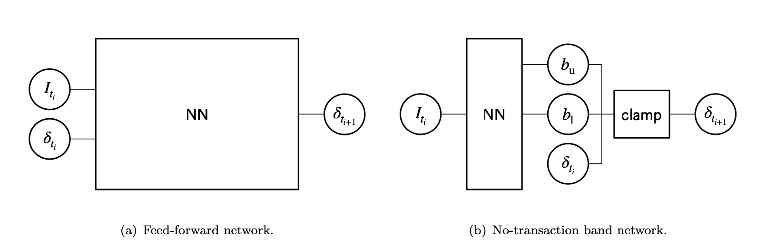
Architecture
If 𝛿_{t} smaller than b_{low}, 𝛿_{t+1} = b_{low}
If 𝛿_{t} greater than b_{up}, 𝛿_{t+1} = b_{up}
Else 𝛿_{t+1} = 𝛿_{t} (No-transaction
Between b_{low} and b_{up} is no-transaction-band

Slide 4
Advantages
Neural network’s inputs do not depend on the current position: This feature overcomes the difficulty of position-dependence to facilitate training.
Neural network encodes an efficient strategy: Strategy using a band is cost-effective because it never transacts inside the band. A Neural network encodes this wisdom as an “induction bias.

Slide 5
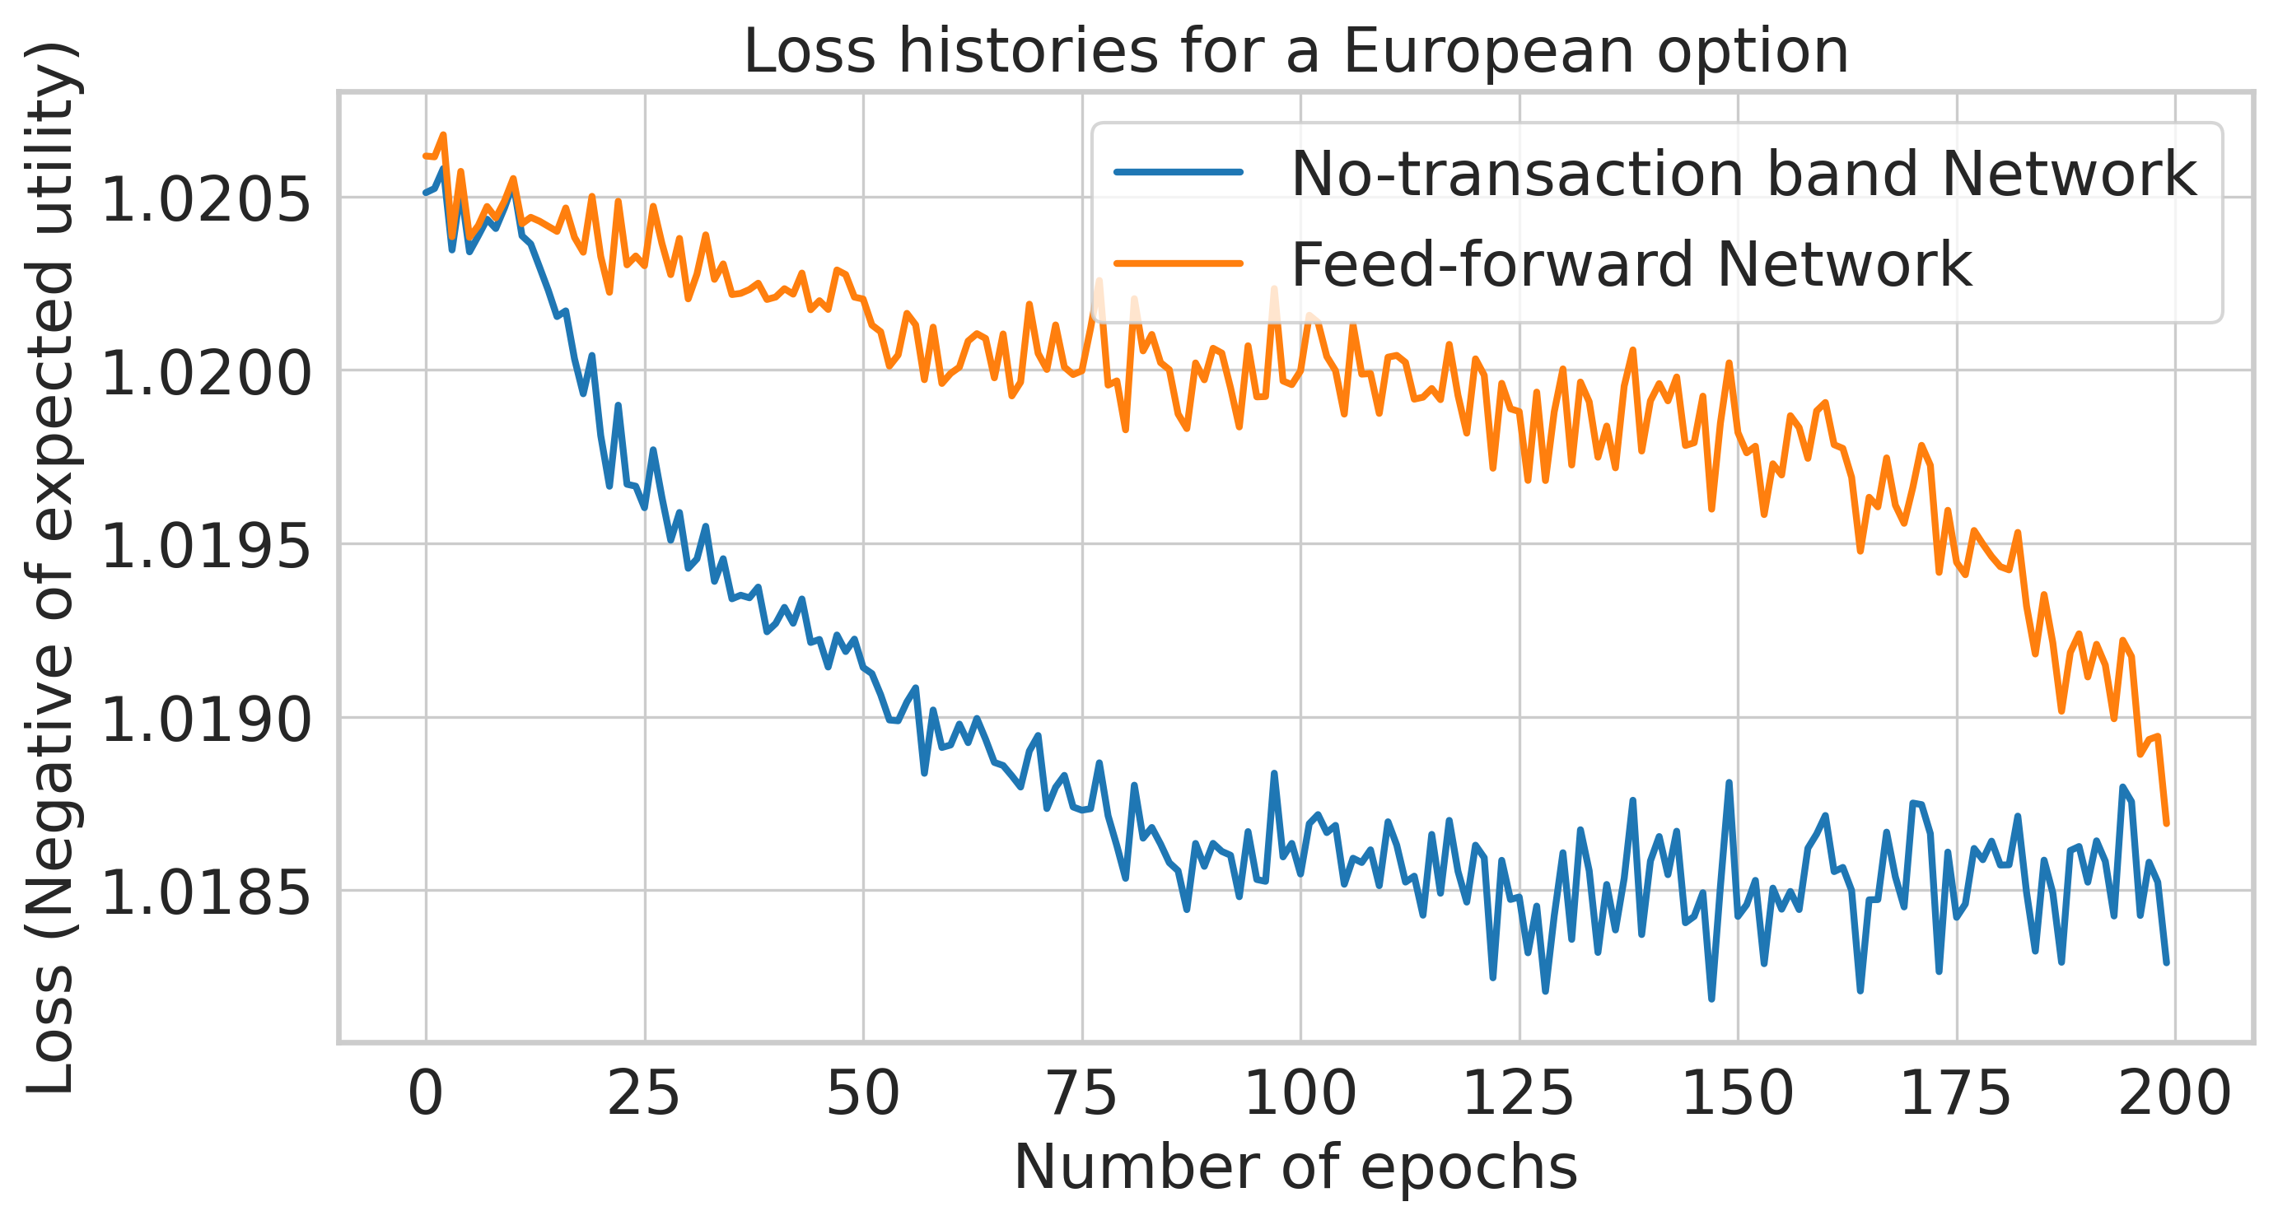

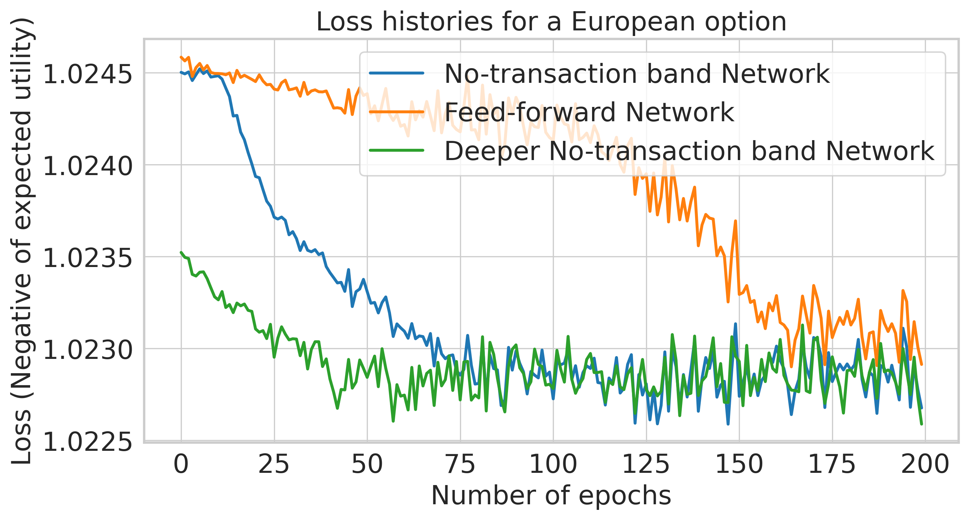
Numerical Experiment

