Slide 1

SMART INDIA HACKATHON 2026
TITLE PAGE
Problem Statement ID – SIH26104
Problem Statement Title-AI-Powered Real-Time Detection and Prevention of Voice Cloning Impersonation Attacks
Theme- Cybersecurity and Blockchain
PS Category- Software/Hardware
Team ID- SIH-S-B3-255
Team Name (Registered on portal)-YoruH

Slide 2


IDEA TITLE
Your Team Name
SMART INDIA HACKATHON 2026

Slide 3

TECHNICAL APPROACH
Your Team Name
Technologies to be used (e.g. programming languages, frameworks, hardware)
Methodology and process for implementation (Flow Charts/Images/ working prototype)

Slide 4
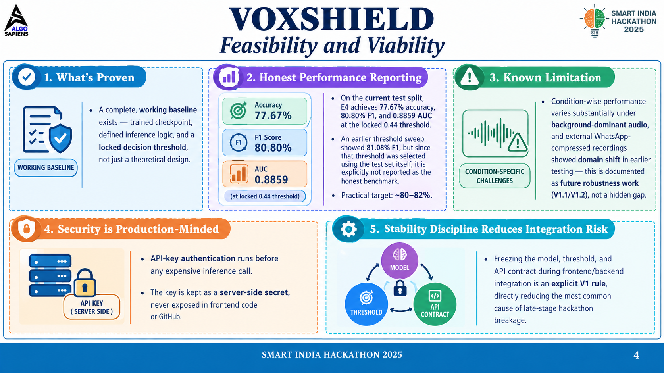
FEASIBILITY AND VIABILITY
Your Team Name
Analysis of the feasibility of the idea
Potential challenges and risks
Strategies for overcoming these challenges

Slide 5


IMPACT AND BENEFITS
YoruH
Potential impact on the target audience
Benefits of the solution (social, economic, environmental, etc.)

Slide 6

RESEARCH AND REFERENCES
Research Papers :
Datasets / Resources :
Wavefake (2021) Frank and Schonherr- https://arxiv.org/abs/2111.02813
Rawnet2 (2020)- https://arxiv.org/abs/2011.01108
ASVspoof 2021 Yamagishi et al.- https://arxiv.org/abs/2109.00537
Wavefake Dataset
ASVspoof 2021
Our own Datasets

