Slide 1

WIPRO NGA Program – EP_Java FullStack (24NAG0970)
Capstone Project Presentation – 11 May 2024
Project Title - Ecommerce
Trainer - Javeed Mohammed Sir
Presented by - Manjula Nannuri
Pavan Kumar
Harshavardhan Gade
Pamisetty Hemanthkumar
SIR
www.rpsconsulting.in

Slide 2
Technologies Used
Spring Boot
MySQL Database
JWT Authentication and Authorization
TypeScript
Angular
Local Storage
Router Guards

Slide 3
About
Ecommerce is an all-inclusive online retail platform that caters to electronics, furniture, and clothing needs. Dedicated to providing top-notch products and outstanding customer service, Ecommerce aims to offer a wide variety of items to fulfill the diverse demands of its clientele. Whether customers are looking for the latest electronic devices, fashionable furniture, or trendy apparel, Ecommerce is designed to meet every taste. The company's mission is to make online shopping easy, enjoyable, and dependable for everyone. With an emphasis on a user-friendly interface, secure payment methods, and swift delivery services, Ecommerce is committed to surpassing customer expectations with every purchase.

Slide 4
MODULES
Ecommerce operates with three distinct modules and can be accessed and utilized by administrators, sellers, and customers. These modules ensure smooth interaction and transactions among all users on the platform.
Admin Module: The Admin module serves as the backbone of the ecommerce platform, granting administrators extensive control over all operations. Administrators can manage product listings, oversee transactions, and monitor user activities. They ensure the platform's integrity by handling the overall functionality of Quitqueue.
Seller Module: The Seller module allows merchants and vendors to display their products to a broader audience. Sellers can create and manage product listings, update inventory, and track sales performance. This module facilitates seamless interaction between sellers and customers, supporting businesses in thriving within the online marketplace.
Customer Module: The Customer module is designed to enhance the shopping experience for users on Quitqueue. Customers can browse a wide variety of products and make secure purchases. They have access to personalized account features, such as order tracking and customer support. This module fosters a dynamic and interactive online shopping environment by enabling customers to engage with sellers.

Slide 5
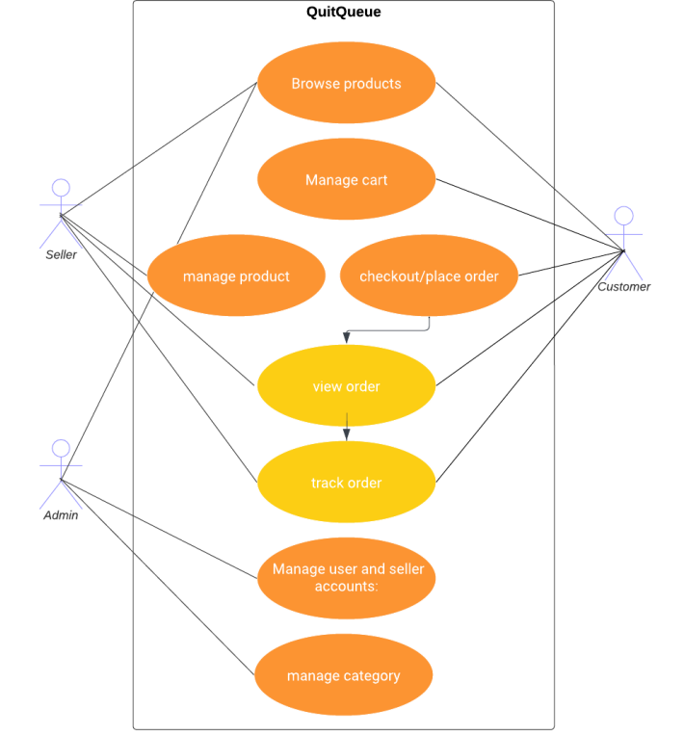

Slide 6
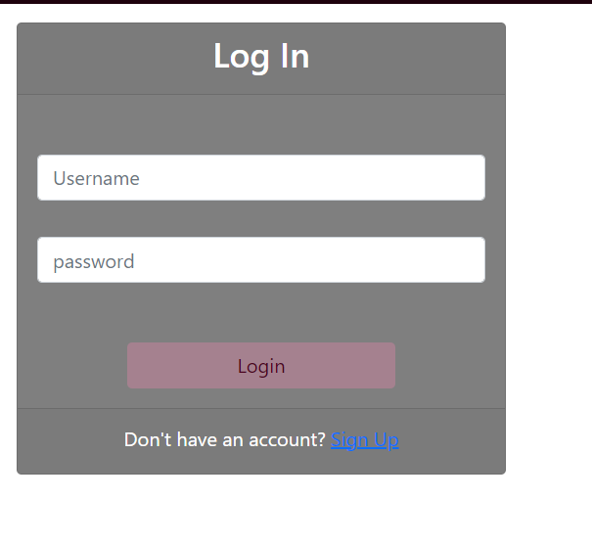

Slide 7
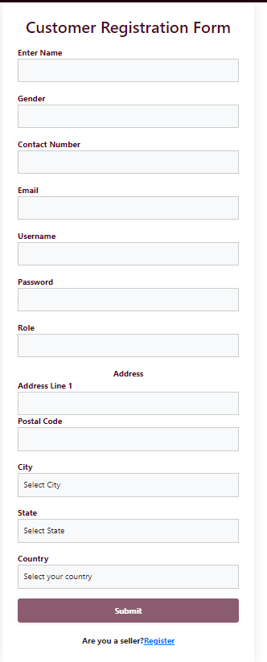

Slide 8
References
YouTube
W3 Schools
Online documentations

Slide 9
Thank You

