Slide 1
Training Set
Learning Algorithm
Number of
Reservations (x)
Hypothesis (h)
Estimated number
of pizzas sold (y)

Slide 2
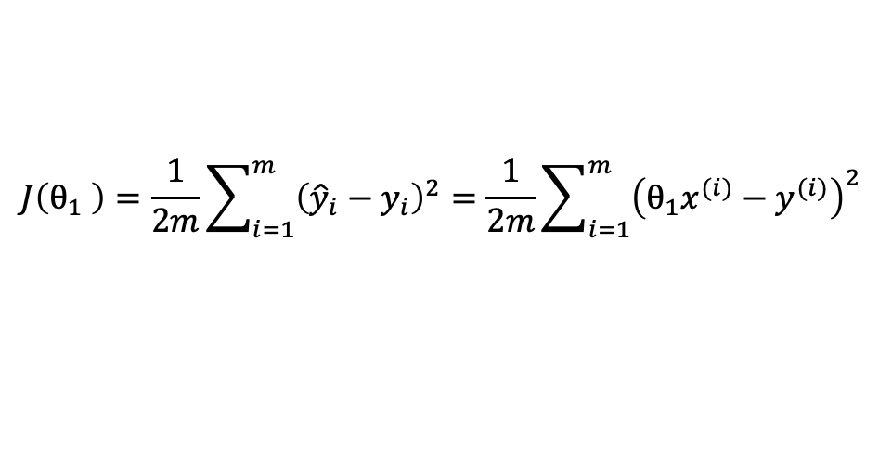
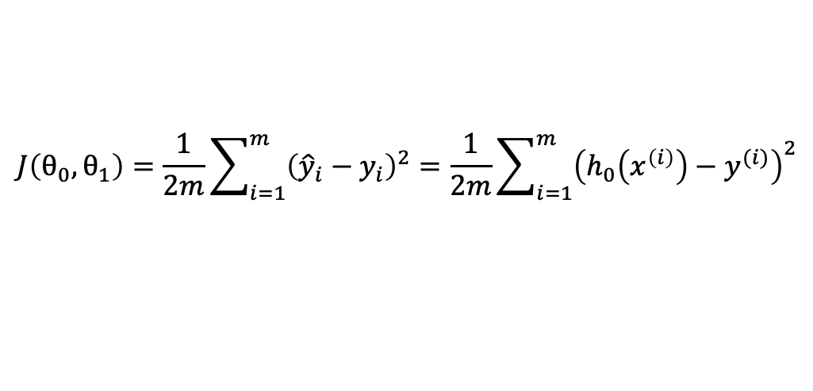
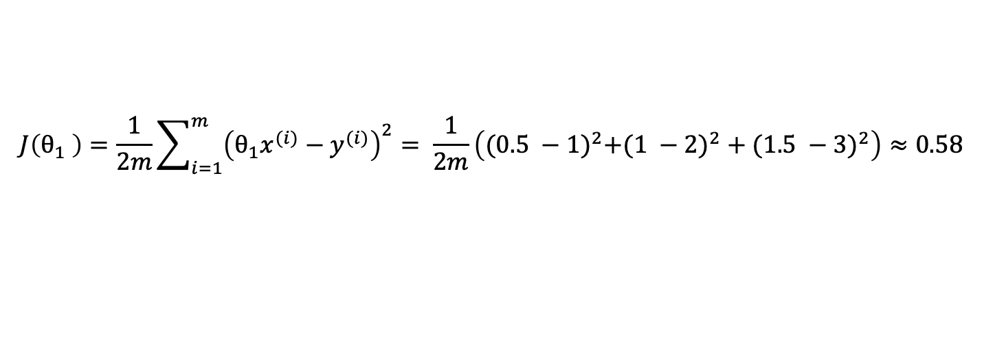
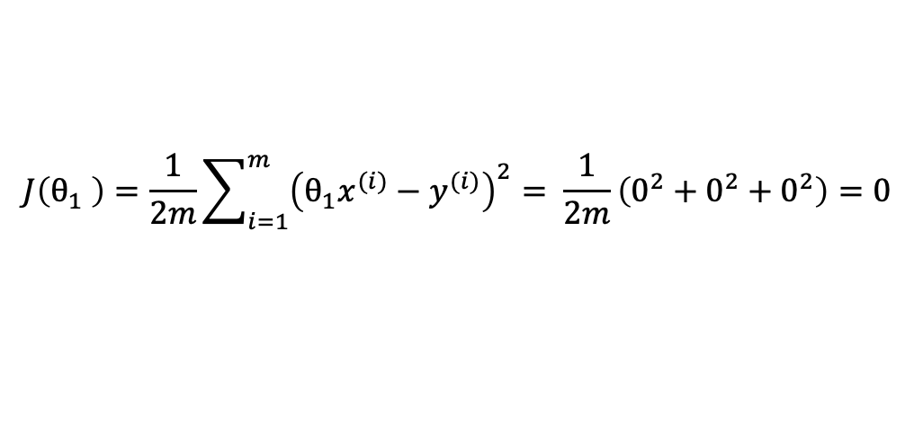
$$J\left(θ_{0},θ_{1}\right)=\frac{1}{2m}\sum_{i=1}^{m}{{\left({\hat{y}}_{i}−y_{i}\right)}^{2}}=\frac{1}{2m}\sum_{i=1}^{m}{{\left(h_{0}\left(x^{\left(i\right)}\right)−y^{(i)}\right)}^{2}}$$
$$J\left(θ_{1} \right)=\frac{1}{2m}\sum_{i=1}^{m}{{\left({\hat{y}}_{i}−y_{i}\right)}^{2}}=\frac{1}{2m}\sum_{i=1}^{m}{{\left(θ_{1}x^{(i)}−y^{(i)}\right)}^{2}}$$
$$J\left(θ_{1} \right)=\frac{1}{2m}\sum_{i=1}^{m}{{\left(θ_{1}x^{(i)}−y^{(i)}\right)}^{2}}= \frac{1}{2m}\left(0^{2}+0^{2}+0^{2}\right)=0$$
$$J\left(θ_{1} \right)=\frac{1}{2m}\sum_{i=1}^{m}{{\left(θ_{1}x^{(i)}−y^{(i)}\right)}^{2}}= \frac{1}{2m}\left({(0.5 −1)}^{2}+({1 −2)}^{2}+{(1.5 −3)}^{2}\right)≈0.58$$

Slide 3
1.
2.
3.
n.
4.

Slide 4
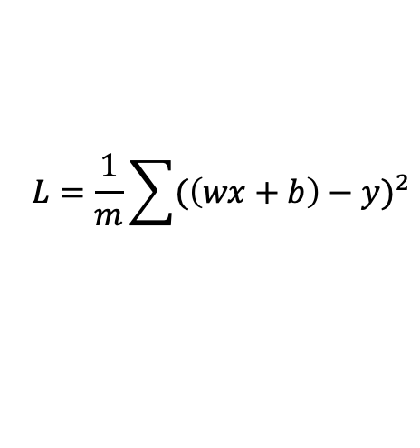
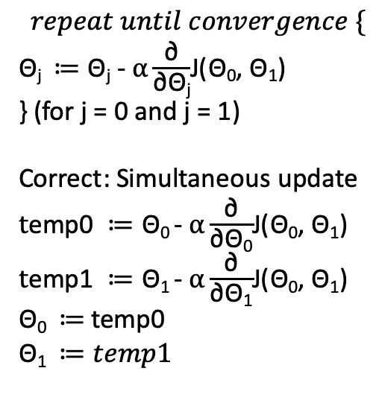
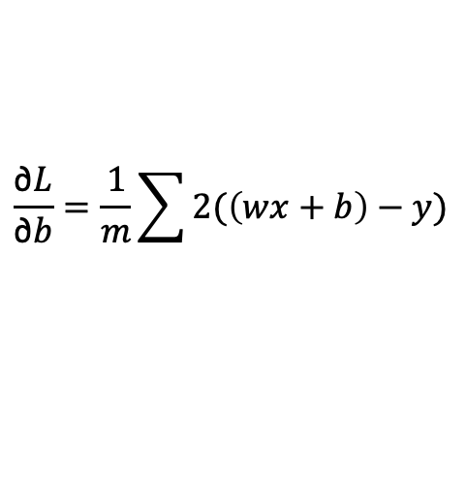
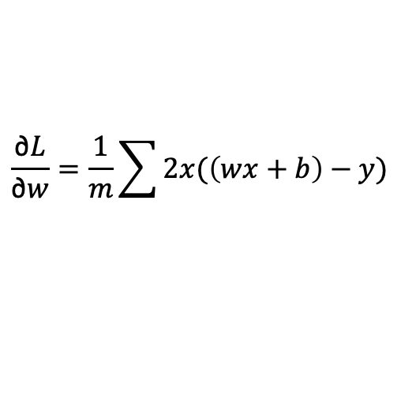
$$repeat until convergence \{$$
$\text{Θ}\text{j} ≔\text{Θ}\text{j}\text{ - }α\frac{\text{∂}}{\text{∂}\text{Θ}\text{j}}$J($\text{Θ}\text{0}$, $\text{Θ}\text{1}$)
} (for j = 0 and j = 1)
Correct: Simultaneous update
$t\text{emp}\text{0 }≔\text{Θ}\text{0}$- $α\frac{\text{∂}}{\text{∂}\text{Θ}\text{0}}$J($\text{Θ}\text{0}$, $\text{Θ}\text{1}$)
$t\text{emp}\text{1} ≔\text{Θ}\text{1}$- $α\frac{\text{∂}}{\text{∂}\text{Θ}\text{1}}$J($\text{Θ}\text{0}$, $\text{Θ}\text{1}$)
$\text{Θ}\text{0} ≔$ temp0
$$\text{Θ}\text{1} ≔temp1$$
$$L=\frac{1}{m}\sum{{(\left(wx+b\right)−y)}^{2}}$$
$$\frac{\text{∂}L}{\text{∂}w}=\frac{1}{m}\sum{2x(\left(wx+b\right)−y)}$$
$$\frac{\text{∂}L}{\text{∂}b}=\frac{1}{m}\sum{2(\left(wx+b\right)−y)}$$

