Slide 1
Training Set
Learning Algorithm
Number of
Reservations (x)
Hypothesis (h)
Estimated number
of pizzas sold (y)

Slide 2
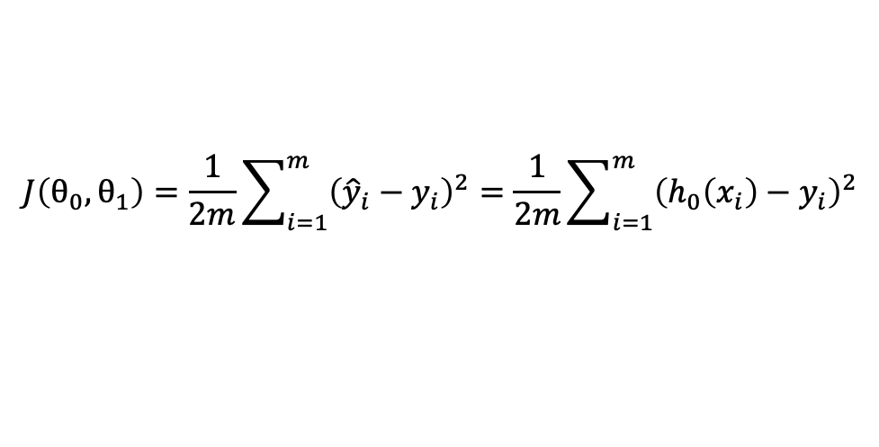
$$J\left(θ_{0},θ_{1}\right)=\frac{1}{2m}\sum_{i=1}^{m}{{\left({\hat{y}}_{i}−y_{i}\right)}^{2}}=\frac{1}{2m}\sum_{i=1}^{m}{{\left(h_{0}\left(x_{i}\right)−y_{i}\right)}^{2}}$$

