Slide 1
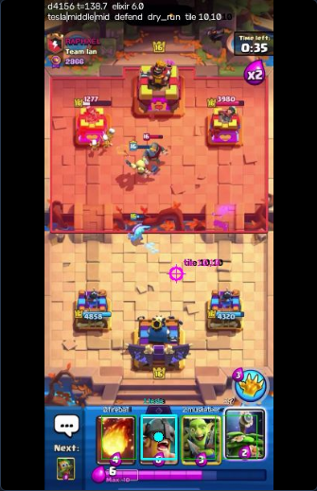


Clashbot: a knowledge-grounded real-time agent for Clash Royale
David Tyler Jackson
CAP 6938 AI Knowledge Systems
University of Central Florida
Instructor: Dr. Ser Nam Lim
Class showcase | 2026-11-09
Live capture of the mirrored game, tap overlay drawn
Clashbot | CAP 6938 AI Knowledge Systems
1

Slide 2
The problem: real-time play from pixels
Non-embedded. No game API: the only input is a mirrored iPhone screen, the only output is a mouse click.
Real time. 3-minute match, elixir regenerates, every play is irreversible: frame to click in 0.34 s (p50).
Noisy perception. Greyed hand cards read as unknown; live state vs dataset builder: feature cosine 0.67.
Hidden information. The opponent's deck and hand are unknown: fill the gap with 197 pro games.
LLM alone is not enough. Zero-shot d1 scores 0.22 on a 4-way pick (chance 0.25).
Scope and rules of play
Training Camp (built-in Trainer AI) only; never ranked or ladder.
Terms of Service: friendly / Training Camp use only.
Taps need the --live flag plus an environment variable, and a banner reading "Trainer".
iPhone
Mac: iPhone
Mirroring window
clashbot
frames in, clicks out
Clashbot | CAP 6938 AI Knowledge Systems
2

Slide 3
System overview: perceive, retrieve, reason, tap
FAST LOOP | every frame, ~10 fps
capture to click: 339 ms p50, 572 ms p95
Capture
iPhone Mirroring window, Quartz grab
Perception
YOLOv8 x2 (KataCR), OCR, Kalman tracker
Live state
hand, elixir, clock, towers, units
When to act?
rules + LightGBM gate (pros wait ~80%)
taps change the game
act
Executor (L15-18)
Quartz taps; double guard + Trainer-banner check
d1 LLM ranker (L11-14)
fine-tuned 600M model picks 1 of 4
Candidates (L8-10)
kNN + BM25 + RRF, KG counters, engine moves: up to 4
Engine + KG (L5-7)
lane simulation: tower HP saved; KG counters, answers
Gold = where the course material lives
SLOW LOOP (optional, off in the demo)
Qwen3-14B coach: pre-game plan, re-plans every ~20 s in quiet moments; its [plan] line goes into d1's context.
Clashbot | CAP 6938 AI Knowledge Systems
3

Slide 4
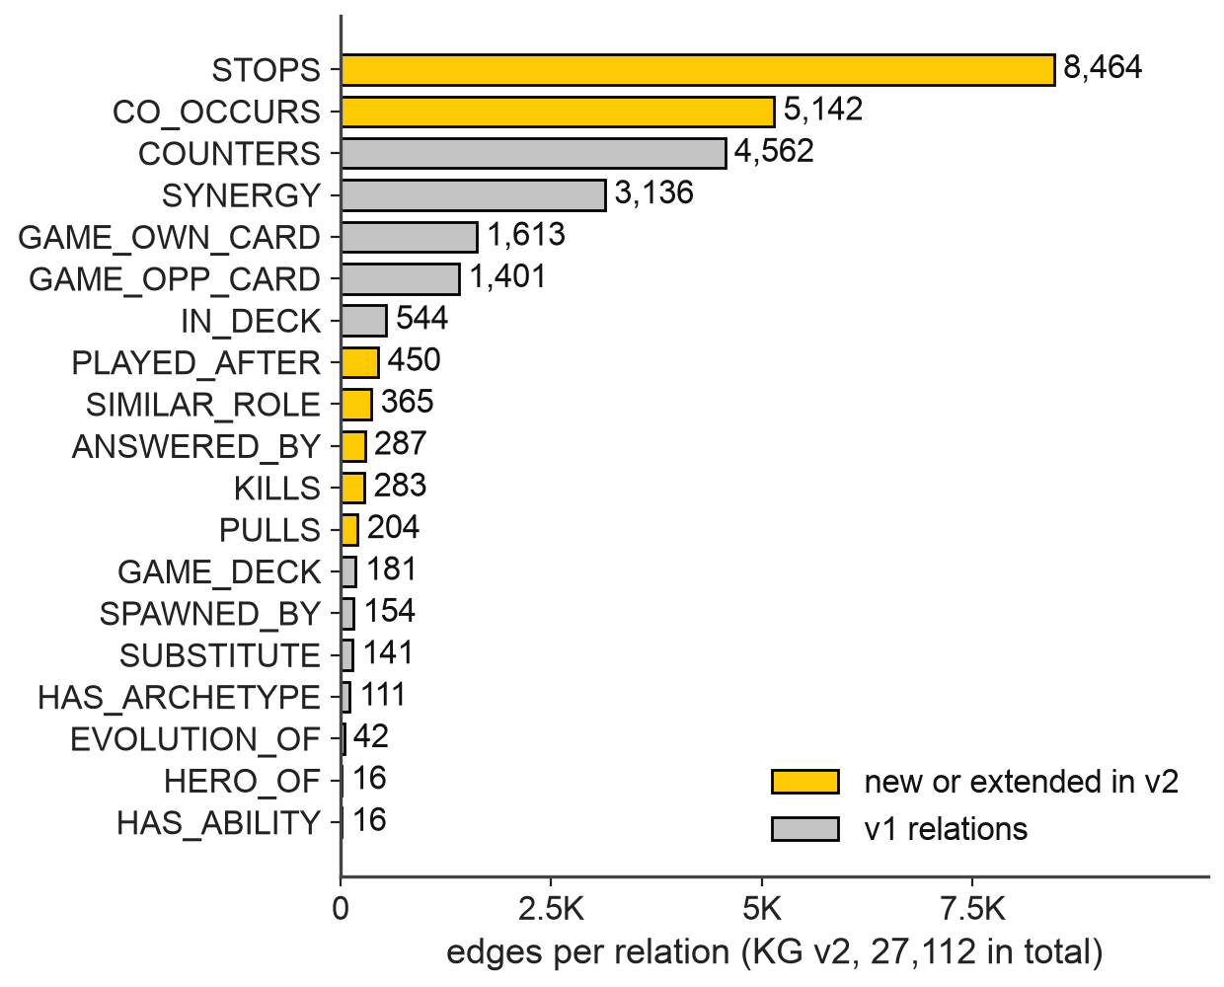
Data and knowledge: 197 pro games, one graph
197
pro games, 33 videos, ~12 match-hours
10,923
states (6,658 train-eligible)
Knowledge graph v2: edges per relation
23 / 5 / 5
videos train / val / test
(142 / 27 / 28 games)
3,620
mined answer events (X played, Y answered)
Cleaned and flagged; 447 states with invalid decks are excluded from training.
Split by video, so no match leaks from train to test.
KG v1: 590 nodes, 12,030 edges (wiki, KB, mined). KG v2: 840 nodes, 27,112 edges, 19 relations.
Clashbot | CAP 6938 AI Knowledge Systems
4

Slide 5
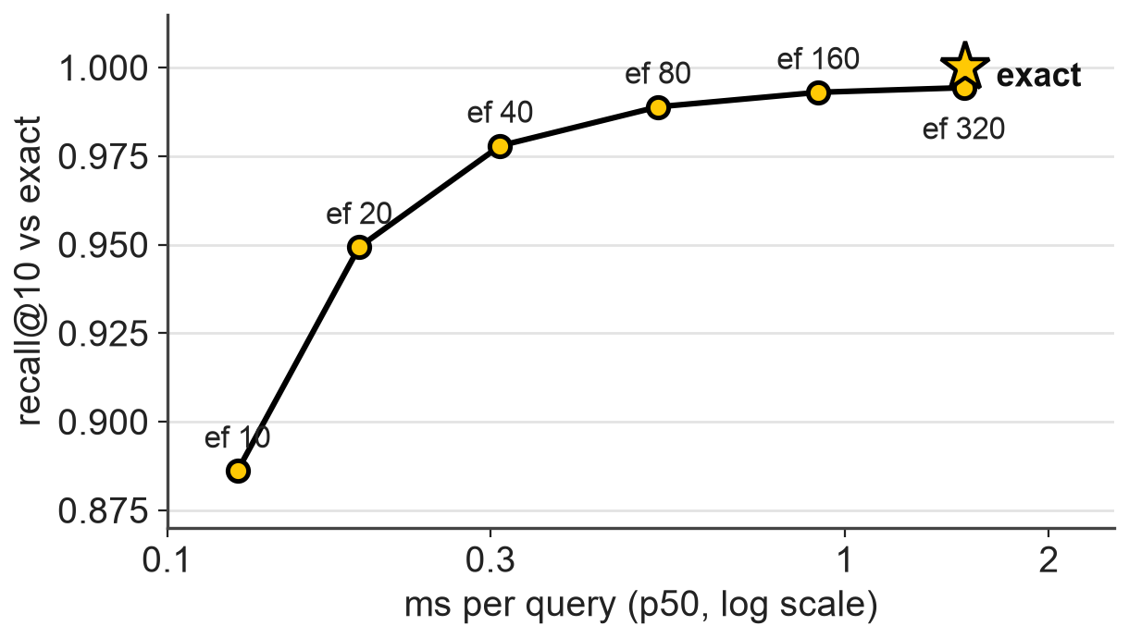
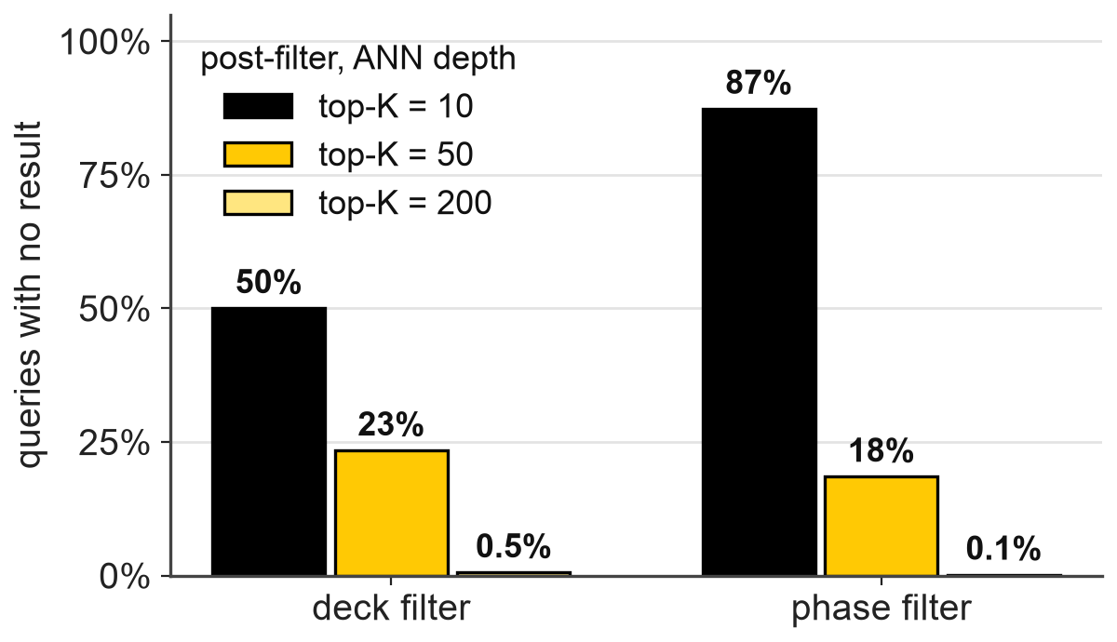
Retrieval (L8-10): hybrid search over pro states
HNSW vs exact search (10.9 K vectors)
Filtering after the ANN search
Hybrid: exact kNN over a 644-d state vector + BM25, fused by RRF (k = 60); channels are within noise (hit@10 0.14-0.17), the text-embedding channel adds ~20 ms for no gain.
Scale: HNSW ef 40 reaches recall@10 0.978 in 0.31 ms vs 1.51 ms exact; at 10.9 K vectors exact is fast enough.
Filters: a deck pre-filter leaves an empty pool for 89% of queries, so the live path filters by legality only.
Clashbot | CAP 6938 AI Knowledge Systems
5

Slide 6
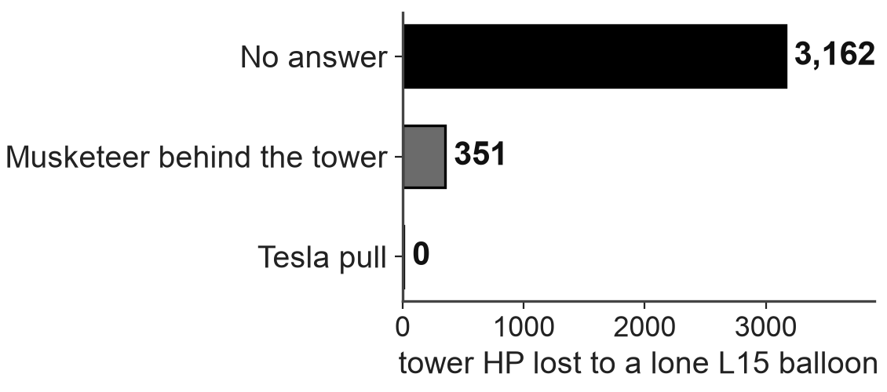
Knowledge graph and rules (L5-7)
Held-out COUNTERS link prediction (test, filtered)
Lane simulation: what an answer saves
Model | MRR | Hits@10
RotatE (best) | 0.159 | 0.326
ComplEx | 0.116 | 0.262
Popularity | 0.110 | 0.239
DistMult | 0.091 | 0.199
TransE | 0.082 | 0.238
Random | 0.022 | 0.113
Mined answer rules, held-out hit@1 [95% CI]
Mined rules beat random when pooled (+4.4 pts, p < 0.001) but not train popularity (-0.6 pts, p = 0.65); on test alone the gap to random is +2.6 pts, p = 0.19.
Hard constraints filter the LLM's options (card in hand, elixir, legal tile, no blind spells); the pros' own move passes only 54-60%.
RotatE is the only embedding clearly above popularity; DistMult is symmetric by construction.
Method | Test (433) | Pooled (1,042)
Mined rules (KG v2) | 0.15 [0.12, 0.20] | 0.17 [0.15, 0.19]
Train popularity | 0.17 [0.12, 0.22] | 0.18 [0.15, 0.21]
Random in deck | 0.13 [0.12, 0.13] | 0.13 [0.13, 0.13]
Clashbot | CAP 6938 AI Knowledge Systems
6

Slide 7
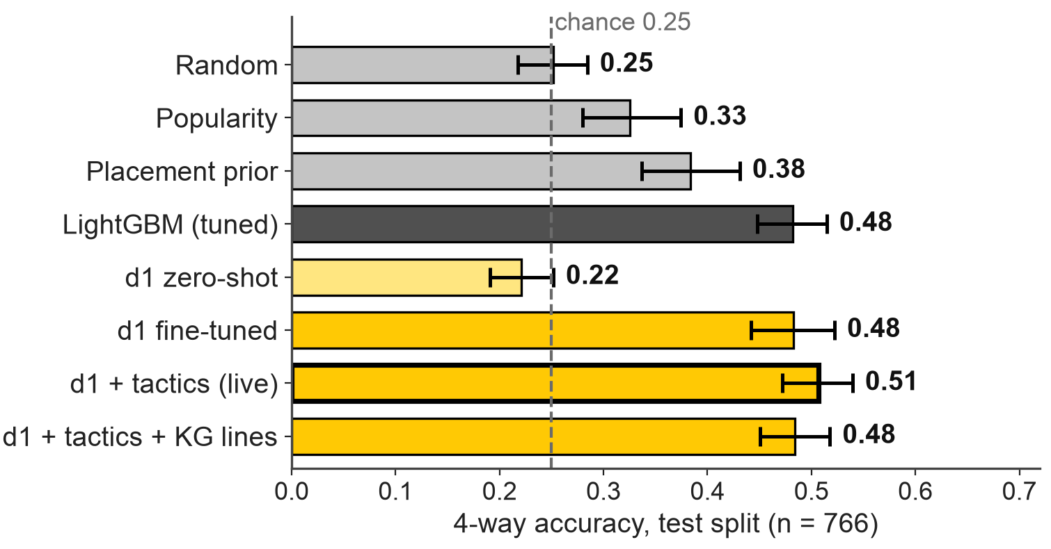
The ranker: RAG + recommendation (L11-14)
Stage 1: up to 4 candidates
Stage 2: d1 picks one
Hard negatives: a 2x2 grid
 | same spot | other spot
same card | pro play | negative
other card | negative | negative
Finding: the option-set shortcut
The first negatives leaked the answer: a rule that only read the option keys scored 0.85. The 2x2 grid makes it 0.25 by construction.
d1 + tactics (0.51) vs LightGBM (0.48): not significant (p = 0.26); vs placement prior +12.3 pts, p < 0.001.
Whiskers: 95% CI, bootstrap over the 27 test games (stats_audit_v1).
Clashbot | CAP 6938 AI Knowledge Systems
7

Slide 8
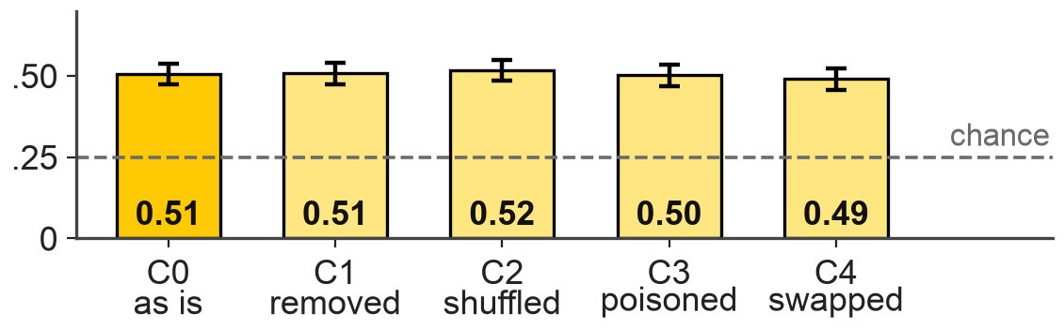
Agents (L15-18): an LLM over tools, behind guards
Tactics lines
engine, lane sim
KG facts
up to 3 lines
Retrieval notes
similar pro plays
Knowledge editing (synthetic +1 elixir, 5 cards)
Criterion | Edited | No edit
Reliability (n = 15) | 1.00 | 0.00
Generalization (n = 465) | 1.00 | 0.00
Locality (n = 2500) | 1.00 | 1.00
Portability (n = 465) | 1.00 | 0.07
Stale-card hit share | 0.002 | 0.124
tool-like context
d1 LLM = the decision maker
reads the state + context, picks 1 of up to 4 plays
Context conflict: d1 accuracy under corrupted notes (test)
Executor: separate, guarded
--live + CLASHBOT_ALLOW_LIVE=1, checked before each tap
taps only when the banner reads "Trainer"
no tap from an unread hand; failed taps get a 2 s cooldown
taps landed: 75/84 = 89% and 78/95 = 82% (two newest runs)
d1 barely reads its context: poisoned notes (C3) leave accuracy at 0.50 vs 0.51; it follows them only 4% of the time.
The Qwen planner made 0 tool calls: context is precomputed.
Clashbot | CAP 6938 AI Knowledge Systems
8

Slide 9
Bot vs pros on their own videos
Pro video
8 of 24 test games, preliminary
Full live stack
open loop, dry-run executor
Match by time
bot tap vs pro play, +/- 2 s
Score
timing + choice, vs baselines
Metric | Clashbot (95% CI) | Baseline | Baseline value (95% CI)
Pro-play recall, +/- 2 s | 78% (73-85%) | same taps shifted 20-60 s | 70% (66-76%)
Bot-tap precision, +/- 2 s | 74% (70-79%) | same taps shifted 20-60 s | 67% (63-71%)
Same card (n = 242 pairs) | 17% (12-21%) | random card in perceived hand | 13% (10-16%)
Taps per minute | 23.5 | the pros' plays per minute | 16.9
Perception ceiling: the pro's card is in the hand the bot perceived only 40% of the time (36-46%), so same-card agreement cannot be high.
AGREE: video 6qYQNJ1Uaeg, t = 222 s
DISAGREE: video Zt6Onn89EVk, t = 56 s
pro: bomb-tower, middle, mid
bot: bomb-tower, middle, mid
bot's reason: defend monk left: bomb-tower (high)
pro: valkyrie, middle, mid
bot: magic-archer, middle, back
bot's reason: learned: fast act p=0.61 h=2s
Clashbot | CAP 6938 AI Knowledge Systems
9

Slide 10
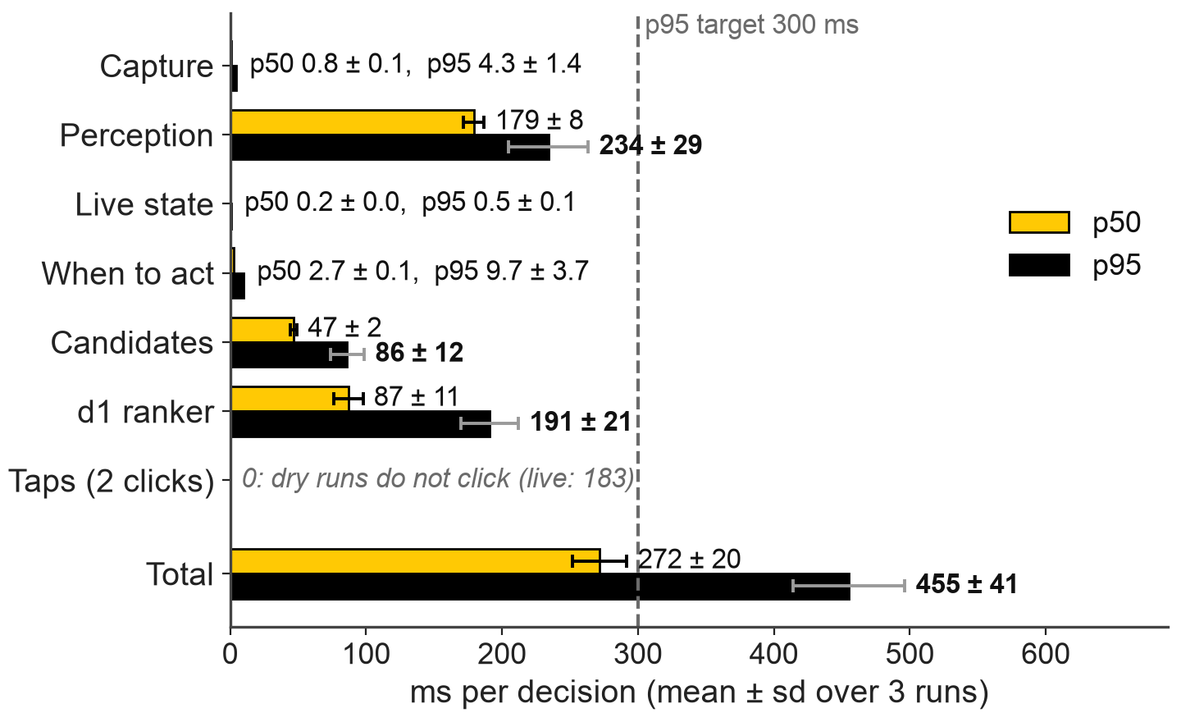
Live results: Training Camp
Decision latency by stage (3 dry runs, mean ± sd)
n/10
Training Camp games won (95% CI pending)
First win
game 3 of run 20261107-013441, in overtime
75/84 = 89% and 78/95 = 82%
taps landed in the two newest live runs (older run: 95/100)
339 / 572 ms
live run 20261107-111554: capture to click, p50 / p95 (183 ms = 2 clicks)
Total 272 ± 20 / 455 ± 41 ms (p50 / p95, no clicks); p95 target 300 ms met in 0 of 3 runs.
Clashbot | CAP 6938 AI Knowledge Systems
10

Slide 11
Comparison with prior bots
 | KataCR (Wu et al. 2025) | Claude Royale (Houseworth 2025) | Clashbot (ours)
Setting | phone video + ADB taps; Training Camp built-in AI | BlueStacks on a Mac; ladder vs humans | iPhone Mirroring on a Mac; Training Camp only
Perception | YOLOv8-l x2 (mAP 67.4), OCR, ResNets | Claude vision reads screenshots | same KataCR YOLOv8 weights, OCR, Kalman tracker
Decision | offline-RL transformer imitating 1 human | Claude Haiku + hand-written prompts | rules + LightGBM gate, engine, KG, retrieval, d1 picks 1 of 4
Latency | 120 ms decide + 240 ms fusion | ~7 s per agent | 339 ms p50 / 572 ms p95, capture to click
Win rate vs built-in AI | 5% (1/20); 0-10% over 9 models | not reported (plays humans) | n/10 (n = 10); one win in game 3 of one run
KataCR 1/20 has a 95% CI of 0.1-24.9%. Decks, opponent versions and n differ: read win rates as context, not a benchmark.
Clashbot | CAP 6938 AI Knowledge Systems
11

Slide 12
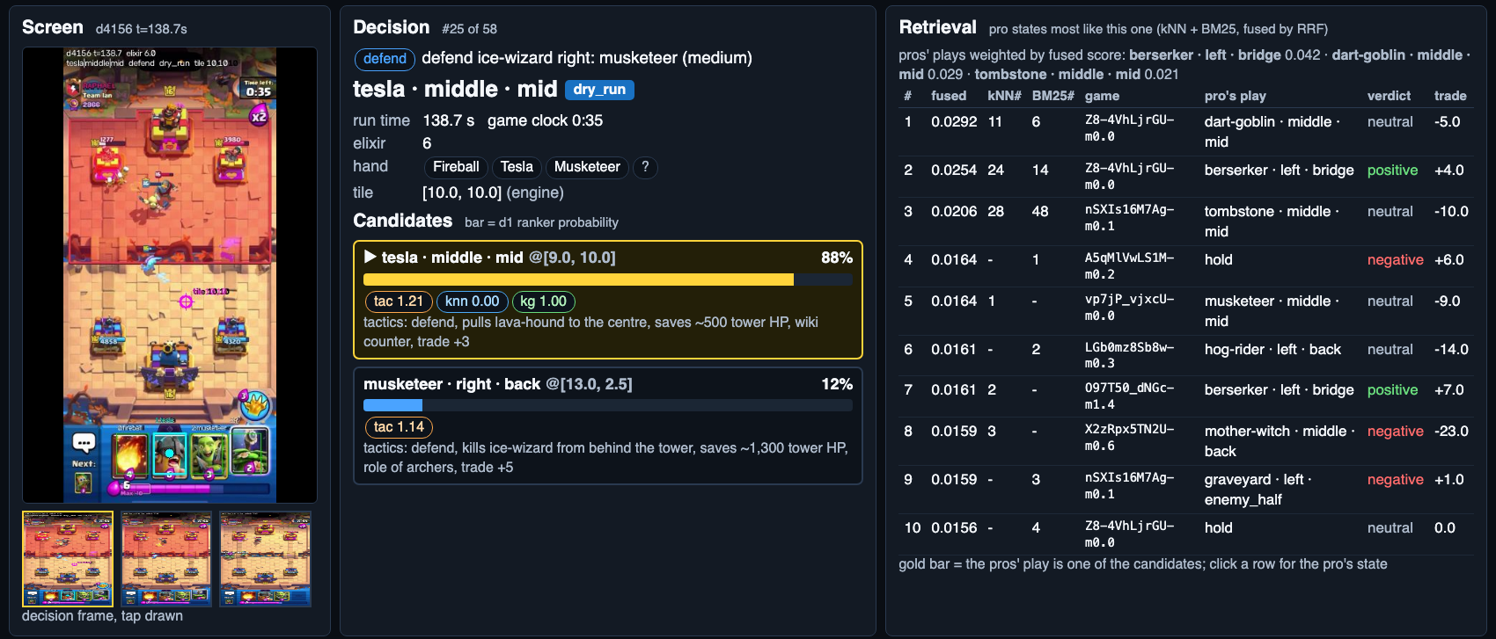
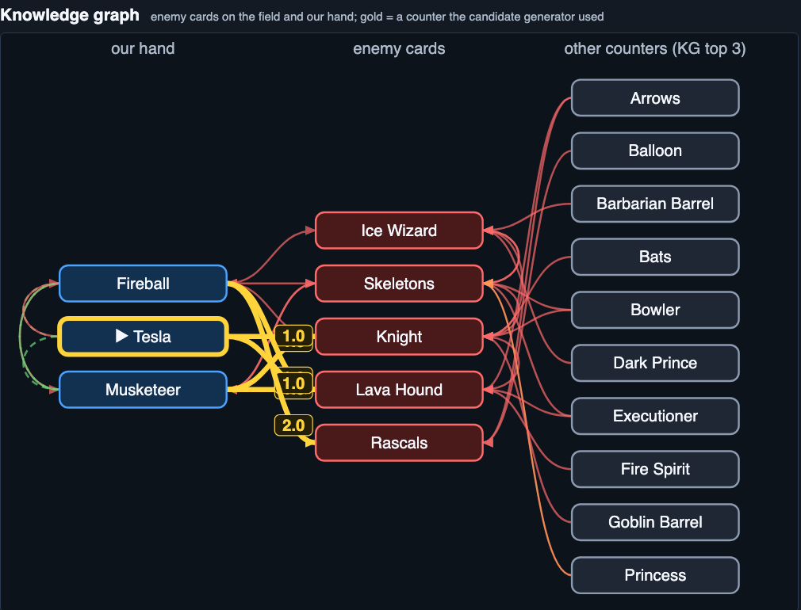
Demo: what the decision dashboard shows
1
DEMO VIDEO
or live screen share
recorded clip, ~60 s
2
3
4
1
Retrieval: the 10 pro states most like this one (kNN + BM25, RRF)
2
Candidates: up to 4 plays, bar = d1 probability (here 88% vs 12%)
3
Reasons: tactics note, e.g. pulls lava-hound to the centre, saves ~500 HP
4
Knowledge graph: counters the candidate generator used, facts given to d1
Clashbot | CAP 6938 AI Knowledge Systems
12

Slide 13
Lessons, limitations, future work
What worked
What to be honest about
Next
Knowledge + fine-tuning lift a chance-level LLM (0.22) to 0.51 on pick-the-pro-move.
A separate, guarded executor: taps landed 75/84 = 89% and 78/95 = 82% in the two newest runs; first Training Camp win in overtime.
Simple baselines match the LLM: tuned LightGBM 0.48 vs d1 0.51, inside the noise (n = 766).
Perception caps everything (pros' own move passes our legality check only 54-60%); n is small, wins are counted in tens.
Elixir management: no affordable card on ~1/3 of match frames in the last run; save for the answer.
Retrain with the KG-lines leak fixed, own detector, 10+ Training Camp games with intervals.
Take-away: knowledge made a chance-level LLM useful; honest baselines show how much of the gain is the LLM.
Clashbot | CAP 6938 AI Knowledge Systems
13

Slide 14
Backup: course-concept map
Block | Concept | In clashbot | Evidence
L8-10 | BM25 + dense + RRF | kNN over 644-d vector + FTS5, k = 60 | hit@10 0.16 (test), 26 ms
L8-10 | HNSW, pre/post filter | exact live; HNSW + filters offline | recall 0.978 @ 0.31 ms; 89% empty
L5-7 | KG + KGE link prediction | KG v2 840 / 27,112; RotatE | MRR 0.159 vs 0.110 popularity
L5-7 | Rule mining, neuro-symbolic | mined answers; legality filter | hit@1 0.17 vs 0.13 random
L11-14 | Two-stage RAG / recsys | candidates, then d1 picks 1 of 4 | 0.51 vs 0.38 placement prior
L11-14 | Hard negatives, baselines | 2x2 grid; LightGBM | shortcut 0.85 to 0.25; LGBM 0.48
L15-18 | Typed tools, executor split | engine + KG context; guarded taps | taps 89% / 82%; 0 planner calls
L15-18 | Knowledge editing, conflicts | versioned fact store; re-weighting | reliability 1.00 vs 0.00
L2-4 | Dense representation | 644-d vector; bge-small text channel | text channel: no gain, off
Clashbot | CAP 6938 AI Knowledge Systems
14

