Slide 1




CSC611M · Machine Project 1
PARALLEL OCR
Pipeline
Lance Xavier Lim · Julian Johan Briones
De La Salle University · AY 2026-27 T1

Slide 2


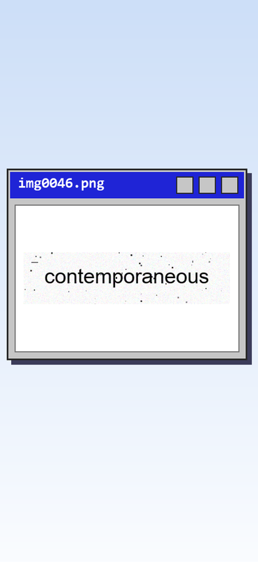
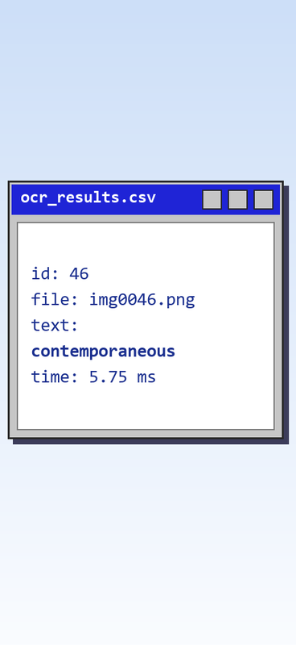

Input → Output
Noisy images in, clean text out.
Project Overview
Parallel OCR
One loader thread queues 100 noisy word images; N worker threads preprocess them and run Tesseract OCR in parallel.
config.txt sets image_dir and n_workers. Output: ocr_results.csv with ID, filename, text and time (ms).
94.15% of characters recognized (required: 50%)

Slide 3

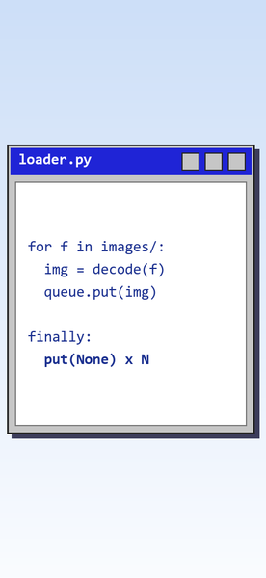
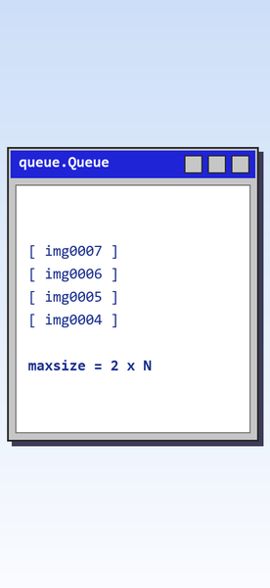
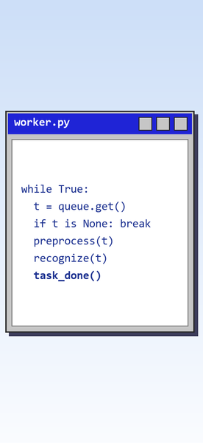
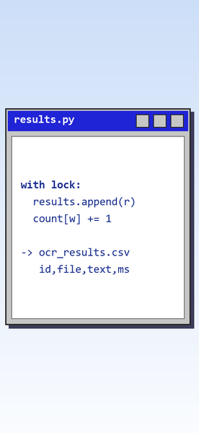

Architecture
Loader
Queue
Workers
Results
PIPELINE ARCHITECTURE
One loader (producer) feeds N OCR workers (consumers) through one shared queue.
Results go to a lock-protected store; the CSV is written after all threads join.
Decodes images, sends sentinels
Bounded shared queue, maxsize 2 × N
Preprocess + OCR in parallel
Lock-protected store, then one CSV

Slide 4

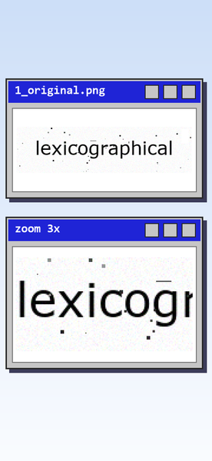
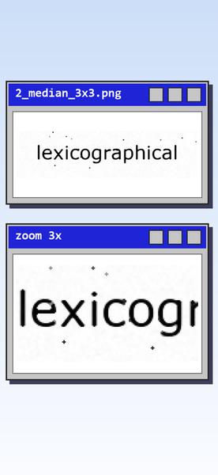


Preprocessing
Cleaning each image before OCR.
Grayscale input with salt-and-pepper noise
3×3 median filter removes 1-px specks
3×3 opening removes larger specks
Otsu binarization + white border

Slide 5
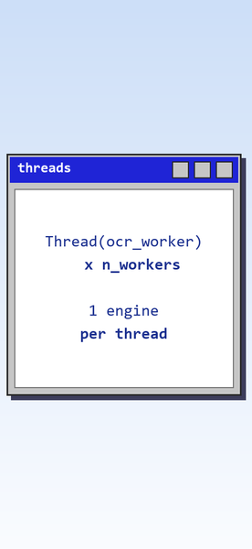
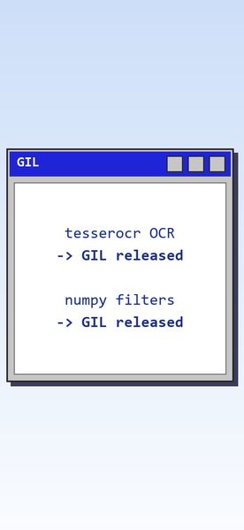
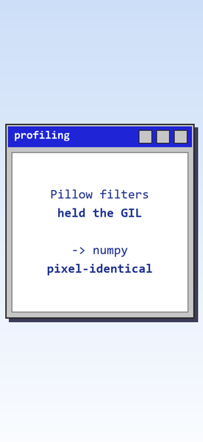

Parallelization
THREADS THAT TRULY RUN IN PARALLEL.
tesserocr runs Tesseract in-process. pytesseract started tesseract.exe per image, and antivirus stalled ~1 s on every other launch.
N threads, one Tesseract engine each
OCR + numpy filters release the GIL
Pillow filters held the GIL → numpy

Slide 6
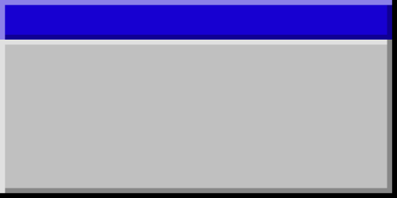
Python standard library only
SYNCHRONIZATION CONSTRUCTS
queue.Queue
bounded, 2 × N
threading.Lock
protects results
Sentinels
one per worker
task_done()
+ Queue.join()
Thread.join()
loader + workers
Confinement
own OCR engine

Slide 7

01
02
Shared
Shared
Image Queue
Results + Counts
Loader puts, workers get and call task_done(), main joins. queue.Queue locks internally; bounded to 2 × N.
Every worker appends its result and bumps its count. One threading.Lock guards both; main reads a snapshot.
Shared Variables
WHO TOUCHES WHAT
03
04
Written once
Not shared
Loader Statistics
Tesseract Engine
Only the loader writes them. Main reads them after loader.join(), so no lock is needed.
Each worker creates and owns one engine. It is never shared between threads, so no lock is needed.

Slide 8
01
02
Step 1
Step 2
loader.join()
queue.join()
The loader has queued every image, then one None sentinel per worker in a finally block.
Every item, sentinels included, has had task_done(), which workers call in a finally block.
Coordination
CLEAN SHUTDOWN, NO DEADLOCK
03
04
Step 3
Step 4
worker.join() × N
Snapshot + CSV
Each worker exits after its sentinel. Errors are logged and recorded, so no worker quits early.
No thread is alive, so main snapshots the results under the lock and writes ocr_results.csv once.

Slide 9
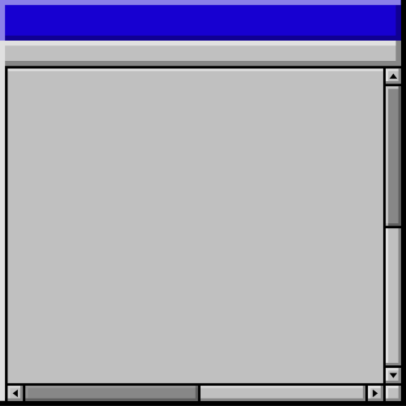
Benchmark Setup
How we measured speedup
6C/12T
1–16
10 runs
Speedup:
Ryzen 5 5600G
S = T1 / Tn, mean of 10 runs
OCR workers (10 counts)
per count, after a warm-up

Slide 10
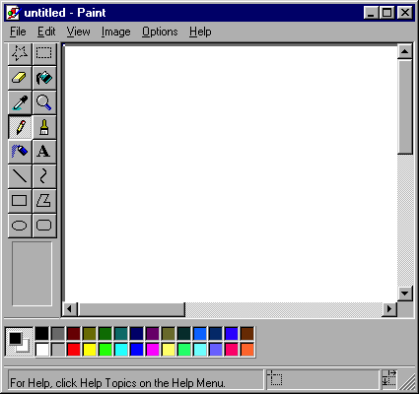
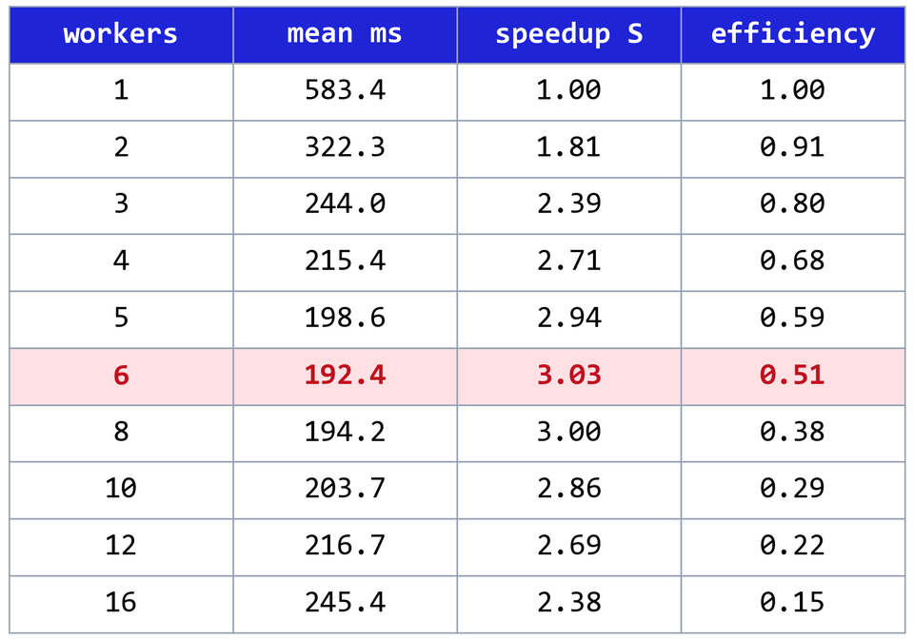
Benchmark Results
Time & speedup

Slide 11
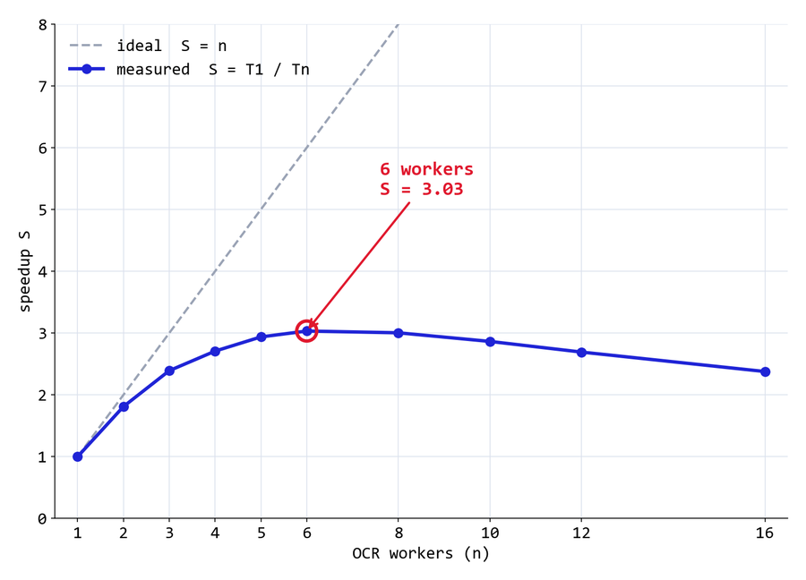
Speedup per worker count
S = T1 / Tn

Slide 12
01
02
Overhead
Contention
Startup cost grows
Slower per image
One engine per worker, partly serialized: 27 ms with 1 worker, 101 ms with 16. Without it, S reaches about 4.0.
Mean time per image rises from 5.5 ms to 8.2 ms at 6 workers: shared cache, lower boost clock, SMT.
Analysis
WHY SPEEDUP PLATEAUS
03
04
GIL
Oversubscription
Python glue is serial
Too many threads
OCR and numpy release the GIL, but queue calls, the Otsu loop and result handling run one thread at a time.
Past 12 workers there are more threads than hardware threads. The single loader is already ~65% busy at 6.

Slide 13
Key Results
What the benchmark showed
3.03×
6
94.15%
Correctness:
peak speedup
0 mismatches in 100 runs
optimal workers, one per core
characters read (50% needed)

Slide 14
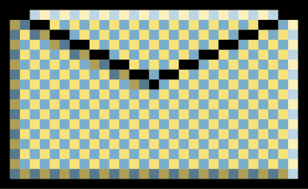


Conclusion
Optimal: 6 OCR workers.
3.03× faster than 1 worker.
Thank you!
Lance Xavier Lim · Julian Johan Briones
Queue, Lock, sentinels, joins
Clean shutdown, no races
94.15% OCR accuracy

