Slide 1
Hackathon Galaxtars
Jyoshika Barathimogan | Rishika Bimal Attodi

Slide 2
Table of contents
01
02
03
04
05
06
THE problem statement
Solution introduction
Deep dive into solution
IMPACT OF SOLUTION
Conclusion
ARCHITECTURE SOLUTION
ZALORA

Slide 3
01
THE problem statement
ZALORA

Slide 4
THE problem statement
Helping shoppers to select the right sized apparel and shoes without having to worry about returns is one of the biggest challenges faced by the fashion e-commerce industry. Develop a solution that provides ZALORA's diverse range of shoppers with the confidence that they are selecting the right size when shopping online.

Slide 5
02
Solution introduction
Our Solution

Slide 6
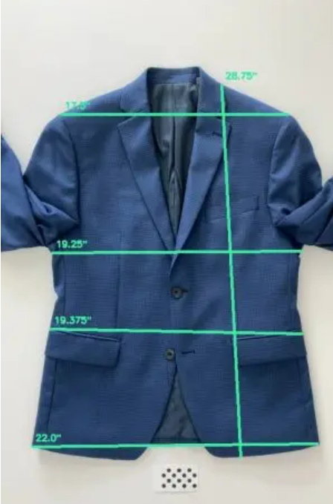
OUR SOLUTION
An application inside ZALORA that help to obtain the measurements from images uploaded by the customer to filter products based their size.

Slide 7
Our SOLUTION WALK THROUGH
The user will be requested to upload their photo of their apparel /shoes.
The system will obtain the measurements of their apparel/shoes and use it when comes to filtering products.
The user will also receive a notification pertaining to the measurements obtained.
The system will match the customers sizing with the size conversion chart of each product. This will be called as customized filtration.
When browsing for product, there will be a customized filtering based on their measurements to filter the “available” products based on the customer’s size.
The uploading and changing their photos will be done in their account page.
When adding a product to cart, it automatically input the size based on measurement when they select customized filter.
Notes:
“available” = not out of stock.

Slide 8
03
Deep dive into solution
Greater insight to our Solution

Slide 9
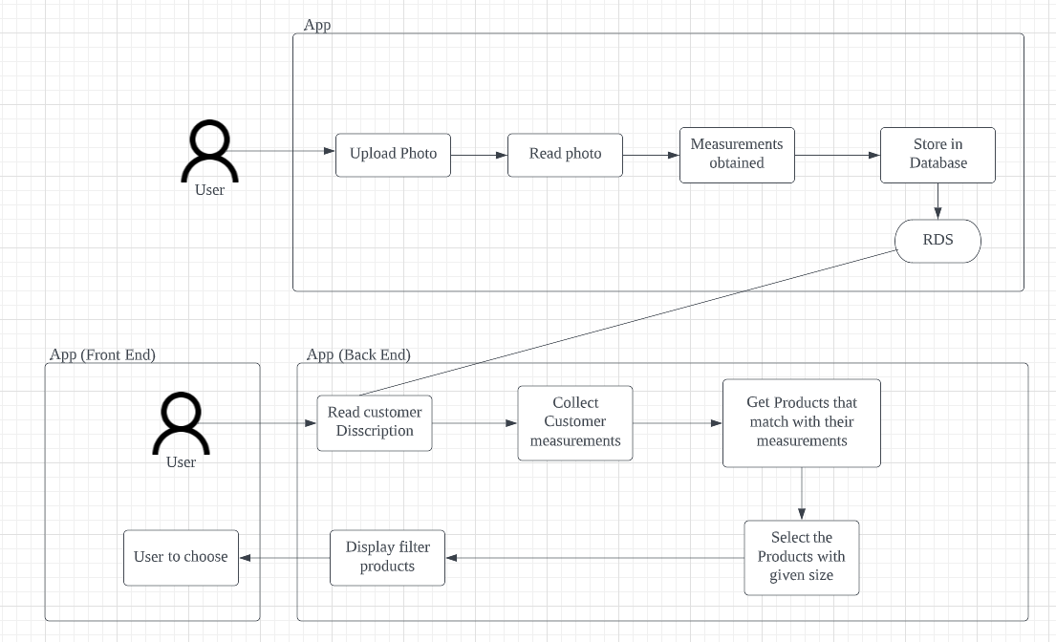
DATA FLOW Diagram

Slide 10
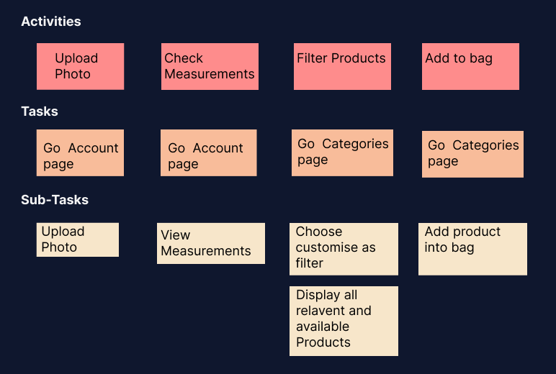
Story Map

Slide 11
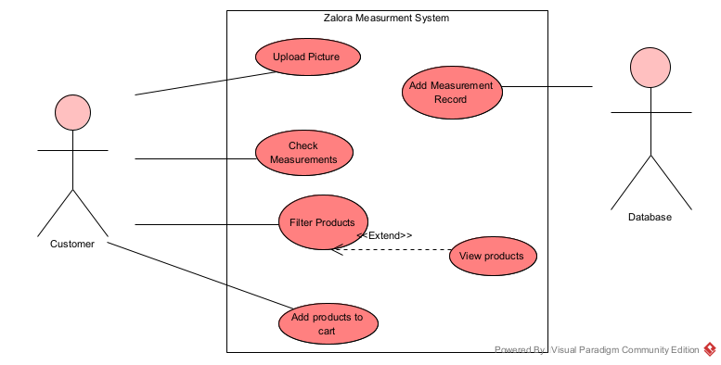
Use case diagram

Slide 12
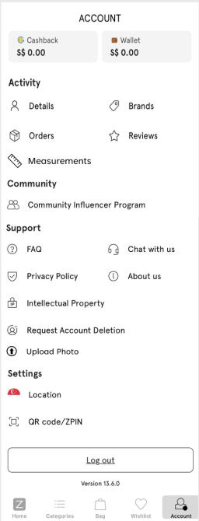
Wireframe
A new measurement option will be added for the customer/user to check their measurements
A new upload photo option will be added for the customer/user help them change their photo or add a new photo
Notes:
How does your solution benefit the society or the target audience?
Why is your solution a good solution?
How is it better than competitors or existing solutions on the market?
What is your solution's competitive advantage or unique selling point?

Slide 13
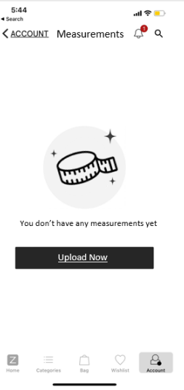

Wireframe
Under the new measurement option, customer can check their measurements.
For new users, it will ask them to upload a photo
Notes:
How does your solution benefit the society or the target audience?
Why is your solution a good solution?
How is it better than competitors or existing solutions on the market?
What is your solution's competitive advantage or unique selling point?

Slide 14
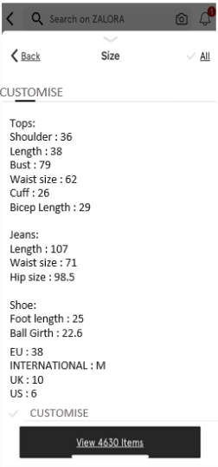
Wireframe
Users have a new filter option called customise that caters to their measurements.
It will display the available products when this filter is chosen
It also automatically choose the size of the product when it is added to the bag.
Hence it does not request user to select their size.
Notes:
How does your solution benefit the society or the target audience?
Why is your solution a good solution?
How is it better than competitors or existing solutions on the market?
What is your solution's competitive advantage or unique selling point?

Slide 15
04
IMPACT OF SOLUTION
How our solution have a great impact

Slide 16


Our IMPACT
Benefits to the society or target audience
User-friendly, since users don’t have to constantly check if they are buying the right size
Time-saving as they just need to click on customised filter
It is a effective tool as users are prone to human error by choosing wrong size especially since different product have different sizes.
Reasons why it’s a good solution
Company can cater to customer satisfaction
It is feasible, user-friendly and simple to use as well as to implement
straightforward solution with minimal error margin
New to market which will reduce human error and save company money n resources
Notes:
How does your solution benefit the society or the target audience?
Why is your solution a good solution?
How is it better than competitors or existing solutions on the market?
What is your solution's competitive advantage or unique selling point?

Slide 17


Our IMPACT
Solution’s competitive advantage/unique
selling point
Guarantee measurements will be taken correctly, leading to customer satisfaction as it leverage on conveniency.
What makes our solution different and fresh
It is a unique solution which is not presented in other e-commerce website based on our research
Notes:
How does your solution benefit the society or the target audience?
Why is your solution a good solution?
How is it better than competitors or existing solutions on the market?
What is your solution's competitive advantage or unique selling point?

Slide 18
05
ARCHITECTURE SOLUTION
AWS infrastructure

Slide 19
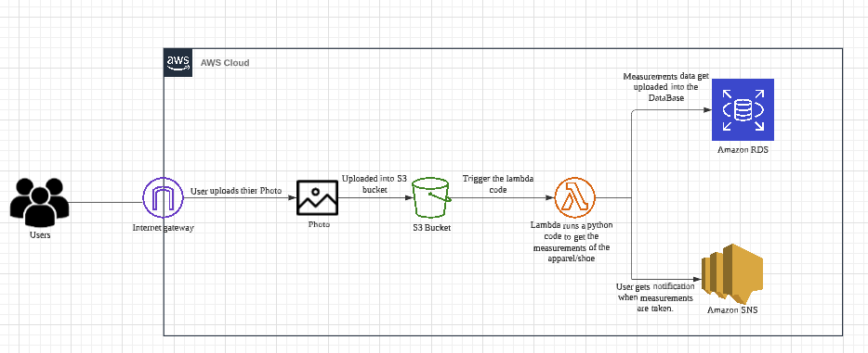
Architecture Diagram

Slide 20
Architecture Diagram EXPLANATION
S3 Bucket
LAMBDA
RDS & sns
When users upload their photo onto the website, the photo will be uploaded into S3 bucket. Since ZALORA have been using S3 bucket as their storage , we would be implementing the same application.
When photo is uploaded in S3, the lambda code will be triggered. This causes a python file to run to get the measurements from the photos.
Measurements will be uploaded into the Relational Database service (RDS) which is also been used by existing ZALORA cloud infrastructure.
Moreover, users will get notification when their measurements have been uploaded.
JUPITER
SATURN
Despite being red, Mars is actually a very cold place
Jupiter is a gas giant and the biggest planet in the Solar System
Saturn is composed mostly of hydrogen and helium

Slide 21
Thank You!
Please keep this slide for attribution

