Slide 1
Port Authority Bus Terminal
Data Cleaning, Preparation and Integration
Presenting by Group-4

Slide 2
Available Data Sources
Traffic Database
Unit_571_Database
Weather Database

Slide 3
Data Preparation
The files which are given are .accdb files to be accessed through MS Access.
Extracted those databases into PowerBI via Access database.

Slide 4
Data Cleaning
Checking the data types of all the columns in all the tables.
1
Changing the datatypes of Date/Time Columns into Date/Time Format.
2
Checking if there are any null values and replacing them with median of the same column.
3
Removing duplicates and blank rows in all the tables.
4
Notes:
let TimeText = Text.PadStart(Text.From([Time]), 4, "0"), // Ensures "600" becomes "0600" Hours = Number.From(Text.Start(TimeText, 2)), // Extracts the first two digits as hours Minutes = Number.From(Text.End(TimeText, 2)), // Extracts the last two digits as minutes TimeValue = #time(Hours, Minutes, 0) // Converts to Time formatin TimeValue

Slide 5
Data Integration
Establish relationships and joining the tables in a way that we get the final dataset where we have
Date
Total Bus Departures
Total Passengers
Average wind
Min, Max Temperatures etc.,.

Slide 6
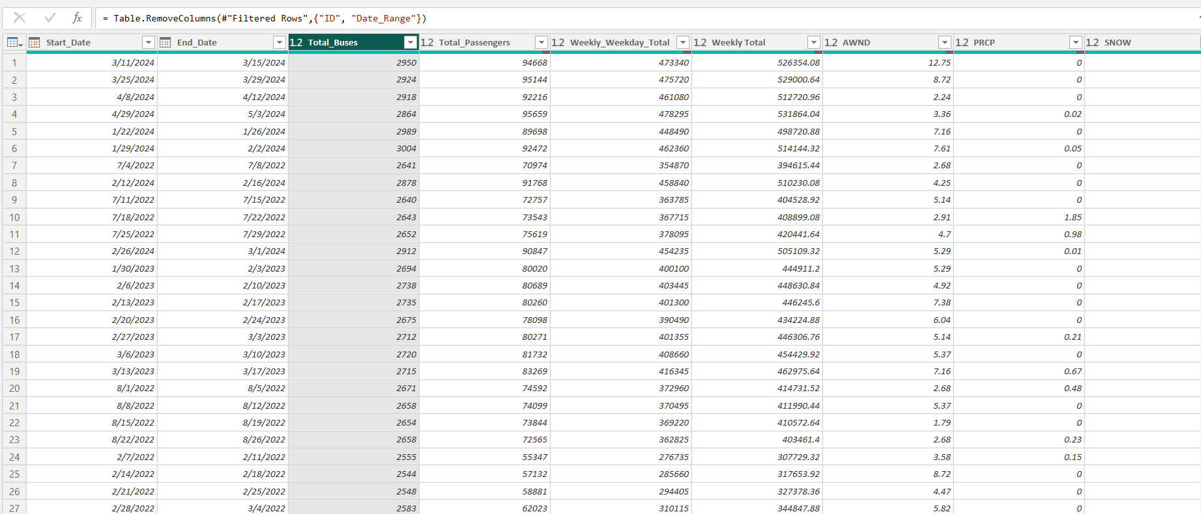
Final Dataset to be ready for further Analysis

Slide 7

Thank You

