Slide 1
Mini_Project_1
File created on: 6/23/2025 11:35:04 AM

Slide 2
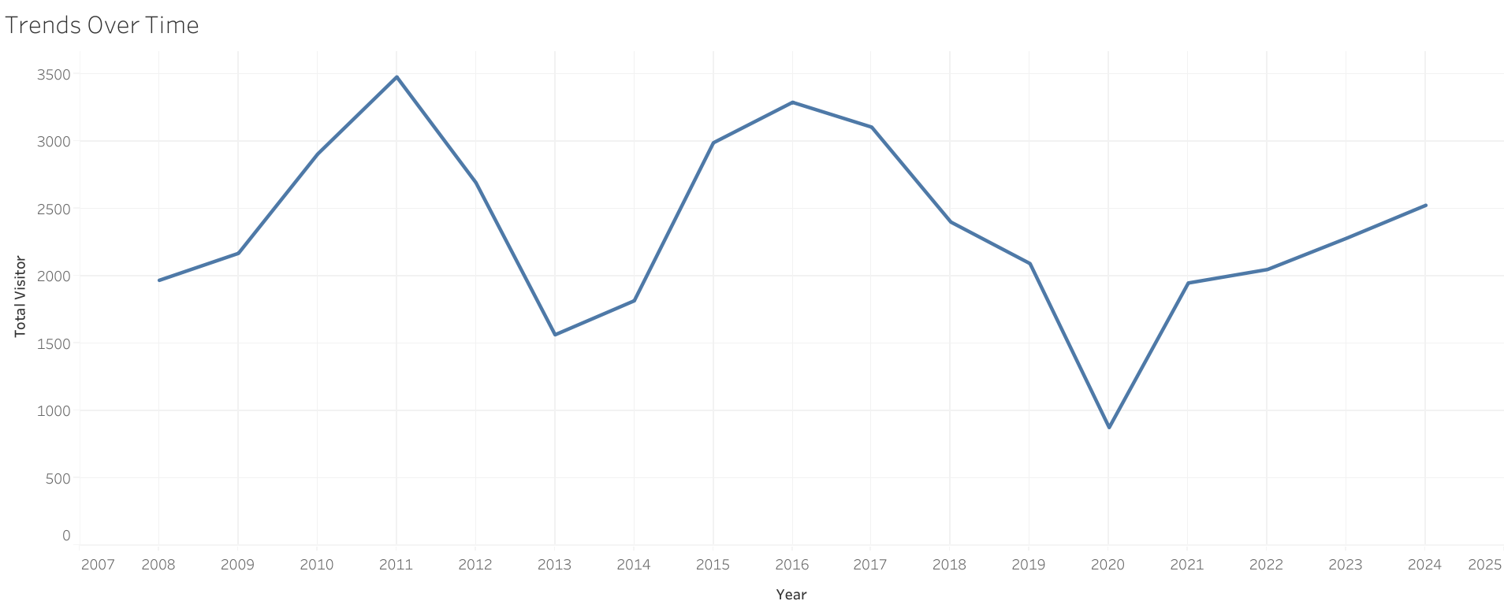

Slide 3
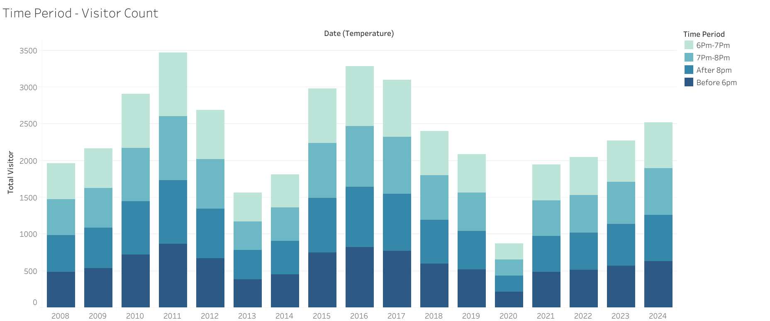

Slide 4
