Slide 1
LINUX
SHELL COMMANDS AND THEIR USES
Submitted by:
Jyothi Prajapathi
166730

Slide 2
BASIC COMMANDS
ls : used to list files
cal :displays calendar
date: gives current date and time
users : gives the name of users
-a: displays hidden files
touch : used to create new file
nano : enables to edit files
cat: shows the files content
wc: gives the word count

Slide 3
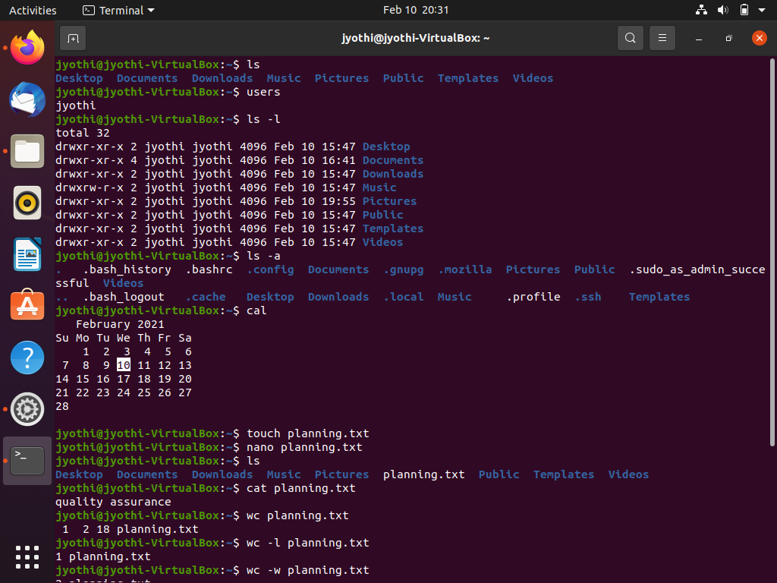

Slide 4
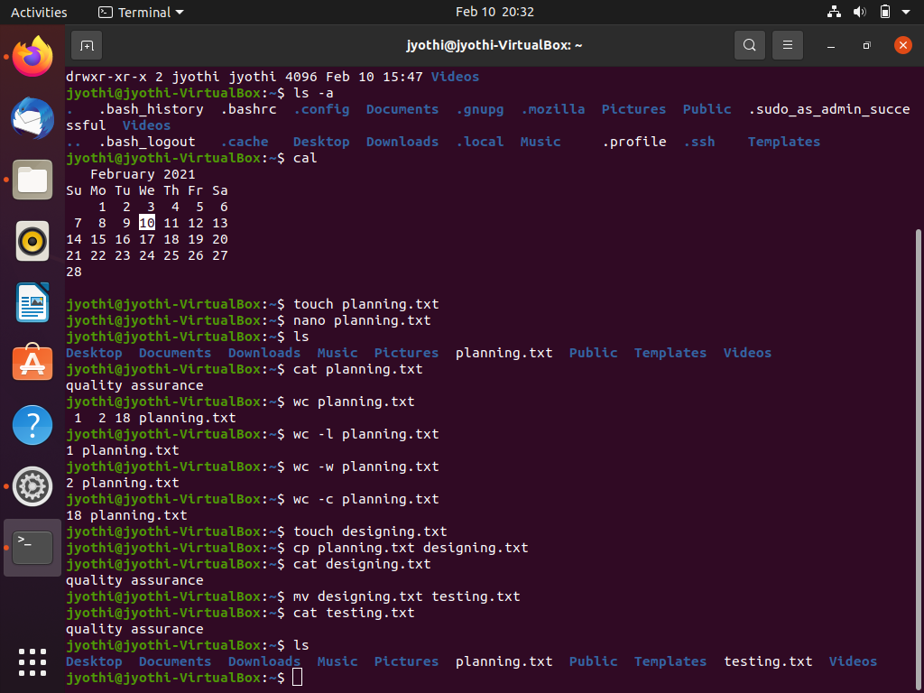

Slide 5
cp : used to copy files
mv: used to move files from one location to another
rm: used to remove files
mkdir: used to create directory
rm -r dir: used to remove directory
cd : used to change directory
chmod: used to remove permission
d-directory/file
r-read
w-write
x-execute

Slide 6
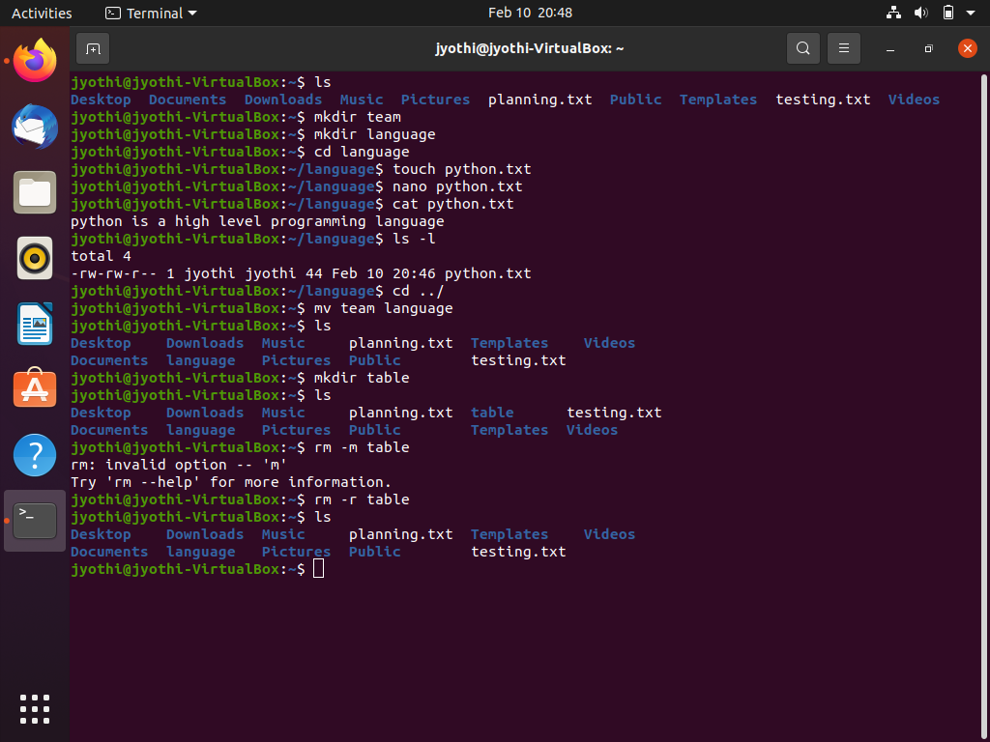

Slide 7
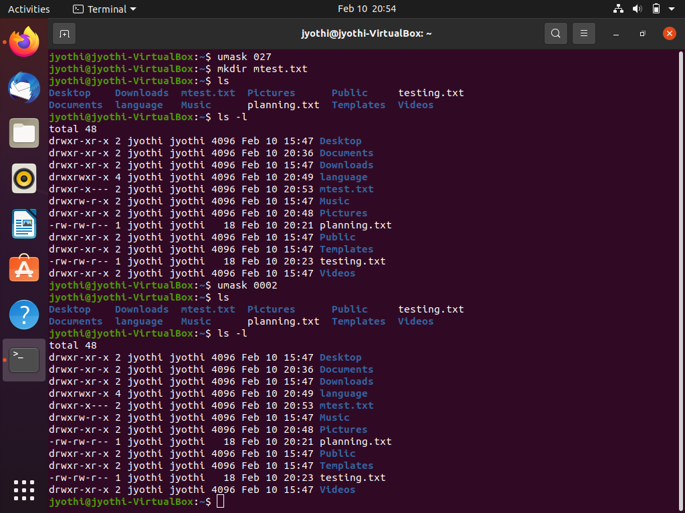

Slide 8
“+” Adds permission
“-” removes permission
“=” sets permission
“.” returns to current working directory
“../” returns to parent or a level above directory
rm * :removes all the files
chown: used to change owner name
chgroup: used to change group name
umask:allows to set or view file mode creation mask
umask 0002: default value
clear: clears the terminal

Slide 9
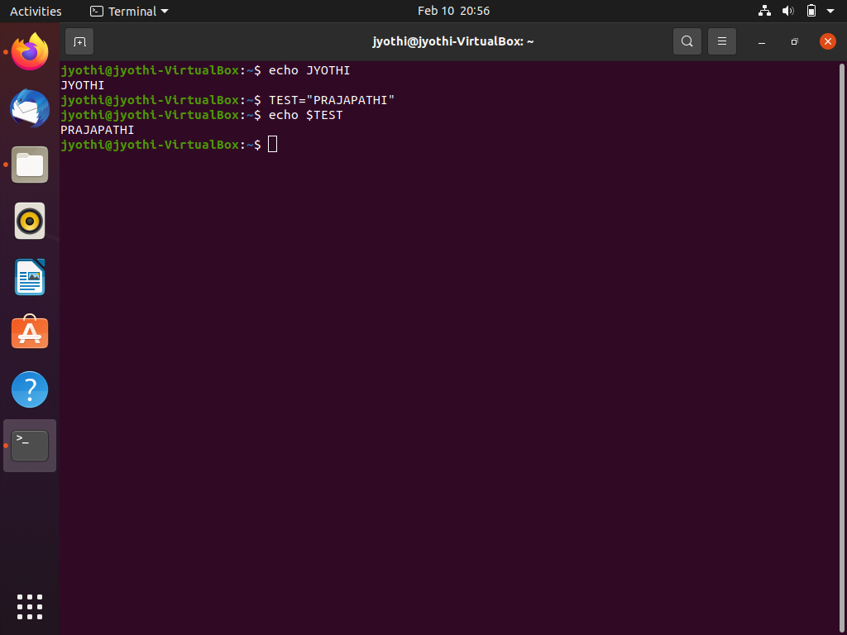

Slide 10
Thank you

