Slide 1
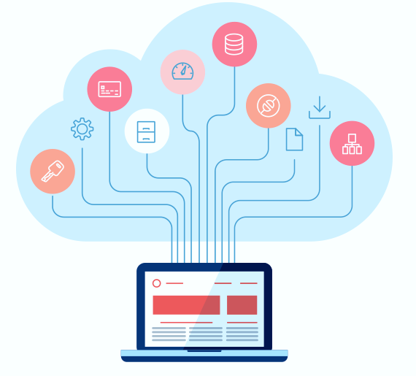
Infrastructure as a Service
Fundamentals of IaaS

Slide 2
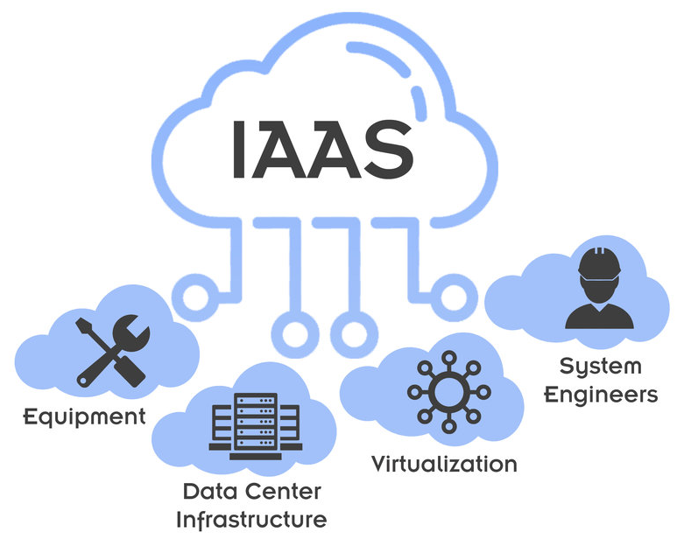
Introduction
What is IaaS?
Cloud infrastructure is the fundamental framework of hardware and software resources that empower cloud computing services. It encompasses essential components like servers, storage, networking, and virtualization enabling businesses to securely store, process and retrieve their data and applications in the cloud.
Cloud Computing
Cloud infrastructure refers to the foundation of hardware and software resources that enable cloud computing services.
It provides the necessary infrastructure components, such as servers, storage, networking, and virtualization, for businesses to store, process, and access data and applications in the cloud.
Infrastructure as a Service

Slide 3
Components of Infrastructure as a Service
Key components of IaaS
IaaS comprises several essential components:
Virtual Machines (VMs): These are virtual instances of computers that provide computing power, including processing, memory, and storage, on demand.
Storage: IaaS offers scalable and reliable storage solutions that allow businesses to store and access data as needed.
Networking: IaaS provides networking capabilities, including virtual networks, load balancers, and firewalls, to connect and secure the infrastructure.
Management Tools: IaaS platforms offer management tools that allow users to provision, monitor, and manage their infrastructure efficiently.
Cloud Computing
Infrastructure as a Service

Slide 4
Benefits of IaaS
IaaS offers numerous benefits for businesses:
Scalability: IaaS enables businesses to scale their infrastructure up or down instantly, providing agility and cost optimization.
Cost Savings: With IaaS, businesses can avoid the upfront costs of purchasing and maintaining physical hardware, paying only for the resources they consume.
Flexibility: IaaS allows businesses to choose the infrastructure components they need and customize their environments to meet specific requirements.
Reliability: IaaS providers ensure high availability and redundancy, minimizing downtime and providing reliable infrastructure services.
Cloud Computing
Infrastructure as a Service

Slide 5
IaaS for Adoption
When adopting IaaS, What organizations should consider?
Security: Implementing robust security measures to protect data and applications is essential. This includes access controls, encryption, and compliance with relevant regulations.
Performance: Optimizing network performance, latency, and bandwidth is crucial to ensure a seamless user experience.
Vendor Selection: Choose a reputable and reliable IaaS provider that aligns with your business needs and offers adequate support and service level agreements (SLAs).
Data Transfer and Integration: Consider the ease of transferring data to and from the IaaS environment and integrating it with other systems or services.
Cloud Computing
Infrastructure as a Service

Slide 6
Cloud Infrastructure Simplified with IaaS: Key Takeaways
Cloud infrastructure serves as the foundation for cloud computing services, enabling businesses to store, process, and access data and applications in the cloud.
IaaS provides virtualized computing resources, scalable storage, networking capabilities, and management tools.
Key benefits of IaaS include scalability, cost savings, flexibility, and reliability.
Security, performance, vendor selection, and data transfer are important considerations when adopting IaaS.
Cloud Computing
Infrastructure as a Service

Slide 7
Use cases of IaaS
Development and Testing Environments: IaaS is commonly used to create and manage development and testing environments, allowing businesses to rapidly provision resources and reduce time-to-market.
Web and Mobile Applications: IaaS provides a scalable and reliable infrastructure for hosting web and mobile applications, ensuring optimal performance and availability.
Big Data Analytics: IaaS platforms offer the necessary computational power and storage capacity to process and analyze large datasets in real-time.
Disaster Recovery: IaaS can serve as a backup and disaster recovery solution, allowing businesses to replicate their infrastructure and data in the cloud.
Cloud Computing
Infrastructure as a Service

Slide 8
Conclusion
Infrastructure as a Service (IaaS) is a powerful cloud computing model that provides businesses with flexible and scalable infrastructure resources.
By leveraging IaaS, organizations can reduce costs, improve agility, and focus on their core competencies.
Understanding the fundamentals of IaaS is essential for businesses looking to embrace the benefits of cloud computing.
Cloud Computing
Infrastructure as a Service

Slide 9
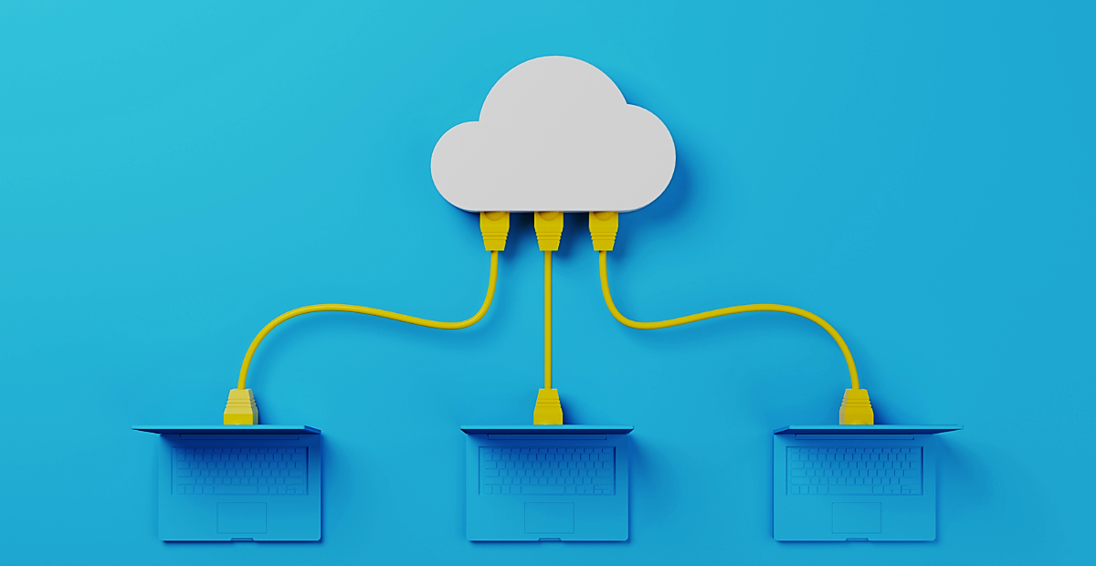
THANK YOU

