Slide 1

Security in Cloud
Understanding Cloud Security
Best Practices in Business

Slide 2
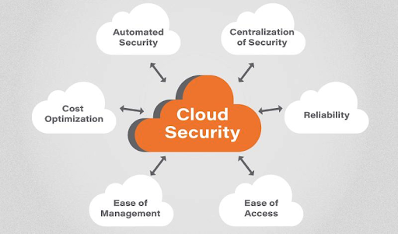
Introduction
What is Security in Cloud?
Cloud security is of utmost importance in today's digital landscape.
It involves safeguarding sensitive data, applications, and infrastructure hosted in the cloud from potential threats and unauthorized access.
Cloud Computing
With the rapid adoption of cloud technologies, it is essential for businesses to understand and implement best practices to protect their valuable data and ensure the integrity and confidentiality of their systems.
Security in Cloud

Slide 3
Security Benefits
Benefits of Cloud Security for Business
In today's digital landscape, businesses rely heavily on cloud services to store, process, and manage their data. Cloud technology offers numerous benefits, including scalability, cost-effectiveness, and flexibility. However, it also introduces new security risks. Without proper security measures in place, businesses are vulnerable to cyberattacks, data leaks, and other security incidents that can have severe consequences, such as financial loss, reputational damage, and legal liabilities.
Cloud Computing
Flexible Features
Security in Cloud
Protection against DDoS attack
Protection against DDoS attack
Benefits
Data Security & Data Integrity
Analyse Risks

Slide 4
Security Models
Cloud Security Models:
Infrastructure as a Service (IaaS): Customers are responsible for securing their applications and data running on cloud infrastructure.
Platform as a Service (PaaS): The cloud provider manages security for the underlying infrastructure, while customers focus on securing their applications.
Software as a Service (SaaS): The cloud provider is responsible for securing both the infrastructure and applications.
Cloud Computing
Security in Cloud

Slide 5
Shared Responsibility Model
The shared responsibility model outlines the division of security responsibilities between the cloud provider and the customer.
Cloud providers typically handle security "of" the cloud, while customers are responsible for security "in" the cloud.
It is essential to understand the specific security responsibilities when working with cloud services.
Cloud Computing
Security in Cloud

Slide 6

Identity and Access Management (IAM)
Implement strong identity and access management controls to ensure only authorized users can access cloud resources.
Use strong authentication mechanisms such as multi-factor authentication (MFA) to add an extra layer of security.
Regularly review and update user access privileges to prevent unauthorized access.
Cloud Computing
Security in Cloud

Slide 7

Data Encryption
Data encryption plays a crucial role in maintaining the confidentiality and integrity of sensitive information stored in the cloud.
Encryption is the process of converting plaintext data into ciphertext, making it unreadable to unauthorized individuals. When it comes to cloud security, data encryption can be implemented in two primary forms: encryption at rest and encryption in transit.
Encrypt sensitive data at rest and in transit to prevent unauthorized access.
Use strong encryption algorithms and key management practices to ensure data confidentiality.
Implement encryption for both storage and communication channels.
Cloud Computing
Security in Cloud

Slide 8
Cont…
Encryption at rest
Encryption at rest refers to the process of encrypting data when it is stored in persistent storage, such as databases or files.
It ensures that even if an unauthorized party gains access to the physical storage media, they won't be able to decipher the encrypted data.
Strong encryption algorithms and robust key management practices should be employed to ensure the effectiveness of encryption at rest.
Encryption at rest
Cloud Computing
Security in Cloud

Slide 9
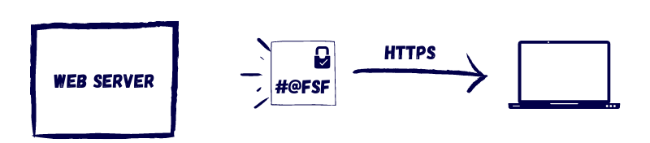
Cont…
Encryption in transit
Encryption in transit, also known as data in motion, involves securing data while it is being transmitted over networks.
It protects against eavesdropping, interception, and tampering by encrypting the data while it travels from the source to the destination.
Transport Layer Security (TLS) and Secure Sockets Layer (SSL) protocols are commonly used for encrypting data during transit.
Cloud Computing
Security in Cloud

Slide 10

Network Security
Implement network security measures, such as firewalls, intrusion detection systems (IDS), and intrusion prevention systems (IPS).
Segregate and isolate different parts of the network to minimize the impact of a potential breach.
Regularly monitor network traffic and analyze logs for any signs of suspicious activity.
Cloud Computing
Security in Cloud

Slide 11
Best Practices for Cloud Security
1. Strong Authentication and Access Control
Implementing strong authentication mechanisms, such as multi-factor authentication (MFA), helps ensure that only authorized individuals can access sensitive data and systems.
Additionally, businesses should regularly review and update access controls to align with their evolving security requirements and employee roles.
Cloud Computing
2. Data Encryption and Privacy
Implementing strong authentication mechanisms, such as multi-factor authentication (MFA), helps ensure that only authorized individuals can access sensitive data and systems.
Additionally, businesses should regularly review and update access controls to align with their evolving security requirements and employee roles.
Security in Cloud

Slide 12
Best Practices for Cloud Security
3. Regular Data Backups
Encrypting sensitive data both in transit and at rest provides an extra layer of protection against unauthorized access. Utilizing encryption technologies, such as SSL/TLS protocols for data in transit and robust encryption algorithms for data at rest, helps safeguard data confidentiality and integrity.
Cloud Computing
4. Monitoring and Auditing
Implementing strong authentication mechanisms, such as multi-factor authentication (MFA), helps ensure that only authorized individuals can access sensitive data and systems. Additionally, businesses should regularly review and update access controls to align with their evolving security requirements and employee roles.
Security in Cloud

Slide 13
Best Practices for Cloud Security
5. Employee Training and Awareness
Employees play a significant role in maintaining cloud security. It is crucial to provide comprehensive training and awareness programs to educate employees about security best practices, the importance of data protection, and how to recognize and report potential security threats.
Cloud Computing
6. Incident Response and Recovery
Having a well-defined incident response plan is essential for minimizing the impact of security incidents. This plan should include clear procedures for reporting, containment, eradication, and recovery. Regularly testing the incident response plan through simulations and tabletop exercises ensures its effectiveness during real incidents.
Security in Cloud

Slide 14
Conclusion
Cloud security best practices are essential for ensuring the integrity, confidentiality, and availability of data and resources in cloud computing environments.
By implementing robust identity and access management, data encryption, network security measures, and secure development practices, organizations can mitigate risks and protect their cloud-based assets.
Continuous monitoring, incident response planning, and adherence to compliance regulations further strengthen cloud security.
Organizations should prioritize employee training and create a security-conscious culture to combat evolving security threats.
Cloud security is an ongoing process that requires regular evaluation, updates, and collaboration with reputable cloud providers.
Cloud Computing
Security in Cloud

Slide 15
Remember
Implement strong identity and access management controls to restrict unauthorized access.
Encrypt sensitive data at rest and in transit using robust encryption algorithms.
Employ network security measures such as firewalls and intrusion detection systems.
Follow secure development practices to minimize vulnerabilities in cloud applications.
Evaluate cloud providers based on their security practices and certifications.
Conduct employee training programs to foster a security-conscious culture.
Implement continuous monitoring and stay updated on emerging threats.
Comply with relevant data protection regulations and consider data residency requirements.
Regularly review and update security measures to address evolving threats.
Cloud Computing
Security in Cloud

Slide 16

THANK YOU

