Slide 1
AGENDA
▸What is DevOps?
▸What problems does DevOps address?
▸How does DevOps relate to Agile?
▸What can DevOps do for you?

Slide 2
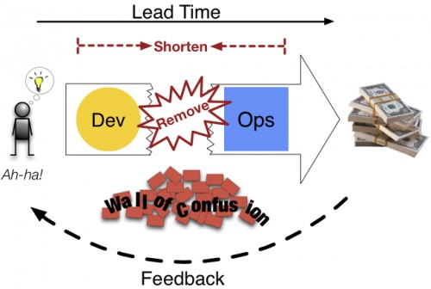
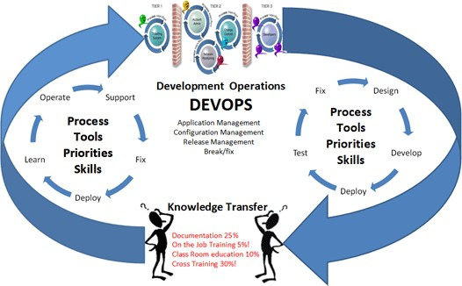
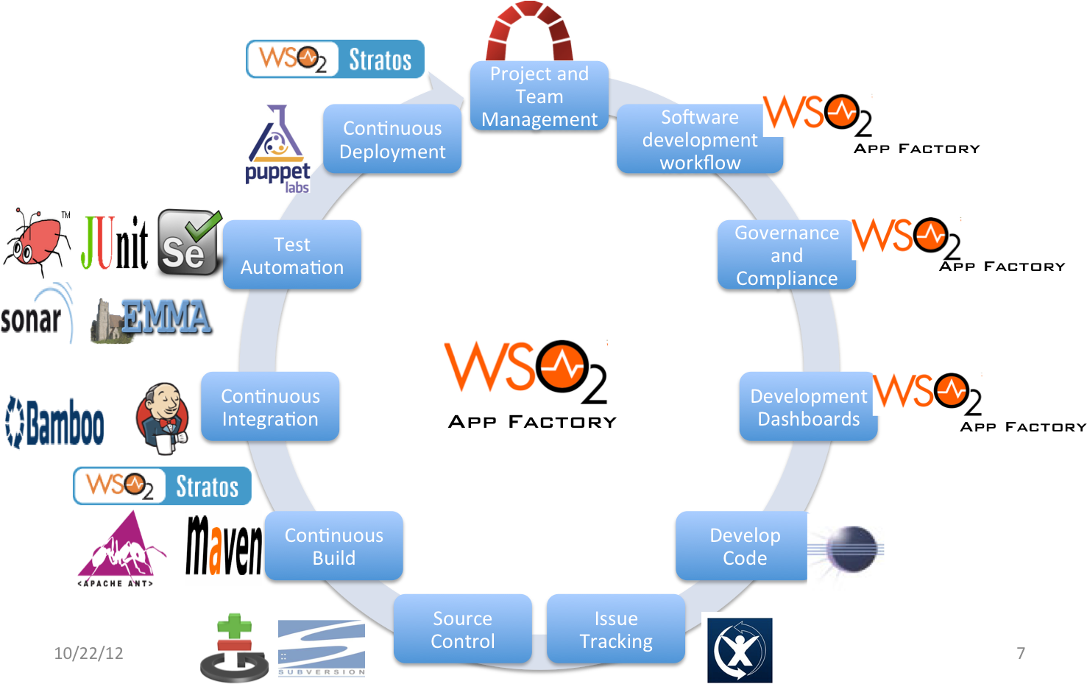
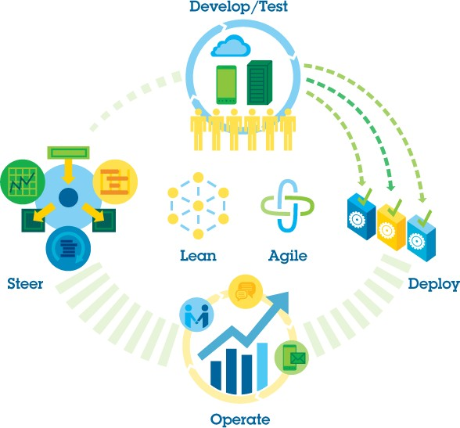

Slide 3
PROBLEM STATEMENT
▸ Everything needs software nowadays.
▸ Software has to run on a server to become a service.
▸ Delivering a service from inception to its users is too slow and error- prone.
▸ There are internal friction points that make this the case.
▸ This loses you money. (delay = loss)
▸ IT is frequently the bottleneck in the transition of “concept to cash.”

Slide 4
SYMPTOMS
PROBLEM STATEMENT
▸ Defects are released into production, causing outages
▸ Inability to diagnose production issues quickly
▸ Problems appear in some environments only
▸ Blame shifting/finger pointing
▸ Long delays while dev, QA, or another team waits on resource or response from other teams
▸ “Manual error” is a commonly cited root cause
▸ Releases slip/fail
▸ Quality of life issues in IT

Slide 5
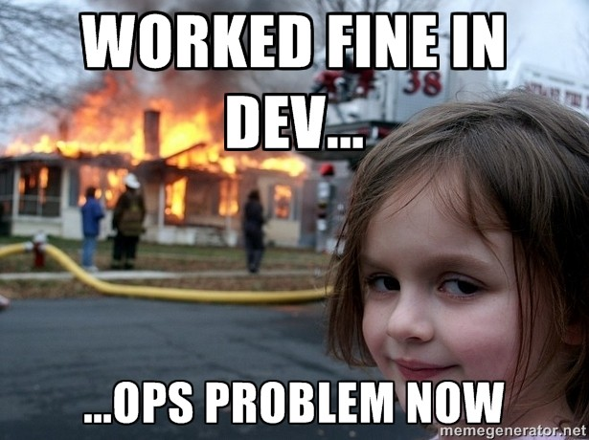

Slide 6

WHAT IS DEVOPS?

Slide 7

DEVOPS IS THE PRACTICE OF OPERATIONS AND DEVELOPMENT ENGINEERS PARTICIPATING TOGETHER IN THE ENTIRE SERVICE LIFECYCLE, FROM DESIGN THROUGH THE DEVELOPMENT PROCESS TO PRODUCTION SUPPORT.

Slide 8
DEVOPS IS ALSO CHARACTERIZED BY OPERATIONS STAFF MAKING USE OF MANY OF THE SAME TECHNIQUES AS DEVELOPERS FOR THEIR SYSTEMS WORK.

Slide 9
DEV
ADDING OPS TO THE AGILE TEAM
PRODUCT
OPS
CONCEPT
CASH
QA

Slide 10
DEVOPS = AGILE?
“DEVOPS IS THE APPLICATION OF AGILE METHODOLOGY TO SYSTEM ADMINISTRATION.”
- Tom Limoncelli, The Practice of Cloud System Administration

Slide 11
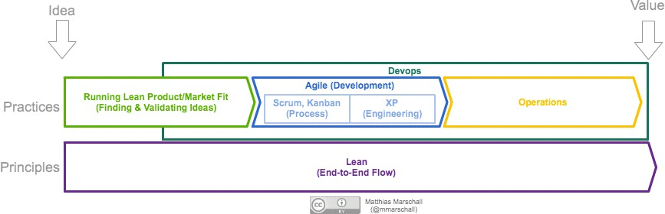

Slide 12
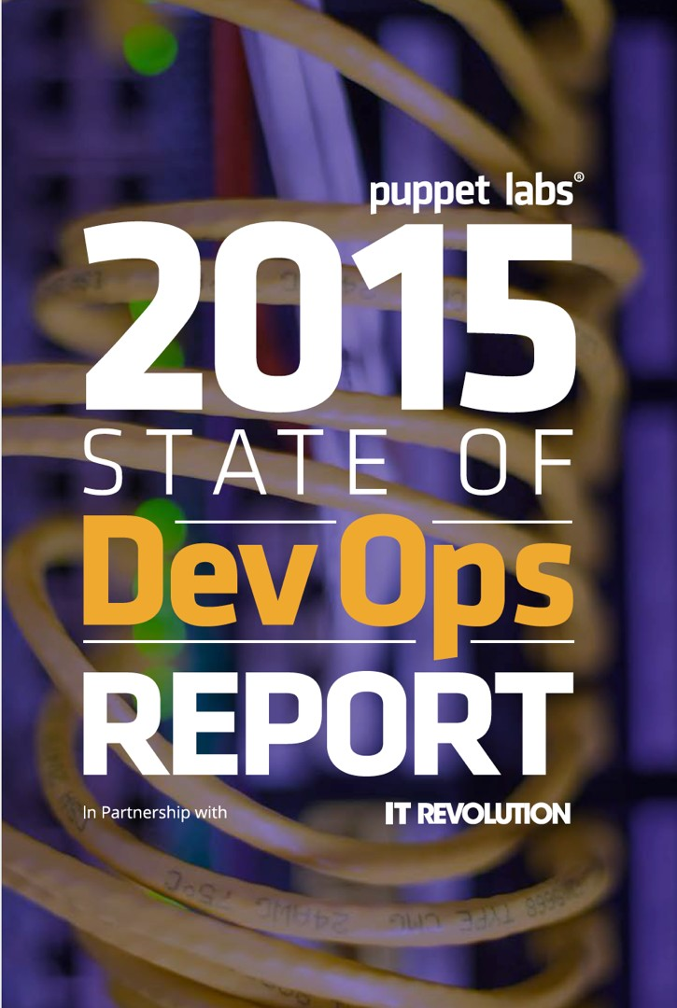
High-performing IT organizations deploy 30x more frequently with
200x shorter lead times; they have 60x fewer failures and recover from issues 168x faster.
Lean management and continuous delivery practices create the
conditions for delivering value faster, sustainably.
High performance is achievable
whether your apps are greenfield, brownfield or legacy.

Slide 13
DEVOPS IN DEPTH

Slide 14
CAMS
DEVOPS CORE VALUES
▸Culture – People > Process > Tools
▸Automation – Infrastructure as Code
▸Measurement – Measure Everything
▸Sharing – Collaboration/Feedback

Slide 15
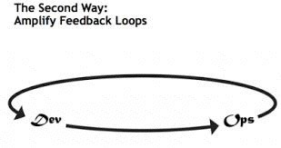
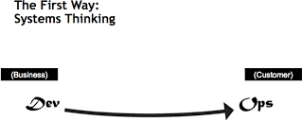
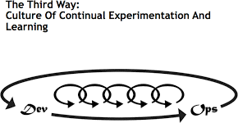
DEVOPS PRACTICES
THE THREE WAYS

Slide 16
THE THREE PILLARS OF DEVOPS
DEVOPS PRACTICE AREAS
▸Infrastructure Automation
▸Continuous Delivery
▸Reliability Engineering

Slide 17
INFRASTRUCTURE AUTOMATION

Slide 18
INFRASTRUCTURE AS CODE
INFRASTRUCTURE AUTOMATION
▸ Automate everything
▸ Infrastructure provisioning
▸ Application deployment
▸Runtime orchestration
▸ Model driven automation

Slide 19
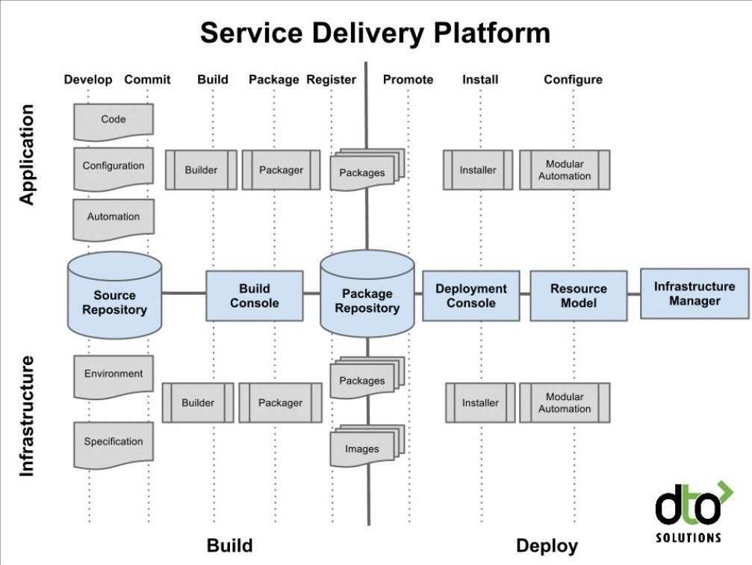
INFRASTRUCTURE AS CODE
INFRASTRUCTURE AUTOMATION
▸ Dev workflow
▸ Write it in code
▸ Validate the code
▸ Unit test the code
▸ Built it into an artifact
▸ Deploy artifact to test
▸ Integration test it
▸ Deploy artifact to prod

Slide 20
INFRASTRUCTURE AUTOMATION TOOLING
TEXT
▸ Infrastructure Models - AWS Cloudformation, Terraform, Azure ARM Templates, Ubuntu Juju
▸ Hardware Provisioning - Packer, Foreman, MaaS, Cobbler, Crowbar, Digital Rebar
▸ Configuration Management - Puppet, Chef, Ansible, Salt, CFEngine
▸ Integration Testing - rspec, serverspec
▸ Orchestration - Rundeck, Ansible, Kubernetes (for docker)

Slide 21
SPECIAL TOPICS
TEXT
▸Immutable deployment with docker
▸Serverless with AWS Lambda/Azure Functions/Google Cloud Functions
▸Single model for infra and apps is best (Juju, Kubernetes)

Slide 22
CONTINUOUS DELIVERY

Slide 23
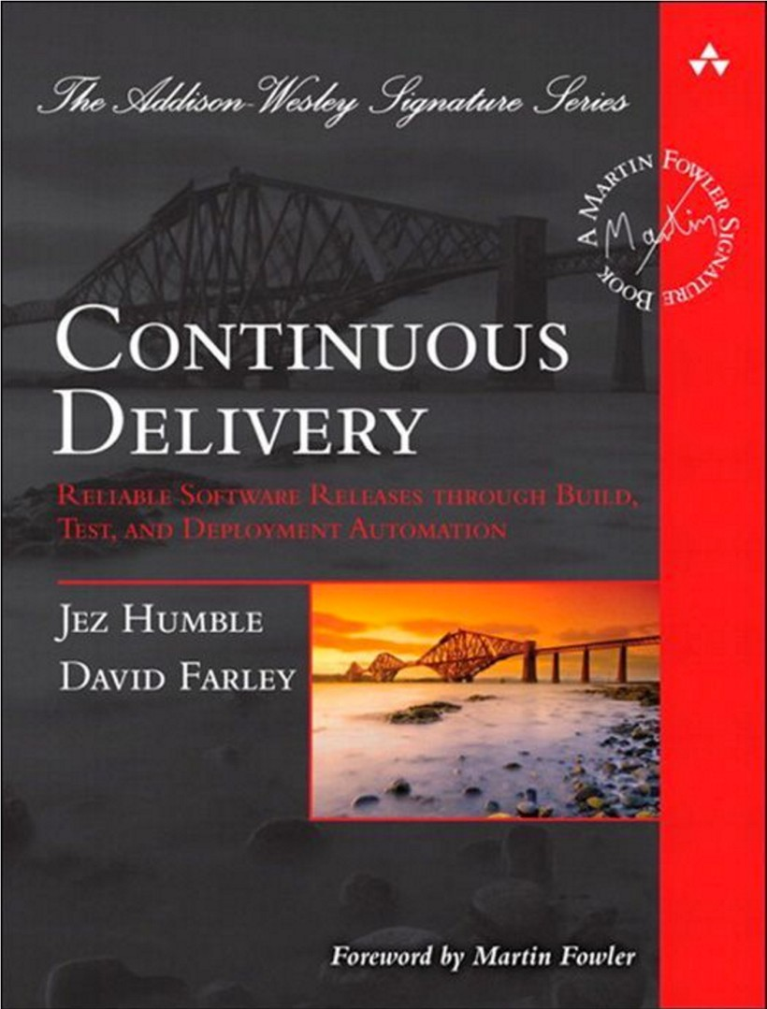
<- All You Need To Know
Integration (CI): Build and test
Deployment (CD): Deploy and integration test
Delivery: All the way to production, baby

Slide 24
LEAN THINKING
“CEASE DEPENDENCE ON INSPECTION TO ACHIEVE QUALITY. ELIMINATE THE NEED FOR INSPECTION ON A MASS BASIS BY BUILDING QUALITY INTO THE PRODUCT IN THE FIRST PLACE.“
W. Edwards Deming

Slide 25
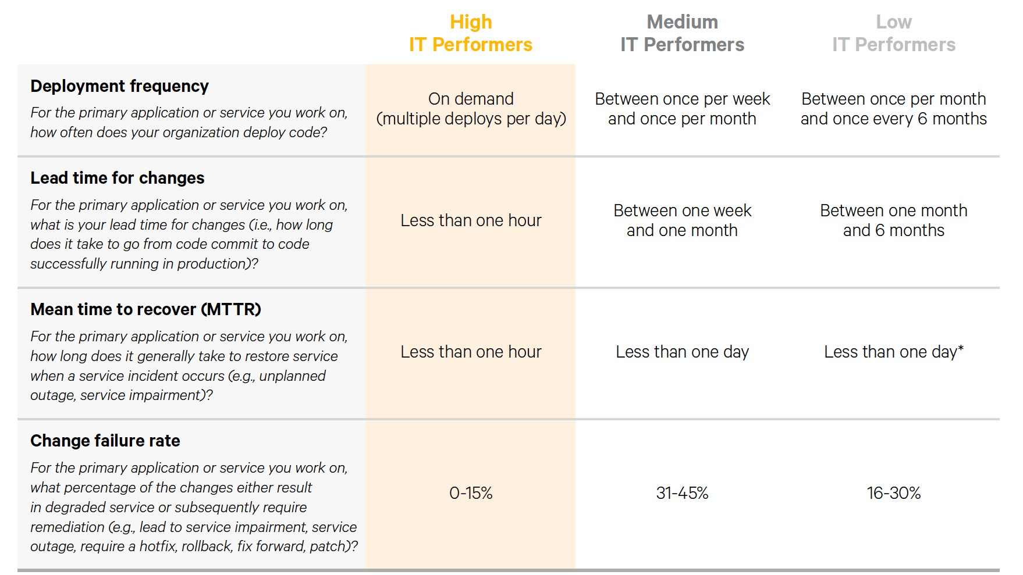

Slide 26
WORKING SOFTWARE, ALL THE TIME
BEST PRACTICES
▸ Builds should pass the coffee test (< 5 minutes)
▸ Commit really small bits
▸ Don’t leave the build broken
▸ Use a trunk/master based development flow (branch less than a day - use feature flags to branch by abstraction)
▸ Don't allow flaky tests, fix them!
▸ The build should return a status, a log, and an artifact.

Slide 27
THE CD PIPELINE
HOW IT WORKS
▸ Only build artifacts once
▸ Artifacts should be immutable
▸ Deployment should go to a copy of production before going into production
▸ Stop deploys if it a previous step fails
▸ Deployments should be idempotent

Slide 28

TEST FOR SUCCESS
TEST FIRST TEST OFTEN
NO PULL REQUESTS
▸ Automated testing is CI table stakes
▸ Unit tests
▸ Integration tests
▸ Crossbrowser, performance, security, etc.
▸ Test driven development, ideally (TDD/BDD/ATDD)
▸ Do it
▸ Stop being a crybaby
▸ Really, do it
WITHOUT TESTS

Slide 29
TOOLING
SHINY TRINKETS
▸ Version Control (git, others, doesn’t matter as long as you use it)
▸ CI System (jenkins, bamboo, circleCI, travisCI)
▸ Build (whatever your platform needs - make/rake, maven, gulp, packer)
▸ Test (*unit, robot/protractor, cucumber)
▸ Artifact Repository (artifactory, nexus, dockerhub, S3)
▸ Deployment (rundeck, ansible, your CM system)

Slide 30
RELIABILITY ENGINEERING

Slide 31
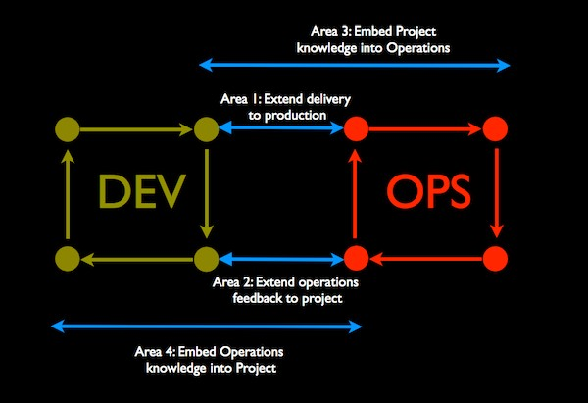

Slide 32
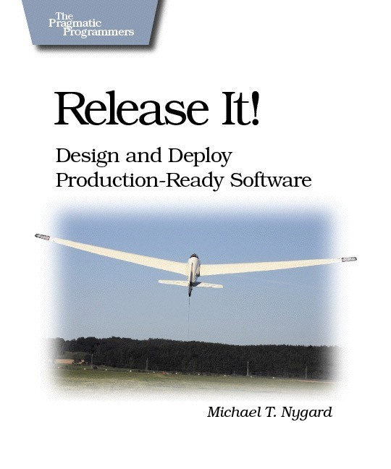
DESIGN FOR OPERATION
RELIABILITY ENGINEERING
▸ Design patterns exist for creating resilient systems.
▸ If your app sucks, there’s only so much an ops team can do about it once it’s deployed.
▸ Devs need to take responsibility for their app through deployment.

Slide 33
ADDING OPS INTO DEV
▸ Enhance Service Design With Operational Knowledge
▸ Reliability
▸ Performance
▸ Security
▸ Test These
▸ Design Patterns (Release It!, 12-factor apps)
▸ Foster a Culture of Responsibility
▸ Whether your code passes test, gets deployed, and stays up for users is your responsibility – not someone else’s
▸ Make Development Better With Ops
▸ Productionlike environments
▸ Power tooling - vagrant, etc.

Slide 34
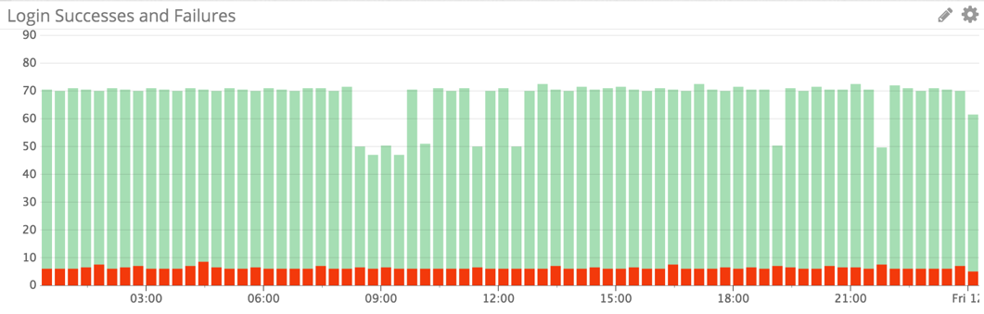
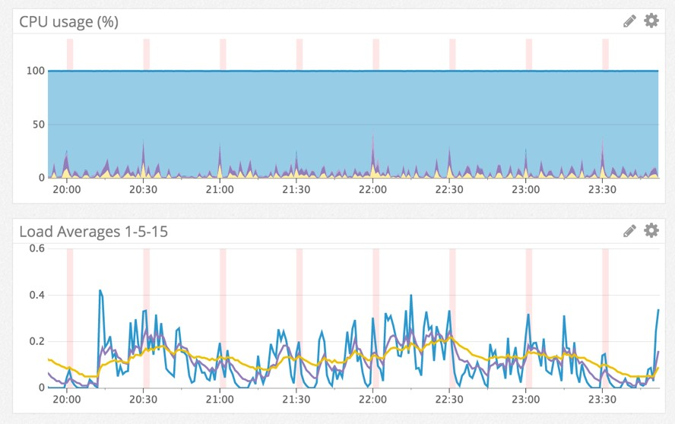
OPERATE FOR DESIGN
RELIABILITY ENGINEERING
▸Build
▸Measure
▸Learn
▸Repeat

Slide 35
ADDING DEV INTO OPS
▸ Don’t do tasks for people. Build tools so they can do their own work. Ops is now a dev team and the platform is their product.
▸ Automate. This means code, and using coder practices (from source control on)
▸ Build Feedback Paths Back To Dev From Production
▸ Monitoring and metrics - Ensure that monitoring/logging/metrics feed back into dev (and the business)
▸ Blameless Incident Postmortems
▸ Developers Do On Call Production Support
▸ SRE model - devs support till it gets big and ops accepts support

Slide 36
TO LEARN MORE
OTHER RESOURCES
▸ Gene Kim, John Willis, Jez Humble, and Damon Edwards’ The DevOps Handbook
▸ Gene Kim’s The Phoenix Project
▸ Jez Humble’s Continuous Delivery
▸ Michael Nygard’s Release It!
▸ Tom Limoncelli’s The Practice Of Cloud System Administration
▸ Mary and Tom Poppendieck’s Lean Software Development
▸ Velocity Conference (velocityconf.com)
▸ DevOpsDays Conferences (devopsdays.org)
▸ DevOps Weekly newsletter (devopsweekly.com)
▸ DevOps Café Podcast (devopscafe.com)
▸ The Twelve Factor App (12factor.net)
▸ The Agile Admin (theagileadmin.com)

Slide 37
GETTING STARTED
NEXT STEPS
▸Automated infrastructure and automated testing give you safety
▸Making it all continuous gives you speed and safety
▸Engineering for reliability gives you more safety
▸Accelerating flow makes you money

Slide 38
BONUS PRO TIP: BIMODAL IT

Slide 39
FUD BUNKER
BIMODAL HAS MOVED FROM 38% OF COMPANIES ADOPTING THIS STRATEGY IN 2016 TO 43% IN 2017.
Gartner

Slide 40
TRUTH BOMB
AM I THE ONLY ONE WHO READS THIS AS “43% OF COMPANIES STILL CAN’T FIGURE OUT WHY THEIR IT ORGANIZATIONS ARE DYSFUNCTIONAL”?
Damon Edwards

Slide 41
THANKS!

