Slide 1
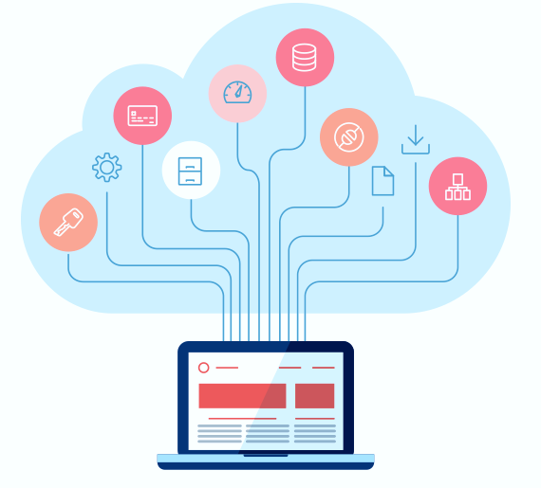
Software as a Service
Fundamentals of SaaS

Slide 2
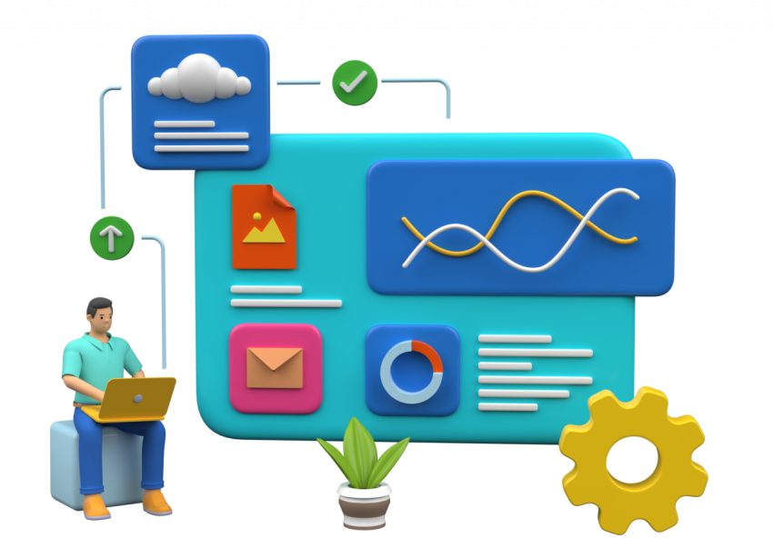
Introduction
What is SaaS?
SaaS stands for Software as a Service.
It is a cloud computing model where software applications are provided to users over the internet. Users access the software through a web browser, eliminating the need for installation and maintenance on their local machines.
Cloud Computing
With SaaS, users can remotely access the software without the need for installation on their local devices. This model allows businesses to subscribe to the software service with a monthly fee and a pay-as-you-go approach, providing flexibility and cost-effectiveness.
Software as a Service

Slide 3
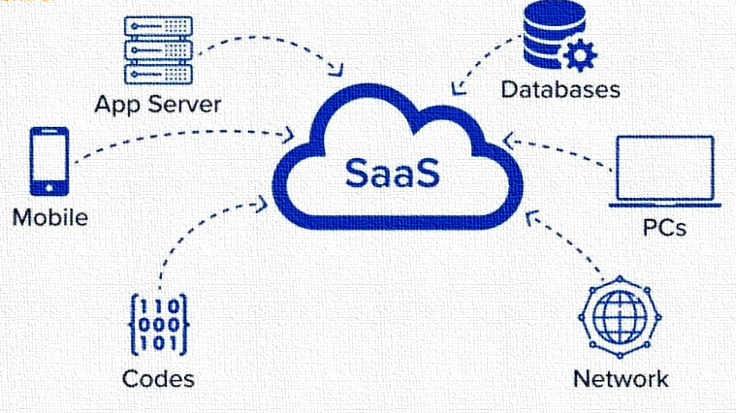
Cont…
How Does SaaS Work?
SaaS providers host and manage the software applications on their servers. Users access the applications through a client interface, usually a web browser. The provider takes care of software updates, security, and infrastructure management, allowing users to focus on using the software rather than maintaining it.
Cloud Computing
Software as a Service
The future of SaaS

Slide 4
Benefits of SaaS
Benefits of SaaS
Cost Savings: SaaS eliminates the need for upfront hardware and software investments, reducing costs for businesses.
Scalability: SaaS allows users to easily scale up or down based on their requirements, paying only for the resources they use.
Accessibility: Users can access SaaS applications from any device with an internet connection, enabling remote work and collaboration.
Easy Updates: SaaS providers handle software updates and patches, ensuring users always have access to the latest features and improvements.
Cloud Computing
Software as a Service

Slide 5
Advantages of SaaS for Businesses
Advantages for Businesses
Rapid Deployment: SaaS applications can be quickly deployed, reducing time-to-market for businesses.
Lower Maintenance: With SaaS, businesses don't need to worry about software maintenance, updates, or infrastructure management.
Enhanced Collaboration: SaaS applications often include collaboration features, enabling teams to work together seamlessly.
Improved Security: SaaS providers implement robust security measures to protect user data, often surpassing what individual businesses can achieve.
Cloud Computing
Software as a Service

Slide 6
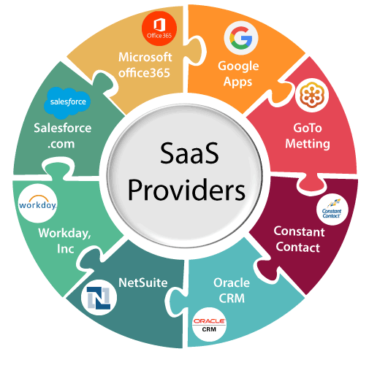
SaaS Applications
Examples of SaaS Applications
Customer Relationship Management (CRM) systems like Salesforce.
Project Management tools such as Asana and Trello.
Communication and Collaboration platforms like Slack and Google Workspace.
Accounting Software such as QuickBooks Online and Xero.
Cloud Computing
Software as a Service

Slide 7
SaaS vs Traditional Software
SaaS vs. Traditional Software
SaaS: Pay-as-you-go pricing, no upfront costs, automatic updates, scalable, accessible from anywhere.
Traditional Software: Upfront license fees, installation required, manual updates, limited scalability, tied to specific devices.
Cloud Computing
SaaS Adoption Considerations
Data Security: Assess the security measures implemented by the SaaS provider to protect your sensitive data.
Service Level Agreements (SLAs): Review the SLAs to ensure the availability and performance of the SaaS application meet your business needs.
Integration Capabilities: Check if the SaaS application can integrate with your existing systems and workflows.
Vendor Reputation: Research the vendor's reputation, customer reviews, and track record before committing to a SaaS solution.
Software as a Service

Slide 8
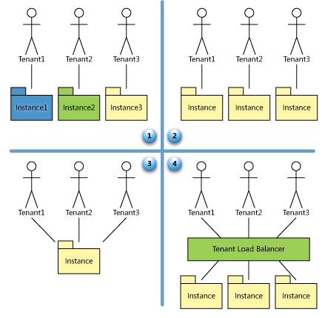
SaaS Maturity Model
What is SaaS Maturity Model?
The SaaS Maturity Model is a framework that helps organizations assess and enhance their capabilities in adopting and leveraging Software as a Service (SaaS). It provides a structured approach to understand the journey from initial adoption to full utilization and optimization of SaaS solutions. Let's explore the different stages of the SaaS Maturity Model.
Cloud Computing
Software as a Service

Slide 9
SaaS Maturity Model
Stage 1: Ad Hoc
At the initial stage, organizations have limited awareness and experience with SaaS. Adoption is ad hoc, with sporadic usage of SaaS applications. There is a lack of standardized processes and governance. The focus is primarily on solving immediate challenges rather than long-term strategy.
Stage 2: Defined
Cloud Computing
In the defined stage, organizations start formalizing their SaaS adoption. There is a clearer understanding of business requirements and alignment with SaaS solutions. Defined processes and governance frameworks are established, ensuring better control and security. However, the usage of SaaS is still limited to specific departments or functions.
Software as a Service
Stage 3: Managed
At the managed stage, organizations have a comprehensive strategy for SaaS adoption. SaaS applications are managed across the organization with standardized processes and controls. Integration with other systems is prioritized, enabling data flow and collaboration. Cost optimization and vendor management strategies are implemented.

Slide 10
SaaS Maturity Model
Stage 4: Optimized
In the optimized stage, organizations have fully embraced SaaS and maximize its potential. SaaS solutions are strategically aligned with business goals. Continuous improvement and innovation are emphasized, leveraging analytics and insights to drive optimization. Scalability, security, and performance are key considerations.
Key Benefits of the SaaS Maturity Model:
Clear Roadmap: The model provides a roadmap for organizations to progress from initial adoption to optimized utilization of SaaS, ensuring a strategic approach.
Governance and Control: It helps establish standardized processes and governance frameworks, enabling better control and security.
Integration and Collaboration: Organizations can focus on integrating SaaS applications with other systems, fostering data flow and collaboration.
Cost Optimization: The model facilitates cost optimization strategies by evaluating SaaS investments, avoiding redundant applications, and optimizing vendor management.
Innovation and Optimization: It encourages organizations to continuously improve and innovate, leveraging insights to drive optimization and gain a competitive edge.
Cloud Computing
Software as a Service

Slide 11
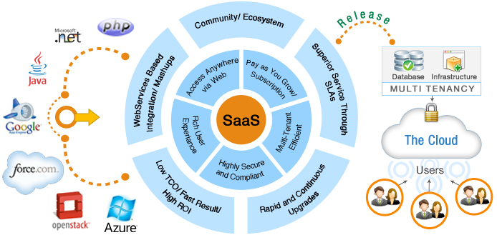
Consideration for SAAS Application development
Cloud Computing
Software as a Service

Slide 12
Important factors for good design of SAAS model
A well-designed SaaS application can be distinguished from a poorly designed one based on three key factors: scalability, configurability, and multi-tenancy efficiency.
Scalability: A well-designed SaaS application focuses on maximizing concurrency and efficiently utilizing resources. This involves optimizing factors such as locking duration, statelessness, utilizing shared resources like threads and network connections, caching reference data, and partitioning large databases.
Configurability: In a well-designed SaaS application, customization and configuration are achieved without the need for code changes. Each customer should be able to configure the application to meet their specific needs, without affecting other customers. The application should provide simple and easy-to-use tools for customers to configure the appearance and behavior of the application for their users, without incurring additional development or operational costs.
Cloud Computing
Software as a Service

Slide 13
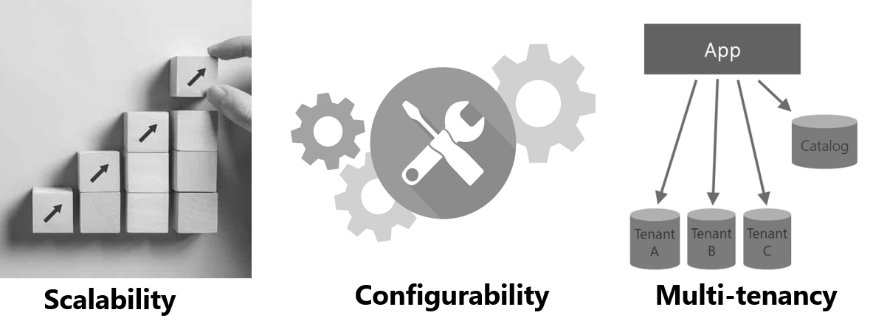
Important factors for good design of SAAS model
Multi-tenancy: A well-designed SaaS application embraces a multi-tenant architecture, allowing multiple companies to use the same application instance simultaneously while ensuring transparency. The architecture should enable efficient sharing of resources across tenants, ensuring optimal utilization and performance.
Cloud Computing
Software as a Service

Slide 14
Challenges & Future Trends
SaaS Implementation Challenges:
Data Migration: Transferring data from existing systems to a SaaS application can be complex and time-consuming.
Internet Connectivity: SaaS applications require a stable internet connection for uninterrupted access.
Customization Limitations: SaaS applications may have limited customization options compared to on-premises software.
Vendor Lock-in: Evaluate the contract terms and exit strategy in case you decide to switch or terminate the SaaS service.
Cloud Computing
Future Trends in SaaS
Industry-Specific Solutions: SaaS offerings tailored to specific industries will continue to grow.
Artificial Intelligence (AI) Integration: SaaS applications will increasingly leverage AI capabilities for enhanced functionality and user experience.
Internet of Things (IoT) Integration: SaaS solutions will integrate with IoT devices to enable data-driven insights and automation.
Hybrid SaaS Models: Hybrid models combining SaaS and on-premises solutions will emerge to meet diverse business requirements.
Software as a Service

Slide 15
Conclusion
Software as a Service (SaaS) offers numerous advantages, including cost savings, scalability, and accessibility.
Businesses can leverage SaaS to streamline operations, improve collaboration, and focus on core competencies.
As technology continues to evolve, SaaS will play a crucial role in driving digital transformation and innovation.
Cloud Computing
Software as a Service

Slide 16
Remember
Scalability: Plan for growth and optimize resource usage.
Security: Prioritize data protection and implement robust security measures.
User Experience: Focus on intuitive interfaces and seamless workflows.
Integration: Provide APIs for seamless integration with other systems.
Monitoring: Implement monitoring and analytics for performance tracking.
Documentation: Offer comprehensive user guides and support resources.
Continuous Improvement: Gather feedback and iterate for ongoing enhancements.
Cloud Computing
Software as a Service

Slide 17
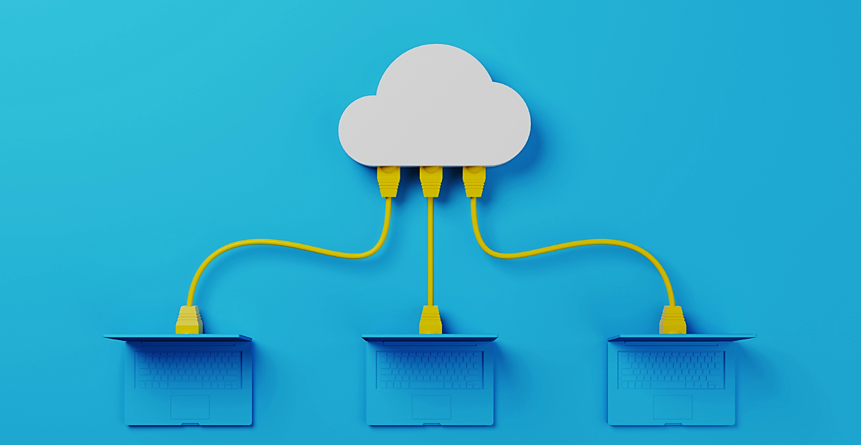
THANK YOU

