Slide 1
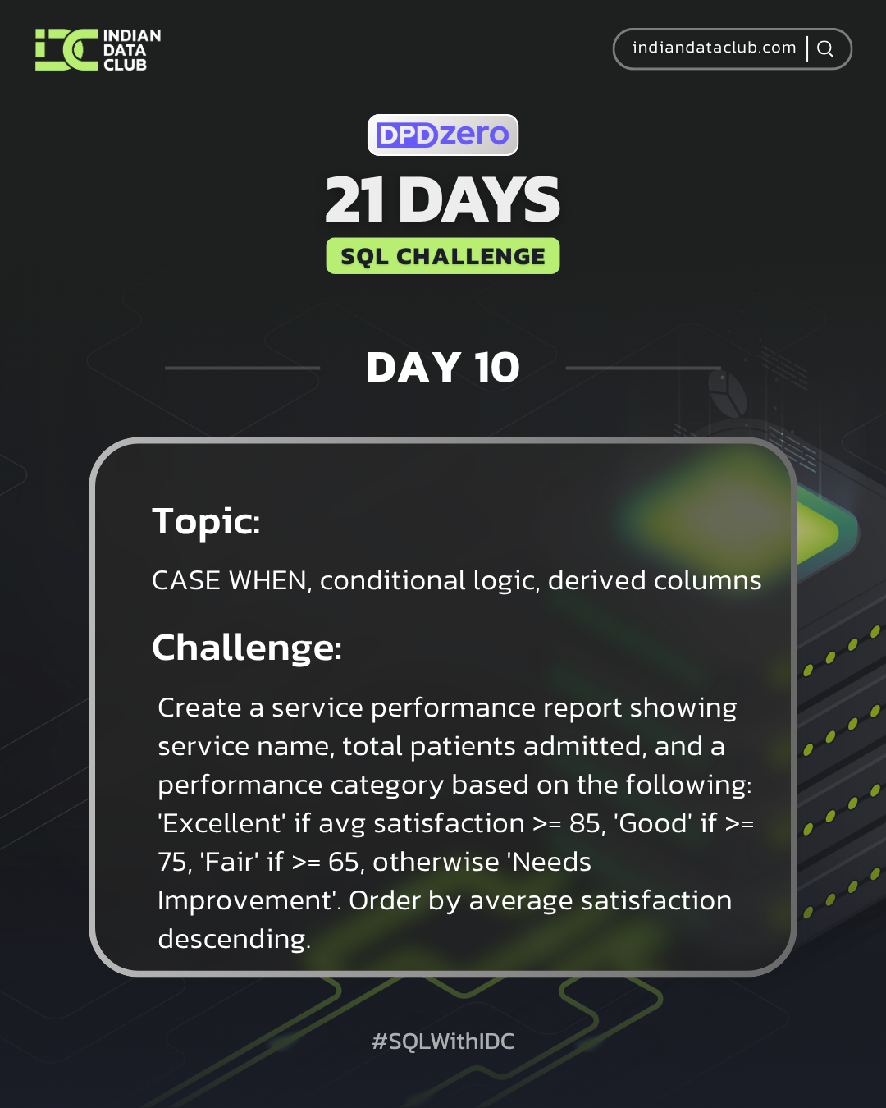

Slide 2

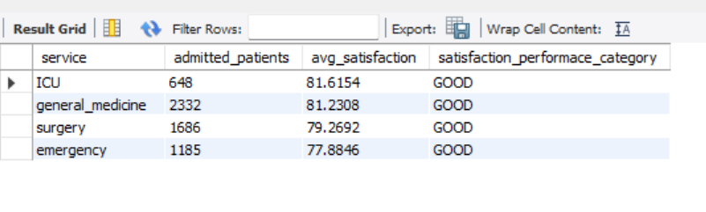
Day 10
QUERY:
SELECT service,sum(patients_admitted) as admitted_patients, avg(patient_satisfaction) as avg_satisfaction,
CASE
WHEN avg(patient_satisfaction) >= 85 then "EXCELLENT"
WHEN avg(patient_satisfaction) >= 75 then "GOOD"
WHEN avg(patient_satisfaction) >= 65 then "FAIR"
ELSE "NEEDS IMPROVEMENT" END as avg_satisfaction
FROM services_weekly
GROUP BY service
ORDER BY avg_satisfaction desc;
RESULT:
Daily Challenge:
Question: Create a service performance report showing service name, total patients admitted, and a performance category based on the following: 'Excellent' if avg satisfaction >= 85, 'Good' if >= 75, 'Fair' if >= 65, otherwise 'Needs Improvement'. Order by average satisfaction descending.

Slide 3
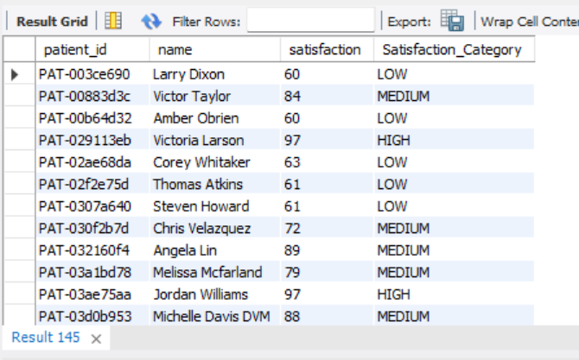
Day 10
RESULT:
QUERY:
SELECT patient_id,name,satisfaction,
CASE
WHEN satisfaction>=90 then "HIGH"
WHEN satisfaction>=70 then "MEDIUM" ELSE "LOW" END as Satisfaction_Category
FROM patients;
Practice Question:
1. Categorise patients as 'High', 'Medium', or 'Low' satisfaction based on their scores

Slide 4
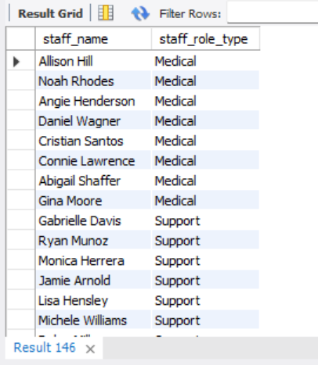
Day 10
RESULT:
QUERY:
SELECT distinct staff_name,
CASE
WHEN role="doctor" then "Medical"
ELSE "Support" END as staff_role_type
FROM staff_schedule;
Practice Question:
2. Label staff roles as 'Medical' or 'Support' based on role type.

Slide 5
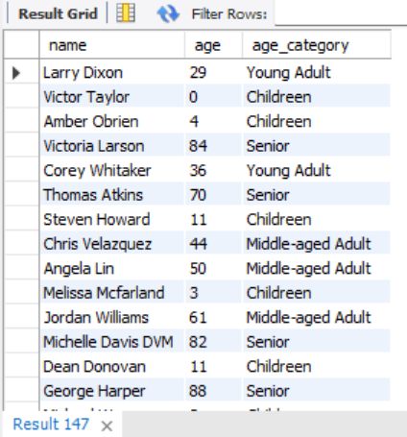
Day 10
QUERY:
Select name,age,
CASE
WHEN age between 0 and 18 then "Childreen"
WHEN age between 19 and 40 then "Young Adult"
WHEN age between 41 and 65 then "Middle-aged Adult"
ELSE "Senior"
END as age_category
FROM patients;
RESULT:
Question 3. Create age groups for patients (0-18, 19-40, 41-65, 65+).

