Slide 1

School Library
Instructor:
Saeedeh Shekarpour
Team Members:
Minaly Yalamanchili Jyothi Mavilla

Slide 2
Contents
Aim and Reference
Rdfs graph
Classes used
Object properties
Data properties
Onto Graph

Slide 3
Aim & Reference
Ontology : It is a form of representation of a particular domain and it’s set of concepts with all the associated properties and relations between them.
Reference :
https://udayton.edu/libraries/
Roesch Library (University of Dayton)

Slide 4
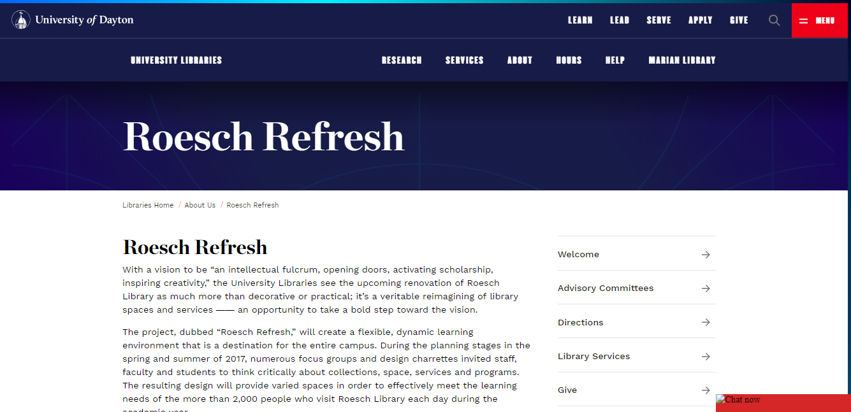

Slide 5
RDFS:Class
RDFS:Property
Vocabulary Layer
Rdf:type
Rdf: type
Rdf : type
Rdf:type
Library
Person
has
FirstName
Book
R
D
F
S
L
A
Y
E
R
Rdf: subclassOf
Academic
Rdf: subclassOf
Rdf: subclassOf
Public
Student
Professor
Novels
BookAuthor
SchoolBooks
Librarian
Staff
Rdf: type
Rdf: type
Ex: Roesch
worksIn
Ex: Kathie
RDF Layer

Slide 6

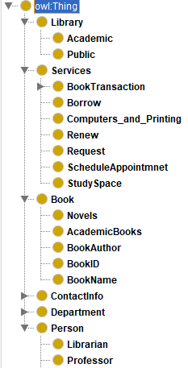




Classes

Slide 7
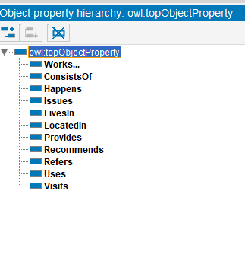
Object Properties

Slide 8
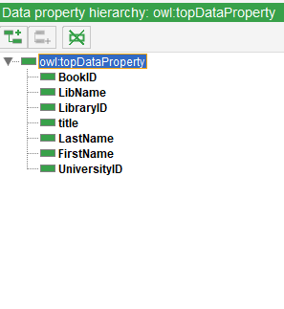
Data Properties

Slide 9
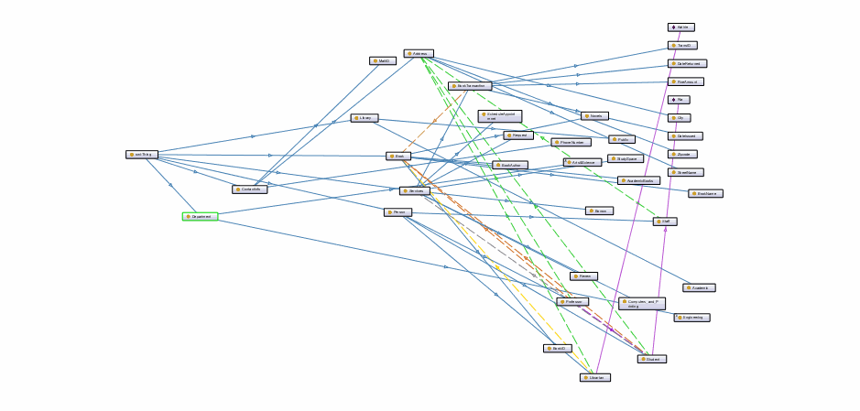
OntoGraph

