Slide 1


DEPARMENT OF ELECTRONICS AND COMMUNICATION ENGINEERING
TKR COLLEGE OF ENGINEERING AND TECHNOLOGY
TKR COLLEGE OF ENGINEERING AND TECHNOLOGY
SOLAR BASED SMART ROOF FROM UNUSUAL RAINFALL EVENTS USING ARDUINO
Co-Ordinator:
Mrs. K. SUDHA RANI Associate Professor
Under the Guidance of :
Mr S. Balakrishna
Assistant professor
BY:
G. Sriya 22K91A0466
J. Gowtham 22K91A0483
K. Anish 22K91A04A0
K. Jyothi 22K91A04A8
Mrs. K.SUSHMA Assistant Professor

Slide 2
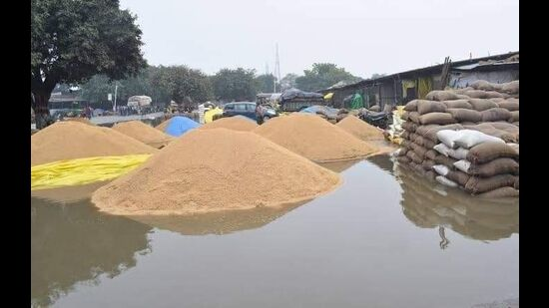
AIM
The main aim of the project is to protect the crops which are kept for dry up from unusual rains. Many times crop which is kept for dry up leads to huge loss for the farmers due to unseasonal rains.
Solar based Automatic crop protection from unusual rainfalls develop a solar-powered automatic crop protection system that uses a rain sensor to detect rainfall and activates a mechanical roof to shield crops from unexpected rain, ensuring crop safety and reducing manual effort.

Slide 3
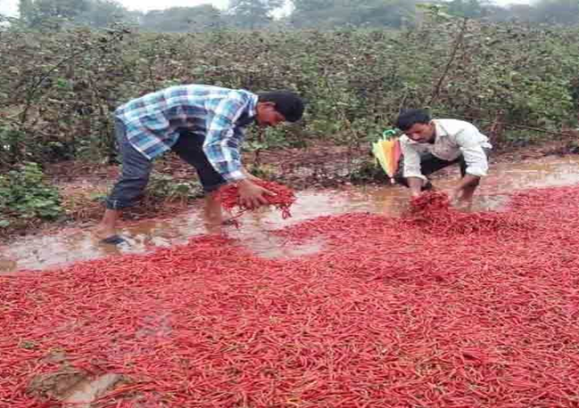
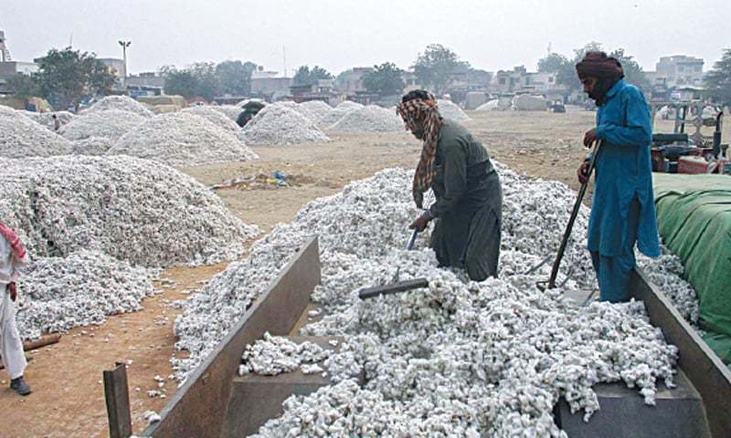
Existing method
Current Techniques: Traditional crop protection methods include chemical pesticides and manual irrigation adjustments; however, these approaches can be labor-intensive and environmentally damaging
Limitations of Existing Methods: Current practices may not adequately address sudden weather changes, leading to crop losses or inappropriate responses to unpredicted weather events.

Slide 4
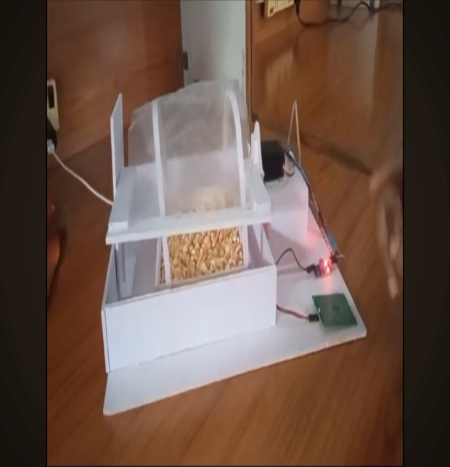
Proposed Method
System Overview: Our proposed method introduces an automated system that actively monitors environmental conditions and deploys protective measures against adverse weather, specifically focusing on rain.
Solar Power Integration: Harnessing solar energy not only provides a sustainable power source but also reduces operational costs over time, making the system more viable for farmers.
Automation Features: The system incorporates automation, enabling sensors to trigger actuators that protect crops in real-time, ensuring swift action leading to minimized damage

Slide 5
BLOCK DIAGRAM
Automated solar energy
Arduino Uno
Servo motor
STEPPER MOTOR
LDR
Rain Drop sensor
Roof

Slide 6
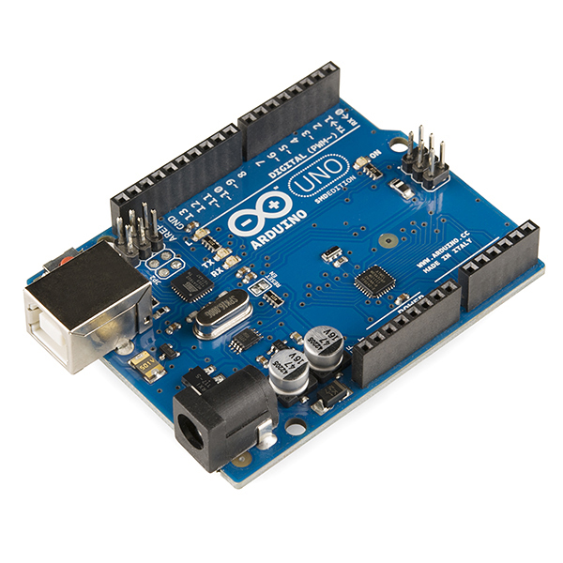
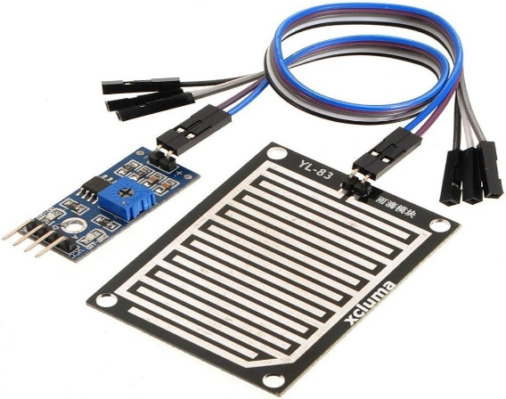
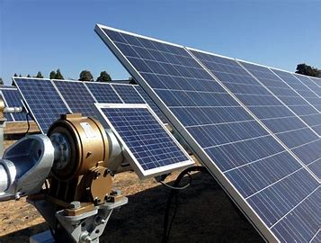
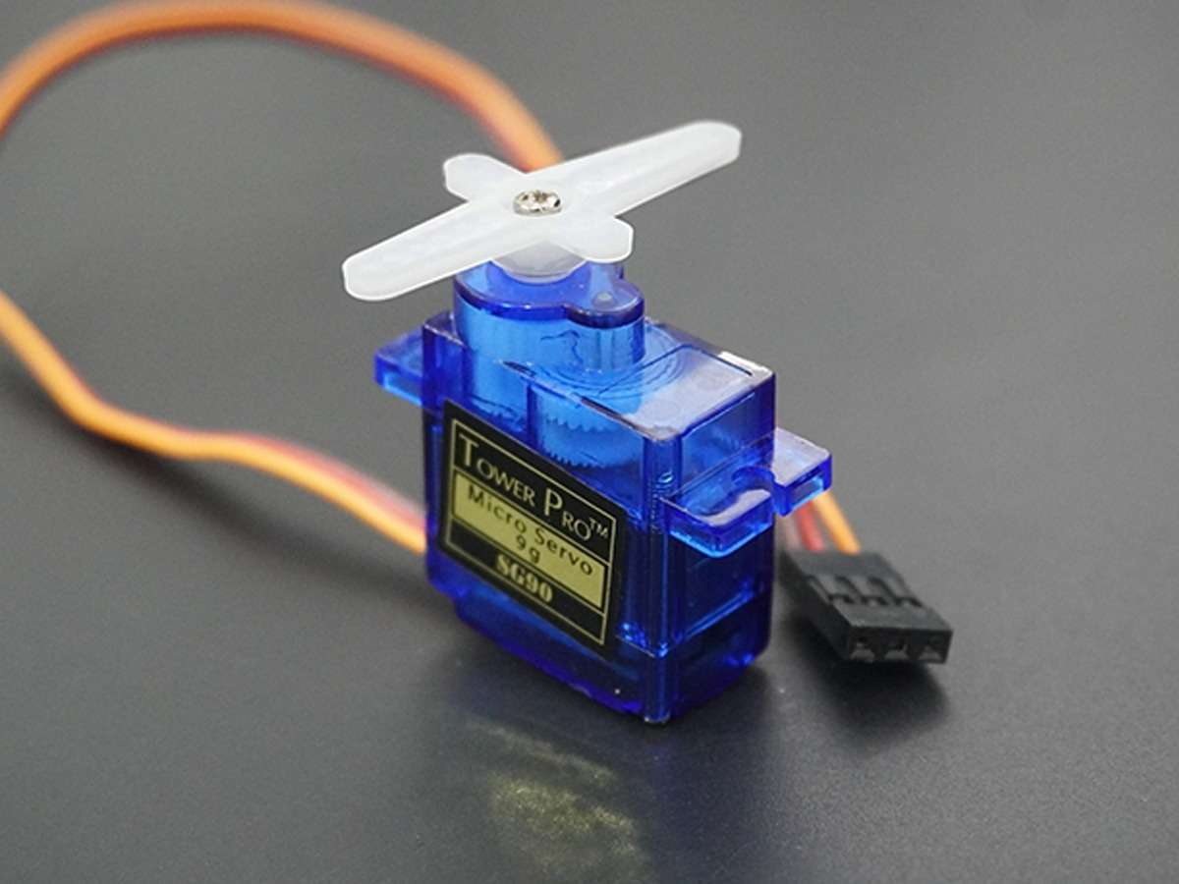
HARDWARE COMPONENTS
ARDUINO UNO
RAIN DROP SENSOR
SERVO MOTOR
AUTOMATED SOLAR ENERGY
LDR
STEPPER MOTOR

Slide 7
ADVANTAGES
Reduce crop damage
Reduce labour cost
System works for longer period
Energy efficient & eco friendly
Protection for outdoor spaces

Slide 8
APPLICATIONS
Terrace gardens and car parking sheds
Farm storage areas
Industrial use-open storage yards & construction sites
Restaurant and resorts

Slide 9
REFERENCES
“Automatic Crop Protection from Heavy Rainfall and Preserving Rain Water” by the International Journal of Advanced Science and Technology.
"Automatic Harvested Crop Protector from Rain" by Ashokkumar, K. et al., published in the Journal of Computational and Theoretical Nanoscience.
"Automatic Crop Protection system during Harvesting" by B. Abdul Raheem et al., published in the International Journal of Engineering Research.

Slide 10
THANK YOU

