Slide 1

INDUSTRIAL ORIENTED MINI PROJECT
CANTEEN AUTOMATION SYSTEM

Slide 2
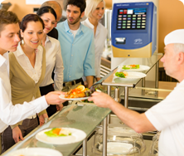
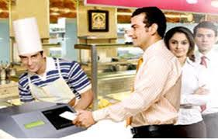
CANTEEN AUTOMATION SYSTEM
This Canteen Automation System enables the end users to register online, read and select the food from e-menu card and order food online by just selecting the food that the user want to have using android application. The results after selecting the food from the E-menu card will directly appear in the screen near the Chef who is going to cook the food for you. The system is the combination of Android as well as Web Application. By using this application, the work of the waiter is reduced and we can also say that the work is nullified. The benefit of this is that if there is rush in the Canteen then there will be chances that the waiters will be unavailable and the users can directly order the food to the chef online by using this application. The user will have a username and a password, by using which they can login into the system. This implies that the customer is the regular user of the Canteen.

Slide 3
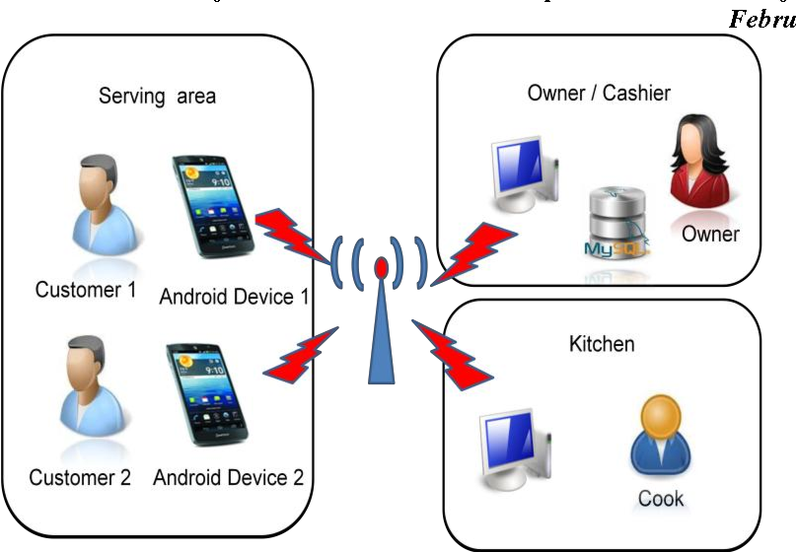
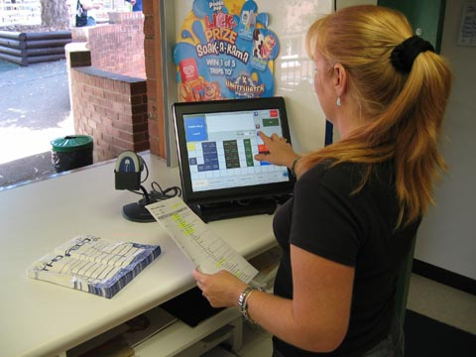
Manual system involves paper work in the form of maintaining various files and manuals. Maintaining critical information in the files and manuals is full of risk and a tedious process. Including a framework showing how to apply Internet technology progressively as skills and confidence grow, the project demonstrates the route from adapting materials to developing an online environment. Nowadays people don’t have much time to spend in canteen by just there and waiting for the waiter to take their order. Many customers visit the canteen in their lunch break and recess so they have limited time to eat and return to their respective office and colleges. So, this software helps them to save time and order food whenever they want without calling the waiter again and again.

Slide 4
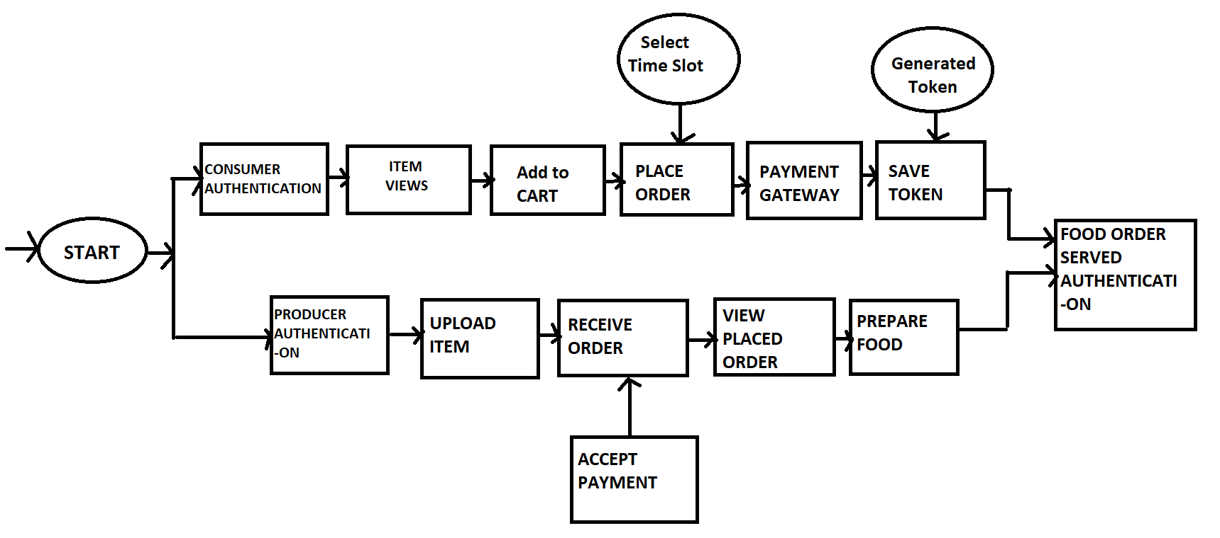
WORK FLOW:

Slide 5
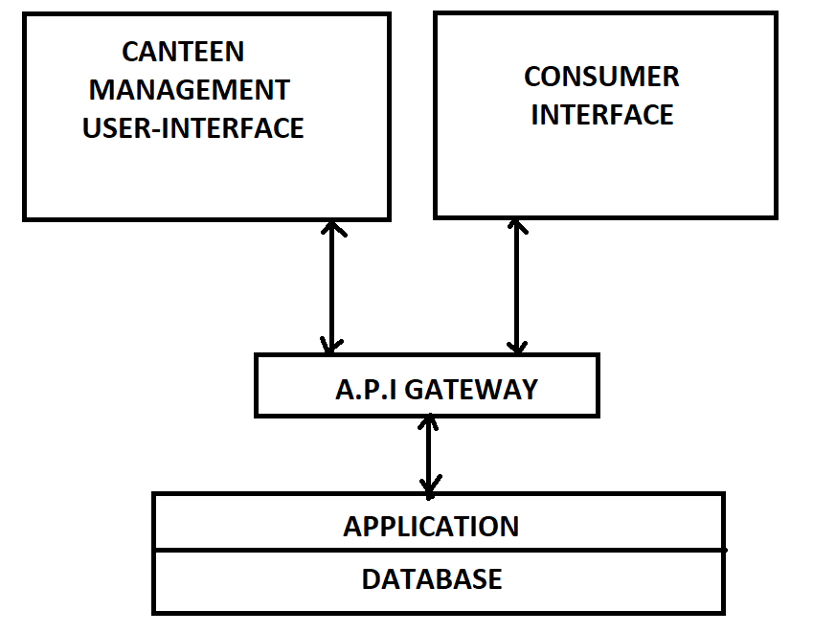
STRUCTURAL IMPLEMENTATION:

Slide 6
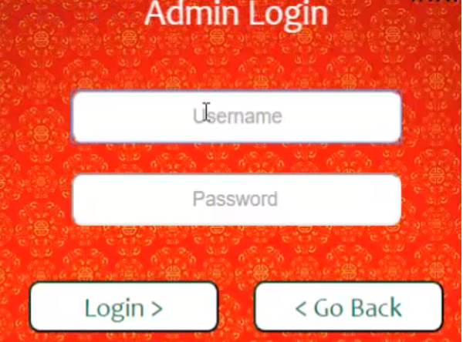
MODULES:
The system comprises of 3 major modules and their sub modules as follows:
ADMIN LOGIN:
  Take Order
  Bill Print
  Add/ Remove Food Items
  Update Inventory
  Order Forecasting (Predict Items Most Frequently During Specific Hours)
  Sales for each day and month
  Sales of individual item for the day
  Total Earnings

Slide 7
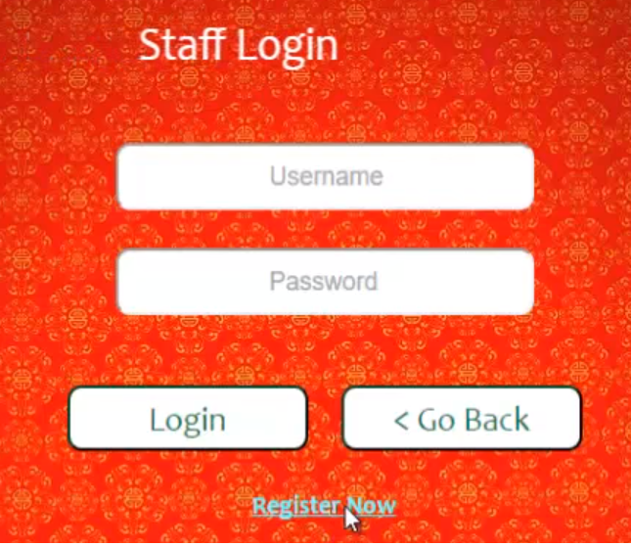
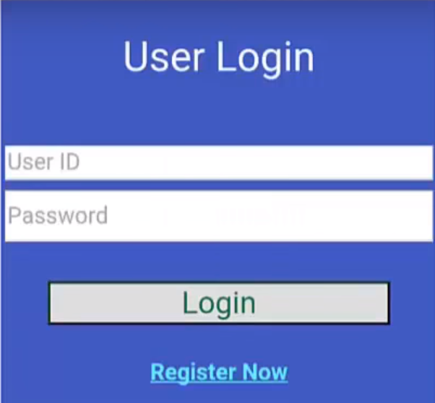
fcs
STAFF LOGIN:
  Order placed by Customer
  Order Forecasting
USER LOGIN:
  Menu Items
  Place an Order
  Combo Box Selection
  Bill Payment

Slide 8
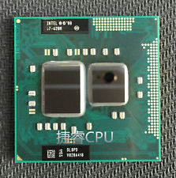
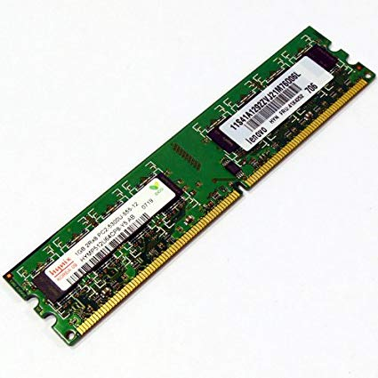
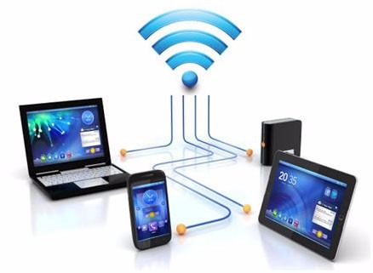
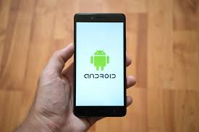
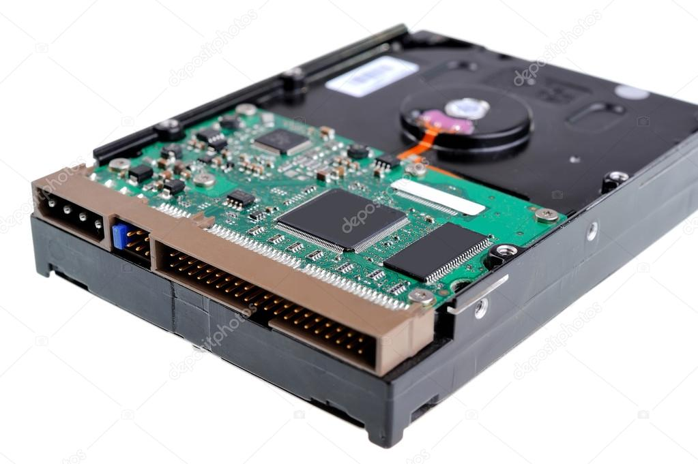
HARDWARE REQUIREMENT:
Processor with 1Ghz or higher
Memory: 1 GB RAM
Hard Drive: 50 GB
Internet Connection
Android Device with 2GB RAM or higher

Slide 9
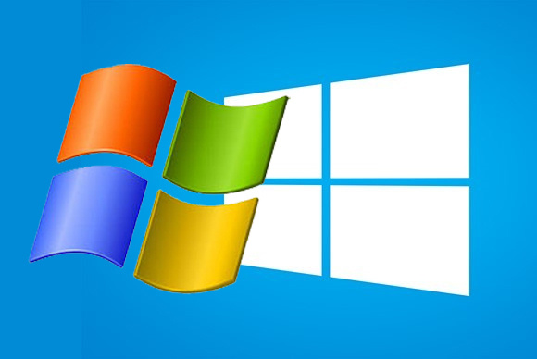



Software Requirements:
Windows 7 or higher
Android Development Toolkit (ADT)
VISUAL STUDIO 2010
SQL Server 2008
Android 4.0 or higher

Slide 10
ADVANTAGES:
Completely automated online ordering of food in a canteen.
Order can be placed using personal android phones.
Food ordering pages that look and feel exactly the same as the existing restaurant website.
User can also order a Special Combo Box which contains multiple food items.
Food ordering pages hosted on secure and special server so no risk of customers getting redirected to servers where competitors' websites are listed.
Developed using the latest website programming protocols for minimum server loads and ultra-fast loading and processing.
Simple user-interface Admin Panel for creation and configuration of menu groups, menu items, etc.
Built-in facility to set modifiers on different menu items
Facility to create modifier groups, individual modifier items and assign modifier items into different groups
Single and individual Admin Panel and login for each Canteen
Detailed summary of orders placed with option to search orders, update order status, print orders, etc.
Various reports to view total sales, details of registered members with facility to print report.

Slide 11
Disadvantages:
      Requires an active internet connection.
      Requires Android phone if user is ordering.
APPLICATION:
This can be used in cafeterias, restaurants, etc.

Slide 12

Conclusion:
  One of the most common problems of canteens is overcome by technology that enables people to have more time efficient stress free environment.
  Thus using the latest domains of mobile, embedded and cloud computing, we can use the technology to make peoples life easier and efficient
Thank You

