Slide 1


Real-Time Chat Application using FastAPI and WebSockets
A full-stack messaging platform delivering secure, scalable real-time communication
Final Year Project Presentation
Notes:
1

Slide 2

CHALLENGE
Problem Statement
Traditional HTTP Limitations
Modern applications demand instant, bidirectional communication for seamless user experiences. Traditional request-response patterns fall short when users expect messages to appear instantaneously, leading to poor user satisfaction and increased infrastructure costs.
Conventional HTTP polling creates unnecessary server load and introduces significant latency in message delivery, making real-time conversations inefficient and resource-intensive.
The need for persistent connections and real-time data synchronisation has become critical in contemporary web applications, particularly for collaborative platforms and messaging systems.
Notes:
2

Slide 3

Project Objectives
Real-Time Communication
Security First
Scalable Design
Deploy JWT-based authentication combined with bcrypt password hashing to ensure secure user sessions and data protection.
Build modular backend architecture with separation of concerns, enabling future enhancements and efficient maintenance.
Implement WebSocket-based architecture for instant bidirectional messaging with minimal latency and optimal performance.
Notes:
3

Slide 4



Technology Stack
Backend Framework
Frontend Framework
Data & Security
  FastAPI for high-performance API
  WebSockets for real-time connections
  SQLAlchemy ORM for database operations
  React with Create React App
  WebSocket API integration
  REST API consumption
  SQLite database for persistence
  JWT for authentication tokens
  bcrypt for password hashing
Notes:
4

Slide 5

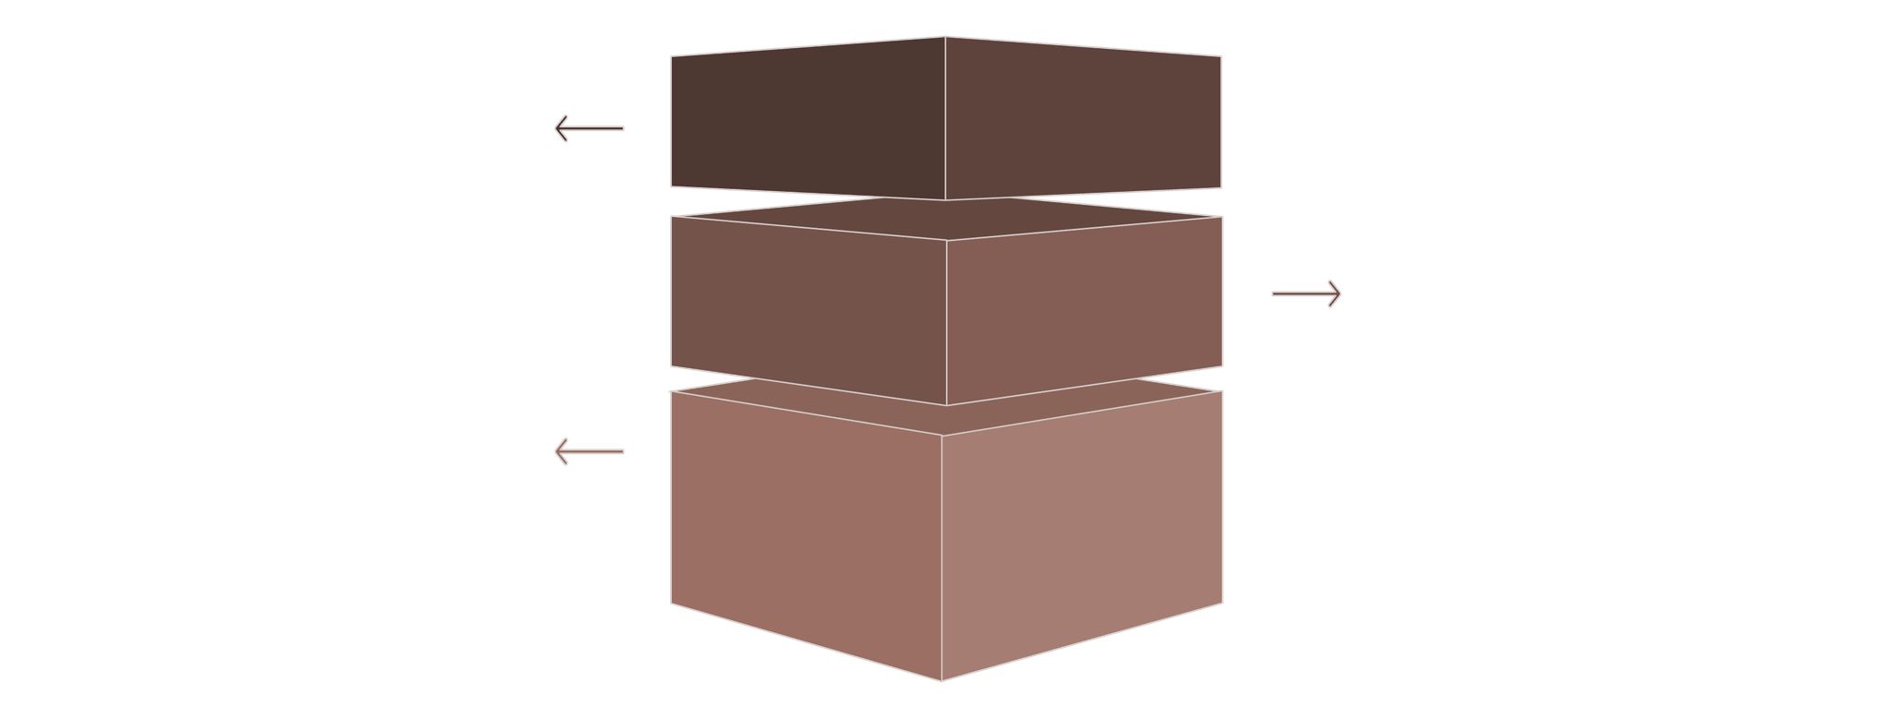
ARCHITECTURE
System Architecture
The application employs a hybrid architecture combining REST APIs for authentication and WebSocket connections for real-time messaging. This design separates stateless HTTP operations from stateful WebSocket sessions, optimising both security and performance.
React Frontend
User interface handling UI and WebSocket client.
FastAPI Backend
Hosts REST API and manages WebSocket connections.
SQLite Database
Stores persistent data and session state.
The modular backend design ensures clear separation between authentication logic, message handling, and data persistence, enabling independent scaling and maintenance of each component.
Notes:
5

Slide 6
Database Design
User Table
The database schema implements a simple yet effective relational model. Users and messages are linked through foreign key relationships, enabling efficient queries for chat history retrieval.
Field
Type
Purpose
id
Integer
Primary key
The recipient_id field supports both private messaging (when populated with a user ID) and broadcast messaging (when set to null), providing flexibility in message routing without complicating the schema.
username
String
Unique identifier
hashed_password
String
bcrypt hash
SQLAlchemy ORM abstracts database operations, providing protection against SQL injection attacks whilst maintaining code readability and maintainability.
Message Table
Field
Type
Purpose
id
Integer
Primary key
sender_id
Integer
Foreign key to User
recipient_id
Integer
Null for broadcast
content
Text
Message body
timestamp
DateTime
Creation time
Notes:
6

Slide 7




Authentication Flow
Registration
Login
Authorization
User submits credentials. Backend validates uniqueness, hashes password with bcrypt, stores in database.
User provides credentials. System verifies hashed password, generates JWT token with expiration.
Client includes JWT in requests. Backend validates token signature and expiration before granting access.
Notes:
7

Slide 8






WEBSOCKET
Real-Time Communication Flow
WebSocket connections establish persistent, bidirectional channels between clients and server, enabling instant message delivery without polling overhead. The connection remains open throughout the user session, allowing the server to push messages proactively.
Connect
Send Message
Deliver
Authenticate
Route
Private Messaging
Broadcast Messaging
Messages with specified recipient IDs are routed only to the target user's active WebSocket connection, ensuring privacy and reducing network traffic.
Messages without recipient IDs are distributed to all connected clients simultaneously, enabling group chat functionality.
Notes:
8

Slide 9




Backend Architecture
auth.py
models.py
websocket_manager.py
history.py
Handles user registration, login, password hashing with bcrypt, and JWT token generation/validation.
Defines SQLAlchemy ORM models for User and Message tables with relationships and constraints.
Manages active WebSocket connections, handles message routing, and maintains connection registry.
Provides endpoints for retrieving persistent chat history from database with pagination support.
The modular design promotes code reusability, simplifies testing, and enables independent scaling of different functional components. Each module has a single, well-defined responsibility aligned with SOLID principles.
Notes:
9

Slide 10

Key Achievements and Learnings
Technical Accomplishments
Future Enhancements
  Successfully implemented hybrid REST and WebSocket architecture
  Achieved real-time message delivery with minimal latency
  Deployed secure authentication using industry-standard practices
  Built scalable modular backend with clear separation of concerns
  Migrate to PostgreSQL for production scalability
  Implement Redis for distributed WebSocket sessions
  Add WebSocket authentication layer
  Containerise with Docker for deployment
Learning Outcomes
Gained practical experience in asynchronous programming, WebSocket protocol implementation, JWT-based security, and full-stack application development with modern frameworks.
Notes:
10

