Slide 1
Customer:
Vinod
Mobile:
9959665961
Address:
HYD

Slide 2
Google AdSense Online Terms of Service
1. Welcome to AdSense!
Thanks Eloi for your interest in our search and advertising services (the “Services”)!
By using our Services, you agree to these terms (the “AdSense Terms”), the AdSense Program Policies and the Google Branding Guidelines (collectively, the “Agreement”). If ever in conflict, to the extent of such conflict, the AdSense Terms will take precedence over any other terms of the Agreement. Please read the Agreement carefully.
As used in the Agreement, “you” or “publisher” means the individual or entity using the Services (and/or any individual, entity or successor entity, agency or network acting on your behalf), “we,” “us” or “Google” means Google Inc., and the “parties” means you and Google.
2. Access to the Services; AdSense Accounts
Your use of the Services is subject to your creation and our approval of an AdSense account (an “Account”). We have the right to refuse or limit your access to the Services. By submitting an application to use the Services, if you are an individual, you represent that you are at least 18 years of age. You may only have one Account.
By enrolling in AdSense, you permit Google to serve, as applicable, (i) advertisements and other content (“Ads”), (ii) Google search boxes and search results, and (iii) related search queries and other links to your websites, mobile applications, media players, mobile content, and/or other properties approved by Google (each individually a “Property”). In addition, you grant Google the right to access, index and cache the Properties, or any portion thereof, including by automated means. Google may refuse to provide the Services to any Property.
Any Property that is a software application and accesses our Services (a) may require preapproval by Google in writing, and (b) must comply with Google’s Software Principles.

Slide 3

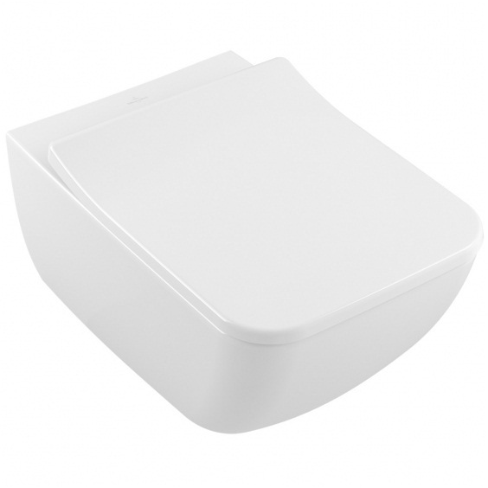
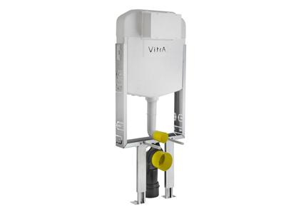
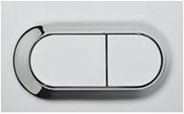
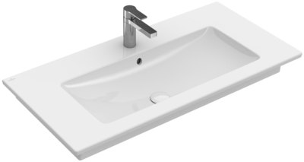
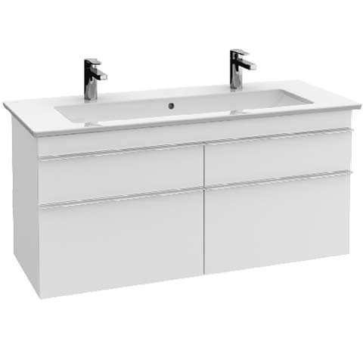
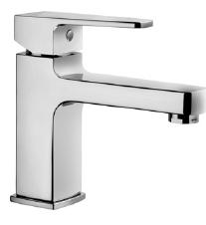
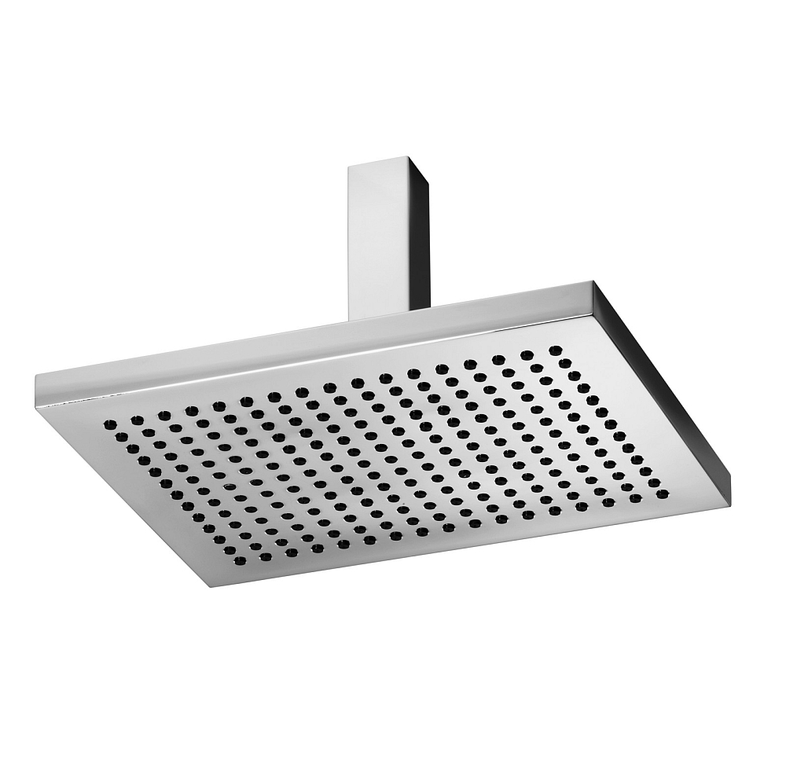
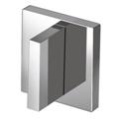
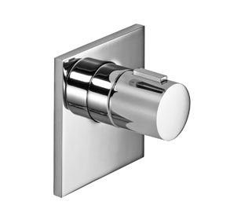
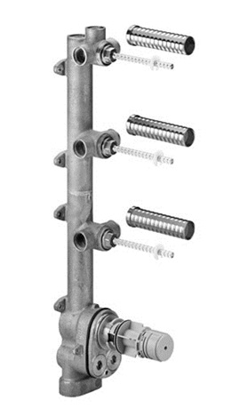
Master Bed Room
Brand | Item Name | Description | Color | Quantity | Unit Price | Special Price | Total
Venticello | 4611R001 | Venticello Wall Hung WC With Hinges And Black Bushes | White Alpin | 1 | 40800.00 | 40800.00 | 40800.00
Kombifix | 740-1850-01IND/748-1850-01IND | Vitra Concealed Cistern With Frame, Connection Pipe, Rubber Bush, Bolts And Nuts, Full Set.. | White | 1 | 9770.00 | 9770.00 | 9770.00
Loop O | 740-0580IND | Dual Flush Plate | Chrome | 1 | 2310.00 | 2310.00 | 2310.00
Venticello | 4104CL01 | Vanity Wash Basin one tap hole.Size 1200 x 500 mm | White Alpin | 1 | 84330.00 | 84330.00 | 84330.00
Venticello 1153x590x502 mm | A92901DH | Vanity Unit Only.1153x590x502 mm | Glossy White | 1 | 144990.00 | 144990.00 | 144990.00
Q Line | A40775IND | Q Line Basin Mixer | Chrome | 1 | 7670.00 | 7670.00 | 7670.00
Mem | 28755980-00/28775980-00 | Mem Ceiling Mounted Rain Shower | Polished chrome | 1 | 126287.50 | 126287.50 | 126287.50
MEM -Ext.W Valve | 3631078200/3631078000 | Wall Valve External Part | Chrome | 3 | 20425.00 | 20425.00 | 61275.00
MEM -xTool Ext.Valve | 3641678000 | Xtool concealed Thermostat without volume control. | Polished chrome | 1 | 77237.50 | 77237.50 | 77237.50
Mem 3way | 3554697090 | Thermostat xTool with 3 Valves concealed Rough Part..(Concealed Body, Internal Control Valves - 3, .Thermostat Control Valves - 1) | Chrome | 1 | 198425.00 | 198425.00 | 198425.00

Slide 4

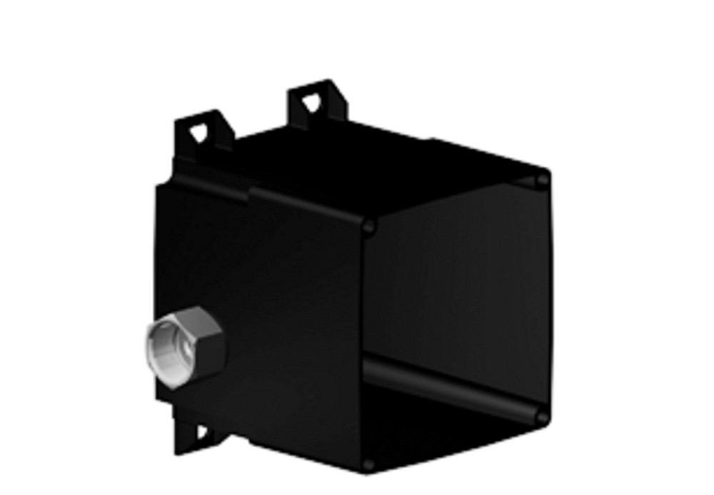
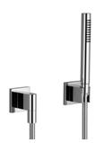
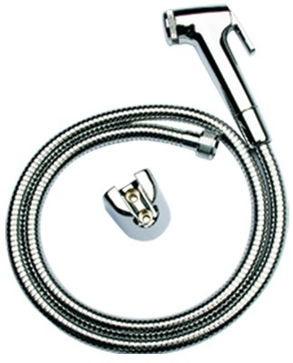
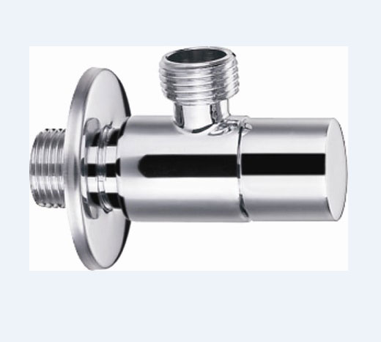
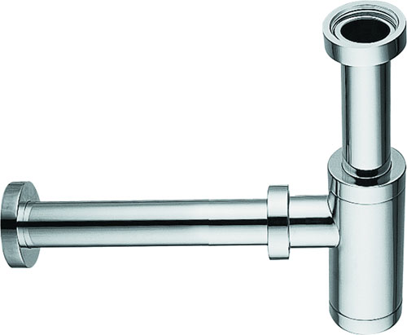
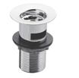
Master Bed Room
Brand | Item Name | Description | Color | Quantity | Unit Price | Special Price | Total
Supernova | 3651597900 | Water Points concealed body spray | N-A | 4 | 53425.00 | 53425.00 | 213700.00
Wall Installation | 3520597090 | Wall Installation unit, .for Concealed Body Spray. | N-A | 4 | 20650.00 | 20650.00 | 82600.00
- | 2780898000 | Hand Shower Set.(Hand Shower, Pipe, Hook, Wall Outlet) | Chrome | 1 | 68862.50 | 68862.50 | 68862.50
TOTO | THX20MCRB | Health Faucet (Faucet, Hosepipe, Hook) | Chrome | 1 | 3600.00 | 3600.00 | 3600.00
Essentials | E0014 | Angle Valve w/Flange | Chrome | 3 | 1242.00 | 1242.00 | 3726.00
SIRIUS | E8503.97 | Bottle Trap | Chrome | 1 | 5432.00 | 5432.00 | 5432.00
Essentials | Waste Coupling H/T | - | Chrome | 1 | 550.00 | 550.00 | 550.00

