Slide 1
Customer:
Vijayawada muncipal corporation
Mobile:
9398948678
Address:
Vijayawada

Slide 2
Google AdSense Online Terms of Service
1. Welcome to AdSense!
Thanks Eloi for your interest in our search and advertising services (the “Services”)!
By using our Services, you agree to these terms (the “AdSense Terms”), the AdSense Program Policies and the Google Branding Guidelines (collectively, the “Agreement”). If ever in conflict, to the extent of such conflict, the AdSense Terms will take precedence over any other terms of the Agreement. Please read the Agreement carefully.
As used in the Agreement, “you” or “publisher” means the individual or entity using the Services (and/or any individual, entity or successor entity, agency or network acting on your behalf), “we,” “us” or “Google” means Google Inc., and the “parties” means you and Google.
2. Access to the Services; AdSense Accounts
Your use of the Services is subject to your creation and our approval of an AdSense account (an “Account”). We have the right to refuse or limit your access to the Services. By submitting an application to use the Services, if you are an individual, you represent that you are at least 18 years of age. You may only have one Account.
By enrolling in AdSense, you permit Google to serve, as applicable, (i) advertisements and other content (“Ads”), (ii) Google search boxes and search results, and (iii) related search queries and other links to your websites, mobile applications, media players, mobile content, and/or other properties approved by Google (each individually a “Property”). In addition, you grant Google the right to access, index and cache the Properties, or any portion thereof, including by automated means. Google may refuse to provide the Services to any Property.
Any Property that is a software application and accesses our Services (a) may require preapproval by Google in writing, and (b) must comply with Google’s Software Principles.

Slide 3

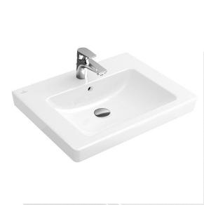
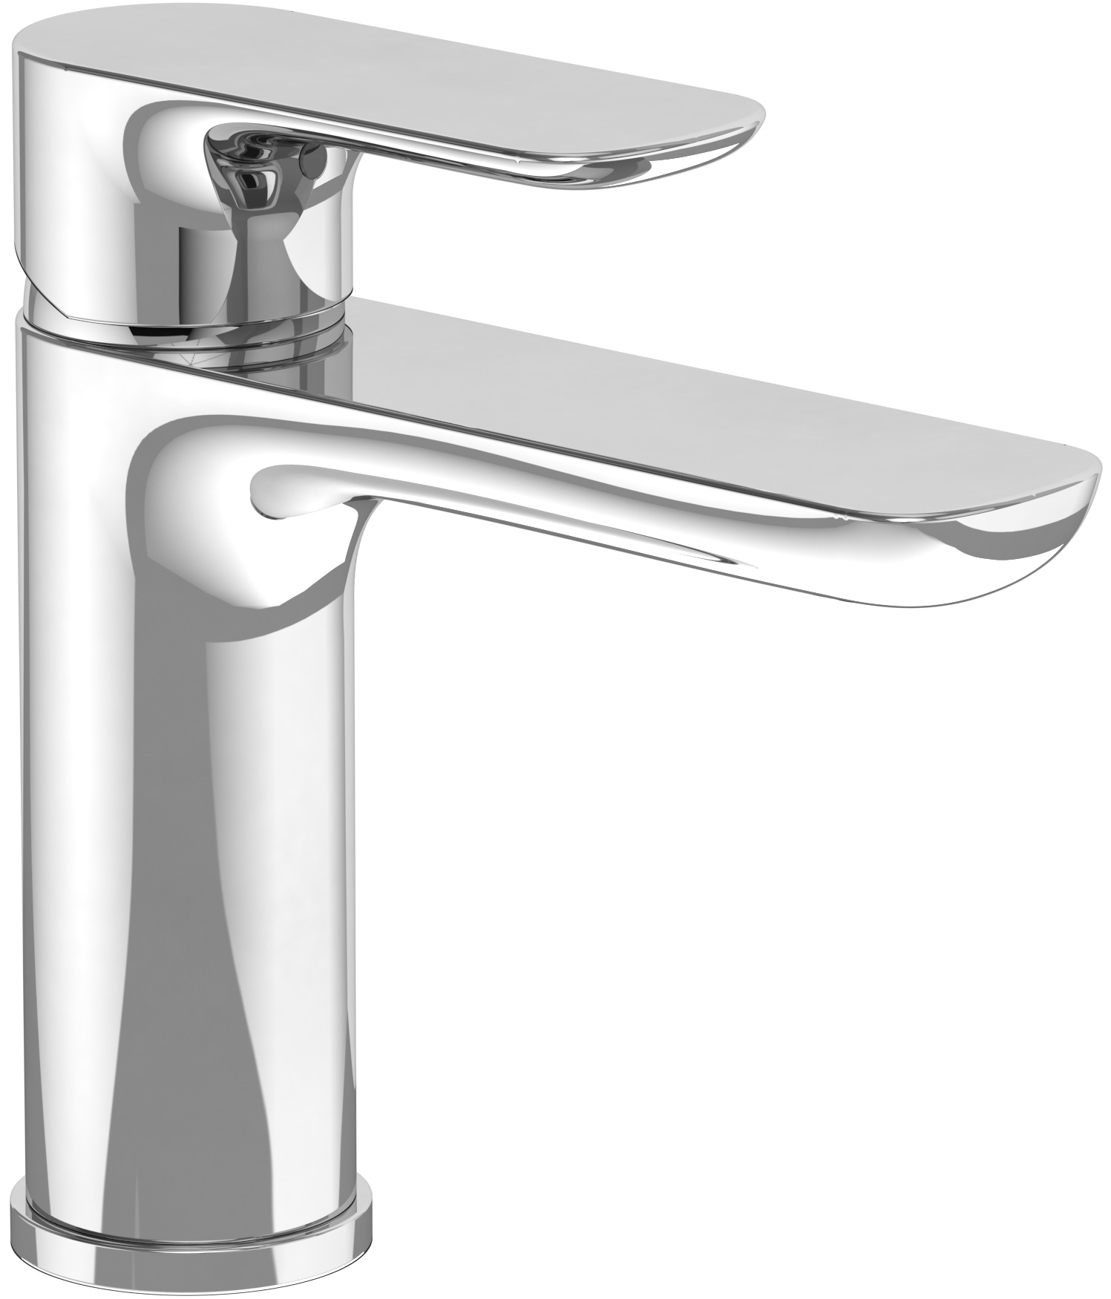
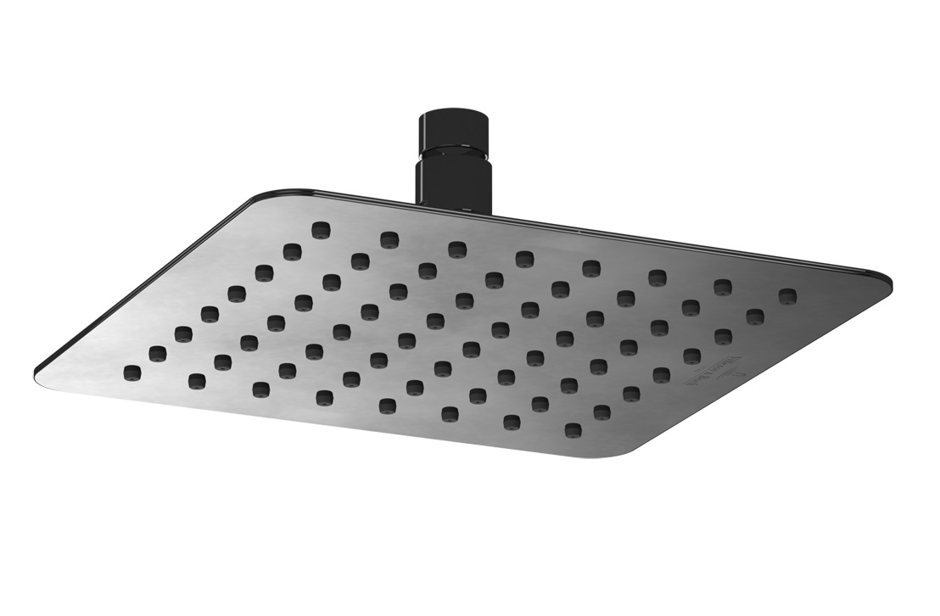
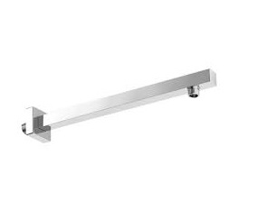
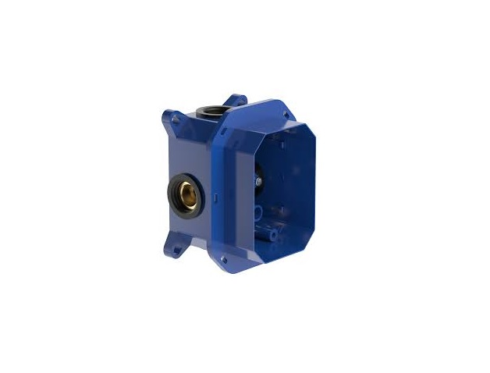

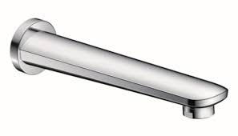
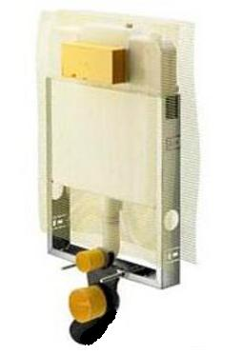

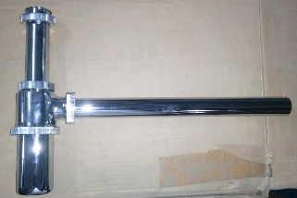
-
Brand | Item Name | Description | Color | Quantity | Unit Price | Special Price | Total
Subway 2 | 71136001 | Subway 2 Wash Basin 60cm.Size: 600 x 470 mm.with overflow and 1 tap hole | White Alpin | 3 | 12400.00 | 12400.00 | 37200.00
O.Novo | TVW10410311061 | Single Lever Basin Mixer Without Waste & With Fittings | Chrome | 3 | 11880.00 | 11880.00 | 35640.00
SQUARE 200X200mm | TVC00040220061 | SQUARE RAIN OVER HEAD SHOWER 200X200mm | Chrome | 3 | 7920.00 | 7920.00 | 23760.00
Universal | TVC00045453061 | Wall Mounted Shower Arm Square with Flange.400 mm | Chrome | 3 | 5040.00 | 5040.00 | 15120.00
- | TVS00035100000 | VI-Box for Concealed Bath Shower Mixer With Fittings | N-A | 3 | 4770.00 | 4770.00 | 14310.00
O.Novo | TVS10435300061 | Concealed Single Lever Mixer with Diverter.Exposed trim parts and concealed part | Chrome | 3 | 13230.00 | 13230.00 | 39690.00
O Novo | TVT10550511061 | Bath Spout | Chrome | 3 | 5760.00 | 5760.00 | 17280.00
MONO TEC | 755669 / 8308-648794 | Mono Tech Concealed cistern w/Connector pipe and Rubber bush w/Frame and bolts | N-A | 3 | 10750.00 | 10750.00 | 32250.00
Style 10 | 8315.1-596323 | Visign for Style 10 Actuating Plate with rods | Chrome | 3 | 1692.00 | 1692.00 | 5076.00
Bottle Trap | F1861S03CR | Bottle Trap with 12 inch Pipe 32mm | CHROME | 3 | 2300.00 | 2300.00 | 6900.00

Slide 4
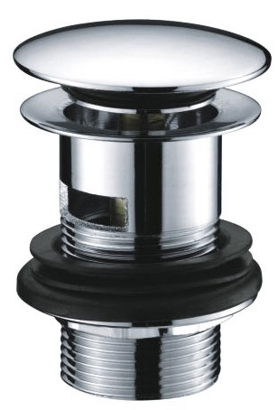
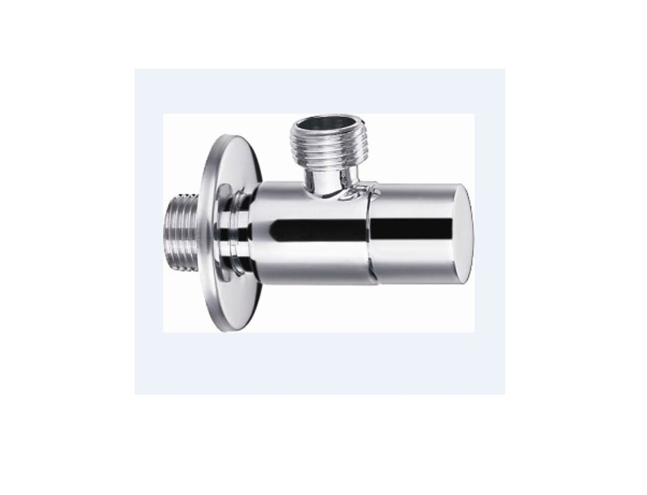
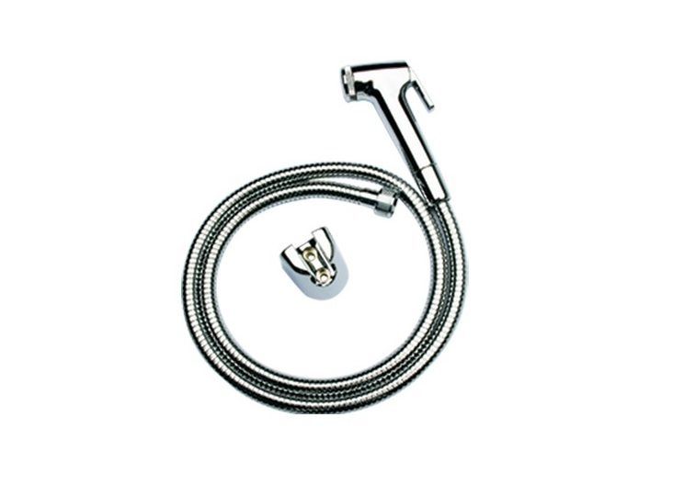

-
Brand | Item Name | Description | Color | Quantity | Unit Price | Special Price | Total
Essentials | E8307.97 | Click pop up waste | Chrome | 3 | 1841.00 | 1841.00 | 5523.00
Essentials | E0014 | Angle Valve w/Flange | Chrome | 9 | 1242.00 | 1242.00 | 11178.00
TOTO | THX20MCRB | Health Faucet (Faucet, Hosepipe, Hook) | Chrome | 3 | 4000.00 | 4000.00 | 12000.00
Elite 80cm | 61316 / 56861 | Elite Mirror 80 cm Including Fixing Brackets.Size: DxH 4x70 cm | N-A | 1 | 19940.00 | 19940.00 | 19940.00

Slide 5
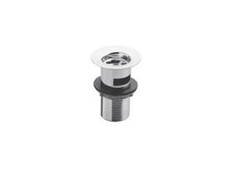
Option
Brand | Item Name | Description | Color | Quantity | Unit Price | Special Price | Total
Essentials | Waste Coupling H/T | Waste Coupling | Chrome | 3 | 550.00 | 550.00 | 1650.00

