Slide 1

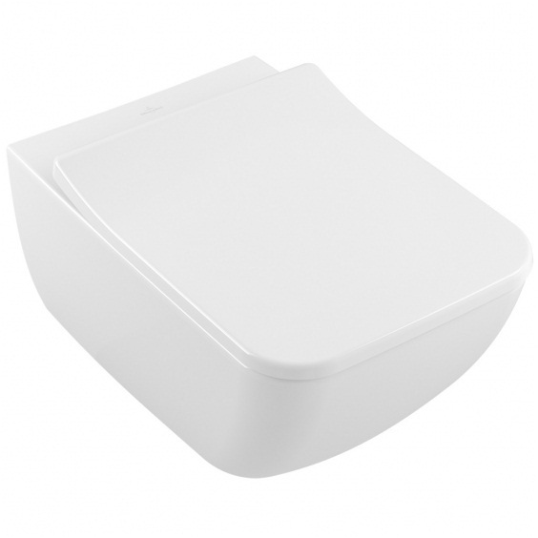
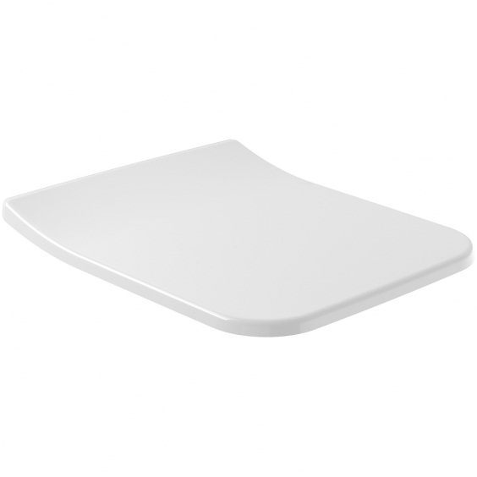
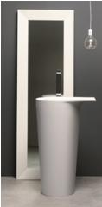
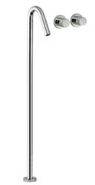
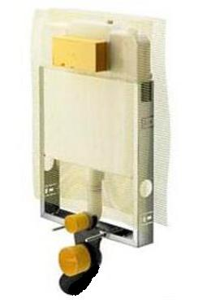
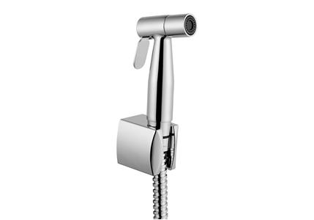
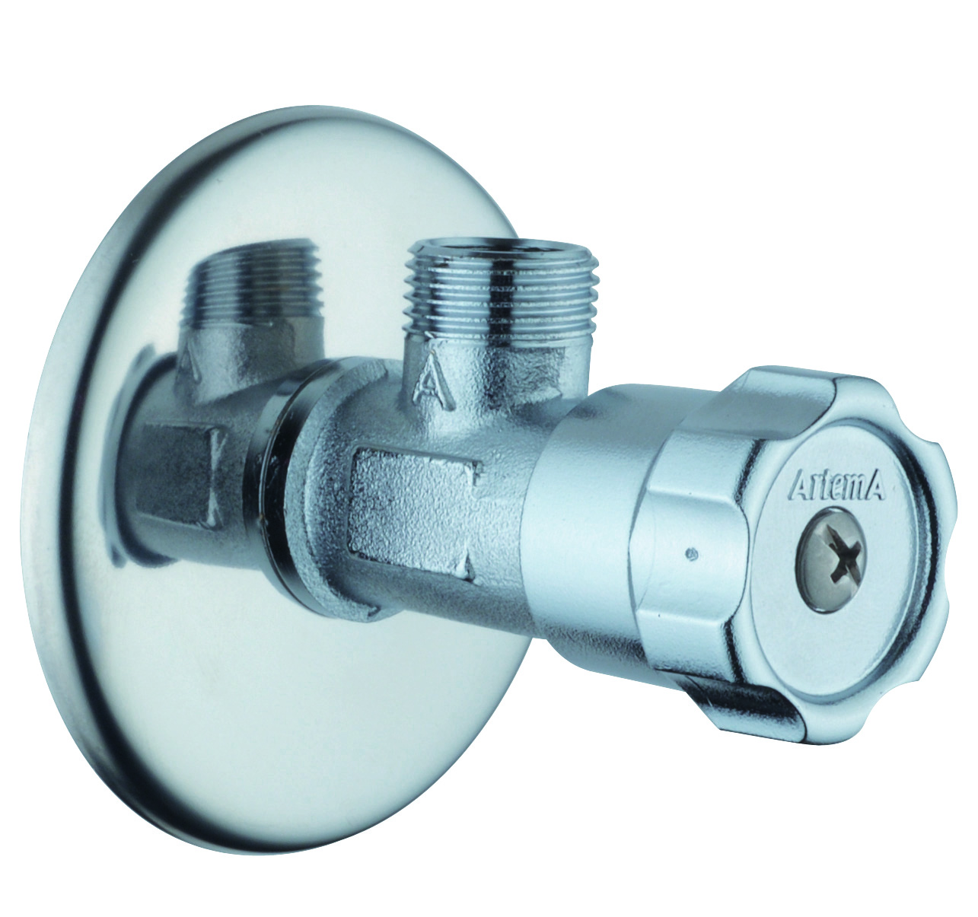
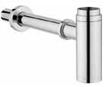
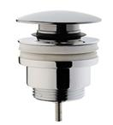
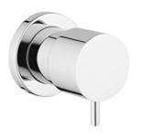
GYM
Brand | Item Name | Description | Color | Quantity | Unit Price | Special Price | Total
Venticello | 4611R001 | Venticello Wall Hung WC | White Alpin | 1 | 29200.00 | 29200.00 | 29200.00
Venticello | 9M79S101 | Slim Soft Closing seat cover with Hinges | White Alpin | 1 | 10400.00 | 10400.00 | 10400.00
Ala | 08A02 | Floor Standing wash basin with free.Drainage pipe- siphon on the floor.Size L 57 X D 43 X H 90CM | Cristal Plant | 1 | 240500.00 | 240500.00 | 240500.00
X Change XR | 7282XRCC | Three Hole Basin Mixer .Spout Height 1064mm | Chrome | 1 | 67689.00 | 67689.00 | 67689.00
MONO TEC | 8308-648794 | Mono Tech Concealed cistern w/Connector pipe and Rubber bush w/Frame and bolts | N-A | 1 | 14100.00 | 14100.00 | 14100.00
- | A45534IND | Bidet hand shower | Chrome | 1 | 3050.00 | 3050.00 | 3050.00
- | A45217IND | Interval Tap (Angle Valve) | Chrome | 3 | 650.00 | 650.00 | 1950.00
- | A45123IND | Bottle Trap for basins | Chrome | 1 | 4300.00 | 4300.00 | 4300.00
- | A45149IND | Waste Set Universal push open | Chrome | 1 | 1700.00 | 1700.00 | 1700.00
- | A41449IND | Built in stop valve | Chrome | 1 | 1050.00 | 1050.00 | 1050.00

Slide 2
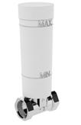
GYM
Brand | Item Name | Description | Color | Quantity | Unit Price | Special Price | Total
con. | A41441IND | Built in stop valve - Concealed part | Chrome | 1 | 1500.00 | 1500.00 | 1500.00

Slide 3
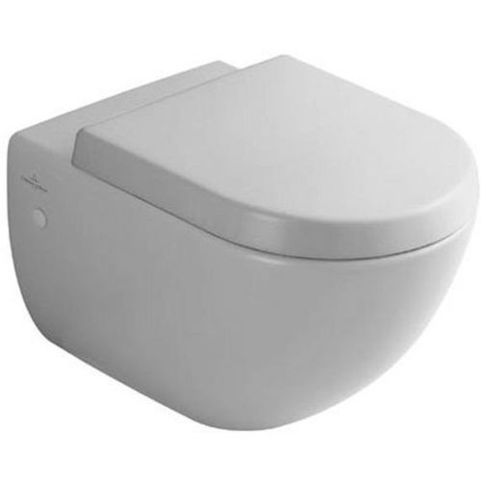
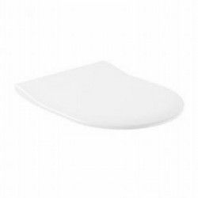
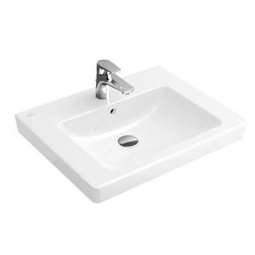
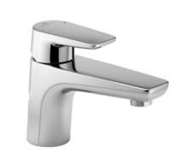

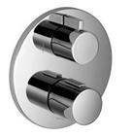
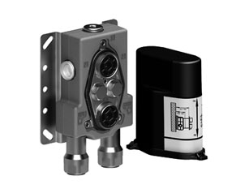
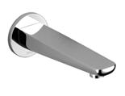
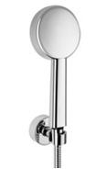
MR
Brand | Item Name | Description | Color | Quantity | Unit Price | Special Price | Total
Subway | 66001001 | Wall Hung WC | White Alpin | 1 | 21900.00 | 21900.00 | 21900.00
Subway | 9M65S101 | Soft Closing Slim Seat and Cover | White Alpin | 1 | 16500.00 | 16500.00 | 16500.00
Subway 2.0 | 71136501 | Subway 2 .0 Wash Basin .Size 650x470mm | White Alpin | 1 | 12500.00 | 12500.00 | 12500.00
Subway | 3352193500 | Subway single lever basin mixer without pop-up waste set | Chrome | 1 | 27925.00 | 27925.00 | 27925.00
L Aura | 28579969-00 | Rain Shower with Arm 300mm x240mm | Polished Chrome | 1 | 102700.00 | 102700.00 | 102700.00
Subway | 36426969-00 | Subway concealed thermostat with two-way volume control | Chrome | 1 | 64263.00 | 64263.00 | 64263.00
IMO | 35426970-90 | Thermostat with Two Function volume control- .Concealed Part. | Chrome | 1 | 62025.00 | 62025.00 | 62025.00
MONO TEC | 8308-648794 | Mono Tech Concealed cistern w/Connector pipe and Rubber bush w/Frame and bolts | N-A | 1 | 14100.00 | 14100.00 | 14100.00
Subway-W | 13801935-00 | Subway Bath Spout for Wall Mounting | Chrome | 1 | 44475.00 | 44475.00 | 44475.00
Subway | 27805935-00 | Hand Shower | Chrome | 1 | 24563.00 | 24563.00 | 24563.00

Slide 4
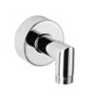
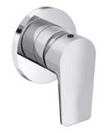
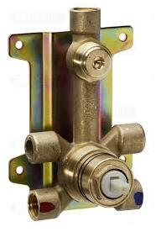
MR
Brand | Item Name | Description | Color | Quantity | Unit Price | Special Price | Total
Subway | 28450935-00 | Subway Wall elbow | Chrome | 1 | 7188.00 | 7188.00 | 7188.00
Subway w/m | 36008935-00 | Subway Wall Mounted Single lever Shower Mixer -External Part. | Chrome | 1 | 26363.00 | 26363.00 | 26363.00
Outlet Parts | 35008970-90 | S/L Shower Mixer-concealed part | N-A | 1 | 29850.00 | 29850.00 | 29850.00
- | A45534IND | Bidet hand shower | Chrome | 1 | 3050.00 | 3050.00 | 3050.00
- | A45217IND | Interval Tap (Angle Valve) | Chrome | 3 | 650.00 | 650.00 | 1950.00
- | A45123IND | Bottle Trap for basins | Chrome | 1 | 4300.00 | 4300.00 | 4300.00
- | A45149IND | Waste Set Universal push open | Chrome | 1 | 1700.00 | 1700.00 | 1700.00
- | A41449IND | Built in stop valve | Chrome | 1 | 1050.00 | 1050.00 | 1050.00
con. | A41441IND | Built in stop valve - Concealed part | Chrome | 1 | 1500.00 | 1500.00 | 1500.00

Slide 5
Office Room
Brand | Item Name | Description | Color | Quantity | Unit Price | Special Price | Total
Venticello | 4611R001 | Venticello Wall Hung WC | White Alpin | 1 | 29200.00 | 29200.00 | 29200.00
Venticello | 9M79S101 | Slim Soft Closing seat cover with Hinges | White Alpin | 1 | 10400.00 | 10400.00 | 10400.00
Subway 2.0 | 71136501 | Subway 2 .0 Wash Basin .Size 650x470mm | White Alpin | 1 | 12500.00 | 12500.00 | 12500.00
Subway | 3352193500 | Subway single lever basin mixer without pop-up waste set | Chrome | 1 | 27925.00 | 27925.00 | 27925.00
MONO TEC | 8308-648794 | Mono Tech Concealed cistern w/Connector pipe and Rubber bush w/Frame and bolts | N-A | 1 | 14100.00 | 14100.00 | 14100.00
- | A45534IND | Bidet hand shower | Chrome | 1 | 3050.00 | 3050.00 | 3050.00
- | A45217IND | Interval Tap (Angle Valve) | Chrome | 3 | 650.00 | 650.00 | 1950.00
- | A45123IND | Bottle Trap for basins | Chrome | 1 | 4300.00 | 4300.00 | 4300.00
- | A45149IND | Waste Set Universal push open | Chrome | 1 | 1700.00 | 1700.00 | 1700.00
- | A41449IND | Built in stop valve | Chrome | 1 | 1050.00 | 1050.00 | 1050.00

Slide 6
Office Room
Brand | Item Name | Description | Color | Quantity | Unit Price | Special Price | Total
con. | A41441IND | Built in stop valve - Concealed part | Chrome | 1 | 1500.00 | 1500.00 | 1500.00

Slide 7
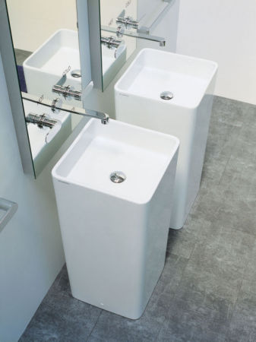
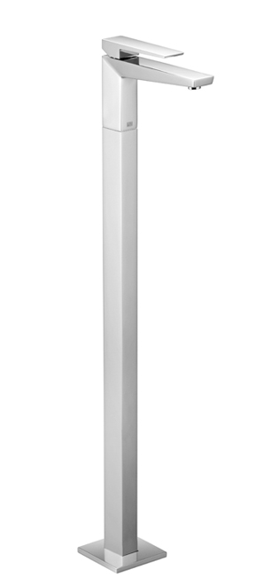
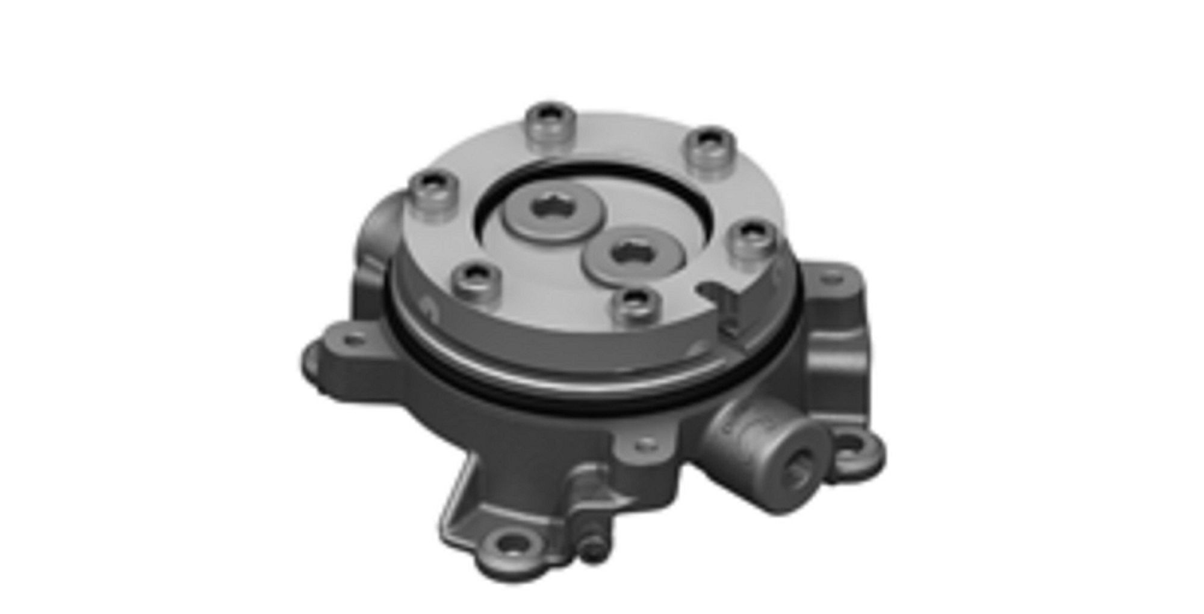
PR
Brand | Item Name | Description | Color | Quantity | Unit Price | Special Price | Total
Venticello | 4611R001 | Venticello Wall Hung WC | White Alpin | 1 | 29200.00 | 29200.00 | 29200.00
Venticello | 9M79S101 | Slim Soft Closing seat cover with Hinges | White Alpin | 1 | 10400.00 | 10400.00 | 10400.00
Mono multi colored | MW40C | Monowash 40 standing column-basin.with AZ pattern.(floor fixing kit and siphon included) | White | 1 | 156345.00 | 156345.00 | 156345.00
Supernova | 3358473000 | Supernova Freestanding basin Mixer | Chrome | 1 | 273038.00 | 273038.00 | 273038.00
LuLu | 35945970-90 | LuLu Tub filler - Concealed Part | Chrome | 1 | 73287.00 | 73287.00 | 73287.00
MONO TEC | 8308-648794 | Mono Tech Concealed cistern w/Connector pipe and Rubber bush w/Frame and bolts | N-A | 1 | 14100.00 | 14100.00 | 14100.00
- | A45534IND | Bidet hand shower | Chrome | 1 | 3050.00 | 3050.00 | 3050.00
- | A45217IND | Interval Tap (Angle Valve) | Chrome | 3 | 650.00 | 650.00 | 1950.00
- | A45123IND | Bottle Trap for basins | Chrome | 1 | 4300.00 | 4300.00 | 4300.00
- | A45149IND | Waste Set Universal push open | Chrome | 1 | 1700.00 | 1700.00 | 1700.00

Slide 8
PR
Brand | Item Name | Description | Color | Quantity | Unit Price | Special Price | Total
- | A41449IND | Built in stop valve | Chrome | 1 | 1050.00 | 1050.00 | 1050.00
con. | A41441IND | Built in stop valve - Concealed part | Chrome | 1 | 1500.00 | 1500.00 | 1500.00

Slide 9
R1
Brand | Item Name | Description | Color | Quantity | Unit Price | Special Price | Total
Subway | 66001001 | Wall Hung WC | White Alpin | 1 | 21900.00 | 21900.00 | 21900.00
Subway | 9M65S101 | Soft Closing Slim Seat and Cover | White Alpin | 1 | 16500.00 | 16500.00 | 16500.00
Subway 2.0 | 71136501 | Subway 2 .0 Wash Basin .Size 650x470mm | White Alpin | 1 | 12500.00 | 12500.00 | 12500.00
Subway | 3352193500 | Subway single lever basin mixer without pop-up waste set | Chrome | 1 | 27925.00 | 27925.00 | 27925.00
L Aura | 28579969-00 | Rain Shower with Arm 300mm x240mm | Polished Chrome | 1 | 102700.00 | 102700.00 | 102700.00
Subway | 36426969-00 | Subway concealed thermostat with two-way volume control | Chrome | 1 | 64263.00 | 64263.00 | 64263.00
IMO | 35426970-90 | Thermostat with Two Function volume control- .Concealed Part. | Chrome | 1 | 62025.00 | 62025.00 | 62025.00
Subway-W | 13801935-00 | Subway Bath Spout for Wall Mounting | Chrome | 1 | 44475.00 | 44475.00 | 44475.00
Subway | 27805935-00 | Hand Shower | Chrome | 1 | 24563.00 | 24563.00 | 24563.00
Subway | 28450935-00 | Subway Wall elbow | Chrome | 1 | 7188.00 | 7188.00 | 7188.00

Slide 10
R1
Brand | Item Name | Description | Color | Quantity | Unit Price | Special Price | Total
Subway w/m | 36008935-00 | Subway Wall Mounted Single lever Shower Mixer -External Part. | Chrome | 1 | 26363.00 | 26363.00 | 26363.00
Outlet Parts | 35008970-90 | S/L Shower Mixer-concealed part | N-A | 1 | 29850.00 | 29850.00 | 29850.00
MONO TEC | 8308-648794 | Mono Tech Concealed cistern w/Connector pipe and Rubber bush w/Frame and bolts | N-A | 1 | 14100.00 | 14100.00 | 14100.00
- | A45534IND | Bidet hand shower | Chrome | 1 | 3050.00 | 3050.00 | 3050.00
- | A45217IND | Interval Tap (Angle Valve) | Chrome | 3 | 650.00 | 650.00 | 1950.00
- | A45123IND | Bottle Trap for basins | Chrome | 1 | 4300.00 | 4300.00 | 4300.00
- | A45149IND | Waste Set Universal push open | Chrome | 1 | 1700.00 | 1700.00 | 1700.00
- | A41449IND | Built in stop valve | Chrome | 1 | 1050.00 | 1050.00 | 1050.00
con. | A41441IND | Built in stop valve - Concealed part | Chrome | 1 | 1500.00 | 1500.00 | 1500.00

