Slide 1

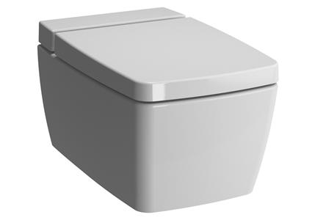
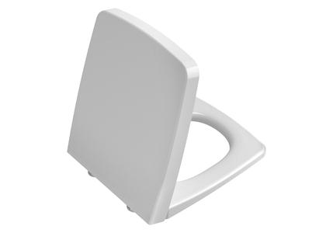

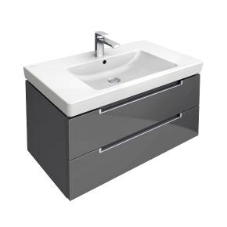
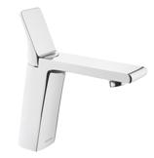
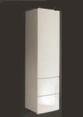
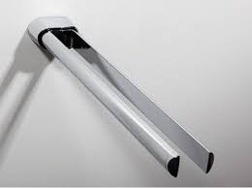
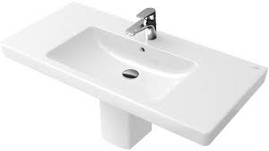
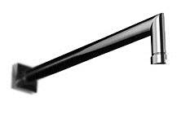
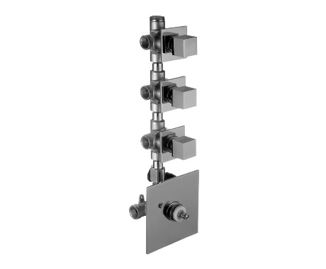

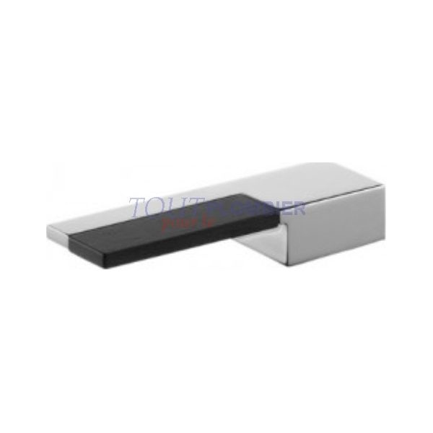
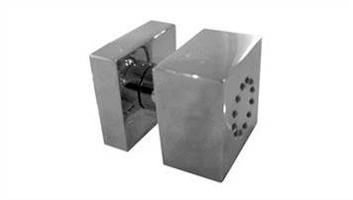
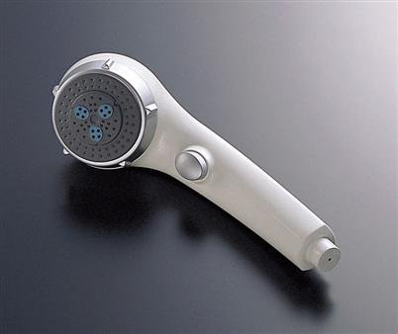
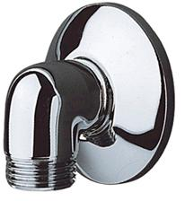
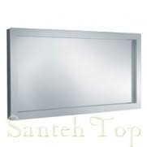
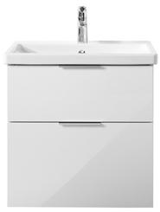
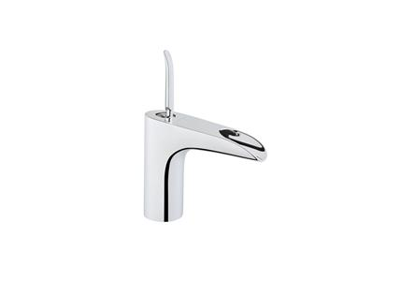
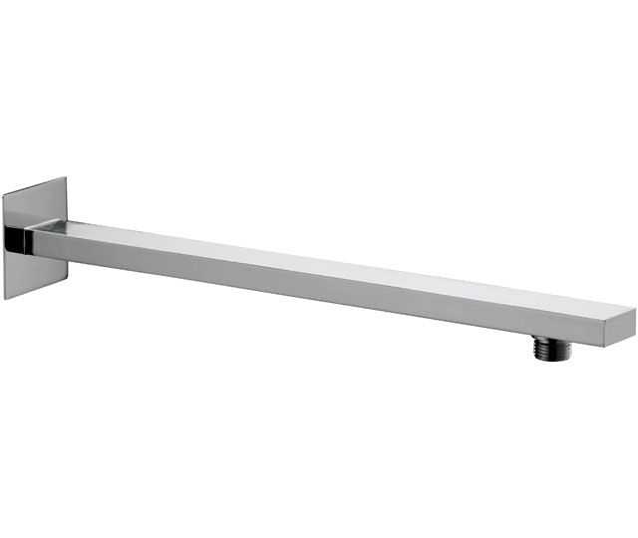
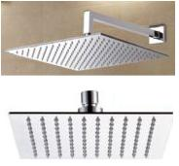
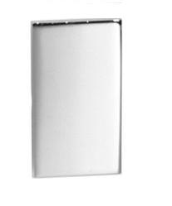
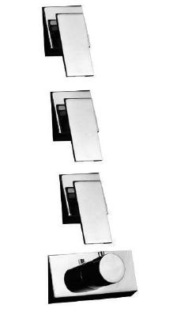
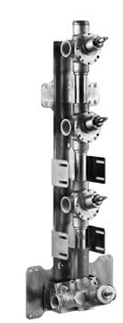
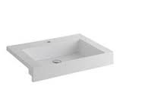
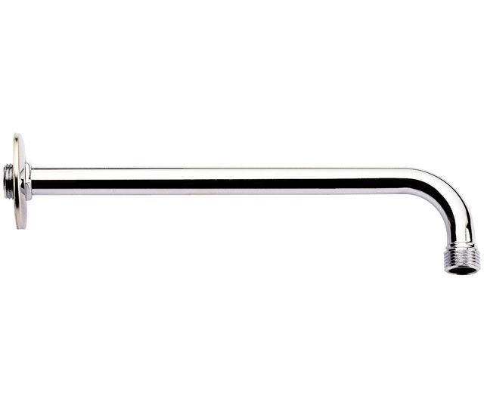
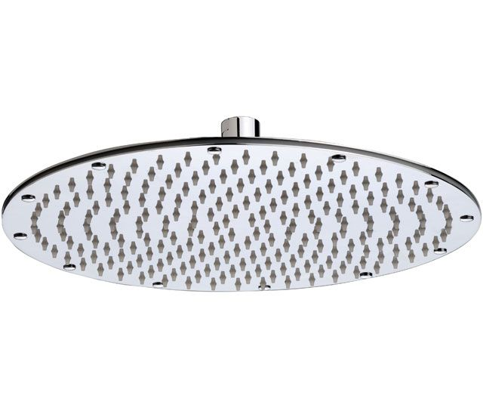
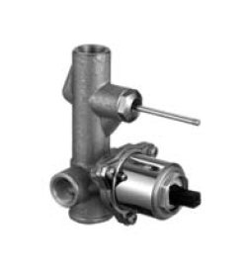
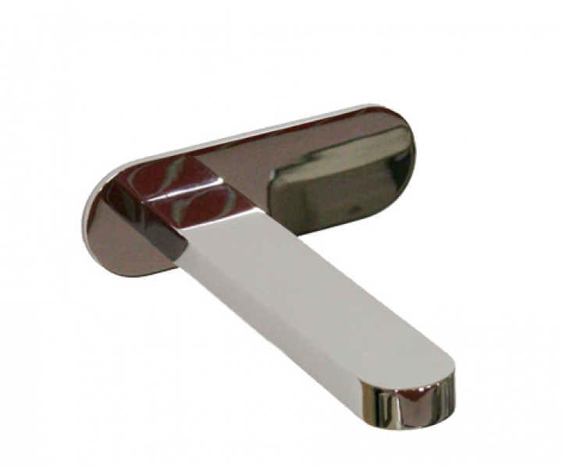
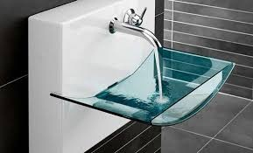
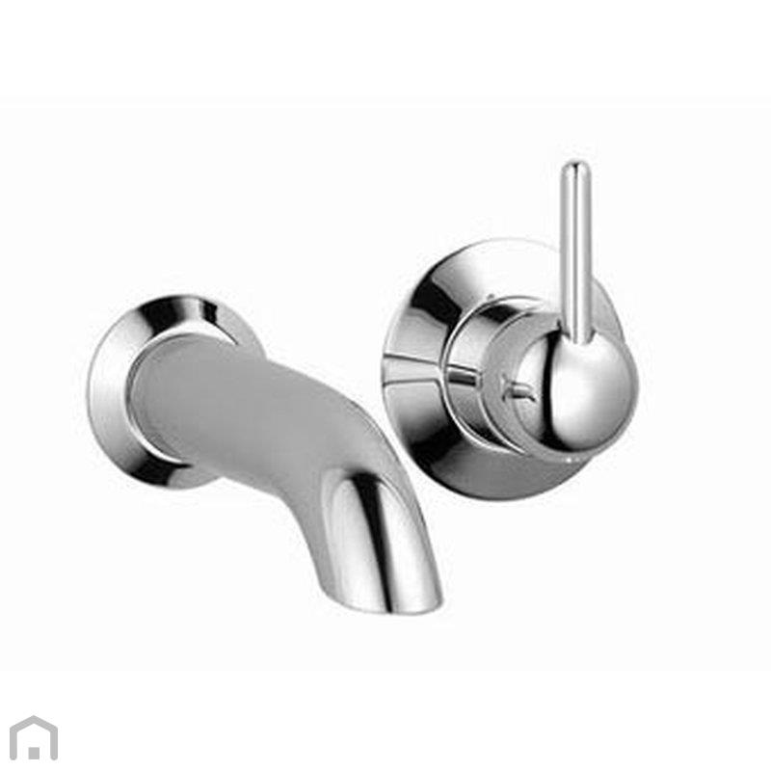
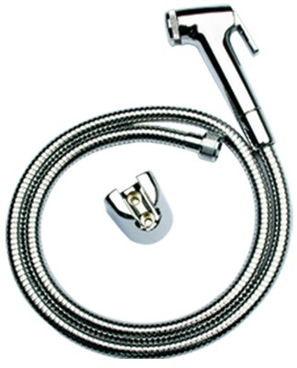
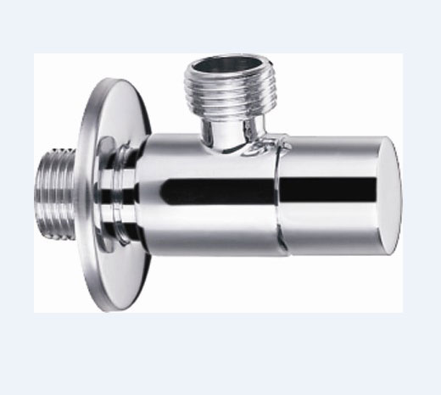
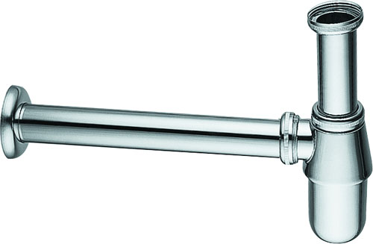
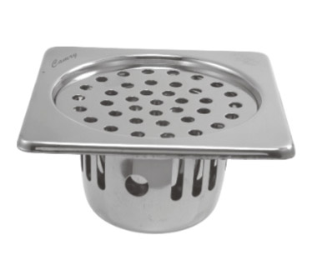
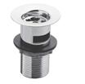

-
Brand | Item Name | Description | Color | Quantity | Unit Price | Special Price | Total
Metropole | 7672B003-1086/5672B003-1086 | Rim-ex Wall Hung WC With Vitra A Fresh Liquid Cleaner tank | White | 3 | 29200.00 | 29200.00 | 87600.00
Metroploe | 90-003-009 | Metropole Soft Closing seat cover w/Hinges | White | 3 | 8000.00 | 8000.00 | 24000.00
Furniture | GU172F | Mirror Cabinet.Size 1000x660x127 | N-A | 1 | 45000.00 | 45000.00 | 45000.00
Subway 2.0 | A68900FQ | Vanity Unit .Size: 787 x 420 x 449 mm. | Oak Graphite | 1 | 71100.00 | 71100.00 | 71100.00
Memoria | A42329IND | Basin Mixer | Chrome | 1 | 29000.00 | 29000.00 | 29000.00
Burgbad | HSCE050 | Tall Unit | N-A | 1 | 135204.00 | 135204.00 | 135204.00
Elegance New | 11618010000 | Towel holder.Two arms, swivelling ,Projection: 450 mm. | Chrome | 3 | 8500.00 | 8500.00 | 25500.00
Subway 2.0 | 71758001 | Subway 2.0 washbasin.800 x 470 mm, | White Alpin | 1 | 46800.00 | 46800.00 | 46800.00
- | 86028038 | Wall Mounted Shower arm .size: 30cm | Chrome | 1 | 14520.00 | 14520.00 | 14520.00
Ar/38 | 38023903SB | Thermostatic built-in shower mixer, .With 3 out-lets. | Chrome | 1 | 65780.00 | 65780.00 | 65780.00
- | 19003903A | Built In Piece - For Thermostat | N-A | 1 | 77220.00 | 77220.00 | 77220.00
Plano | 3802394902 | Handle for Thermostatic | Chrome | 1 | 15400.00 | 15400.00 | 15400.00
- | 86028024 | Body-Jets | Chrome | 8 | 16830.00 | 16830.00 | 134640.00
DisCont.- Aug-2014 | TH769MH#N11 | Hand Shower | Chrome | 2 | 14189.00 | 14189.00 | 28378.00
Outlet | TX424SV1 | WALL OUTLET | Chrome | 2 | 1510.00 | 1510.00 | 3020.00
Elegance New | 11696012500 | Light mirror | N-A | 1 | 72180.00 | 72180.00 | 72180.00
Eqio | SEYQ063 | Vanity Unit W64.5x H63xD49 CM including Ceramic Wash Basin..Size: 570x340xD130 mm | Grey High Gloss | 2 | 91517.00 | 91517.00 | 183034.00
T4 | A41242IND | Basin Mixer, Cascade Flow. | Chrome | 2 | 18700.00 | 18700.00 | 37400.00
Docce | A553CM40 | Shower arm | Chrome | 1 | 6732.00 | 6732.00 | 6732.00
- | A579CM30 | Over Head Shower 30CM | Chrome | 1 | 16874.00 | 16874.00 | 16874.00
Belvedere | 30025448 | Rectangular Brass Handle | Chrome | 3 | 8360.00 | 8360.00 | 25080.00
Belvedere | 30025703SB | Thermostatic Built-in Shower mixer -with 3 out-lets | Chrome | 1 | 89320.00 | 89320.00 | 89320.00
Belvedere | 19025703A | Built In Piece for Thermostatic Built in Shower Mixer With.3 Out lets | Chrome | 1 | 102960.00 | 102960.00 | 102960.00
Plan B-free | 37598002000 | Light mirror Plan B-free | White | 1 | 81387.00 | 81387.00 | 81387.00
Docce | A555CM40 | Wall Mounted Shower Arm 40 CM | Chrome | 1 | 1276.00 | 1276.00 | 1276.00
- | A595CR | Shower Head 35cm | Chrome | 1 | 52305.00 | 52305.00 | 52305.00
Nostromo | 42021822SB/4202E422B | Nostromo Built-in single-lever bath and shower mixer,with diverter | Chrome | 1 | 30592.00 | 30592.00 | 30592.00
- | 19020422A | Built-in single-lever bathtub/shower mixer(Built-in piece) | N-A | 1 | 13568.00 | 13568.00 | 13568.00
MARE | 51021045 | Bath Spout | Chrome | 1 | 22550.00 | 22550.00 | 22550.00
LIAISON | 51960001 | Wash Basin.600 x 500 x 480 mm, | White Alpin | 1 | 85359.00 | 85359.00 | 85359.00
Source | 3681094000 | Wall Mounted Single Lever Basin Mixer . | Chrome | 1 | 73513.00 | 73513.00 | 73513.00
Source | 3581697090 | W/M Basin Mixer Conc. Part | Chrome | 1 | 33625.00 | 33625.00 | 33625.00
TOTO | THX20MCRB | Health Faucet (Faucet, Hosepipe, Hook) | Chrome | 3 | 3850.00 | 3850.00 | 11550.00
Essentials | E0014 | Angle Valve w/Flange | Chrome | 9 | 1242.00 | 1242.00 | 11178.00
SIRIUS | E8502.97 | Bottle Trap | Chrome | 3 | 3689.00 | 3689.00 | 11067.00
SQUARE | CCR-S-129 | Camry Cockroach Trap.Size 129 x 129 mm | Chrome | 6 | 770.00 | 770.00 | 4620.00
Essentials | Waste Coupling H/T | - | Chrome | 3 | 550.00 | 550.00 | 1650.00
Essentials | Fischer Bolt | Fischer Bolt for WC | N-A | 3 | 1200.00 | 1200.00 | 3600.00
Slip In Connector | TX215C | Slip In Connector For WC | N-A | 3 | 830.00 | 830.00 | 2490.00
Nostromo | 50021649 | Handle | Chrome | 1 | 5120.00 | 5120.00 | 5120.00

Slide 2
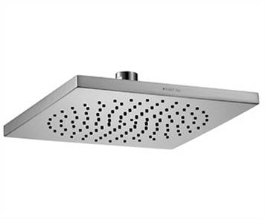
other Toilets
Brand | Item Name | Description | Color | Quantity | Unit Price | Special Price | Total
- | 86028008 | Squared Rain Shower Head .Size: 200 x 200 mm | Chrome | 1 | 64900.00 | 64900.00 | 64900.00

