Slide 1

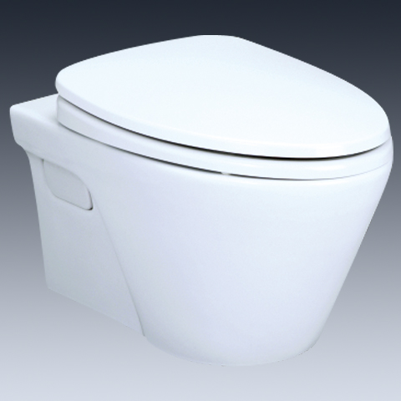
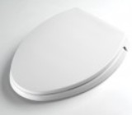
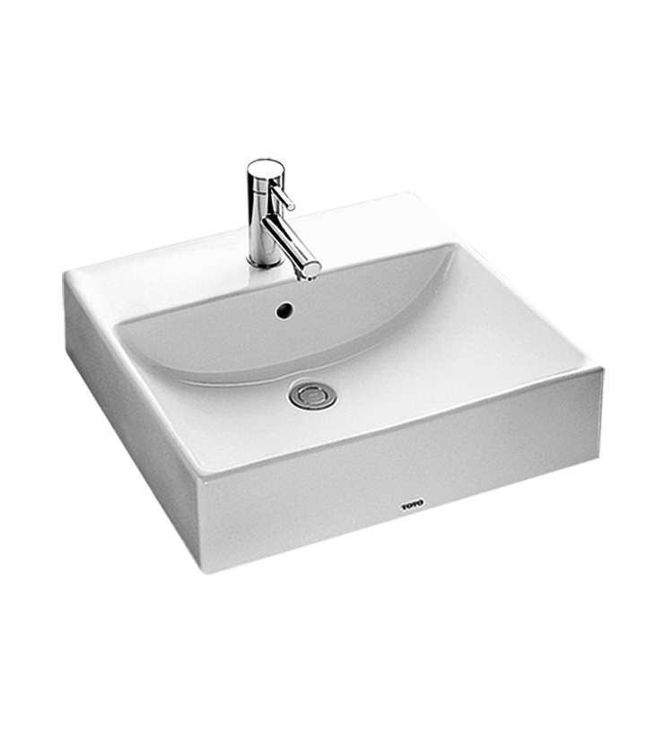

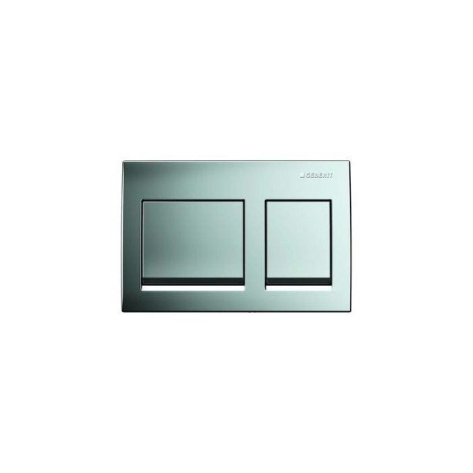
-
Brand | Item Name | Description | Color | Quantity | Unit Price | Special Price | Total
AVANTE | CW822J/CW822M | Avante -Wall Hung WC | White | 1 | 13990.00 | 13990.00 | 13990.00
- | TC394CVK | Soft Closing Seat Cover with Hinges | White | 1 | 5730.00 | 5730.00 | 5730.00
- | L710/L710CET/LW710CM | CONSOLE BASIN.Size: 500x450x135 mm | White | 1 | 11930.00 | 11930.00 | 11930.00
Alpha | 109.010.00.1 | Alpha Concealed Flush Cistern.with Connector Pipe and Rubber Bush | N-A | 1 | 5600.00 | 5600.00 | 5600.00
Alpha | 115.045.21.1 | Alpha Dual Actuating Flush Plates | Chrome | 1 | 2200.00 | 2200.00 | 2200.00

