Slide 1

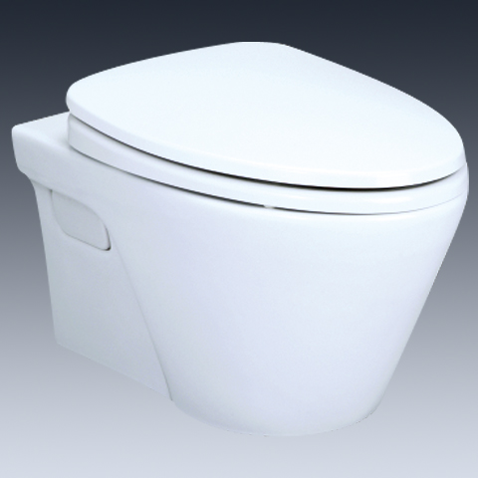
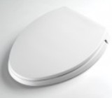
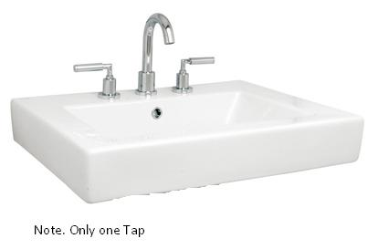
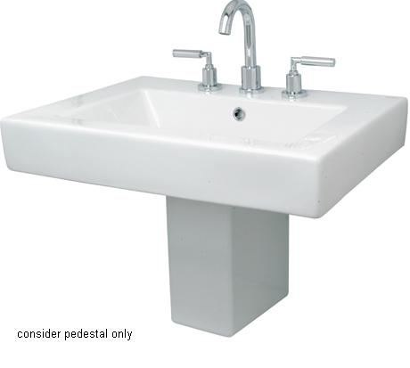
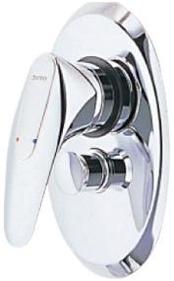
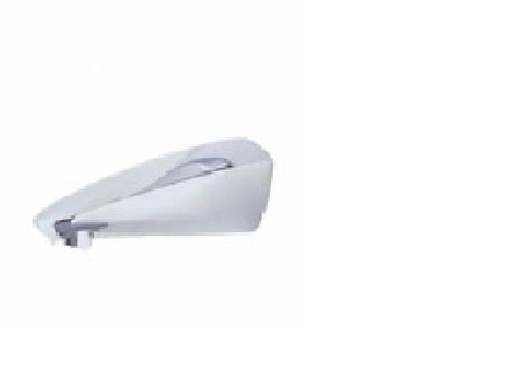
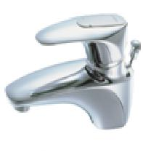
-
Brand | Item Name | Description | Color | Quantity | Unit Price | Special Price | Total
AVANTE | CW822J/CW822M | Avante -Wall Hung WC | White | 1 | 13990.00 | 13990.00 | 13990.00
- | TC394CVK | Soft Closing Seat Cover with Hinges | White | 1 | 5730.00 | 5730.00 | 5730.00
Hako | LW315CJ | Wash Basin with 1 tap hole.Size : 660 x 500 mm | White | 1 | 15950.00 | 15950.00 | 15950.00
Hako | LW315HFJ | Hako Half Pedestal Lavatory | White | 1 | 6790.00 | 6790.00 | 6790.00
RINO | TS322AV | Single Lever Bath And Shower Mixer | Chrome | 1 | 18540.00 | 18540.00 | 18540.00
Rino | TS653 | Bath Spout.. | Chrome | 1 | 4920.00 | 4920.00 | 4920.00
RINO- Aug-2014 | TS205D | Rino Series Single Lever Basin Mixer w/o Pop-Up. | Chrome | 1 | 9330.00 | 9330.00 | 9330.00

