Slide 1

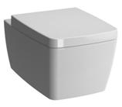
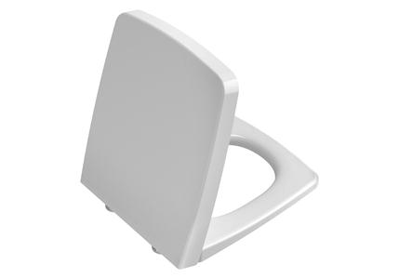
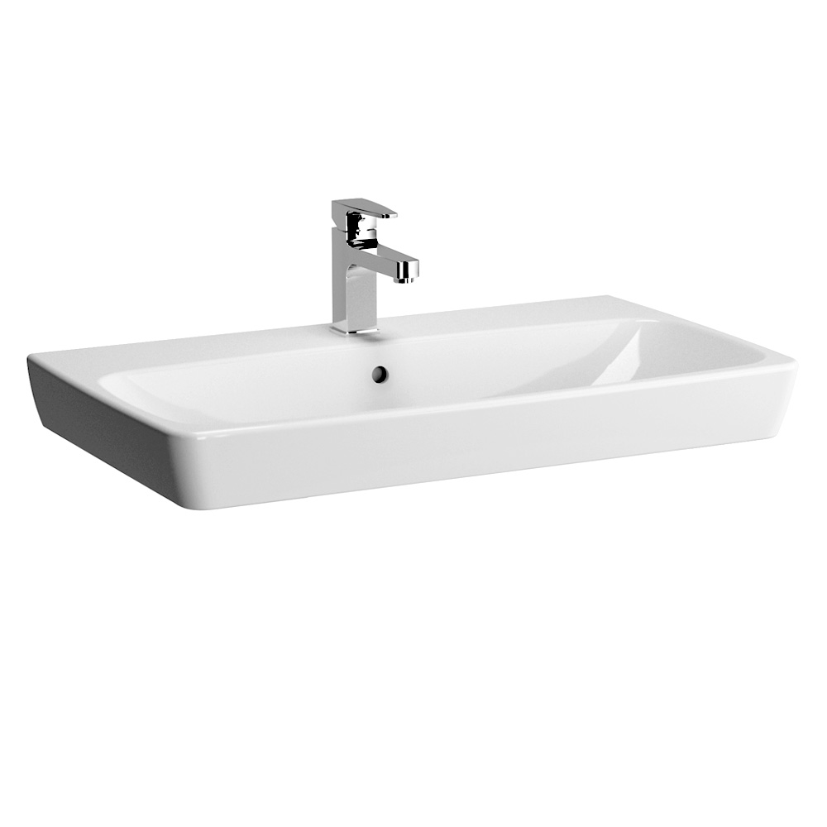
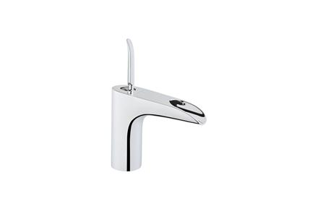
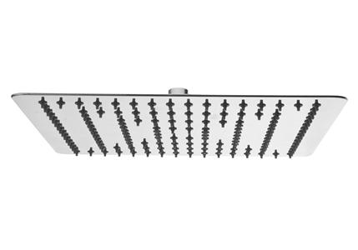
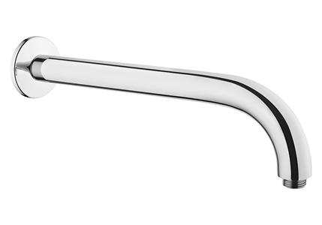
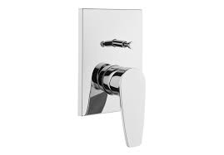
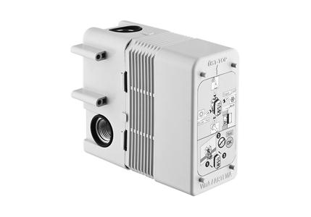
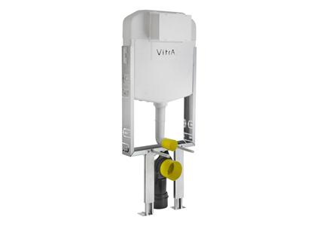
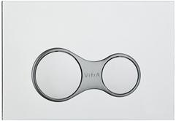

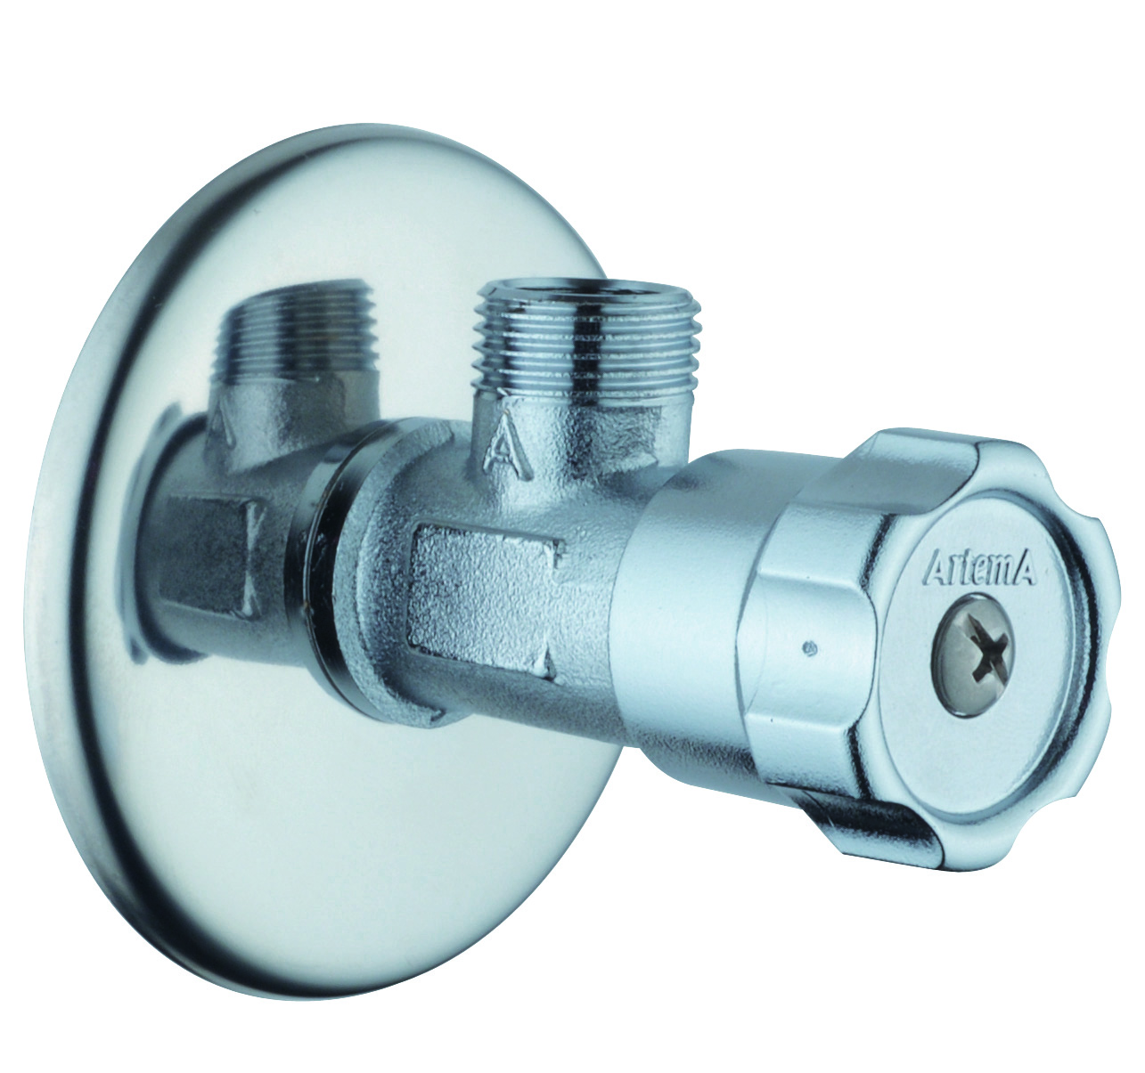
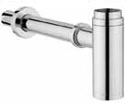
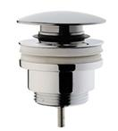

A
Brand | Item Name | Description | Color | Quantity | Unit Price | Special Price | Total
Metropole | 5676B003-7204 | Wall Hung WC pan | White | 1 | 28760.00 | 28760.00 | 28760.00
Metroploe | 90-003-009 | Metropole Soft Closing seat cover w/Hinges | White | 1 | 8000.00 | 8000.00 | 8000.00
Metropole | 5663B003-0001 | Metropole Wash basin 80 CM.one tap hole, with overflow hole | White | 1 | 14250.00 | 14250.00 | 14250.00
T4 | A41242IND | Basin Mixer, Cascade Flow. | Chrome | 1 | 18700.00 | 18700.00 | 18700.00
LITE LS | A45641IND | Lite Ls Shower Head.300mm | Chrome | 1 | 14000.00 | 14000.00 | 14000.00
- | A45651IND | Wall Mounted Shower Arm 332mm | Chrome | 1 | 5250.00 | 5250.00 | 5250.00
Q Line | A42208IND | Single Lever Built in bath/shower mixer exposed part | Chrome | 1 | 5900.00 | 5900.00 | 5900.00
- | A41949IND | Built-in Bath/Shower Mixer (Concealed Part) | N-A | 1 | 4600.00 | 4600.00 | 4600.00
Kombifix | 740-1850-01IND | Kobifix Concealed Cistern.Standard installation set for wall hung wc pans | White | 1 | 9900.00 | 9900.00 | 9900.00
- | 740-0480IND | Control Panel Dual flush plate | Chrome | 1 | 2750.00 | 2750.00 | 2750.00
SIRIUS | S1359 | Health Faucet (Faucet, Hosepipe, Hook) | Chrome | 1 | 1864.00 | 1864.00 | 1864.00
- | A45217IND | Interval Tap (Angle Valve) | Chrome | 3 | 650.00 | 650.00 | 1950.00
- | A45123IND | Bottle Trap for basins | Chrome | 1 | 4300.00 | 4300.00 | 4300.00
- | A45149IND | Waste Set Universal push open | Chrome | 1 | 1700.00 | 1700.00 | 1700.00
SIRIUS | ESFD52 | Floor Drain .Size : 115x115mm | Chrome | 2 | 3490.00 | 3490.00 | 6980.00

