Slide 1
Customer:
G Shalini Reddy
Mobile:
9849237336
Address:
924H, Road no: 46, Jubilee hills, Hyderabad

Slide 2
Google AdSense Online Terms of Service
1. Welcome to AdSense!
Thanks Eloi for your interest in our search and advertising services (the “Services”)!
By using our Services, you agree to these terms (the “AdSense Terms”), the AdSense Program Policies and the Google Branding Guidelines (collectively, the “Agreement”). If ever in conflict, to the extent of such conflict, the AdSense Terms will take precedence over any other terms of the Agreement. Please read the Agreement carefully.
As used in the Agreement, “you” or “publisher” means the individual or entity using the Services (and/or any individual, entity or successor entity, agency or network acting on your behalf), “we,” “us” or “Google” means Google Inc., and the “parties” means you and Google.
2. Access to the Services; AdSense Accounts
Your use of the Services is subject to your creation and our approval of an AdSense account (an “Account”). We have the right to refuse or limit your access to the Services. By submitting an application to use the Services, if you are an individual, you represent that you are at least 18 years of age. You may only have one Account.
By enrolling in AdSense, you permit Google to serve, as applicable, (i) advertisements and other content (“Ads”), (ii) Google search boxes and search results, and (iii) related search queries and other links to your websites, mobile applications, media players, mobile content, and/or other properties approved by Google (each individually a “Property”). In addition, you grant Google the right to access, index and cache the Properties, or any portion thereof, including by automated means. Google may refuse to provide the Services to any Property.
Any Property that is a software application and accesses our Services (a) may require preapproval by Google in writing, and (b) must comply with Google’s Software Principles.

Slide 3

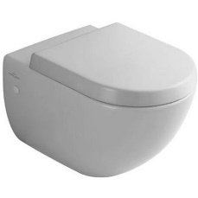
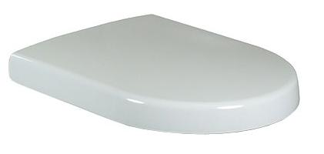
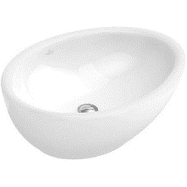
CBR 1
Brand | Item Name | Description | Color | Quantity | Unit Price | Special Price | Total
Subway | 66001001 | Wall Hung WC | White Alpin | 1 | 26788.00 | 26788.00 | 26788.00
Subway | 9955C101 | Subway Soft Closing Seat Cover . | White Alpin | 1 | 7657.00 | 7657.00 | 7657.00
AVEO | 718400R1 | Surface Mounted Wash Basin.Size: 650 x 475 mm | White Alpin cermaicplus | 1 | 84991.00 | 84991.00 | 84991.00

Slide 4
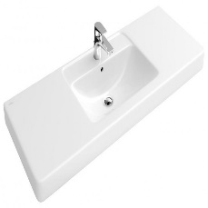
CBR 2
Brand | Item Name | Description | Color | Quantity | Unit Price | Special Price | Total
Subway | 66001001 | Wall Hung WC | White Alpin | 1 | 26788.00 | 26788.00 | 26788.00
Subway | 9955C101 | Subway Soft Closing Seat Cover . | White Alpin | 1 | 7657.00 | 7657.00 | 7657.00
Omnia Architectura | 61181301 | Omnia Architectura Vanity Wash Basin With 1 tap Hole, overflow.Size 1300mm. | White Alpin | 1 | 84761.00 | 84761.00 | 84761.00

Slide 5
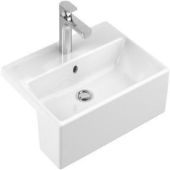
GBR
Brand | Item Name | Description | Color | Quantity | Unit Price | Special Price | Total
Subway | 66001001 | Wall Hung WC | White Alpin | 1 | 26788.00 | 26788.00 | 26788.00
Subway | 9955C101 | Subway Soft Closing Seat Cover . | White Alpin | 1 | 7657.00 | 7657.00 | 7657.00
Memento | 41335501 | Semi recessed wash basin .Size: 550x420mm 1 tap hole and with overflow. | White Alpin | 1 | 42721.00 | 42721.00 | 42721.00

Slide 6
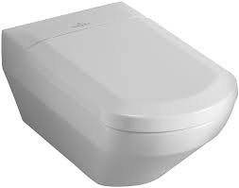
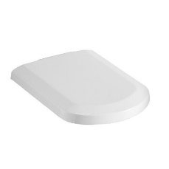
MBR
Brand | Item Name | Description | Color | Quantity | Unit Price | Special Price | Total
Sentique | 56221001 | Wall Hung WC w/hinges and black bushes | White Alpin | 1 | 47668.00 | 47668.00 | 47668.00
Sentique | 98M8S101 | Soft Closing Seat and Cover With Hinges | White Alpin | 1 | 30576.00 | 30576.00 | 30576.00

Slide 7
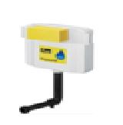
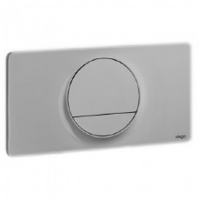
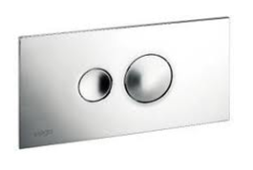
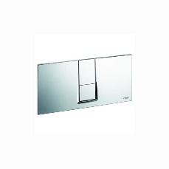
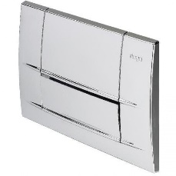
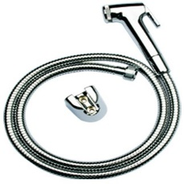
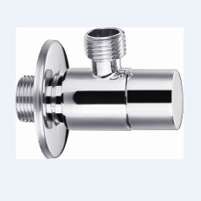
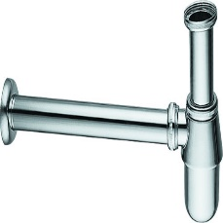
PR
Brand | Item Name | Description | Color | Quantity | Unit Price | Special Price | Total
Subway | 66001001 | Wall Hung WC | White Alpin | 2 | 26788.00 | 26788.00 | 53576.00
Subway | 9955C101 | Subway Soft Closing Seat Cover . | White Alpin | 2 | 7657.00 | 7657.00 | 15314.00
- | 8864.4-622220 | Concealed Cistern with connector pipe and rubber bush | N-A | 6 | 6500.00 | 6500.00 | 39000.00
Sty-13 | 8333.1-654504 | Visign For Style 13 Flush Plate with rods | Chrome | 2 | 5995.00 | 5995.00 | 11990.00
Style 10 | 8315.1-596323 | Visign for Style 10 Actuating Plate with rods | Chrome | 2 | 3175.00 | 3175.00 | 6350.00
Style 14 | 8334.1-654696 | Vision For Style 14 Flush Plate | Chrome | 1 | 5995.00 | 5995.00 | 5995.00
Life 3 | 8313.1-463854 | vsign for life-3 Actuating Plate w/rods | Chrome | 1 | 2465.00 | 2465.00 | 2465.00
TOTO | THX20MCRB | Health Faucet (Faucet, Hosepipe, Hook) | Chrome | 6 | 3500.00 | 3500.00 | 21000.00
Essentials | E0014 | Angle Valve w/Flange | Chrome | 6 | 1242.00 | 1242.00 | 7452.00
SIRIUS | E8502.97 | Bottle Trap | Chrome | 3 | 3689.00 | 3689.00 | 11067.00

Slide 8
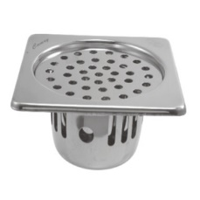
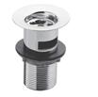


PR
Brand | Item Name | Description | Color | Quantity | Unit Price | Special Price | Total
SQUARE | CCR-S-129 | Camry Cockroach Trap.Size 129 x 129 mm | Chrome | 10 | 675.00 | 675.00 | 6750.00
Essentials | Waste Coupling H/T | - | Chrome | 3 | 550.00 | 550.00 | 1650.00
Essentials | Fischer Bolt | Fischer Bolt for WC | N-A | 6 | 1200.00 | 1200.00 | 7200.00
Slip In Connector | TX215C | Slip In Connector For WC | N-A | 6 | 720.00 | 720.00 | 4320.00

